Slide 1

DEPARTMENT OF LIFELONG LEARNING
BHARATHIDASAN UNIVERSITY
Tiruchirappalli- 620024,
Tamil Nadu, India
Programme: M.A.,HUMAN RESOURCE MANAGEMENT
Course Title : Global Human Resource Management
Course Code : 22HRM4EC5
Unit-VI
Global Business
Dr. T. KUMUTHAVALLI
Associate Professor
Department of Lifelong Learning

Slide 2

Global
Business
International business is a complex and fascinating field. It involves companies operating across national borders, engaging in trade, investment, and other business activities worldwide.

Slide 3
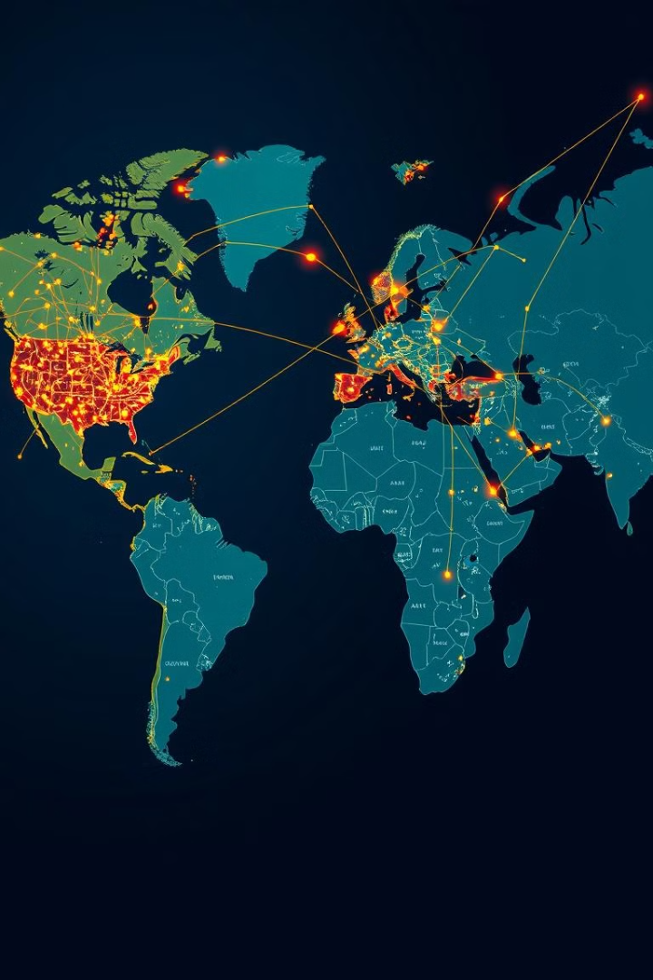

Changing Environment of International Business
1
Technological Advancements
Rapid technological advancements such as the internet and social media have transformed communication and business operations.
2
Globalization of Markets
The increasing interconnectedness of economies and cultures has created new opportunities and challenges.
3
Economic and Political Shifts
Global economic and political events, such as trade agreements and financial crises, can significantly impact international businesses.

Slide 4

Globalization of Markets
Increased Competition
Expansion of Consumer Base
Access to Resources
Companies face competition from global players, requiring them to adapt their strategies and offerings.
Businesses have access to a larger customer base, creating opportunities for growth and revenue.
Globalization allows companies to source materials, labor, and technology from various parts of the world.

Slide 5

Effects and Benefits of Globalization
1
Economic Growth
2
Job Creation
Globalization has led to increased trade, investment, and economic activity, boosting growth and prosperity.
International businesses create new jobs in both developed and developing countries, fostering employment opportunities.
3
Cultural Exchange
4
Technological Advancements
Increased interaction between people from different cultures promotes understanding, tolerance, and innovation.
Globalization facilitates the transfer of knowledge and technology across borders, driving innovation and progress.

