Slide 1

DEPARTMENT OF LIFELONG LEARNING
BHARATHIDASAN UNIVERSITY
Tiruchirappalli- 620024,
Tamil Nadu, India
Programme: M.A.,HUMAN RESOURCE MANAGEMENT
Course Title : Global Human Resource Management
Course Code : 22HRM4EC5
Unit-I
Introduction to IHRM
Dr. T. KUMUTHAVALLI
Associate Professor
Department of Lifelong Learning

Slide 2



Introduction to IHRM
International Human Resource Management (IHRM) is a complex and dynamic field that deals with the management of human resources in a global context. It encompasses a wide range of activities, from recruitment and selection to training and development, compensation and benefits, and labor relations. IHRM is essential for organizations that operate in multiple countries, as it helps them to navigate the complexities of different legal, cultural, and economic environments.
by Presentation

Slide 3
Domestic and International HRM
Domestic HRM
International HRM
Domestic HRM focuses on managing human resources within a single country. It deals with the policies, practices, and procedures that are specific to a particular national context.
International HRM encompasses the management of human resources across national borders. It involves dealing with the complexities of different legal, cultural, and economic environments, as well as the challenges of managing a diverse workforce.

Slide 4
The Seven Cs of IHRM
1
Cultural Sensitivity
2
Communication
Understanding and respecting cultural differences is crucial for effective IHRM. This includes adapting management styles, communication approaches, and employee motivation strategies to fit the local context.
Effective communication is essential for building relationships, conveying information, and resolving conflicts in a global workplace. This includes understanding language barriers, cultural nuances in communication styles, and using appropriate channels for communication.
3
Compensation
4
Compliance
Developing competitive compensation packages that are aligned with local market conditions and employee expectations is a key aspect of IHRM. This involves considering factors such as cost of living, salary levels, benefits, and tax implications.
Navigating the legal and regulatory frameworks of different countries is a complex task for IHRM professionals. This includes understanding labor laws, employment regulations, and tax compliance requirements in each country of operation.

Slide 5
Development of IHRM
1
Early Stages
The early stages of IHRM were largely focused on the expatriation of employees to overseas locations. This involved managing the challenges of relocating employees and their families, as well as ensuring their cultural adaptation to the new environment.
2
Globalization and the Rise of Multinational Corporations
The increasing globalization of business in the latter half of the 20th century led to a significant expansion in the scope of IHRM. Multinational corporations (MNCs) began to operate in a wider range of countries, leading to the need for more sophisticated strategies for managing human resources across diverse cultures.
3
Focus on Diversity and Inclusion
In recent years, there has been a growing emphasis on diversity and inclusion in IHRM. Organizations are increasingly recognizing the value of a diverse workforce and are implementing strategies to promote equity and fairness in all aspects of human resource management.

Slide 6
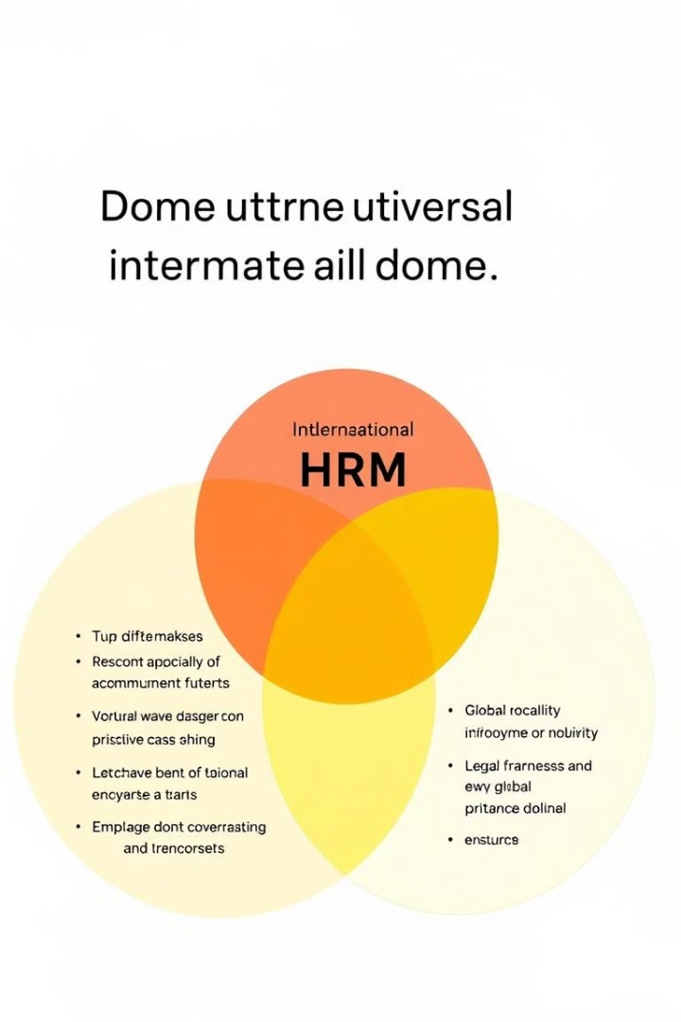
Difference between IHRM and Domestic HRM
Characteristic
Domestic HRM
International HRM
Scope
Single country
Multiple countries
Cultural Context
Single culture
Multiple cultures
Legal Framework
Single legal system
Multiple legal systems
Workforce Diversity
Typically less diverse
Highly diverse

