Slide 1

DEPARTMENT OF LIFELONG LEARNING
BHARATHIDASAN UNIVERSITY
Tiruchirappalli- 620024,
Tamil Nadu, India
Programme: M.A.,HUMAN RESOURCE MANAGEMENT
Course Title : Entrepreneurship Development
Course Code : 22HRM4EC4
Unit-IV
Business Plan Preparation
Dr. T. KUMUTHAVALLI
Associate Professor
Department of Lifelong Learning

Slide 2


Creating a Successful Business Plan
Developing a comprehensive business plan is a crucial first step for any aspiring entrepreneur. This presentation will guide you through the key elements of crafting an effective business plan that can secure funding, attract talent, and set your venture up for long-term success. From identifying your target market to projecting financial performance, we'll cover the essential building blocks to turn your business idea into reality.

Slide 3
Identifying Your Opportunity
Defining the Problem
Unique Value Proposition
Start by clearly articulating the specific problem your business will solve. What unmet needs or pain points exist in the market that your product or service can address? Thoroughly research your target customers to understand their challenges and frustrations.
Clearly define how your offering is uniquely positioned to solve the problem better than existing alternatives. What are the distinct features, benefits, or capabilities that set you apart from the competition?

Slide 4
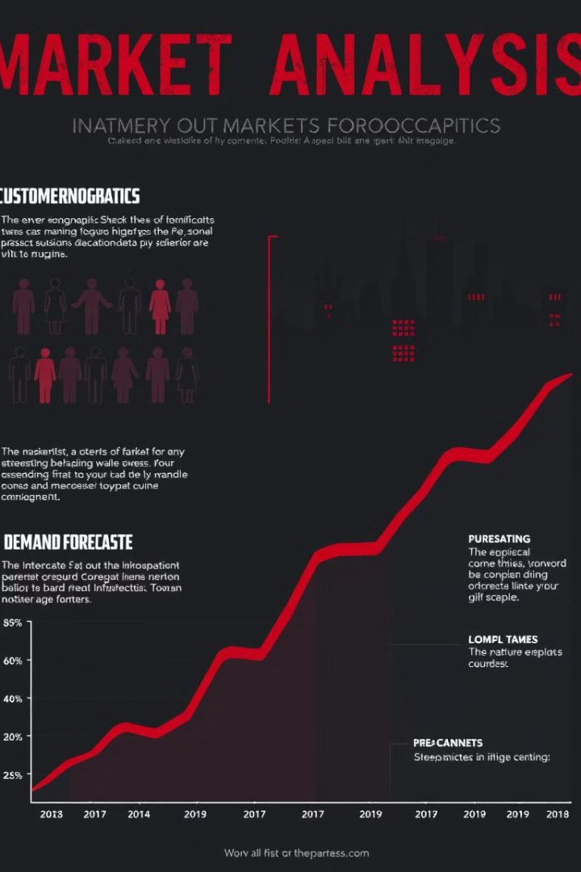
Market Analysis and Competitive Landscape
1
Understand Your Target Customers
2
Analyze the Competition
Conduct thorough market research to profile your ideal customer demographics, psychographics, buying behaviors, and pain points. Identify the size and growth potential of your target market.
Examine the competitive landscape, including direct and indirect competitors. Assess their strengths, weaknesses, pricing, and market share. Identify opportunities to differentiate and position your offering.
3
Forecast Demand
Use market data and customer insights to estimate potential demand for your product or service. Project sales volumes, growth rates, and market share to build a realistic revenue forecast.

Slide 5

Operational Plan and Financial Projections
1
Operations
Outline the key operational components required to deliver your product or service, including manufacturing, supply chain, facilities, and equipment. Describe your production processes, capacity, and quality control measures.
2
Financials
Prepare comprehensive financial projections, including income statements, cash flow statements, and balance sheets. Forecast startup costs, operating expenses, revenue, and profitability to demonstrate the business's financial viability.
3
Management Team
Highlight the experience, expertise, and qualifications of your management team. Explain how their skills and backgrounds will contribute to the success of the business.

Slide 6

Marketing and Go-to-Market Strategy
Branding and Positioning
Marketing and Promotion
Sales and Distribution
Describe your sales process and distribution channels, including any strategic partnerships or channel relationships. Explain how you will efficiently and effectively bring your product or service to market.
Develop a strong brand identity that resonates with your target customers. Define your brand's mission, values, and unique positioning in the market. Ensure your branding is consistent across all customer touchpoints.
Outline your marketing strategy, including customer acquisition channels, content creation, advertising, and promotional activities. Demonstrate how you will effectively reach and engage your target audience.

Slide 7
Executive Summary and Next Steps
Recap of Key Elements
1
Summarize the essential components of your business plan, including the problem you're solving, your unique value proposition, target market, operations, financials, and go-to-market strategy.
Funding and Resources
2
Outline your funding requirements and how you plan to use the capital to fuel your business growth. Highlight any key partnerships, resources, or support you've secured to help execute your plan.
Next Steps
Clearly articulate the next steps you will take to bring your business plan to life, including any immediate action items, milestones, and timelines. Emphasize your readiness and determination to turn your vision into reality.
3

