Slide 1

DEPARTMENT OF LIFELONG LEARNING
BHARATHIDASAN UNIVERSITY
Tiruchirappalli- 620024,
Tamil Nadu, India
Programme: M.A.,HUMAN RESOURCE MANAGEMENT
Course Title : Employee Engagement
Course Code : 22HRM1CC5
Unit-IV
Harnessing Employee Engagement
Dr. T. KUMUTHAVALLI
Associate Professor
Department of Lifelong Learning

Slide 2


Harnessing employee engagement
In today's competitive landscape, engaging employees is crucial for success. This presentation explores strategies to cultivate a thriving, engaged workforce.
Notes:
1

Slide 3
Understanding the Importance of Employee Engagement
Increased Productivity
Enhanced Retention
Improved Customer Satisfaction
Engaged employees are more productive, contributing to higher output and improved business outcomes.
Engagement reduces employee turnover, saving costs associated with hiring and training new staff.
Engaged employees are more enthusiastic and helpful, leading to positive customer experiences.
Notes:
2

Slide 4

Strategies to Nurture Employee Engagement
Recognition and Rewards
Development Opportunities
Open Communication
Publicly acknowledge achievements and offer incentives for outstanding contributions.
Foster a culture of open dialogue and transparency, allowing employees to share feedback and concerns.
Provide opportunities for growth through training programs, mentorship, and career advancement.
Notes:
3

Slide 5





Role of HR in Driving Employee Engagement
Employee Relations
Build strong relationships with employees, address concerns, and create a positive workplace environment.
Talent Development
Develop and implement training programs that empower employees and enhance their skills.
Performance Management
Set clear performance expectations, provide regular feedback, and recognize achievements.
Notes:
4

Slide 6
Top Management's Responsibility in Fostering Engagement
1
Vision and Values
Articulate a clear vision and set of values that inspire and guide employees.
Employee Empowerment
2
Delegate responsibility and provide employees with the autonomy to make decisions.
Open Communication
3
Encourage transparency and open communication at all levels of the organization.
Notes:
5

Slide 7
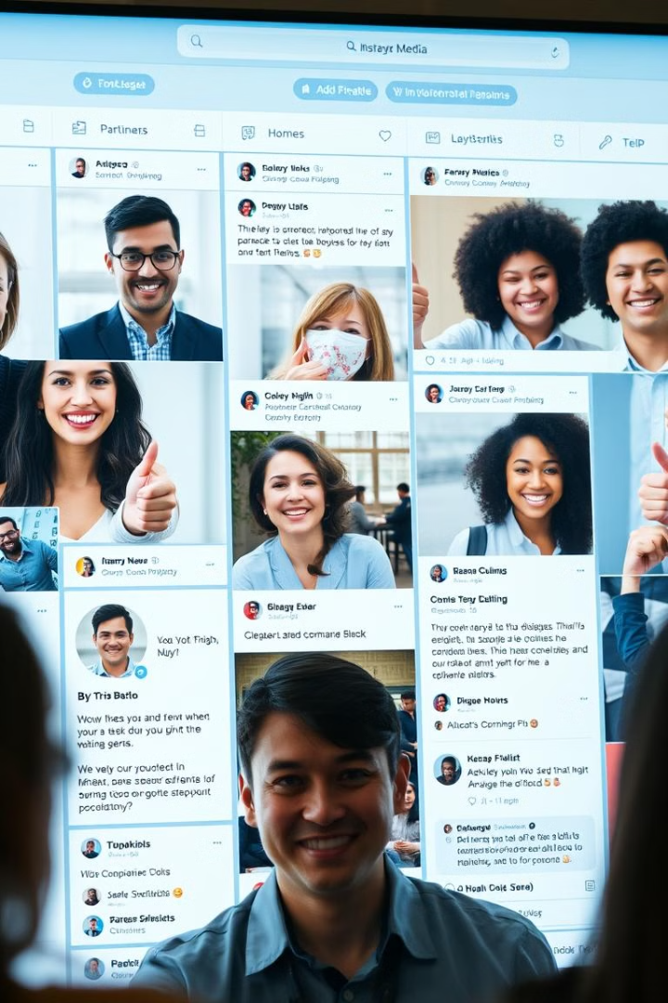
Leveraging Social Media for Employee Engagement
1
Internal Communication
2
Employee Recognition
Use social media platforms to share company news, updates, and events.
Celebrate achievements and recognize employee contributions through social media channels.
3
Community Building
Facilitate employee interactions and connections through social media groups and forums.
Notes:
6

Slide 8

Chatbots and AI-powered Solutions
1
2
3
Onboarding and Training
Employee Assistance
Feedback and Surveys
AI-powered chatbots can provide personalized onboarding and training experiences.
Chatbots can answer employee questions, provide support, and resolve issues quickly.
AI can automate surveys and analyze feedback to gain insights into employee sentiment.
Notes:
7

Slide 9



Machine Learning for Personalised Engagement
Content Personalisation
1
Provide employees with relevant content based on their interests and needs.
Learning Path Recommendations
2
Suggest tailored learning paths based on individual skills and career goals.
Performance Feedback
3
Deliver personalized performance feedback and development suggestions.
Notes:
8

Slide 10

Digitisation and its Impact on Employee Engagement
1
Increased Flexibility
Digitization enables remote work, flexible schedules, and a more balanced work-life.
2
Improved Communication
Digital tools facilitate seamless communication and collaboration across teams and locations.
3
Enhanced Collaboration
Digital platforms provide tools for real-time collaboration, project management, and idea sharing.
Notes:
9

Slide 11

Key Takeaways and Next Steps
Employee engagement is essential for a successful and thriving organization. Embrace these strategies to foster a motivated, engaged, and productive workforce. Start by implementing a few key initiatives and measure the impact over time.
Notes:
10

