Slide 1

DEPARTMENT OF LIFELONG LEARNING
BHARATHIDASAN UNIVERSITY
Tiruchirappalli- 620024,
Tamil Nadu, India
Programme: M.A.,HUMAN RESOURCE MANAGEMENT
Course Title : Employee Engagement
Course Code : 22HRM1CC5
Unit-III
Engagement For Job
Dr. T. KUMUTHAVALLI
Associate Professor
Department of Lifelong Learning

Slide 2


Engagement and Job
This presentation will explore the multifaceted nature of employee engagement, outlining its significance, key drivers, and practical strategies for fostering a thriving work environment.
Notes:
1

Slide 3
Engagement vs. Satisfaction
Engagement
Satisfaction
Active participation, enthusiasm, and dedication towards work and company goals.
A positive feeling of fulfillment and contentment with one's job and work environment.
Notes:
2

Slide 4
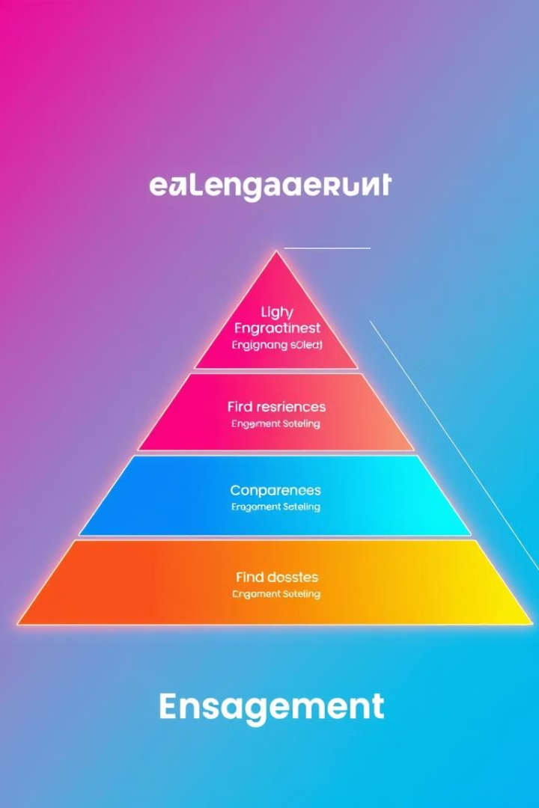
Engagement Drivers and Models
Meaningful Work
Growth Opportunities
Employees feel their work is valuable and contributes to something bigger.
Opportunities for learning, development, and career advancement are provided.
Positive Work Environment
Recognition and Rewards
Respectful, supportive, and collaborative culture fosters a sense of belonging.
Employees feel appreciated and valued for their contributions.
Notes:
3

Slide 5

Types of Engagement
Work Engagement
Job Engagement
Organizational Engagement
Employee's commitment and dedication to the work itself.
Focus on the specific job responsibilities and tasks assigned.
Connection and loyalty towards the company as a whole.
Notes:
4

Slide 6




Gender Issues in Engagement
Gender Gap
Addressing the potential disparities in engagement levels between genders.
Work-Life Balance
Supporting employees with flexible work arrangements to manage both their careers and personal lives.
Leadership Representation
Promoting diverse leadership to create inclusive and equitable work environments.
Notes:
5

Slide 7

Building an Effective Engagement Campaign
1
2
3
Needs Assessment
Campaign Planning
Implementation and Evaluation
Identifying the specific engagement needs of the organization and employees.
Developing a comprehensive strategy with clear goals and actionable steps.
Roll out the campaign, track progress, and gather feedback for continuous improvement.
Notes:
6

Slide 8




Burnout and Disengagement
Signs of Burnout
Physical and emotional exhaustion, cynicism, and reduced productivity.
Addressing Burnout
Promoting work-life balance, providing support resources, and fostering a positive work culture.
Preventing Disengagement
Recognizing early warning signs, offering support, and fostering a culture of open communication.
Notes:
7

Slide 9



Engagement and Attrition
High Engagement
1
Low attrition rates.
2
Moderate Engagement
Moderate attrition rates.
3
Low Engagement
High attrition rates.
Notes:
8

