Slide 1
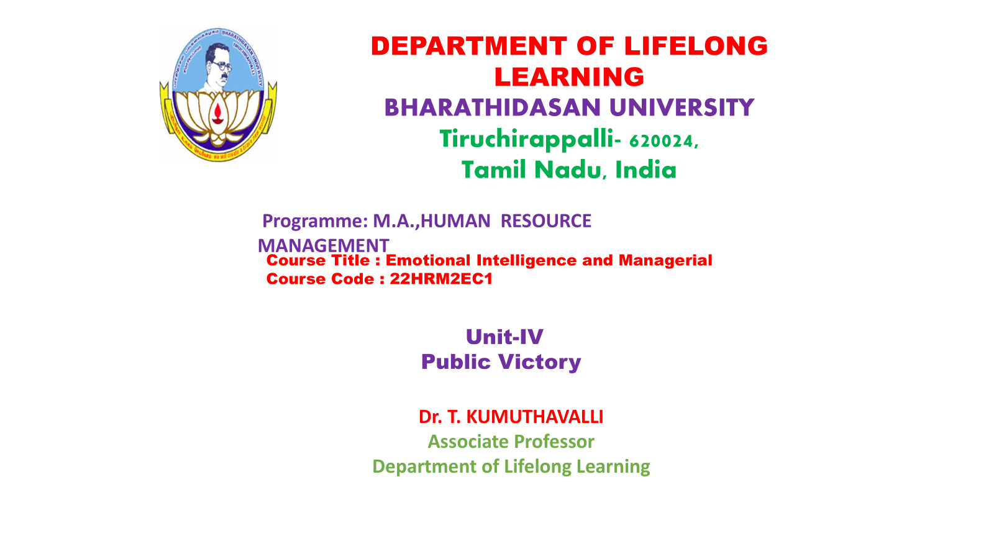

Slide 2


Think Win/Win: Six Paradigms of Human Interaction
This presentation will explore six principles of human interaction, empowering you to build stronger relationships and achieve mutually beneficial outcomes.
Notes:
1

Slide 3
Seek First to Understand, Then to be Understood
Empathy
Active Listening
Put yourself in the other person's shoes to understand their perspective and needs. This creates a foundation for meaningful communication.
Pay undivided attention, ask clarifying questions, and paraphrase to demonstrate understanding. This builds trust and facilitates a deeper connection.
Notes:
2

Slide 4
Empathetic Listening: The Key to Effective Communication
1
Active Listening
2
Reflecting
Paraphrase what you hear to demonstrate understanding and encourage the speaker to share more.
Focus on what is being said, both verbally and non-verbally. Ask questions for clarification.
3
Empathy
Try to understand the speaker's emotions and perspective. This fosters a deeper connection.
Notes:
3

Slide 5
Synergize: Leveraging Collective Intelligence
Shared Goals
Open Communication
Align on a common purpose that everyone is committed to. This creates a sense of shared responsibility and purpose.
Encourage open communication and feedback. This helps to identify blind spots and create a space for innovation.
Creative Thinking
Foster a collaborative environment where diverse perspectives and ideas are valued and contribute to new solutions.
Notes:
4

Slide 6



Synergy in the Classroom: Fostering Collaborative Learning
Project-Based Learning
Students work together to complete projects that require them to apply their skills and knowledge.
Peer Collaboration
Students work in groups to discuss ideas, share information, and support each other's learning.
Group Discussions
Encourage active participation and respectful dialogue to foster critical thinking and deeper understanding.
Notes:
5

Slide 7



Synergy in Business: Unlocking the Power of Partnerships
Shared Vision
1
Align on a common goal and vision that drives the partnership.
Trust & Transparency
2
Build a foundation of trust through open communication and clear expectations.
Mutual Benefit
3
Ensure that the partnership creates value for all parties involved.
Notes:
6

Slide 8
The Essence of Win/Win: Mutually Beneficial Outcomes
1
Respect
Value the other person's perspective and needs.
2
Integrity
Be honest and transparent in your interactions.
3
Collaboration
Work together to find solutions that benefit everyone.
Notes:
7

Slide 9



Applying the Principles: Real-World Case Studies
Business
Education
Family
A company leverages the expertise of a partner to develop a new product line, leading to increased market share and revenue for both.
Teachers use project-based learning to engage students in collaborative projects that foster critical thinking and problem-solving skills.
A family works together to plan a vacation that meets everyone's needs and preferences, resulting in a memorable and enjoyable experience for all.
Notes:
8

