Slide 1

DEPARTMENT OF LIFELONG LEARNING
BHARATHIDASAN UNIVERSITY
Tiruchirappalli- 620024,
Tamil Nadu, India
Programme: M.A.,HUMAN RESOURCE MANAGEMENT
Course Title : Emotional Intelligence and Managerial EffectivenessCourse Code : 22HRM1CC6
UNIT –I
Emotion
Dr. T. KUMUTHAVALLI
Associate Professor
Department of Lifelong Learning

Slide 2

Emotions
Emotions are the driving force behind our thoughts, behaviours, and interactions. Understanding them is key to self-awareness, personal growth, and effective communication.
Notes:
1

Slide 3
Identifying and Understanding Emotions
Recognizing the Signs
Labeling and Reflecting
Pay attention to your physical sensations, thoughts, and behaviours, as these can indicate your current emotional state.
Once you recognize an emotion, try to label it accurately. Take time to reflect on what triggered it and how it makes you feel.
Notes:
2

Slide 4

Positive and Negative Emotions
Positive Emotions
Negative Emotions
Emotions like joy, gratitude, and love motivate and enhance our well-being.
Emotions like anger, sadness, and fear can be challenging, but they provide valuable information about our needs.
Notes:
3

Slide 5
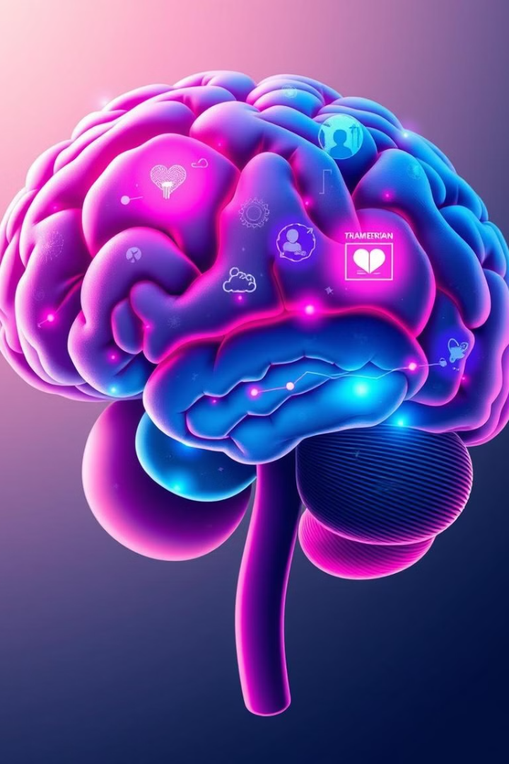



Emotional Models and Frameworks
Emotional Intelligence
Focuses on recognizing, understanding, and managing emotions.
Cognitive Appraisal
Explains how our thoughts influence our emotional experiences.
Six Basic Emotions
Suggests that all emotions are derived from six core emotions: joy, sadness, anger, fear, disgust, and surprise.
Notes:
4

Slide 6
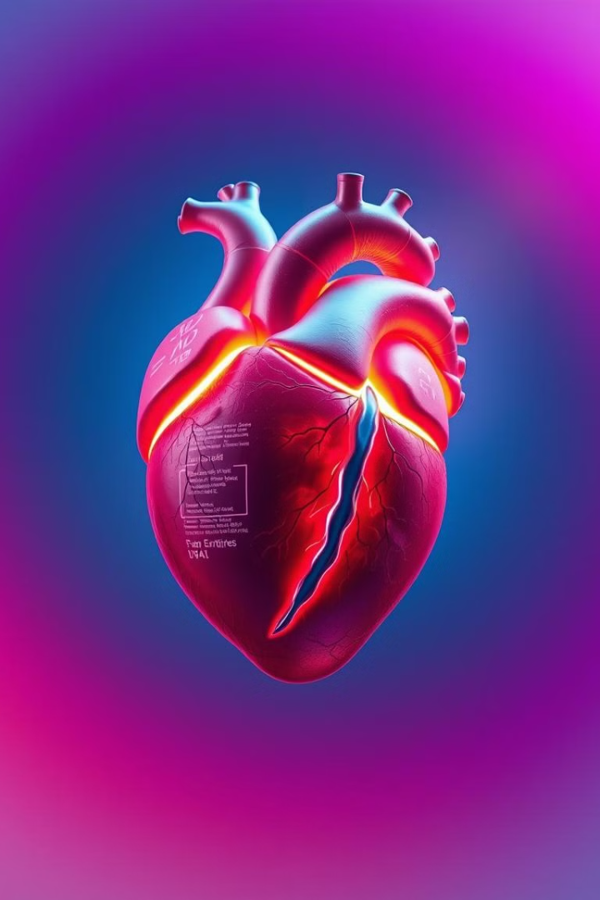
Role of Emotions in our Lives
Motivate and Drive: Emotions guide our decisions and actions, shaping our responses to different situations.
1
Connect with Others: Emotions are fundamental to our relationships, enabling us to empathize and build bonds.
2
Express Ourselves: Emotions allow us to communicate our thoughts and feelings effectively, enhancing our interactions.
3
Notes:
6

Slide 7
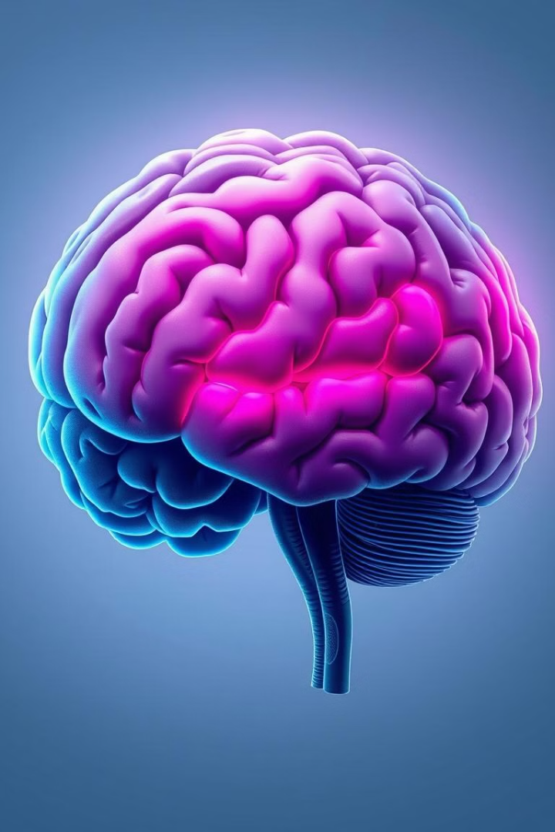




Functions of the Brain and Emotions
Amygdala
Processes and responds to emotional stimuli, particularly those associated with fear.
Hippocampus
Stores memories and associations, influencing our emotional responses to specific situations.
Prefrontal Cortex
Regulates emotions, allows us to think rationally, and make conscious decisions.
Notes:
7

Slide 8




Emotional Intelligence (EQ) and its Significance
Self-Awareness
1
Recognizing and understanding your own emotions.
2
Self-Management
Controlling your emotions and responding appropriately.
3
Social Awareness
Empathizing with others and understanding their emotions.
4
Relationship Management
Building and maintaining healthy relationships.
Notes:
8

Slide 9
Managing and Regulating Emotions
1
Identify and Label
First, acknowledge and name the emotion you're experiencing.
2
Understand the Trigger
Think about what caused this emotion to arise.
Develop Healthy Coping Strategies
3
Practice mindfulness, deep breathing, or other techniques to manage your emotions.
Notes:
9

Slide 10

Transforming Emotions and Attitude
1
Challenge Negative Thoughts
Identify and question negative thoughts that fuel unhelpful emotions.
2
Practice Gratitude
Focus on the positive aspects of your life and cultivate appreciation.
3
Embrace Optimism
Cultivate a hopeful outlook and focus on solutions rather than problems.
Notes:
10

Slide 11

Enhancing Your Emotional Self-Awareness
Developing emotional intelligence is a lifelong journey. By engaging in self-reflection, practicing mindfulness, and learning from your experiences, you can enhance your emotional self-awareness and navigate life with greater clarity and purpose.
Notes:
11

