Slide 1
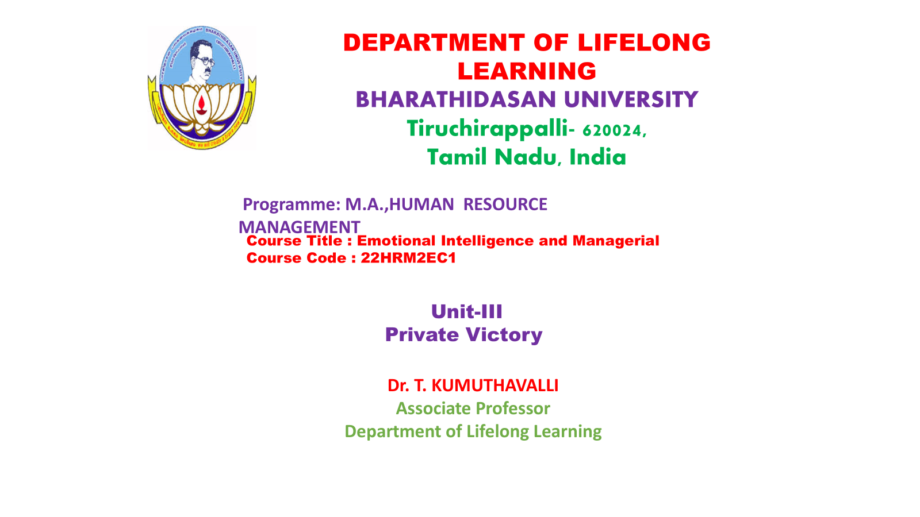

Slide 2

Be Proactive: Your Personal Vision
Focus on the Circle of Influence
Embrace Responsibility
Define Your Values
Develop Your Vision
Clarify your core values and let them guide your decisions and actions.
Envision your desired future and set clear goals to achieve it.
Rather than dwelling on things outside your control, focus on what you can directly impact.
Take ownership of your choices and actions. You are the author of your own life.
Notes:
2

Slide 3
The Social Mirror & Stimulus-Response
The Social Mirror
Stimulus-Response
Our perceptions are often shaped by the opinions of others. This can create self-doubt and limit our potential.
We react to external stimuli, often unconsciously. To be proactive, we must choose our responses.
Breaking the Cycle
By recognizing the social mirror and stimulus-response, we can gain control over our actions.
Notes:
3

Slide 4



Proactive Language & Circle of Influence
Proactive Language
Use "I" statements to take responsibility for your actions.
Circle of Influence
Focus on areas where you can have a direct impact.
Choose Your Responses
Don't let external factors dictate your behavior.
Notes:
4

Slide 5
Begin with the End in Mind
Personal Values
Goal Setting
Visualize your desired future and set clear goals.
Align your goals with your core values and beliefs.
Long-Term Vision
Consider your long-term aspirations and work backwards.
Notes:
5

Slide 6



The Power of Creation & Being a Creator
Creativity
Embrace your creative potential and find innovative solutions.
Problem-Solving
Approach challenges with a proactive mindset and seek solutions.
Goal Achievement
Set clear goals and take proactive steps to achieve them.
Notes:
6

Slide 7



Develop a Personal Mission Statement
Purpose
1
What is your reason for being?
2
Values
What are your core beliefs?
3
Goals
What do you want to achieve?
Notes:
7

Slide 8
Put First Things First: The 4 Generations of Time Management
1
2
Not Urgent, But Important
Urgent and Important
Prevention, relationship building, planning.
Crises, deadlines, pressing problems.
3
4
Urgent, But Not Important
Not Urgent, Not Important
Interruptions, some meetings, pressing matters.
Time wasters, busy work, trivia.
Notes:
8

