Slide 1
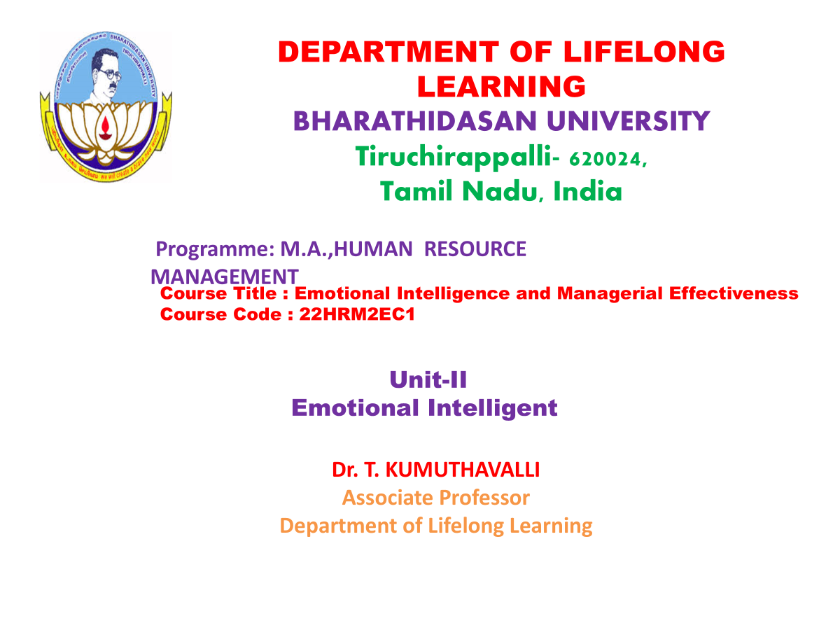

Slide 2
Understanding Self-awareness: The Foundation of Emotional Intelligence
Knowing Yourself
Self-Reflection
Honesty and Openness
Identifying your emotions, strengths, weaknesses, and values.
Regularly evaluating your thoughts, feelings, and behaviors.
Being honest with yourself and others about your emotions.
Notes:
2

Slide 3


Self-Regulation: Mastering Your Emotions
Managing Emotions
Emotional Resilience
Controlling impulses, calming yourself down, and managing stress.
Bouncing back from challenges and setbacks with a positive attitude.
Self-Control
Thinking before acting, considering the consequences of your behavior.
Notes:
3

Slide 4
Harnessing Motivation: Driving Yourself Towards Success
Setting Goals
Positive Mindset
Perseverance
1
2
3
Maintaining optimism and belief in your abilities, even in tough times.
Pushing through obstacles and staying committed to your goals.
Having clear objectives and a strong desire to achieve them.
Notes:
4

Slide 5



Empathy: The Key to Building Meaningful Relationships
Understanding Others
Putting yourself in someone else's shoes and seeing things from their perspective.
Active Listening
Paying attention to what others are saying and trying to understand their emotions.
Non-Judgmental
Accepting others for who they are without judging or criticizing them.
Notes:
5

Slide 6



Interpersonal Skills: Enhancing Social Interaction
Communication
Expressing yourself clearly and effectively, both verbally and nonverbally.
Conflict Resolution
Managing disagreements constructively and finding mutually acceptable solutions.
Teamwork
Working effectively with others to achieve common goals.
Notes:
6

Slide 7
Techniques to Manage Emotions in Challenging Situations
1
Deep Breathing
Slowing down your breathing to regulate your heart rate and calm your nervous system.
2
Mindfulness
Paying attention to the present moment without judgment, helping you stay grounded.
3
Positive Self-Talk
Challenging negative thoughts and replacing them with positive affirmations.
Notes:
7

Slide 8
Adaptability and Stress Management: Navigating Life's Challenges
1
Flexibility
Adjusting to change and embracing new situations with a positive attitude.
2
Stress Reduction
Identifying and managing stress triggers to maintain a healthy balance.
Problem Solving
3
Approaching challenges with a solution-oriented mindset.
Notes:
8

Slide 9




Emotional Intelligence in the Workplace: Enhancing Professional Growth
Stronger Relationships
1
Building trust and rapport with colleagues and clients.
2
Effective Communication
Clearly conveying your ideas and understanding others' perspectives.
3
Increased Productivity
Motivating yourself and others to achieve high performance.
4
Leadership Skills
Inspiring and influencing others to achieve common goals.
Notes:
9

Slide 10
Conclusion: Embracing Emotional Intelligence for Personal and Professional Transformation
Emotional intelligence is a journey, not a destination. By developing these skills, you can unlock your full potential and live a more fulfilling and successful life.
Notes:
10

