Slide 1

DEPARTMENT OF LIFELONG LEARNING
BHARATHIDASAN UNIVERSITY
Tiruchirappalli- 620024,
Tamil Nadu, India
Programme: M.A.,HUMAN RESOURCE MANAGEMENT
Course Title : corporate social responsibility
Course Code : 22HRM3EC5
Unit-V
Features of Indian society
Dr. T. KUMUTHAVALLI
Associate Professor
Department of Lifelong Learning

Slide 2


Introduction to India's Tapestry
India is a vibrant nation, woven with diverse threads of rural, tribal, and urban societies. This presentation explores the social dynamics of these communities through the lens of constitutional justice, illuminating their unique challenges and contributions to the nation’s identity.

Slide 3
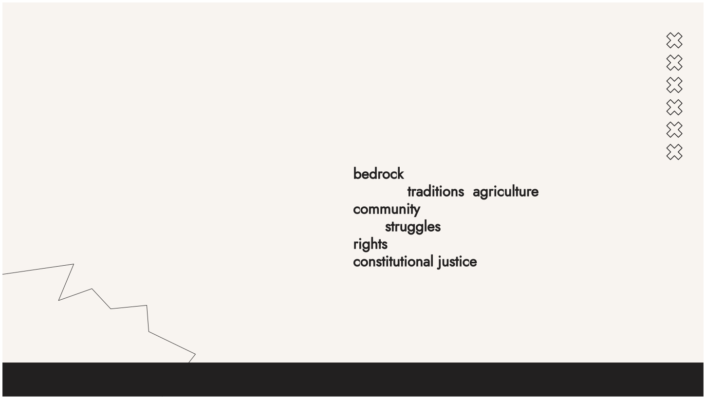
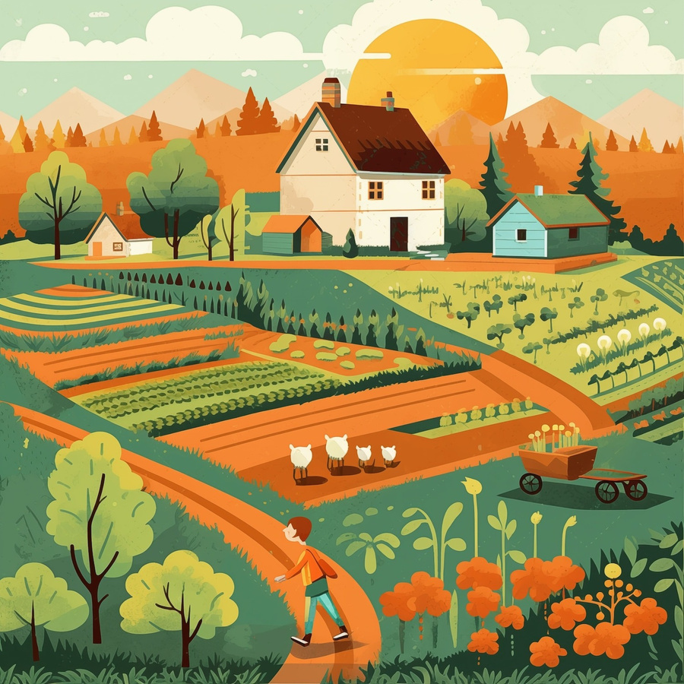
Rural Societies: The Heart of India
Rural societies in India are the bedrock of its cultural heritage. They embody traditions, agriculture, and community living. Understanding their struggles for resources and rights is crucial in promoting constitutional justice and ensuring their voices are heard.

Slide 4
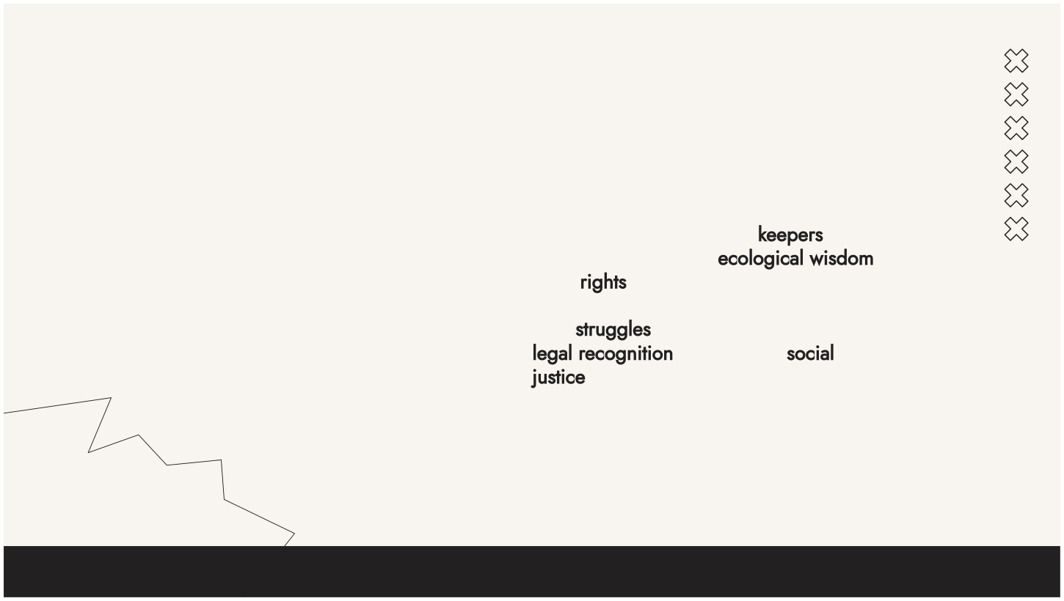
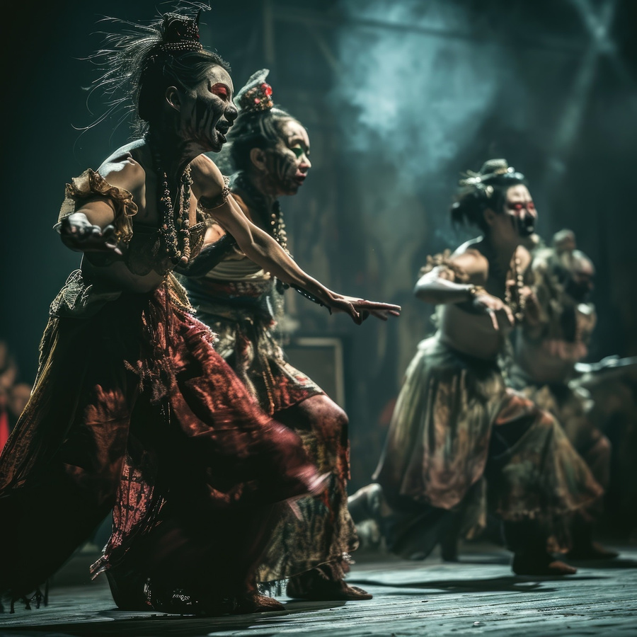
Tribal Communities: Guardians of Tradition
Tribal communities are the keepers of ancient traditions and ecological wisdom. Their rights to land and resources are often overlooked. This slide highlights their struggles and the importance of legal recognition in achieving social justice.

Slide 5
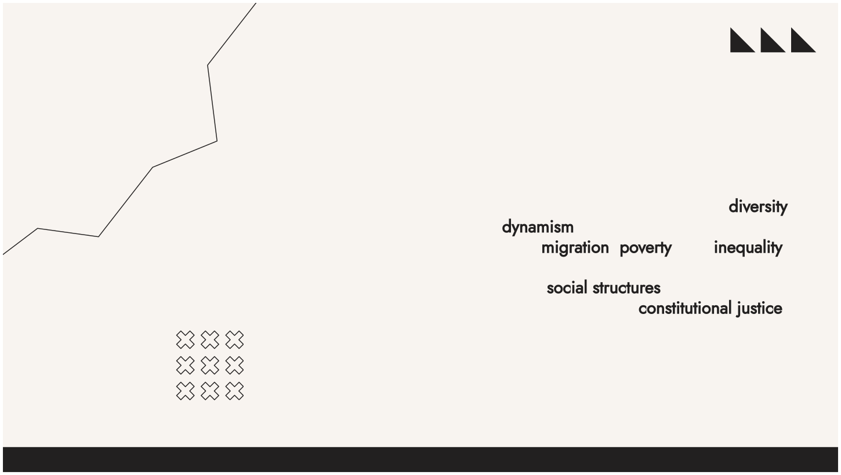
Urban Societies: The Modern Fabric
Urban societies are characterized by diversity and dynamism. They face unique challenges such as migration, poverty, and inequality. This section delves into how urbanization impacts social structures and the quest for constitutional justice.

Slide 6
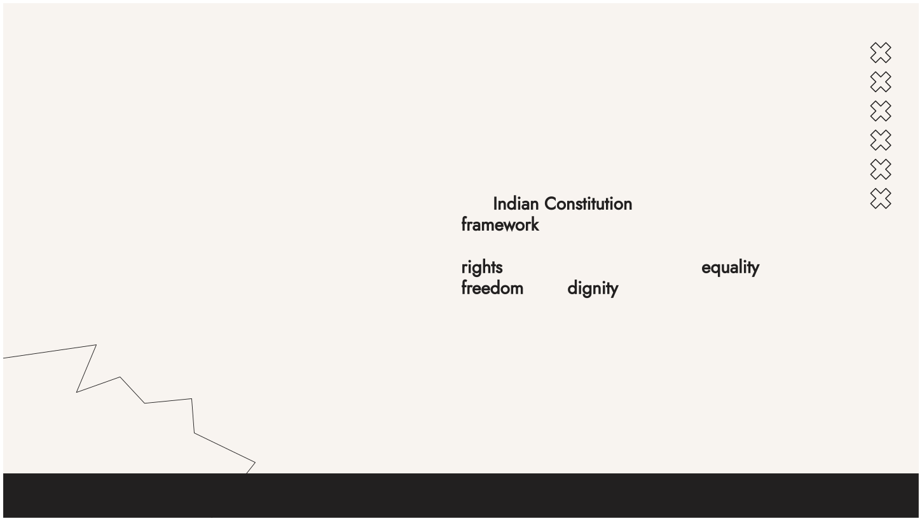
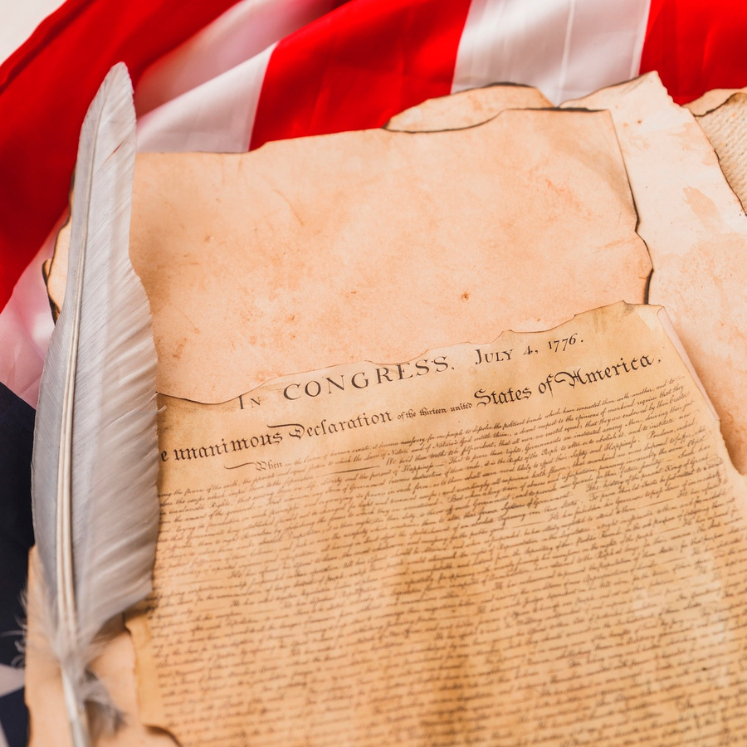
Constitutional Justice: A Framework
The Indian Constitution serves as a framework for establishing justice across diverse societies. It aims to uphold the rights of every citizen, ensuring equality, freedom, and dignity. This slide outlines its significance in addressing societal disparities.

Slide 7
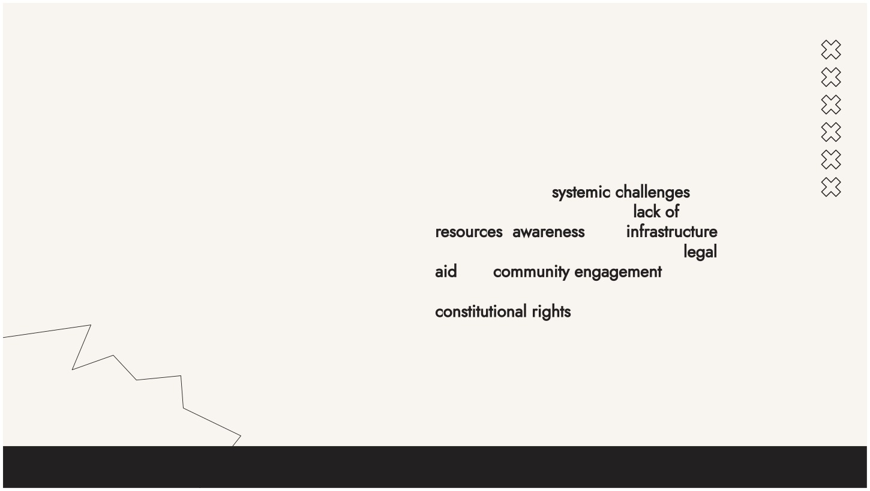

Challenges in Rural Justice
Rural areas face systemic challenges in accessing justice, including lack of resources, awareness, and infrastructure. This slide emphasizes the need for legal aid and community engagement to bridge these gaps and promote constitutional rights.

Slide 8
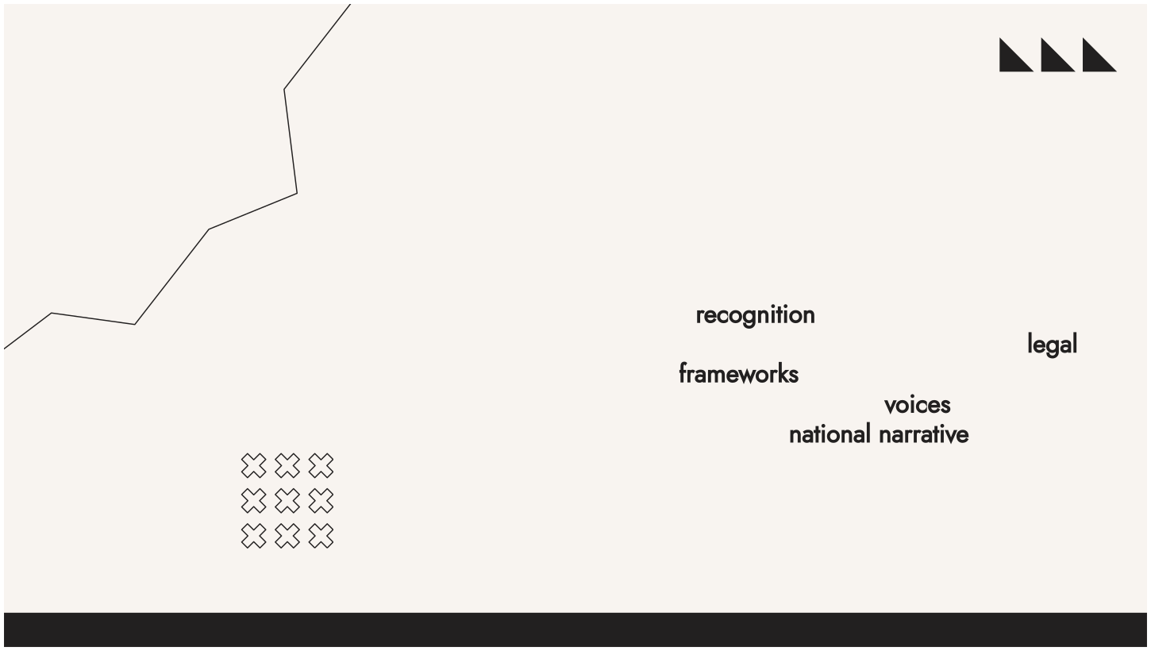
Tribal Rights and Recognition
Tribal communities often struggle for recognition of their rights. This slide discusses the importance of legal frameworks that protect their land and culture, ensuring their voices are integral to the national narrative of justice.

Slide 9
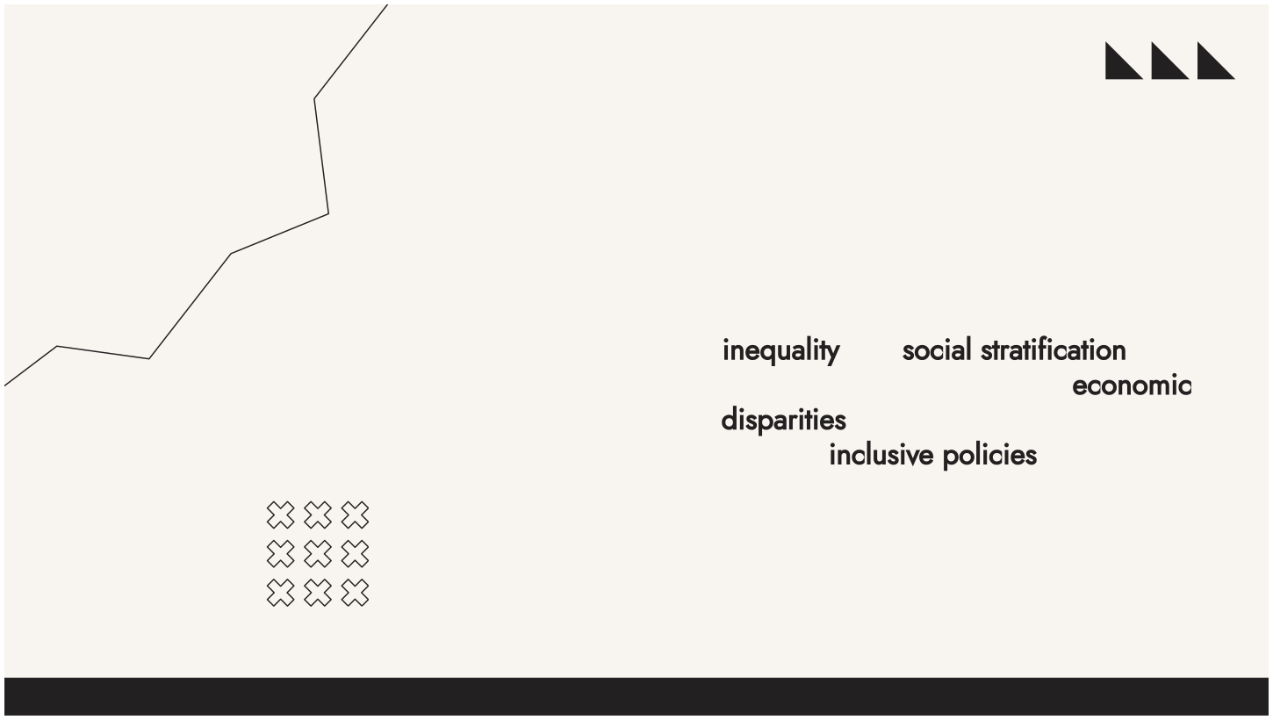
Urban Inequality: A Growing Concern
Urbanization has led to increased inequality and social stratification. This slide explores the impact of economic disparities on access to justice and the need for inclusive policies that address the needs of marginalized urban populations.

Slide 10
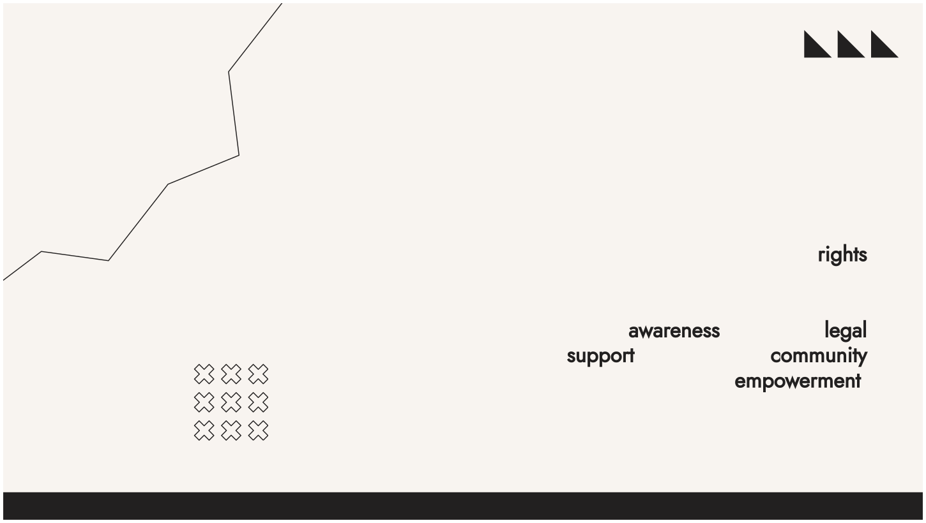
Role of NGOs in Advocacy
Non-Governmental Organizations play a crucial role in advocating for the rights of rural, tribal, and urban communities. This slide highlights their efforts in promoting awareness, providing legal support, and fostering community empowerment.

Slide 11
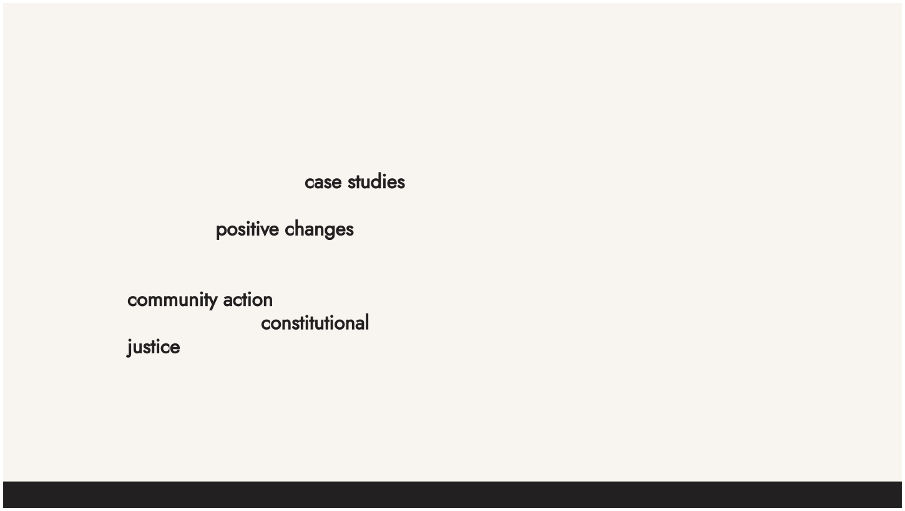
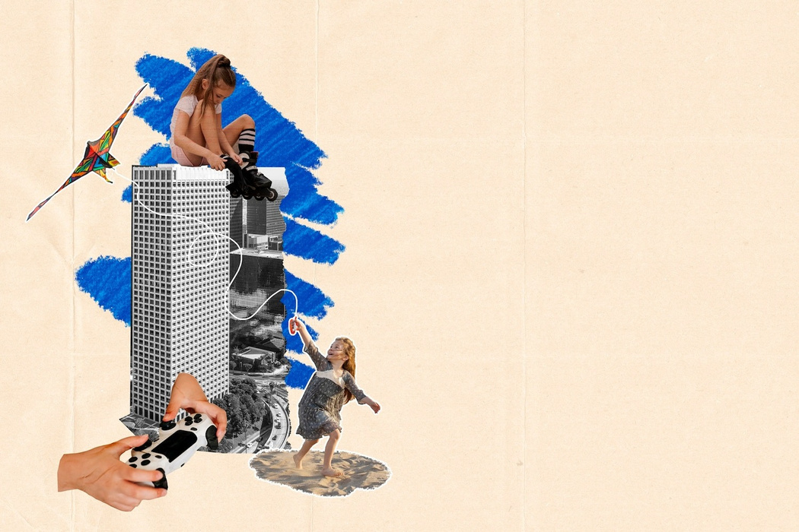


Case Studies: Success Stories
This section presents case studies showcasing successful interventions that led to positive changes in rural, tribal, and urban societies. These stories illustrate the power of community action and the effectiveness of constitutional justice.

Slide 12
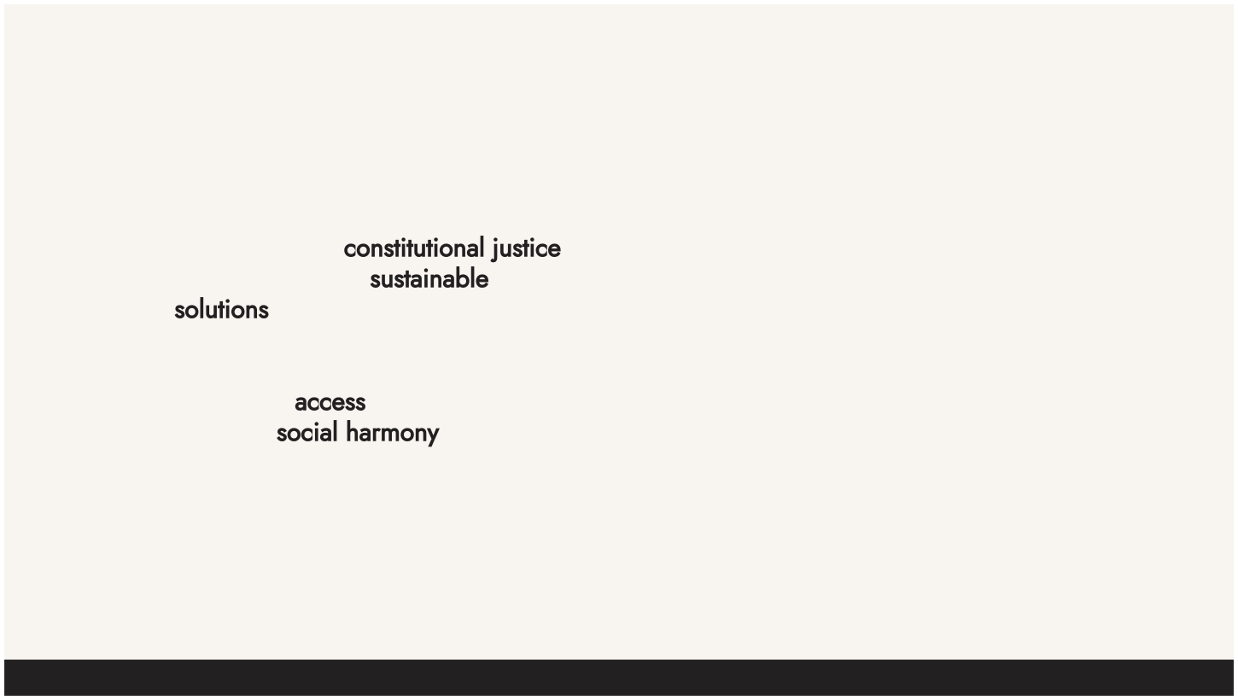
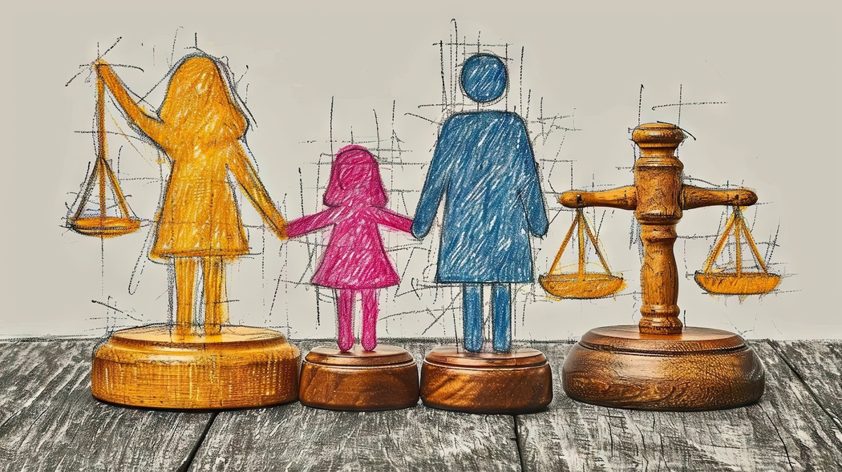
Future Directions for Justice
To achieve true constitutional justice, we must focus on sustainable solutions that address the unique needs of each society. This slide discusses potential strategies for enhancing access to justice and fostering social harmony.

Slide 13











Conclusion: Weaving a Just Society
In conclusion, unraveling India's tapestry requires a holistic approach to justice that respects the diversity of its societies. By promoting constitutional rights and ensuring equity, we can weave a stronger and more just society for all.

