Slide 1
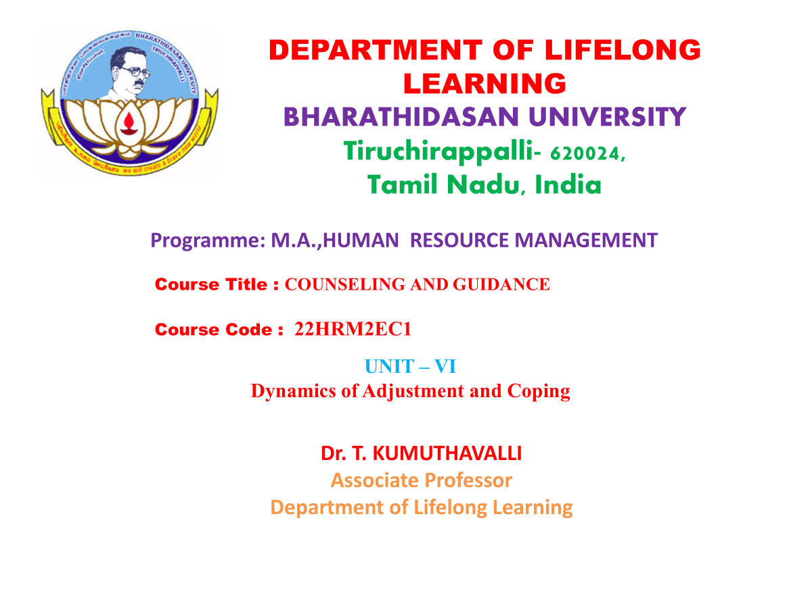

Slide 2
UNIT – VI
Dynamics of Adjustment and Coping

Slide 3

Professional Preparation and Training for Counseling
Welcome! This presentation will explore the essential components of professional preparation and training for aspiring and practicing counselors in India.
Notes:
1

Slide 4
Academic Preparation for Counseling
Foundation
Specialization
A strong foundation in psychology, counseling theories, and human development is crucial. Programs may include courses in human behavior, personality development, psychopathology, and therapeutic techniques.
Counselors can specialize in areas like career counseling, marital and family therapy, substance abuse counseling, or mental health counseling. These specializations require specific knowledge and skills.
Notes:
2

Slide 5

Practical Skills Required for Counseling Professionals
Active Listening
Empathy
Active listening involves paying full attention, understanding the client's perspective, and responding appropriately to their concerns.
Empathy is the ability to understand and share the feelings of another person. It's essential for building trust and rapport with clients.
Communication
Problem-Solving
Effective communication is crucial for conveying information clearly, asking clarifying questions, and providing constructive feedback.
Counselors help clients develop problem-solving skills and explore solutions. This includes identifying patterns, generating alternatives, and evaluating outcomes.
Notes:
3

Slide 6
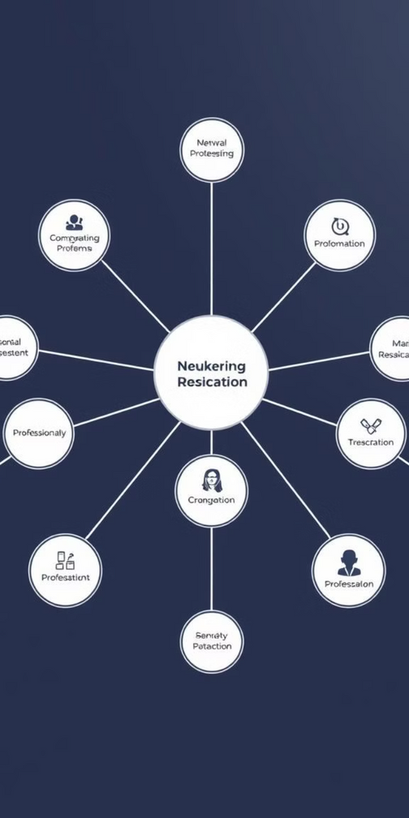



Referral Process and Network Development
Referral Networks
Collaborating with other professionals, such as doctors, therapists, and social workers, can provide clients with a comprehensive support system.
Building Relationships
Attending conferences, joining professional associations, and participating in community events can help expand your network.
Effective Referrals
Providing clear and concise referrals ensures that clients receive appropriate care and support from other professionals.
Notes:
4

Slide 7
Ethical Standards in the Counselling Profession
Confidentiality
1
Keeping client information private and confidential is paramount. This includes respecting client privacy and maintaining the integrity of their disclosures.
Informed Consent
2
Clients must be informed about the nature of counseling, its limitations, and their rights before engaging in the process.
Professional Boundaries
3
Maintaining appropriate boundaries is essential for ethical practice, ensuring that the relationship remains therapeutic and professional.
Notes:
5

Slide 8

Legal Considerations for Counselling Practice
1
Understanding the legal framework surrounding counseling practice is vital. This includes knowledge of laws related to confidentiality, informed consent, and malpractice.
2
Counselors must adhere to ethical guidelines and legal regulations to protect clients' rights and prevent potential legal consequences.
3
Professional liability insurance is crucial to mitigate risks and provide financial protection in case of malpractice claims.
Notes:
6

Slide 9

Selection and Training of Competent Counselors
1
Rigorous Screening
Selection processes should focus on identifying individuals with appropriate qualifications, empathy, and ethical standards.
2
Comprehensive Training
Training programs should equip counselors with essential knowledge, skills, and practical experience in various counseling modalities.
3
Ongoing Supervision
Providing ongoing supervision ensures that counselors remain current, address ethical dilemmas, and maintain competence throughout their careers.
Notes:
7

Slide 10





Emerging Trends and Innovations in Counselling
Online Counselling
The rise of telehealth and virtual therapy platforms has made counseling more accessible and convenient for clients.
Evidence-Based Practices
Counselors are increasingly incorporating research-backed therapeutic approaches to enhance treatment effectiveness.
Cultural Competence
Recognizing and addressing the cultural diversity of clients is becoming a crucial component of ethical and effective counseling.
Notes:
8

Slide 11



The Status of Guidance and Counselling in India
Growing Awareness
1
Awareness of the benefits of counseling is increasing in India, leading to greater demand for services.
Expansion of Programs
2
Schools, universities, and organizations are implementing counseling programs to support individuals and address mental health needs.
Challenges & Opportunities
Challenges include limited access to affordable counseling, a shortage of trained professionals, and cultural barriers. But there are also opportunities for further growth and development.
3
Notes:
9

Slide 12

Strengthening the Counselling Profession in India
The future of counseling in India is promising. By addressing the challenges and embracing the opportunities, we can collectively contribute to the well-being of individuals and communities. This includes advocating for policy changes, promoting research and innovation, and fostering collaboration between stakeholders.
Notes:
10

