Slide 1
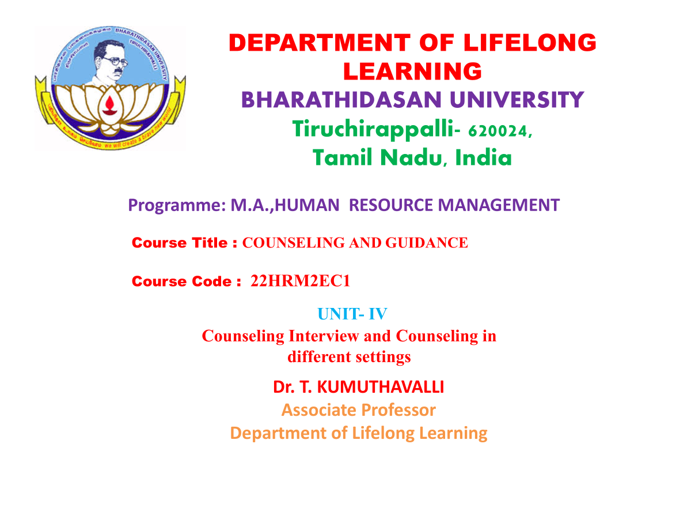

Slide 2


Slide 3


Counseling: A Deep Dive
Welcome! This presentation explores the core concepts and diverse applications of counseling. We'll delve into crucial skills and techniques to build a strong client-counselor relationship. Discover how counseling is applied in various settings, from individual therapy to group and organizational contexts.
Notes:
3

Slide 4
Counselee-Counselor Relationship
Building Trust
Developing Rapport
Trust is paramount. It involves open communication, active listening, and empathy. Showing genuineness helps build rapport.
Rapport is a sense of connection and understanding. It involves being present, creating a safe space, and respecting the client's experiences.
Notes:
4

Slide 5

Interviewing Techniques
Active Listening
Open-ended Questions
Attentively listen without interrupting. Use verbal cues and non-verbal communication to show understanding.
Encourage the client to share their thoughts and feelings. Examples include "Tell me more about that" or "How does that make you feel?"
Reflection
Paraphrase the client's statements to confirm your understanding and demonstrate empathy.
Notes:
5

Slide 6



Structuring the Relationship
Goal Setting
1
Collaborate to define specific, measurable, achievable, relevant, and time-bound (SMART) goals.
Boundaries
2
Establish clear boundaries regarding confidentiality, session length, and communication outside of sessions.
Plan of Action
3
Develop a structured plan to achieve the goals, outlining strategies, timelines, and potential challenges.
Notes:
6

Slide 7

Transference & Counter-Transference
Transference
Counter-Transference
Managing Emotions
The client unconsciously projects feelings from past relationships onto the therapist.
The therapist's own emotional responses to the client, based on past experiences or personal biases.
Awareness and self-reflection are crucial. Supervisees can help therapists navigate these dynamics.
Notes:
7

Slide 8





Counseling in Different Settings
Group Counseling
Educational Counseling
Facilitates shared experiences, promotes social support, and helps individuals learn from others.
Addresses academic challenges, career exploration, and college/university application processes.
Vocational Counseling
Family Counseling
Assists individuals in identifying career paths, developing skills, and navigating the job search process.
Addresses family dynamics, conflict resolution, communication patterns, and individual needs within the family system.
Notes:
8

Slide 9
Organizational Counseling
Employee Support
1
Provides individual and group counseling to address work-related stress, burnout, and personal issues.
Well-being Programs
2
Develops programs to promote employee mental health, work-life balance, and healthy coping mechanisms.
Organizational Development
3
Facilitates organizational change, team building, and conflict resolution, creating a positive work culture.
Notes:
9

Slide 10

Key Takeaways
1
Building Trust
A strong foundation for effective counseling.
2
Diverse Applications
Counseling addresses a wide range of needs in various settings.
3
Positive Impact
Counseling empowers individuals and organizations to thrive.
Notes:
10

Slide 11

Next Steps
Continue exploring the vast field of counseling. Consider further training, mentorship, and ongoing professional development to enhance your skills and knowledge. Remember, every interaction has the potential to make a positive difference in the lives of others.
Notes:
11

