Slide 1
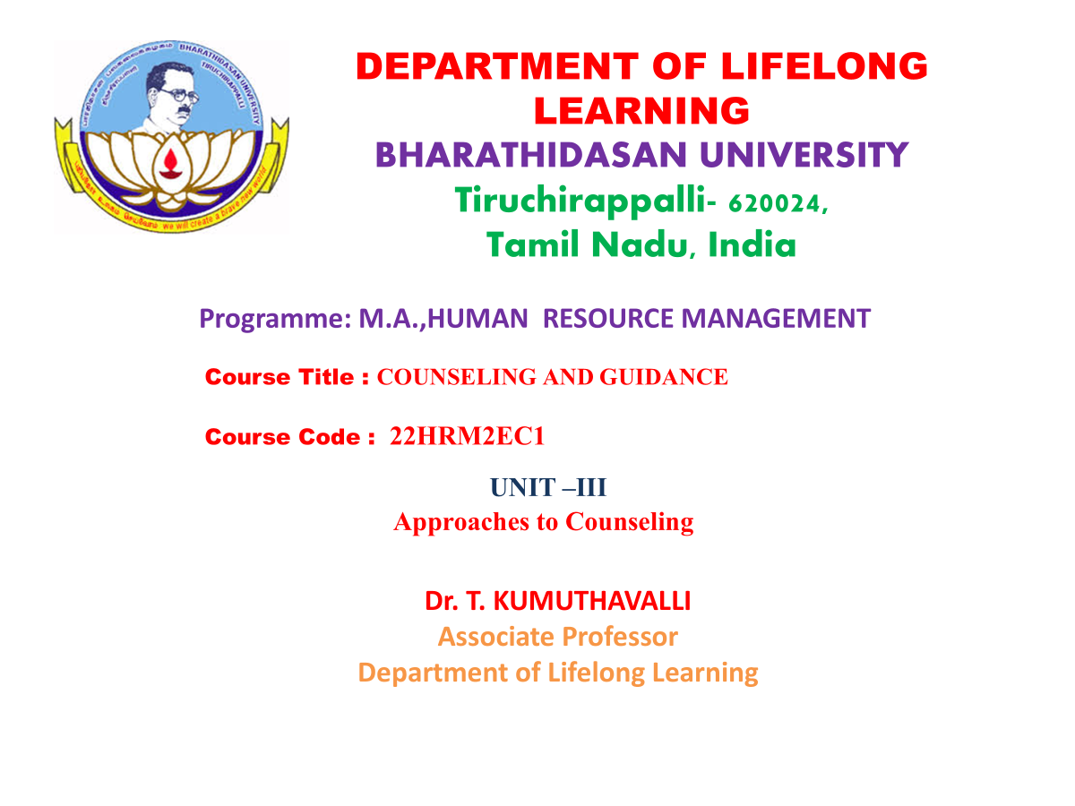

Slide 2
UNIT –III
Approaches to Counseling

Slide 3



Exploring Approaches to Counselling
Counselling offers valuable tools and strategies to navigate life's challenges. This presentation explores various approaches to counselling, highlighting their strengths and unique methodologies.
Notes:
3

Slide 4
Directive or Authoritarian Approach (Psychoanalytic)
Focus on the Unconscious
Therapist-led Approach
This approach aims to uncover hidden thoughts and emotions. It emphasizes the impact of past experiences on current behavior.
The therapist guides the client through interpretations and interventions. This approach can be quite structured and directive.
Notes:
4

Slide 5
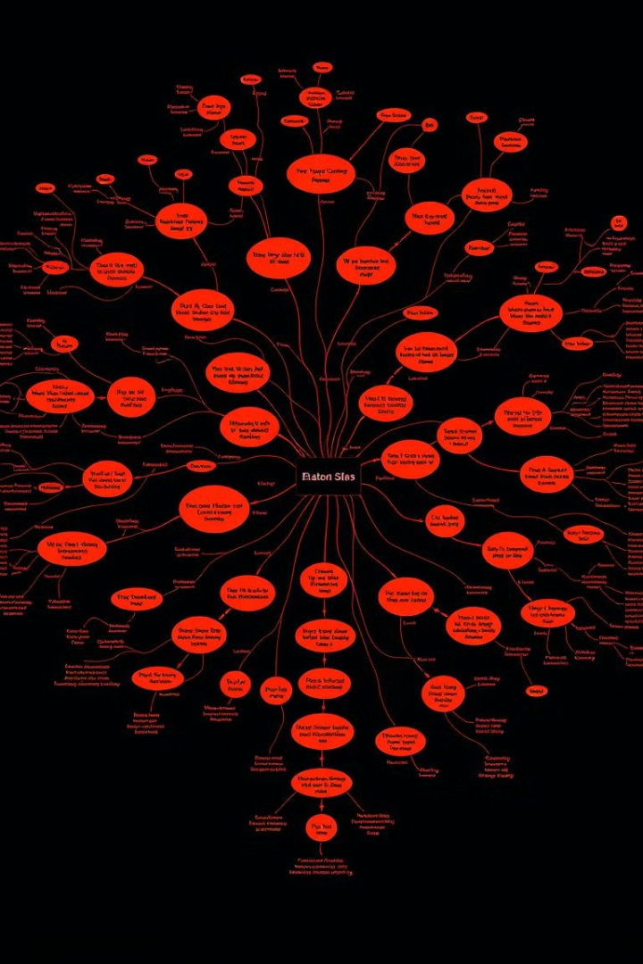
Relevance of Psychoanalysis to Counselling
1
Understanding Early Experiences
2
Addressing Defense Mechanisms
It helps clients understand how childhood experiences may be influencing their current actions and relationships.
It provides insights into the unconscious strategies people use to cope with stress, which can be adapted for positive change.
3
Developing Self-Awareness
It helps clients become more aware of their own inner world and the factors that shape their thoughts and behaviors.
Notes:
5

Slide 6

Humanistic Approach
Focus on the Individual
Emphasis on Empathy and Acceptance
This approach emphasizes the client's inherent potential for growth and self-actualization.
The therapist provides a safe and non-judgmental space for clients to explore their feelings and experiences.
Focus on the Present
This approach focuses on the client's current thoughts, feelings, and experiences, rather than delving into the past.
Notes:
6

Slide 7




Roger's Self-Theory
Self-Actualization
This theory highlights the inherent drive to reach full potential and personal growth.
Unconditional Positive Regard
The therapist provides acceptance and support without judgment, fostering trust and self-acceptance.
Empathy and Congruence
The therapist genuinely understands the client's experiences and communicates authentically.
Notes:
7

Slide 8

Development of Self-Concept
Early Childhood
1
Early experiences shape our sense of self, influenced by relationships and interactions.
2
Adolescence
Exploring identity and values leads to a more defined self-concept. This can be a period of self-discovery and growth.
Adulthood
3
The self-concept continues to evolve as individuals navigate relationships, careers, and life experiences.
Notes:
8

Slide 9



Eclectic Approach
Combines Multiple Techniques
This approach draws from different therapeutic approaches, tailoring interventions to the individual client's needs.
Flexibility and Adaptability
The therapist can utilize a range of techniques to address different challenges and support growth.
Notes:
9

Slide 10





The Counselling Process
Establish Rapport
1
Building a strong and trusting relationship with the client is essential.
2
Assessment
Understanding the client's needs and identifying goals is key.
3
Intervention
Implementing therapeutic techniques and strategies to address the client's challenges.
4
Evaluation
Monitoring progress and making adjustments to ensure effectiveness.
5
Termination
Ending the counselling relationship while supporting the client's continued growth.
Notes:
10

Slide 11
Importance of Counselling in India
Mental Health Awareness
1
Counselling promotes mental health awareness and helps break down stigma associated with seeking help.
Addressing Social Issues
2
It helps individuals cope with challenges like family conflicts, unemployment, and societal pressures.
Personal Growth
3
Counselling provides tools and strategies for personal growth and development, enhancing overall well-being.
Notes:
11

Slide 12

Challenges and Opportunities in Counselling
1
Access to Services
Limited access to affordable and qualified counsellors, especially in rural areas, is a significant challenge.
2
Stigma and Shame
Mental health stigma remains a major barrier to seeking help. There is a need to increase awareness and understanding.
3
Technological Advancements
Online counselling provides greater access and convenience, offering new opportunities for growth.
Notes:
12

