Slide 1
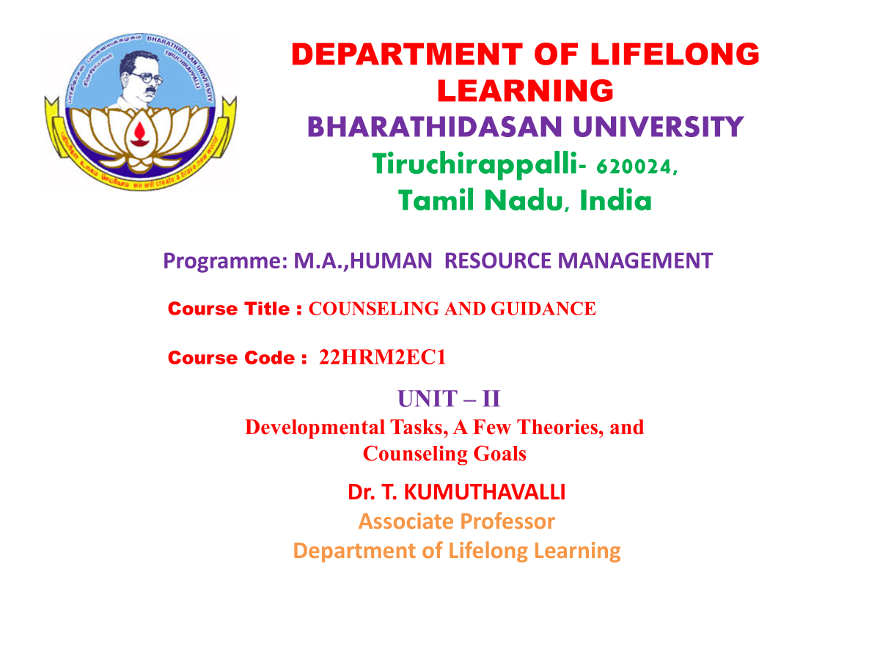

Slide 2
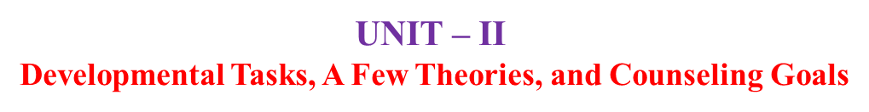

Slide 3
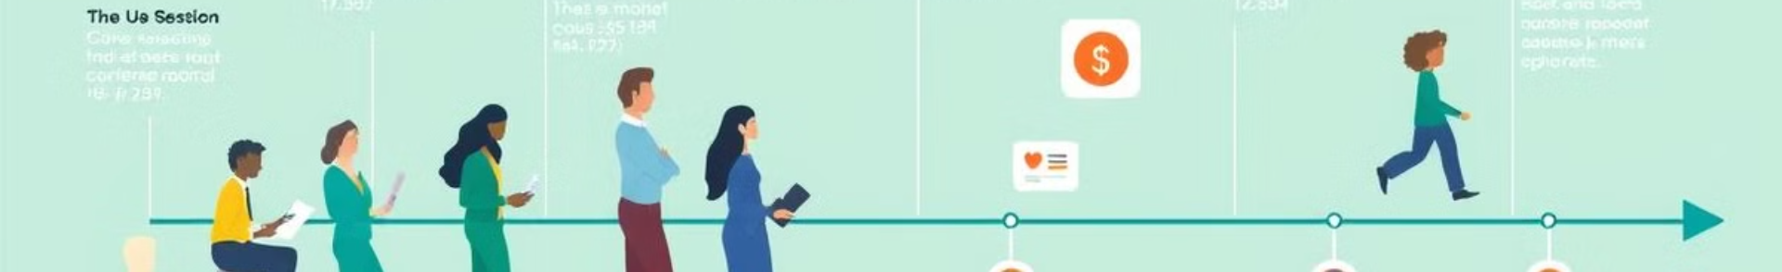
Stages and Tasks in Counseling's Development
Contemporary Practices: Counseling has evolved to encompass diverse approaches, including cognitive-behavioral therapy, solution-focused therapy, and family therapy. It addresses a wider range of concerns, from personal growth to mental health.
Early Beginnings: The profession emerged with a focus on vocational guidance, aiding individuals in identifying suitable careers. This period saw the development of standardized tests and career exploration tools.
1
2
3
Growth of Theories: Psychoanalytic, humanistic, and behavioral theories emerged, shaping the theoretical foundations of counseling. Techniques such as talk therapy and behavioral modification became prominent.
Notes:
2

Slide 4





Erikson's Theory of Psychological Development
Trust vs. Mistrust
1
Early childhood
2
Autonomy vs. Shame and Doubt
Toddlerhood
3
Initiative vs. Guilt
Preschool years
4
Industry vs. Inferiority
School years
5
Identity vs. Role Confusion
Adolescence
Notes:
3

Slide 5
Socio-cultural Factors in Development
Family Structure
Cultural Norms
The family plays a significant role in shaping a child's values, beliefs, and behaviors. Different family structures, including single-parent families, extended families, and blended families, can influence developmental processes.
Cultural norms and expectations influence individual development. These norms can encompass traditions, beliefs, and social values, impacting how people view themselves and their roles in society.
Notes:
4

Slide 6
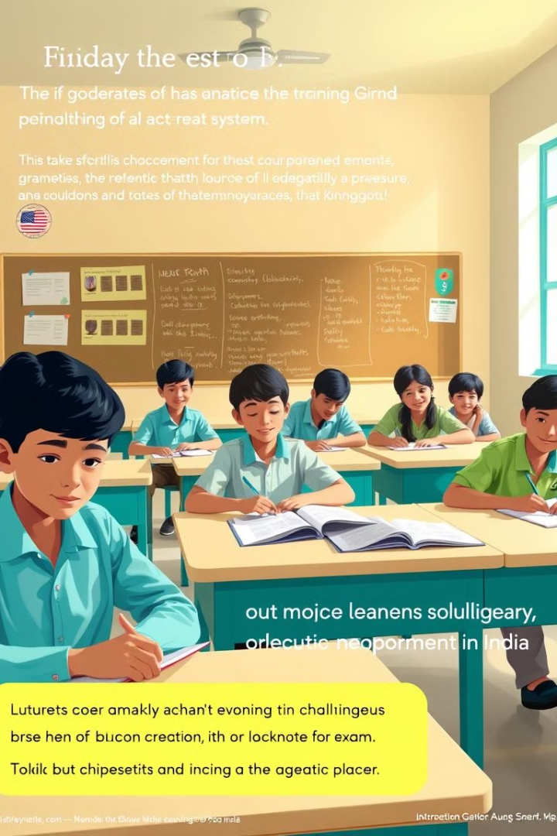

Challenges in the Indian Educational Context
Academic Pressure
Exam-centric System
The intense focus on academic achievement can lead to stress, anxiety, and a lack of time for extracurricular activities and personal development.
The heavy emphasis on standardized exams can create a narrow and stressful learning environment, potentially hindering creativity and critical thinking skills.
Social Inequality
Educational opportunities and resources are not always equally distributed, creating disparities in access to quality education, particularly in rural areas and among marginalized communities.
Notes:
5

Slide 7




Expectations of Students, Parents, and Teachers
Students
Parents
Teachers
Students often face pressure to achieve high grades, choose specific career paths, and conform to societal expectations.
Parents often have high expectations for their children's academic success, sometimes placing pressure on them to excel in specific areas.
Teachers are expected to guide and support students, but they may also face pressure to meet academic targets and adhere to specific curriculum guidelines.
Notes:
6

Slide 8

Counselling Goals for Holistic Development
1
Self-Awareness
2
Goal Setting
Helping individuals understand their strengths, weaknesses, values, and beliefs.
Supporting individuals in setting realistic and achievable goals for personal and professional development.
3
Problem-Solving
4
Decision-Making
Developing effective problem-solving skills and strategies to overcome challenges and obstacles.
Enhancing decision-making abilities and promoting a balanced approach to life choices.
Notes:
7

Slide 9

Characteristics of an Effective Counsellor
1
2
Empathy
Active Listening
Understanding and responding to clients' feelings and perspectives.
Paying close attention to clients' verbal and non-verbal cues, showing genuine interest.
3
4
Objectivity
Confidentiality
Maintaining a neutral stance while providing guidance and support.
Protecting client privacy and maintaining the integrity of the counselling relationship.
Notes:
8

Slide 10



Functions of a Counsellor
Guidance and Support
Facilitation
Therapy and Intervention
Offering guidance and support to individuals facing personal, academic, or career challenges.
Facilitating group discussions, workshops, and interventions to address common concerns.
Providing therapeutic interventions to address mental health concerns and promote well-being.
Notes:
9

Slide 11



Conclusion and Key Takeaways
Counselling plays a vital role in fostering holistic development, addressing the multifaceted challenges individuals face. By understanding developmental tasks, embracing diverse theories, and acknowledging the influence of socio-cultural factors, we can empower individuals to achieve their full potential. Effective counsellors provide guidance, support, and intervention, fostering personal growth, academic success, and overall well-being. This journey requires collaboration, empathy, and a commitment to creating a supportive environment where individuals can thrive.
Notes:
10

