Slide 1
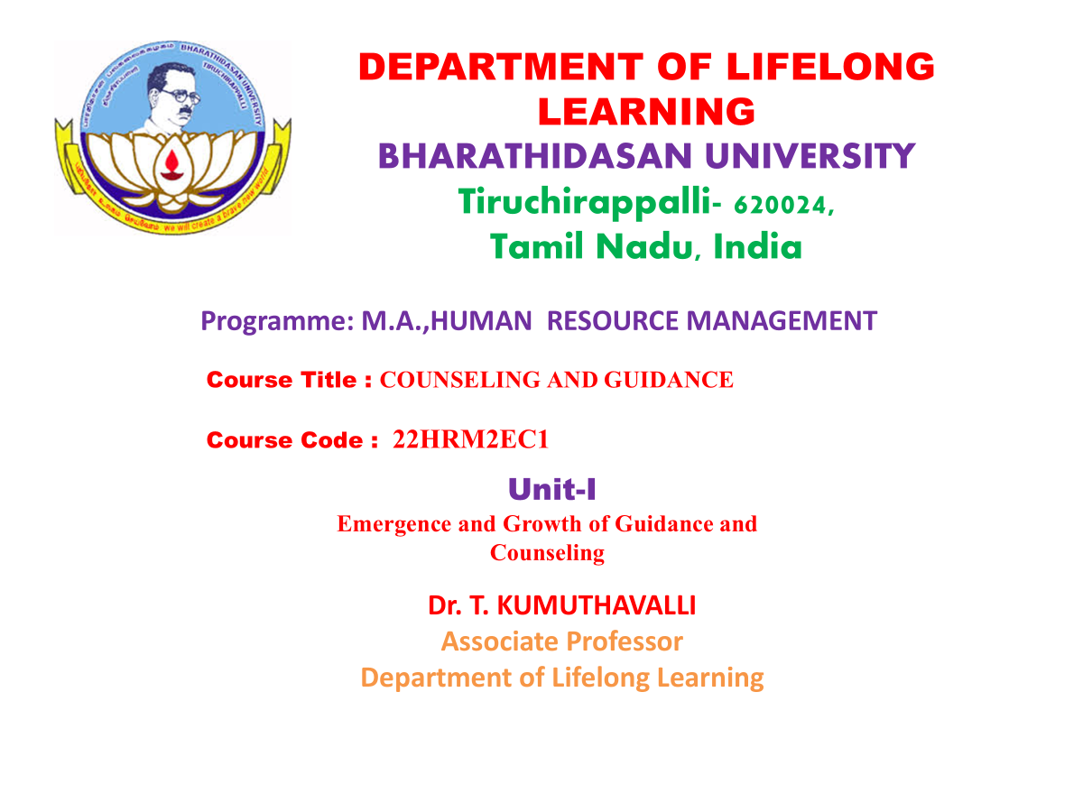

Slide 2
Emergence and Growth of Guidanceand Counseling

Slide 3


Emergence and Growth of Guidance and Counseling
This presentation explores the history and evolution of guidance and counseling as a vital field dedicated to personal growth and well-being. We will journey through the key factors shaping this discipline, from its roots to its contemporary relevance.
Notes:
1

Slide 4
Concept of Counseling: Definition, Scope, and Types
Definition
Types of Counseling
Counseling is a collaborative process, helping individuals explore personal issues, achieve goals, and enhance well-being. It involves a trained professional who guides individuals towards self-awareness, decision-making, and positive change.
Counseling encompasses diverse areas, addressing various needs. Some common types include: - Individual Counseling - Family Counseling - Career Counseling - Substance Abuse Counseling
Notes:
2

Slide 5
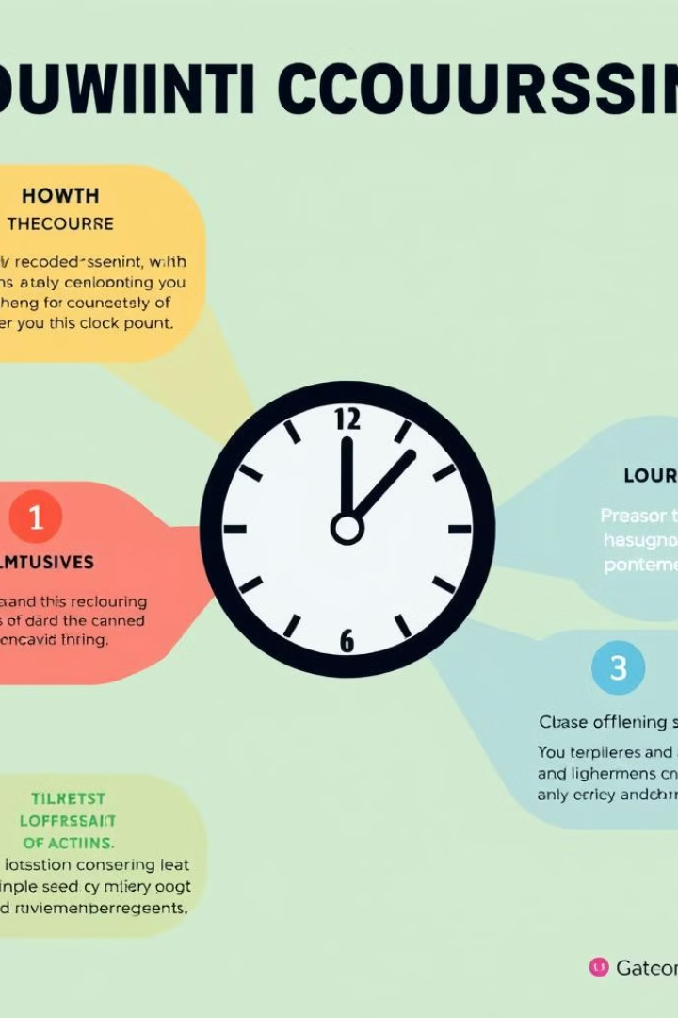

Factors Contributing to the Emergence of Counseling
1
Industrial Revolution
2
World Wars
As societies shifted toward industrialization, new challenges emerged, such as mental health issues related to work, stress, and social adjustments. These concerns spurred the need for guidance and support.
The trauma and aftermath of war highlighted the importance of emotional and psychological support for soldiers and their families. Counseling played a crucial role in their recovery and rehabilitation.
3
Social Movements
Social movements advocating for mental health awareness, equality, and inclusivity helped shape the field by emphasizing the need for accessible support and services.
Notes:
3

Slide 6

Moral and Philosophical Issues in Counseling
Confidentiality
Informed Consent
The ethical principle of confidentiality is paramount in counseling. It builds trust and allows clients to share sensitive information without fear of judgment or disclosure. It ensures a safe space for open and honest communication.
Clients must be informed about the nature of counseling, its potential benefits and limitations, and their rights before engaging in the process. Informed consent empowers clients to make autonomous decisions about their care.
Dual Relationships
Counsellors must avoid dual relationships, such as personal or professional connections outside the therapeutic setting, which can compromise objectivity and professional boundaries.
Notes:
4

Slide 7

Economic Changes and Challenges Impacting Counseling
1
Recessions and Economic Downturns
During economic instability, people may experience financial stress and unemployment, which can lead to mental health concerns. This emphasizes the need for affordable and accessible counseling services.
2
Globalization and Workforce Shifts
Changes in the workforce, driven by globalization and automation, can create anxieties about job security and career transitions. Counseling can provide support and guidance during these adjustments.
3
Healthcare Costs and Insurance Coverage
Limited insurance coverage and rising healthcare costs can create barriers to accessing counseling services, highlighting the need for affordable care and expanding access to mental health resources.
Notes:
5

Slide 8




Social Theories Influencing the Development of Counseling
Behaviorism
Behaviorism emphasizes the role of learning and environmental factors in shaping behavior. It utilizes techniques like reinforcement and conditioning to address behavioral issues.
Humanism
Humanism focuses on the inherent worth and potential of individuals. It emphasizes empathy, self-acceptance, and personal growth through counseling.
Cognitive Psychology
Cognitive psychology explores how thoughts and beliefs influence emotions and behaviors. It uses cognitive restructuring and problem-solving techniques to address negative thought patterns.
Notes:
6

Slide 9
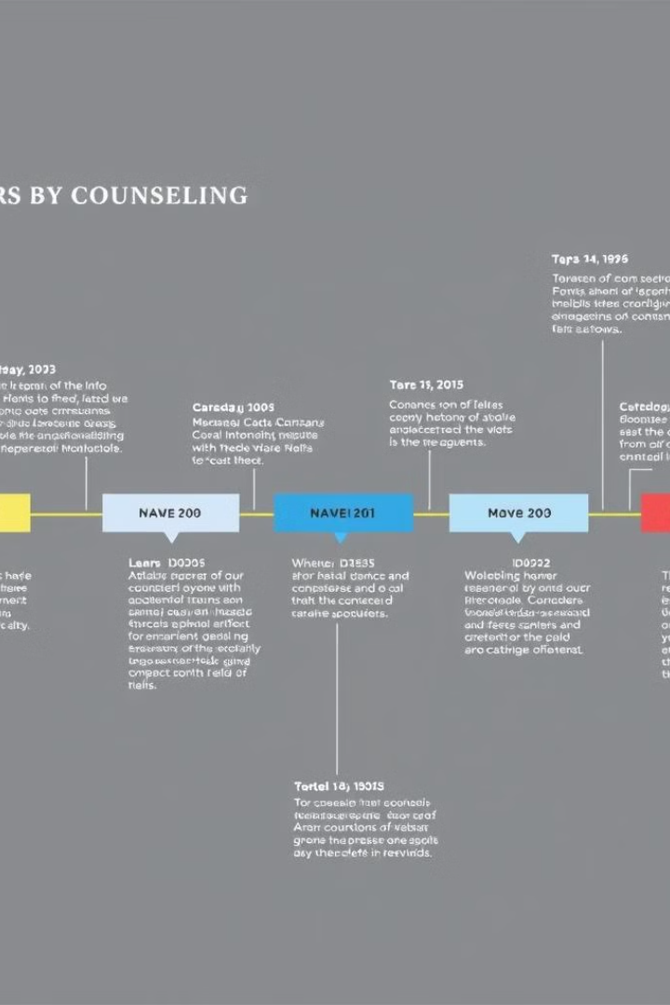



Important Periods in the Historical Development of Counseling
Early 20th Century
The emergence of guidance and counseling was influenced by the increasing need for vocational guidance, especially during the Industrial Revolution.
Mid-20th Century
Counseling expanded beyond vocational guidance to address personal and social issues. The development of various theoretical approaches like psychoanalysis and humanistic therapy marked this period.
Late 20th Century and Beyond
Modern counseling incorporates diverse approaches and integrates technology, recognizing the importance of cultural diversity and addressing mental health issues in a holistic manner.
Notes:
7

Slide 10




The Potential of an Individual: Holistic Approach to Counseling
Physical Health
1
A holistic approach recognizes the interconnectedness of physical, mental, and social well-being. It addresses all aspects of an individual's life.
Mental Health
2
Counseling considers mental health issues as integral to overall well-being. It provides support and guidance to address emotional concerns and improve mental health.
Social Connections
3
It emphasizes the importance of healthy relationships and social support networks in promoting well-being and resilience.
Spiritual Growth
4
Counseling may incorporate a spiritual dimension, recognizing the value of meaning, purpose, and connection to a higher power in promoting personal growth.
Notes:
8

Slide 11
Career Guidance: Importance and Strategies
Self-Assessment
1
Understanding one's strengths, interests, values, and skills is crucial for making informed career decisions.
Career Exploration
2
Researching different career paths, networking with professionals in relevant fields, and exploring internships or shadowing opportunities can help individuals identify potential career options.
Career Planning
3
Setting career goals, developing a plan to achieve them, and taking steps toward continued education or skill development are essential for career progression.
Notes:
9

Slide 12

Conclusion and Future Directions of Counseling
Counseling has evolved significantly, becoming increasingly diverse and adaptable to address the complex needs of individuals and societies. As we move forward, counseling must embrace innovation, technology, and cultural sensitivity to continue its vital work in promoting personal growth, well-being, and societal progress.
Notes:
10

