Slide 1

DEPARTMENT OF LIFELONG LEARNING
BHARATHIDASAN UNIVERSITY
Tiruchirappalli-620024
Tamil Nadu, India
Programme: M.A.,HUMAN RESOURCE MANAGEMENT
Course Title : Compensation Management
Course Code : 22HRM2CC9
Unit-VI
Psychological framework on Compensation
Dr. T. KUMUTHAVALLI
Associate Professor
Department of Lifelong Learning

Slide 2



Psychological Framework on Compensation
Compensation is a complex and multifaceted aspect of organizational behavior, driven by various psychological factors. This framework explores the intricate relationship between compensation, motivation, and employee well-being.
by Kavin

Slide 3
The Motivational Role of Payment Reward
Extrinsic Motivation
Perceived Fairness
Goal-Setting
Monetary rewards can serve as powerful extrinsic motivators, driving employees to perform better in order to earn higher pay or bonuses.
Employees' perception of the fairness and equity of the compensation system can greatly impact their motivation and job satisfaction.
Linking compensation to clear, measurable goals can help employees stay focused and motivated to achieve desired outcomes.

Slide 4

Motivation and Compensation
1
Intrinsic Motivation
Meaningful work, personal growth, and a sense of purpose can intrinsically motivate employees beyond just financial rewards.
2
Total Rewards
Effective compensation strategies consider not just monetary pay, but also benefits, career development, and work-life balance.
3
Personalized Approach
Tailoring compensation to individual needs and preferences can help foster stronger employee engagement and loyalty.

Slide 5
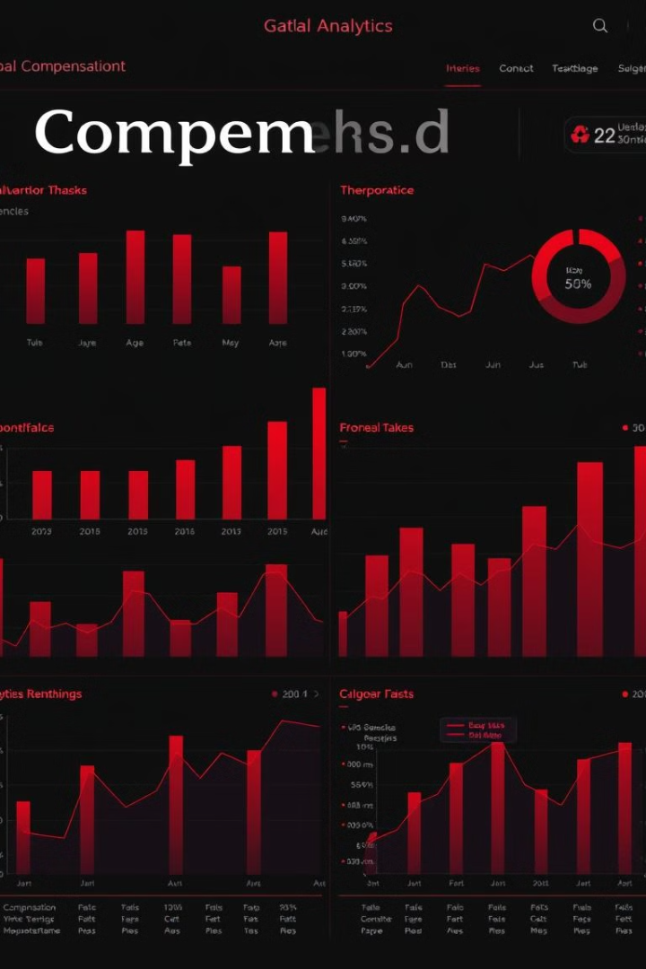
Opportunities, Challenges, and Recent Trends in Compensation
Flexible Rewards
Pay Transparency
The rise of flexible and personalized compensation options, such as variable pay and non-monetary benefits.
Increased emphasis on pay transparency to promote fairness and address pay equity concerns.
Data-Driven Decisions
Balancing Priorities
Addressing the challenge of balancing competitive pay, cost control, and employee satisfaction.
Leveraging data analytics to make more informed, strategic decisions about compensation and reward structures.

