Slide 1

DEPARTMENT OF LIFELONG LEARNING
BHARATHIDASAN UNIVERSITY
Tiruchirappalli-620024
Tamil Nadu, India
Programme: M.A.,HUMAN RESOURCE MANAGEMENT
Course Title : Compensation Management
Course Code : 22HRM2CC9
Unit-II
Theorise of wages
Dr. T. KUMUTHAVALLI
Associate Professor
Department of Lifelong Learning

Slide 2



Theories of Wages
Wages policies are fundamental to managing employee compensation. This presentation will explore the key concepts and influential theories that shape wage determination.
by Kavin

Slide 3
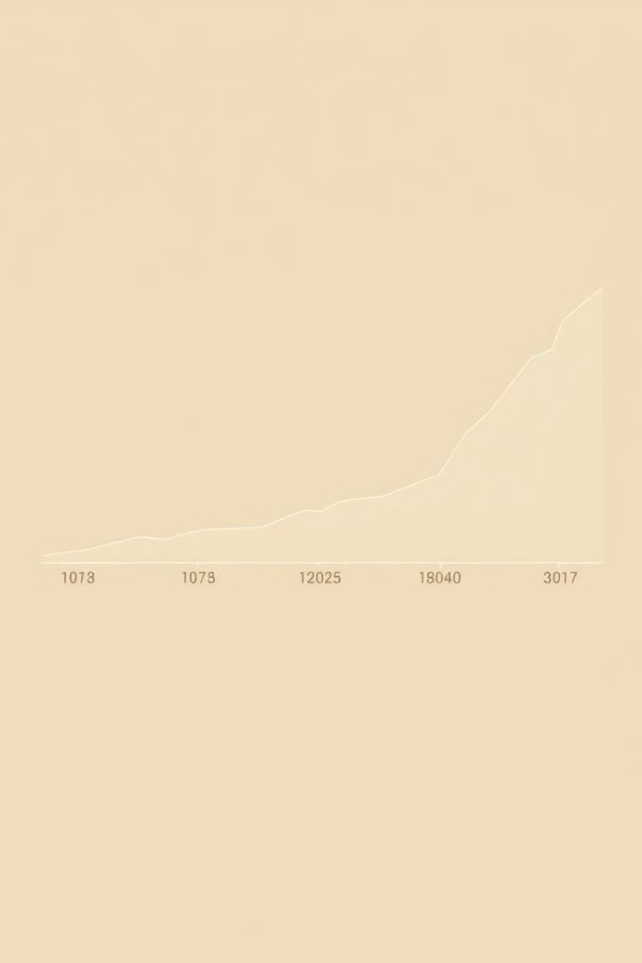
Wages Policy Concept
1
Defining Wages
2
Policy Objectives
Wages refer to the monetary compensation paid to employees in exchange for their labor and services.
Wages policies aim to ensure fair, competitive, and equitable compensation that attracts and retains talent.
3
Key Considerations
Factors like cost of living, productivity, and labor market conditions influence wage policy decisions.

Slide 4
ILO on Wage Policy
ILO Principles
Policy Recommendations
Global Impact
The International Labor Organization (ILO) advocates for living wages, minimum wage laws, and collective bargaining.
The ILO suggests regular minimum wage reviews, social dialogue, and aligning wages with productivity growth.
ILO wage policies have been influential in shaping labor laws and regulations worldwide.

Slide 5

National Wage Policy in India
1
Minimum Wage Act
India's Minimum Wages Act of 1948 established a framework for setting and revising minimum wages.
2
Wage Boards
Tripartite wage boards were formed to recommend industry-specific wages and policies.
3
Evolving Framework
The wage policy has since expanded to include comprehensive labor laws and social security measures.

Slide 6

Ricardo's Subsistence Theory of Wages
Subsistence Level
Demand and Supply
According to Ricardo, wages must be sufficient to maintain the worker and their family at a subsistence level.
Wages are determined by the supply of labor and the demand for it, with a tendency to gravitate towards the subsistence level.
Critique
This theory has been criticized for its lack of consideration for factors like productivity, cost of living, and worker bargaining power.

Slide 7
Adam Smith's Wage Fund Theory
Wage Fund Concept
Demand and Supply
Limitations
Smith believed that the total wages paid in an economy are limited by the available capital, or "wage fund".
Wages are determined by the demand for labor and the supply of labor, within the constraints of the wage fund.
The theory has been criticized for oversimplifying the complex factors that influence wage determination.

Slide 8




Marx's Surplus Value Theory
Labor Value
Marx argued that the value of a product is derived from the labor used to produce it.
Surplus Value
The difference between the value of the product and the cost of labor is the "surplus value" that accrues to the capitalist.
Exploitation
Marx viewed this surplus value as a form of exploitation, where workers are not paid the full value of their labor.

Slide 9




Residual Claimant Theory
Profit
This theory views wages as the residual amount left after other factors of production (capital, land, etc.) have been compensated.
Bargaining Power
The bargaining power of workers and employers determines the distribution of this residual between wages and profits.
Economic Considerations
Factors like productivity, supply and demand, and cost of living also influence the residual wage level.

Slide 10

Purchasing Power Theory
Wage Income
Balanced Economy
This theory posits that wages should be set to provide workers with sufficient purchasing power.
The theory advocates for wage policies that balance the needs of workers, employers, and the broader economy.
1
2
3
Consumer Demand
Adequate wages drive consumer demand, which in turn stimulates economic growth and investment.

Slide 11

Elliot Jacques Theory of Wages
Equitable Compensation
Role Complexity
He proposed a system to objectively assess the cognitive demands and decision-making required in different roles.
Jacques argued that wages should be based on the complexity and responsibility of the work performed, not just market forces.
Motivational Impact
This theory emphasizes the importance of fair and transparent wage structures for employee motivation and retention.

