Slide 1

DEPARTMENT OF LIFELONG LEARNING
BHARATHIDASAN UNIVERSITY
Tiruchirappalli-620024
Tamil Nadu, India
Programme: M.A.,HUMAN RESOURCE MANAGEMENT
Course Title : Compensation Management
Course Code : 22HRM2CC9
Unit-III
Methods of wages
Dr. T. KUMUTHAVALLI
Associate Professor
Department of Lifelong Learning

Slide 2



Methods of Wage Fixation: Compensation Management
Effectively managing employee compensation is a critical aspect of human resources. This series explores key methods and considerations in determining appropriate wage and salary structures, ensuring fair and equitable pay that aligns with productivity and organizational goals.
by Kavin

Slide 3
Computation of Wage & Salary Structure
Job Evaluation
Market Benchmarking
Internal Equity
Assessing the relative worth of different roles within the organization to establish appropriate compensation levels.
Analyzing industry standards and competitor pay scales to ensure competitiveness and attract top talent.
Maintaining fairness by considering factors like experience, skills, and level of responsibility within the company.

Slide 4
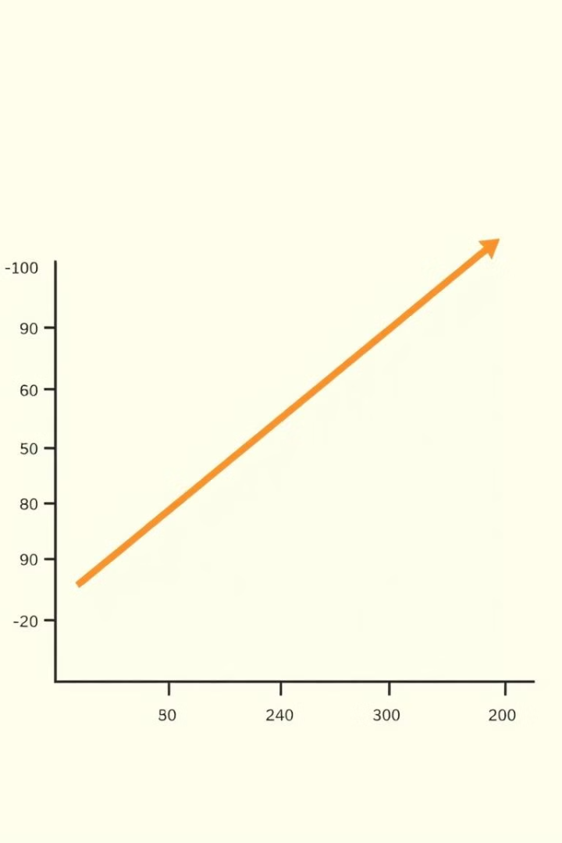
Wage Differentials & Productivity
1
Skill-Based Wages
Compensating employees based on their unique skills and expertise, which directly impact productivity.
2
Incentive Pay
Offering bonuses, commissions, or piece-rate pay to encourage and reward high performance.
3
Profit Sharing
Linking a portion of employee compensation to the overall profitability of the organization.

Slide 5

Dearness Allowance & Fringe Benefits
Dearness Allowance
Health & Retirement
A cost-of-living adjustment that helps maintain purchasing power in the face of inflation.
Fringe benefits like health insurance, retirement plans, and paid time off enhance employee wellbeing and loyalty.
Work-Life Balance
Flexible schedules, remote work options, and other perks can improve job satisfaction and productivity.

