Slide 1
SCIENTOMETRIC ANALYSIS OF RESEARCH PRODUCTIVITY IN THE UNIVERSITY OF JAFFNA, SRI LANKA - DURING THE WAR AND POST-WAR PERIODS: A COMPARATIVE ANALYSIS BASED ON THE WEB OF SCIENCE AND SCOPUS DATABASES
DR. N. AMSAVENI
Assistant Professor, Department of Lib & Info Science
Bharathidasan University.
Amsaveni.n@bdu.ac.in

Slide 2
INTRODUCTION
Higher education institutions play a crucial role in knowledge creation and societal development. Universities, as centers of academic excellence, contribute significantly to national and international research outputs.
The Sri Lankan civil war:
Sri Lankan civil war started due to long-standing ethnic tensions between the majority Sinhalese and the minority Tamils. Key reasons, discrimination against Tamils in language, education, and employment, leading to demands for autonomy. This escalated into armed conflict in 1984 for an independent Tamil state. which lasted from 1984 to 2009 for over 25 years.
Higher Education in Sri Lanka:
State Universities- Governed by the University Grants Commission (UGC) 17 public Universities, including University of Jaffna.
Private Higher Education- In recently, private institutions and international University offering degrees.
Technical & Vocational Education - It provides the alternative higher education pathways.

Slide 3
Conti...,
University of Jaffna- an overview:
University of Jaffna (UoJ) is one of Sri Lanka’s major public Universities, located in the Northern Province. It established in 1974, it has been playing a crucial role in higher education, research, and cultural preservation, specially, for Tamil-speaking communities in Sri Lanka.
Challenges & Growth of University of Jaffna:
During civil war (1984 –2009), University faced significant challenges such as displacement, Infrastructure Damages, Restricted Academic Freedom, Limited Access to Resources, Psychosocial Impact and Lack of Government Support. Despite these challenges, University continued to contribute to knowledge production.
However, the true impact of the war on research productivity of UoJ has not been extensively studied through a scientometric perspective so far. Therefore , the purpose of this study to fill that gap by providing a comparative analysis of research productivity of UoJ.

Slide 4
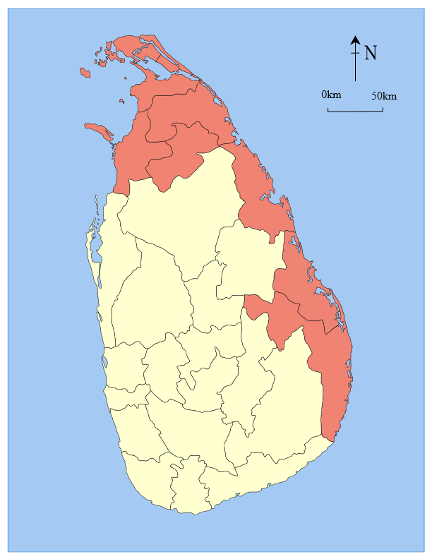
Major affected areas by the war in Sri Lanka, marked in red.
University of Jaffna
University of Vavuniya
Eastern University
South Eastern University

Slide 5
What is Scientometric study?
The metric study is a quantitative analysis of scientific research output. It examines publications, citations, authorship patterns, and research trends to assess the growth and influence of scientific knowledge. Scientometrics is widely applied in evaluating institutions, researchers, and disciplines, often using databases like Web of Science and Scopus.
The Significant of the study:
Understanding the Impact of War on Academic Research of UoJ
Empirical Evidence for Research Growth of UoJ.
Enhancing Institutional Research Strategies
Contribution to Scientometric Studies
Strengthening International Collaborations
Policy Implications for Post-Conflict Higher Education
Resource for Future Research

Slide 6
REVIEW OF LITERATURE
Many researchers have conducted numerous scientometric studies on the research output of various Universities. But, this study specifically examines of University of Jaffna from a comparative perspective two distinct periods: the war periods (1984 -2009) and the post-civil war (2010-2025). Since no any research has focused on this particular aspect, a significant research gap has been identified, highlighting the necessity of this study.
It is divided following sections,
Review of Literature
Scientometric Studies on Research Productivity of various Universities (16 International literatures)
Research Productivity In Sri Lankan Universities (07 National literatures)
Impact of the Civil War on Higher Education In Sri Lanka (02 International literatures)
Previous Studies on The University of Jaffna (04 National literatures)

Slide 7
RESEARCH DESIGN
Research Problem
The civil war of Sri Lanka (1984–2009) had a significant impact on higher education, particularly at the University of Jaffna. However, in the post-war period, the University has experienced a notable increase in research output. Despite this growth, there is no comprehensive scientometric analysis comparing the war and post-war period’s research productivity so far. Therefore, this study seeks to fill this gap by systematically comparing and analyzing the effects of the war on the University’s research productivity using bibliometric tools.
Limitations of the study:
The data was collected from Web of Science (1989-2025) and Scopus (1984-2025).
The war (1984 to 2009) & post - war (2010 to 2025) periods.
The University of Jaffna was selected most war affected institution in Sri Lanka.

Slide 8
3.2 Objectives of the research :
To compare research productivity of the University of Jaffna war (1984–2009) & post-war (2010–2025) periods.
To analyze publication trends and citation impact across the both periods.
To examine authorship patterns, key contributors, collaboration networks, and changes in research teams over time.
To investigate keyword distributions and research themes in academic focus war and post-war periods.
To evaluate international collaborations and their role in enhancing research productivity in the post-war period.
To provide insights into the impact of war on higher education, offering valuable information for policymakers, researchers, librarians and University administrators.

Slide 9
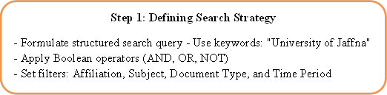
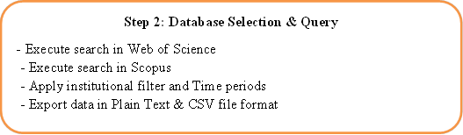
3.4 Data collection methods
Step 3: Data Cleaning & Preprocessing
- Identify and remove duplicate records
- Handle missing data (affiliations, citations)
- Standardize author names, journal titles, keywords
Step 4: Categorization of Collected Data
- Categorize by:
→ Publication year
→ Research domain
→ Citation impact
→ Authorship patterns
→ Keywords & international collaboration
- Classify into war (1984–2009) & post-war (2010–2025)

Slide 10
3.3 Total sample data from the Web of Science and Scopus for different periods
3.5 Tools and software used for research :
HistCite, Biblioshiny, VOSviewer, and Microsoft Excel tools applied for advanced bibliometric analysis, including author impact assessment, citation mapping and others.
3.6 Sampling method:
Census sampling (for all relevant publications) would provide comprehensive and unbiased results. Further, for analyzing of specific faculties or research domains, stratified sampling can used to improve the accuracy.
Reference style manual:
APA 7th edition (American Psychological Association) method is used.

Slide 11
4. Data analysis and interpretations:
4.1 Analysis of research publications and citations trend of University of Jaffna in war & post -war periods in both databases
Web of Science |  |  |  |  |  | Scopus
Year | TP | % | AGR% | TC | % | Year | TP | % | AGR % | TC | %
1989 | 3 | 0.38 | - | 49 | 0.28 | 1984 | 6 | 0.39 | - | 40 | 0.16
1990 | 10 | 1.28 | 233.33 | 174 | 1.01 | 1985 | 2 | 0.13 | -66.67 | 16 | 0.06
1991 | 5 | 0.64 | -50 | 18 | 0.10 | 1986 | 6 | 0.39 | 200 | 4 | 0.02
1992 | 6 | 0.77 | 20 | 59 | 0.34 | 1987 | 7 | 0.45 | 16.67 | 38 | 0.15
1993 | 7 | 0.90 | 16.67 | 246 | 1.42 | 1988 | 4 | 0.26 | -42.86 | 90 | 0.36
1994 | 6 | 0.77 | -14.29 | 107 | 0.62 | 1989 | 5 | 0.32 | 25 | 85 | 0.34
1995 | 11 | 1.41 | 83.33 | 134 | 0.77 | 1990 | 11 | 0.71 | 120 | 217 | 0.86
1996 | 7 | 0.90 | -36.36 | 163 | 0.94 | 1991 | 5 | 0.32 | -54.55 | 61 | 0.24
1997 | 4 | 0.51 | -42.86 | 52 | 0.30 | 1992 | 4 | 0.26 | -20 | 23 | 0.09
1998 | 8 | 1.03 | 100 | 38 | 0.22 | 1993 | 7 | 0.45 | 75 | 399 | 1.59
1999 | 7 | 0.90 | -12.5 | 89 | 0.51 | 1994 | 5 | 0.32 | -28.57 | 23 | 0.09
2000 | 3 | 0.38 | -57.14 | 85 | 0.49 | 1995 | 8 | 0.52 | 60 | 175 | 0.70
2001 | 5 | 0.64 | 66.67 | 519 | 3.00 | 1996 | 8 | 0.52 | 0 | 196 | 0.78
2002 | 2 | 0.26 | -60 | 53 | 0.31 | 1997 | 11 | 0.71 | 37.5 | 211 | 0.84
2003 | 3 | 0.38 | 50 | 19 | 0.11 | 1998 | 7 | 0.45 | -36.36 | 38 | 0.15
2004 | 4 | 0.51 | 33.33 | 364 | 2.10 | 1999 | 7 | 0.45 | 0 | 94 | 0.37
2005 | 1 | 0.13 | -75 | 49 | 0.28 | 2000 | 3 | 0.19 | -57.14 | 72 | 0.29
2006 | 10 | 1.28 | 900 | 922 | 5.33 | 2001 | 6 | 0.39 | 100 | 685 | 2.55
2007 | 8 | 1.03 | -20 | 443 | 2.56 | 2002 | 3 | 0.19 | -50 | 84 | 0.33
2008 | 6 | 0.77 | -25 | 115 | 0.66 | 2003 | 4 | 0.26 | 33.33 | 39 | 0.16
2009 | 7 | 0.90 | 16.67 | 17 | 0.10 | 2004 | 9 | 0.58 | 125 | 406 | 1.62

Slide 12
Conti…,
2010 | 10 | 1.28 | 42.86 | 172 | 0.90 | 2005 | 8 | 0.52 | -11.11 | 320 | 1.27
2011 | 11 | 1.41 | 10 | 197 | 1.14 | 2006 | 15 | 0.97 | 87.5 | 1032 | 4.11
2012 | 13 | 1.67 | 18.18 | 345 | 1.99 | 2007 | 13 | 0.84 | -13.33 | 676 | 2.69
2013 | 32 | 4.10 | 146.15 | 1265 | 7.31 | 2008 | 14 | 0.91 | 7.69 | 189 | 0.75
2014 | 14 | 1.79 | -56.25 | 176 | 1.02 | 2009 | 9 | 0.58 | -35.71 | 89 | 0.35
2015 | 20 | 2.56 | 42.86 | 1110 | 6.41 | 2010 | 20 | 1.29 | 122.22 | 386 | 1.54
2016 | 23 | 2.95 | 15 | 1811 | 10.46 | 2011 | 28 | 1.81 | 40 | 420 | 1.67
2017 | 34 | 4.36 | 47.83 | 1165 | 6.73 | 2012 | 29 | 1.88 | 3.57 | 646 | 2.57
2018 | 44 | 5.64 | 29.41 | 1442 | 8.33 | 2013 | 32 | 2.07 | 10.34 | 1046 | 4.17
2019 | 48 | 6.15 | 9.09 | 1955 | 11.29 | 2014 | 33 | 2.14 | 3.13 | 297 | 1.18
2020 | 51 | 6.54 | 6.25 | 762 | 4.40 | 2015 | 37 | 2.39 | 12.12 | 1390 | 5.54
2021 | 73 | 9.36 | 43.14 | 1183 | 6.83 | 2016 | 56 | 3.62 | 51.35 | 2391 | 9.53
2022 | 71 | 9.10 | -2.74 | 955 | 5.52 | 2017 | 54 | 3.50 | -3.57 | 1563 | 6.23
2023 | 89 | 11.41 | 25.35 | 790 | 4.56 | 2018 | 80 | 5.18 | 48.15 | 1781 | 7.10
2024 | 112 | 14.36 | 25.84 | 284 | 1.64 | 2019 | 107 | 6.93 | 33.75 | 2783 | 11.09
2025 | 18 | 1.54 | -83.93 | 2 | 0.01 | 2020 | 113 | 7.31 | 5.61 | 1709 | 6.81
 |  |  |  |  |  | 2021 | 145 | 9.39 | 28.32 | 2064 | 8.22
 |  |  |  |  |  | 2022 | 152 | 9.84 | 4.83 | 1629 | 6.49
 |  |  |  |  |  | 2023 | 205 | 13.27 | 34.87 | 1158 | 4.61
 |  |  |  |  |  | 2024 | 228 | 14.76 | 11.22 | 574 | 2.29
 |  |  |  |  |  | 2025 | 39 | 2.52 | -82.89 | 6 | 0.02
Total | 780 |  |  | 17,313 |  |  | 1,545 |  |  | 25,100
In total, the University of Jaffna recorded 780 publications with 17,313 citations in Web of Science, while Scopus reported 1,545 publications with 25,100 citations.

Slide 13
4.1.1 Growth Analysis of total Publications in Web of Science database during the War & Post- Par periods at UoJ
Year of Publications
In the war period (1989 to 2009), only 123 publications were produced. The highest number of publications was recorded in 1995, with 11 (8.94%) publications.
In the Post- the war (2010 – 2025), totally 657 publications were produced. The highest number of publications was recorded in 2024, with 112 (17.04%) publications.

Slide 14
Growth Analysis of total Publications in Scopus database during the War & Post - War periods at UoJ
Year of Publications
In the war period (1984-2009) totally, 187 publications were produced. The highest number of publications was recorded in 2006, with 15 (8.02%).
In the post war (2010- 2025) totally, 1,358 publications were published. The highest number of publications was recorded in 2024 with 228 (16.79%) .
Comparison of Growth rate in Both databases: after the war, 84% in Web of Science and 88% in Scopus was increased in both databases.

Slide 15
4.1.2 Growth Analysis of total Citations in Web of Science database during the War & Post-War periods at UoJ
In the war period (1989-2009), only 3,714 citations were recorded. The highest number of citations was received in 2006, with 922 (24.82%) .
After the war (2010 - 2025), 13,599 citations were recorded. The highest number of citations was received in 2019, with 1,945 (14.30%) citations.

Slide 16
Analysis of total citations in Scopus database during War & Post-War periods
In the war period (1984-2009), 5,275 citations received. In 2006, received the highest number of citations, 1,032 (19.56%).
In the post-war period (2010 - 2025), 19,825 citations receicved. The highest number of citations was recorded in 2019, 2,783 (14.04%).
Comparison of citations in both databases - 78% and 79% of citations were received after the war in both databases. While Web of Science recorded a total of 17,313 citations and Scopus have 25,100. The highest number of citations was recorded in 2019 in both databases.

Slide 17
Summary of Research output of UoJ during the War & Post-War periods in both databases
War - Period
Web of Science (1989-2009) |  |  |  | Scopus (1984-2009)
Total Publications | Total Citation | H-Index | A.Per Item | Total Publications | Total Citation | H-Index | A.Per Item
123 | 3, 714 | 29 | 30.195 | 187 | 5275 | 34 | 28.208
Post - War Period
Web of Science (2010-2025) |  |  |  | Scopus (2010-2025)
Total Publications | Total Citation | H-Index | A.Per Item | Total Publications | Total Citation | H-Index | A. Per Item
657 | 13, 599 | 49 | 20.698 | 1358 | 19,825 | 57 | 14.598
Both Periods 1984-2025
Web of Science (1989-2025) |  |  |  | Scopus (1984-2009)
Total Publications | Total Citation | H-Index | A.Per Item | Total Publications | Total Citation | H-Index | A. Per Item
780 | 17, 313 | 52 | 22.196 | 1545 | 25,100 | 64 | 16.245

Slide 18
4.2 Dynamic trend of publication Sources:
Publication Sources at UoJ in the war period in Both databases
Web of Science |  |  |  |  | Scopus database
Name of Sources | TP | % | TC | JIF | Name of Sources | TP | % | TC | JIF
International Journal of Hydrogen Energy | 9 | 7.32 | 170 | 8.1 | International Journal of Hydrogen Energy | 9 | 4.81 | 163 | 8.1
Starch Starke | 6 | 4.88 | 26 | 2.741 | Jrl. of the NSF of Sri Lanka | 8 | 4.28 | 16 | 0.4
World Jrl. of Microbiology Biotechnology | 5 | 4.07 | 96 | 4.1 | Singapore Medical Journal | 6 | 3.21 | 5 | 3.331
Japanese Jrl. of Applied Physics P-1 Regular Papers Short Notes & Review | 3 | 2.44 | 4 | 1.5 | World Jrl. of Microbiology & Biotech. | 4 | 2.14 | 84 | 4.0
Journal of Applied Physics | 3 | 2.44 | 138 | 2.286 | Jrl. of Vector Borne Diseases | 4 | 2.14 | 80 | 0.8
Jrl. of The NSF of Sri Lanka | 3 | 2.44 | 4 | 0.4 | Tesol Quarterly | 3 | 1.60 | 292 | 4.665
Process Biochemistry | 3 | 2.44 | 18 | 3.7 | Starch Starke | 3 | 1.60 | 29 | 2.741
Tesol Quarterly | 3 | 2.44 | 176 | 4.665 | Process Biochemistry | 3 | 1.60 | 26 | 3.7
Current Science | 2 | 1.63 | 13 | 1.102 | Proc.of Spie The Intnl. Society For Optical Engineering | 3 | 1.60 | 10 | 0.26
Defect and Diffusion Forum | 2 | 1.63 | 19 | 0.48 | Jrl. of Tropical Pediatrics | 3 | 1.60 | 1 | 1.8

Slide 19
Publication Sources at UoJ during the Post - War period in both databases
Web of Science |  |  |  |  | Scopus database
Name of Sources | TP | % | TC | JIF | Name of Sources | TP | % | TC | JIF
Journal of The National Science Foundation of Sri Lanka | 25 | 3.81 | 89 | 0.4 | International Jrl. of Surgery Case Reports | 26 | 1.91 | 13 | 0.6.
Parasites & Vectors | 15 | 2.28 | 236 | 3.430 | Journal of The National Science Foundation of Sri Lanka | 25 | 1.84 | 118 | 0.4
Construction & Building Materials | 11 | 1.67 | 727 | 7.4 | Ceylon Journal of Science | 16 | 1.18 | 0 | 1.0
Scientific Reports | 11 | 1.67 | 278 | 3.8 | Parasites And Vectors | 15 | 1.10 | 241 | 3.430
International Journal of Pavement Engineering | 10 | 1.52 | 99 | 3.8 | 10th International Conf. on Information And Automation For Sustainability 2021 | 14 | 1.03 | 134 | -
PLOS One | 8 | 1.22 | 55 | 2.9 | Scientific Reports | 11 | 0.81 | 300 | 3.8
Ceramics International | 7 | 1.07 | 207 | 5.1 | Construction And Building Materials | 11 | 0.81 | 848 | 7.4
Journal of Building Engg. | 7 | 1.07 | 242 | 6.7 | IEEE 9th Internl. Conf. on Information & Automation For Sustainability | 11 | 0.81 | 38 | -
International Jrl of Infectious Diseases | 6 | 0.91 | 15 | 5. 202 | PLOS one | 10 | 0.74 | 69 | 2.9
Malaria Journal | 6 | 0.91 | 142 | 2.4 | Lecture Notes In Civil Engineering | 10 | 0.74 | 8 | 0.42

Slide 20
Comparison of Publication sources, in which the University 's research publications appeared during the war and post-war periods in both databases.
During the war period, the Web of Science database, 123 publications across 81 journals, while the Scopus database contained 187 publications across 120 journals.
In post-war period, the number of journals in the Web of Science increased to 402, with 657 publications, while in Scopus, 810 Journals with 1,358 publications.
This significant increase highlights the substantial growth in research output and scholarly engagement in the post-war period.
Specifically, the number of journals in the Web of Science grew by 396.3% (from 81 to 402), while the number of journals in Scopus increased by 575% (from 120 to 810).

Slide 21
4.3 Analysis of major research areas:
Major research areas of publications during the war period in both databases
Web of Science |  |  |  | Scopus database
Research areas | TP | % | TC | Research areas | TP | % | TC
Physics | 17 | 13.82 | 463 | Medicine | 53 | 28.34 | 1,542
Chemistry | 16 | 13.01 | 1,300 | Agricultural | 31 | 16.58 | 467
Biotechnology | 15 | 12.20 | 183 | Physics | 27 | 14.44 | 864
Materials Science | 13 | 10.57 | 826 | Biochemistry | 24 | 12.83 | 536
Food Science Technology | 10 | 8.13 | 51 | Microbiology | 22 | 11.76 | 468
Biochemistry | 9 | 7.32 | 63 | Engineering | 20 | 10.70 | 130
Electrochemistry | 9 | 7.32 | 170 | Materials Science | 19 | 10.16 | 1,659
Energy Fuels | 9 | 7.32 | 170 | Chemistry | 16 | 8.56 | 2,536
Engineering | 9 | 7.32 | 45 | Mathematics | 14 | 7.49 | 970
Entomology | 9 | 7.32 | 128 | Social Sciences | 10 | 5.35 | 1,509
Major research areas of publications during the Post-War period in both databases
Web of Science |  |  |  | Scopus database
Research Area | TP | % | TC | Research Area | TP | % | TC
Engineering | 116 | 17.66 | 3,820 | Engineering | 331 | 24.37 | 6,046
Materials Science | 98 | 14.92 | 1,848 | Medicine | 272 | 20.03 | 3,546
Science Technology | 85 | 12.94 | 2,410 | Computer Science | 234 | 17.23 | 1,869
Physics | 70 | 10.65 | 914 | Materials Science | 173 | 12.74 | 2,907
Chemistry | 67 | 10.20 | 1,234 | Agricultural | 163 | 12.00 | 2,160
Construction Technology | 38 | 5.78 | 1,159 | Social Sciences | 150 | 11.05 | 1,033
Environmental Sciences | 34 | 5.18 | 228 | Mathematics | 138 | 10.16 | 829
Mathematics | 34 | 5.18 | 105 | Environmental Science | 129 | 9.50 | 2,391
Tropical Medicine | 34 | 5.18 | 578 | Physics & Astronomy | 121 | 8.91 | 2,646
Parasitology | 32 | 4.87 | 568 | Biochemistry | 90 | 6.63 | 1,658

Slide 22
Comparison of Major research areas in war and post-war periods in both databases
In war period, the dominant research fields in Web of Science, Physics (13.82%), Chemistry (13.01%), and Biotechnology (12.20%). In Scopus, Medicine (28.34%), Agricultural (16.58%) and Physics (14.44%).
In the post-war period in both databases, Engineering emerged as the most dominant research area (17.66% in Web of Science & 24.37% in Scopus).
The transition from war to post-war periods highlights the research priorities, with a shift from fundamental sciences toward technological based.
A key reason for this shift, the establishment of a new Faculty of Engineering of University of Jaffna in 2010, on a 25-hectare site that land was used for military purposes more than 25 years during the war period.

Slide 23
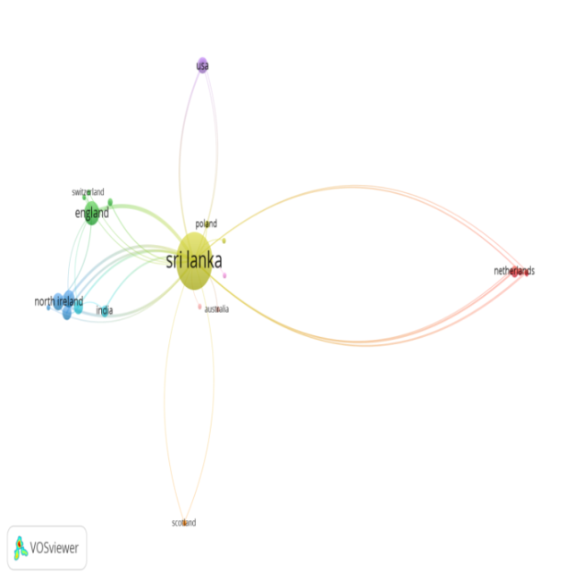
4.4 International Collaboration Networks of University of Jaffna:
Country collaboration from Web of Science database in War period
In the war time, England (24 link), Ireland (18), India (16), Japan (12), Sweden (12), Netherland (10), Cambodia (8), the USA (8).

Slide 24
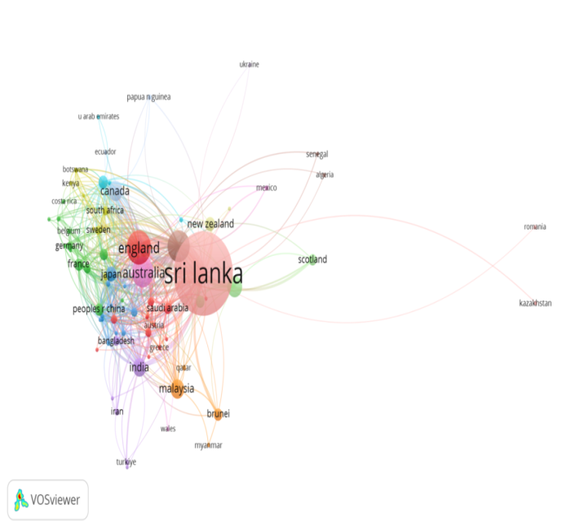
Country collaboration from Web of Science database in post - War period
In the post war, England (270 link), USA (243), Australia (192), India (119). Canada (98), Malaysia (75), Switzerland (74), French (71).

Slide 25
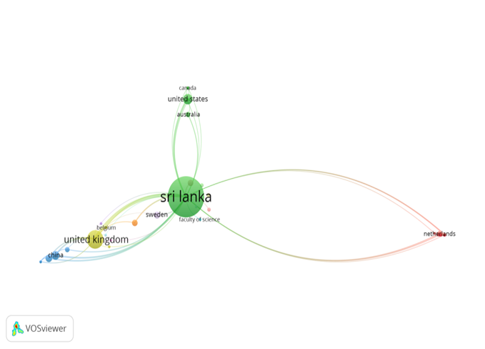
Country collaboration from Scopus database in War period
In the war period, UK (60 links), China (21), USA (17), Japan (14), Netherland (10), Cambodia (9), Sweden (7), Algeria (6).

Slide 26
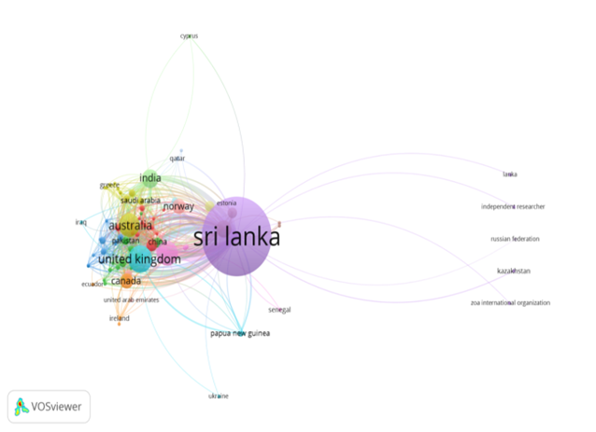
Country collaboration from Scopus database in post- War period
In the post war, England (380 link), USA (314), Australia (240), India (215), Malaysia (139), Canada (131), Pakistan (80), Norway (79).
Comparison of international Collaboration of UoJ in the periods in both databases
During the war time, international collaborations were limited, with fewer items, clusters, and links. In the post-war period, collaborate networks grew remarkably.

Slide 27
4.5 Analysis of Key Funding Agencies:
Funding agencies of publications during the war period in Both databases
Web of Science |  |  |  | Scopus
Funding Agencies | TP | % | TC | Funding Agencies | TP | % | TC
Asian Development Bank | 1 | 0 | 49 | Natural Resources, Energy And Science Authority of Sri Lanka | 3 | 1.60 | 36
Faculty of Graduates Studies University of Jaffna | 1 | 0 | 2 | National Science Foundation | 3 | 1.60 | 19
Irque Qef | 1 | 0 | 2 | Japan Society For The Promotion of Science | 3 | 1.60 | 41
National Institutes of Health Nih Usa | 1 | 0 | 11 | University of Jaffna | 2 | 1.07 | 34
National Science Foundation (NSF | 1 | 0 | 0 | Komitet Badań Naukowych | 2 | 1.07 | 31
NIH National Institute of Neurological Disorders Stroke (Ninds | 1 | 0 | 11 | Engineering And Physical Sciences Research Council | 2 | 1.07 | 63
NSF Directorate For Mathematical Physical Sciences (Mps) | 1 | 0 | 0 | Wellcome Trust | 1 | 0.53 | 59
United States Department of Health Human Services | 1 | 0 | 11 | Swedish National Board For Industrial and Technical Development | 1 | 0.53 | 8
Wellcome Trust | 1 | 0 | 49 | Royal Society | 1 | 0.53 | 35
 |  |  |  | Ministry of Education, Culture, Sports, Science &Technology | 1 | 0.53 | 2

Slide 28
Key funding agencies of publications during the Post -War period in both databases
Web of Science |  |  |  | Scopus database
Funding agencies | TP | % of TP | TC | Funding agencies | TP | % of TP | TC
University of Jaffna Sri Lanka | 33 | 5.02 | 374 | University of Jaffna | 67 | 4.93 | 866
National Science Foundation of Sri Lanka | 25 | 3.81 | 375 | UK Research And Innovation | 34 | 2.50 | 517
Higher Edu. & Res.Collaboration on Nanomaterials For Clean Energy | 18 | 2.74 | 256 | National Science Foundation of Sri Lanka | 32 | 2.36 | 352
National Science Foundation | 18 | 2.74 | 217 | National Research Council Sri Lanka | 26 | 1.91 | 358
Australian Research Council | 17 | 2.59 | 144 | Ministry of Science,Technology Research | 18 | 1.33 | 205
National Research Council of Sri Lanka | 16 | 2.44 | 160 | World Bank Group | 17 | 1.25 | 249
Uk Research Innovation | 15 | 2.28 | 310 | Australian Research Council | 16 | 1.18 | 122
Capacity Building & Establishment of A Research Consortium Cberc Project | 13 | 1.98 | 215 | Japan Society For The Promotion of Science | 15 | 1.10 | 168
Ministry of Education Culture Sports Science And Technology Japan Mext | 9 | 1.37 | 46 | University Grants Commission - Sri Lanka | 14 | 1.03 | 51
Grants In Aid For Scientific Research Kakenhi | 8 | 1.22 | 40 | National Institute For Health And Care Research | 14 | 1.03 | 63

Slide 29
Comparison of funding agencies during the War and Post-War Periods in both databases
During the war period, funding for the UoJ was with only 9 out of 123 Web of Science, and 19 out of 187 in Scopus.
Most research was self-funded, reflecting limited access to funding due to geopolitical constraints. The top funding agencies in this period were the Natural Resources, Energy and Science Authority of Sri Lanka.
In the post-war period, In the Web of Science, 26% of publications (172 out of 657) , while in Scopus, 19% (253 out of 1,358) were funded. University of Jaffna emerged as the leading funder in both databases.
The increased funding highlights improved research infrastructure, international collaborations, and diversified funding sources, enhancing the University’s research output and global impact.

Slide 30
4.6 ANALYSIS OF COLLABORATED INSTITUTIONS :
Institutions collaborate with UoJ during the war period in both databases
Web of Science |  |  |  | Scopus database
Name of the Institutions | TP | % | TC | Name of the Institutions | TP | % | TC
Queens University Belfast | 14 | 11.38 | 288 | University of Peradeniya | 33 | 17.65 | 670
University of Peradeniya | 11 | 8.94 | 187 | Queen's University Belfast | 20 | 10.70 | 408
National institute of fundamental studies | 9 | 7.32 | 140 | University of Colombo | 16 | 8.56 | 861
Tsinghua University | 8 | 6.50 | 166 | Imperial College London | 11 | 5.88 | 1493
Imperial college London | 6 | 4.88 | 1201 | Tsinghua University | 11 | 5.88 | 227
University of Liverpool | 5 | 4.07 | 138 | National Institute of Fundamental Studies, Sri Lanka | 8 | 4.28 | 141
Nagasaki university | 4 | 3.25 | 90 | University of Oxford | 8 | 4.28 | 1109
Auburn university | 3 | 2.44 | 199 | City University of New york | 8 | 4.28 | 759
Lund university | 3 | 2.44 | 60 | Lunds university | 6 | 3.21 | 217
University of Southampton | 3 | 2.44 | 52 | Liverpool School of Tropical Medicine | 4 | 2.14 | 54

Slide 31
Institutions collaborated with UoJ during the Post - War period in both databases
Web of Science |  |  |  | Scopus database
Name of the Institution | TP | % | TC | Name of the Institution | TP | % | TC
University of Peradeniya | 84 | 12.79 | 1107 | University of Peradeniya | 132 | 9.72 | 1487
Western Norway university of applied sciences | 39 | 5.94 | 614 | University of Colombo | 67 | 4.93 | 482
University of Colombo | 35 | 5.33 | 196 | Western Norway University of Applied Sciences | 42 | 3.09 | 660
Imperial college London | 30 | 4.57 | 378 | Imperial College London | 38 | 2.80 | 430
National institute of fundamental studies | 26 | 3.96 | 263 | University of Sri Jayewardenepura | 36 | 2.65 | 302
University Sri Jayewardenepura | 19 | 2.89 | 232 | Teaching Hospital Jaffna | 31 | 2.28 | 105
Queensland university of technology | 17 | 2.59 | 182 | National Institute of Fundamental Studies, Sri Lanka | 31 | 2.28 | 443
Coventry University | 16 | 2.44 | 286 | Eastern University, Sri Lanka | 28 | 2.06 | 814
University Malaya | 15 | 2.28 | 295 | University Malaya | 25 | 1.84 | 451
University Kelaniya | 15 | 2.28 | 168 | Queensland University of Technology | 23 | 1.69 | 294

Slide 32
Comparison of institutional collaborations with University of Jaffna in the war and post war periods in both databases
During the war period, collaborations limited, with fewer institutions involved. Queen’s University Belfast and the University of Peradeniya were the most frequent partners, with a notable presence of international institutions such as Imperial College London and Tsinghua University.
in the post-war period, the number of collaborating institutions increased. University of Peradeniya maintained its position as the top collaborator, with a considerable rise in the number of joint publications (from 11 to 84 in Web of Science and from 33 to 132 in Scopus).
Overall, the data highlights that the University of Jaffna’s research collaborations grew significantly after the war.

Slide 33
4.7 Most Productive authors of University of Jaffna:
Top 10 Most Productive authors during the War period in both databases
Web of Science |  |  |  |  | Scopus
Name of author | TP | % | TC | H-In | Name of author | TP | % | TC | H-In
Arasaratnam. V | 19 | 15.45 | 170 | 7 | Arasaratnam. V | 17 | 9.09 | 195 | 7
Kandasamy.K | 15 | 12.20 | 290 | 11 | Kandasamy.K | 17 | 9.09 | 287 | 10
Ranjan.R | 10 | 8.13 | 151 | 7 | Surendran.S | 14 | 7.49 | 270 | 11
BalasubramaniyamK | 8 | 6.50 | 123 | 6 | Ravarajan.P | 12 | 6.42 | 1765 | 8
Surendran.S | 7 | 5.69 | 123 | 5 | Ranjan.R | 12 | 6.42 | 189 | 9
Somasundaram.D | 5 | 4.07 | 232 | 5 | SomasundaramD | 10 | 5.35 | 901 | 8
Ravarajan.P | 5 | 4.07 | 640 | 5 | Migunthan.G | 6 | 3.21 | 29 | 3
Hoole.R | 5 | 4.07 | 16 | 2 | Kajatheepan.M | 6 | 3.21 | 92 | 5
Migunthan.G | 3 | 2.44 | 9 | 2 | Hoole.R | 5 | 2.67 | 10 | 2
Rajendram.G.F | 2 | 1.63 | 3 | 1 | Thiranagama.R | 4 | 2.14 | 92 | 4
Top 10 Most Productive authors in Post - War period in both databases
Web of Science |  |  |  |  | Scopus
Name of author | TP | % | TC | H-In | Name of the author | TP | % | TC | H-In
Surendran.S | 53 | 8.07 | 1063 | 19 | Sathiparan.N | 73 | 5.38 | 1254 | 19
Dhayalan.V | 40 | 6.09 | 662 | 14 | Surendran.S | 66 | 4.86 | 1325 | 21
Sathiparan.N | 37 | 5.63 | 758 | 14 | Ravarajan.P | 47 | 3.46 | 630 | 13
Ranjan.R | 36 | 5.48 | 835 | 17 | Subramaniyam.D.N | 42 | 3.09 | 333 | 11
Ravarajan.P | 32 | 4.87 | 431 | 13 | Ranjan.R | 41 | 3.02 | 997 | 19
Thanigaiselvan.M | 26 | 3.96 | 426 | 12 | Velayuthampillai.D | 41 | 3.02 | 660 | 13
Daneil.S | 24 | 3.65 | 165 | 8 | Ramanan.A | 38 | 2.80 | 347 | 9
Kuganathan.N | 22 | 3.35 | 302 | 9 | Jeyananthan, P. | 32 | 2.36 | 205 | 8
Kokila.S | 16 | 2.44 | 199 | 9 | Kuganathan, N. | 29 | 2.14 | 339 | 10
Iynkaran.P | 15 | 2.28 | 219 | 7 | SurenthirakumaraR | 26 | 1.91 | 117 | 5

Slide 34
Comparison of Most Productive authors of UoJ during the war & post war periods in both databases
Rank | Name of Author | War Period (WoS) | War Period (Scopus) | Post-War Period (WoS) | Post-War Period (Scopus) | TP | H-Index
1 | Surendran S. | 7 | 14 | 53 | 66 | 140 | 30
2 | Sathiparan N. | - | - | 37 | 73 | 110 | 28
3 | Ranjan R. | 10 | 12 | 36 | 41 | 99 | 40
4 | Ravarajan P. | 5 | 12 | 32 | 47 | 96 | 22
5 | Kuganathan N. | - | - | 22 | 29 | 51 | 30
6 | Dhayalan V. | - | - | 40 | - | 40 | 40
7 | Ramanan A. | - | - | - | 38 | 38 | 12
8 | Arasaratnam V. | 19 | 17 | - | - | 36 | 13
9 | Kandasamy K. | 15 | 17 | - | - | 32 | 17
10 | Jeyananthan P. | - | - | - | 32 | 32 | 9
In the both periods, in Web of Science & Scopus, Surendran S., Ranjan R & Ravarajan P. were active authors. Overall, the data demonstrate a substantial increase in research output post-war, with newer authors playing a dominant role.

Slide 35
4.8 Most Impactful author analysis of University of Jaffna:
Top 10 impactful authors during the war period in both databases
Web of Science |  |  |  | Scopus
Name of the author | TC | % of TC | TP | Name of the author | TC | % of TC | TP
Ravirajan. P | 1442 | 38.83 | 7 | Ravirajan P | 1764 | 33.44 | 12
Somasundaram. D | 535 | 14.40 | 5 | Somasundaram D | 1101 | 20.87 | 10
Kandasamy. K | 310 | 8.35 | 15 | Kandasamy.K | 319 | 6.05 | 18
Arasaratnam. V | 173 | 4.66 | 19 | Surendran S.N | 270 | 5.12 | 14
Ramasamy. R | 151 | 4.07 | 10 | Arasaratnam.V | 241 | 4.57 | 18
Surendran. S.N | 123 | 3.31 | 7 | Ramasamy.M.S | 206 | 3.91 | 12
Dhanasekaran. M | 119 | 3.20 | 3 | Parameswaran.K | 127 | 2.41 | 3
Parameshwaran. K | 119 | 3.20 | 3 | Suppiramaniam. V | 127 | 2.41 | 3
Suppiramaniam. V | 108 | 2.91 | 2 | Uthayathas. S | 116 | 2.20 | 2
Uthayathas. S | 108 | 2.91 | 2 | Thiranagama.R | 92 | 1.74 | 4
Impactful authors during the post- war period in both databases
Web of Science |  |  |  | Scopus
Name of the author | TC | % | TP | Name of the author | TC | % | TP
Vignarooban. K | 2680 | 19.71 | 17 | Vignarooban.K | 3088 | 15.58 | 24
Kannan. N | 1191 | 8.76 | 1 | Kannan.N | 1612 | 8.13 | 16
Vakeesan. D | 1191 | 8.76 | 1 | Surendran.S.N | 1328 | 6.70 | 67
Surendran. S.N | 1046 | 7.69 | 55 | Sathiparan.N | 1128 | 5.69 | 70
Somasundaram. D.J | 901 | 6.63 | 2 | Ramasamy .R | 999 | 5.04 | 41
Ramasamy. R | 816 | 6.00 | 37 | Ketheesan.B | 958 | 4.83 | 20
Sathiparan. N | 755 | 5.55 | 38 | Somasundaram.D | 660 | 3.33 | 10
Ravirajan.P | 531 | 3.90 | 42 | Ravirajan.P | 634 | 3.20 | 47
Kapilan.R | 342 | 2.51 | 6 | Thanihaiselvan.M | 611 | 3.08 | 33
Sivakanthan.S | 323 | 2.38 | 10 | Mathanarangan.T | 497 | 2.51 | 24

Slide 36
Comparison between Most impactful authors at UoJ during the War & Post war periods in both databases
Rank | Name of Author | War Period (WoS) | War Period (Scopus) | Post-War Period (WoS) | Post-War Period (Scopus) | TC
1 | Vignarooban K. | - | - | 2680 | 3088 | 5768
2 | Kannan N. | - | - | 1191 | 1612 | 2803
3 | Vakeesan D. | - | - | 1191 | - | 1191
4 | Ravirajan P. | 1442 | 1764 | 531 | 634 | 4371
5 | Somasundaram D. | 535 | 1101 | 901 | 660 | 3197
6 | Surendran S.N. | 123 | 270 | 1046 | 1328 | 2767
7 | Sathiparan N. | - | - | 755 | 1128 | 1883
8 | Ramasamy R. | 151 | 206 | 816 | 999 | 2172
9 | Ketheesan B. | - | - | - | 958 | 958
10 | Kapilan R. | - | - | 342 | - | 342
Ravirajan P., Somasundaram D Surendran S.N. & Ramasamy R. active in both periods in both databases. But Vignarooban K., Kannan N. & Vakeesan D. are top of the impactful authors in University of Jaffna.

Slide 37
4.9 Author Keywords analysis of University of Jaffna:
Author keywords were used during the war & post - war periods in both databases
Web of Science |  |  |  | Scopus
Keywords | TP | % | TC | Keywords | TP | % | TC
Sri lanka | 48 | 39.02 | 892 | Human | 52 | 27.81 | 1701
Hydrogen | 16 | 13.01 | 310 | Article | 52 | 27.81 | 1929
Malaria | 9 | 7.32 | 137 | Sri lanka | 43 | 22.99 | 859
Diffusion | 8 | 6.50 | 185 | Male | 29 | 15.51 | 1367
Palladium | 8 | 6.50 | 184 | Female | 29 | 15.51 | 1347
Production | 8 | 6.50 | 137 | Adult | 25 | 13.37 | 1129
Corn | 7 | 5.69 | 27 | Nonhumans | 20 | 10.70 | 503
Jaffna | 7 | 5.69 | 58 | Animals | 20 | 10.70 | 353
Strain | 7 | 5.69 | 167 | Humans | 15 | 8.02 | 368
Cells | 6 | 4.88 | 489 | Adolescent | 14 | 7.49 | 457
Web of Science |  |  |  | Scopus
Key words | TP | % | TC | Key words | TP | % | TC
Sri lanka | 274 | 41.70 | 2763 | Article | 222 | 16.35 | 3011
Using | 52 | 7.91 | 586 | Sri lanka | 217 | 15.98 | 2447
Solar | 43 | 6.54 | 2604 | Human | 206 | 15.17 | 3030
Review | 39 | 5.94 | 4663 | Female | 128 | 9.43 | 1435
Northern | 37 | 5.63 | 288 | Humans | 116 | 8.54 | 1948
Cells | 33 | 5.02 | 421 | Adult | 109 | 8.03 | 843
Jaffna | 33 | 5.02 | 268 | Male | 103 | 7.58 | 988
Analysis | 32 | 4.87 | 458 | Controlled study | 90 | 6.63 | 1105
Properties | 32 | 4.87 | 415 | Nonhuman | 83 | 6.11 | 1275
Concrete | 23 | 3.50 | 233 | Animals | 67 | 4.93 | 1404

Slide 38
Comparison of keywords analysis of UoJ during the War & Post- War periods in both databases
War period, in Web of Science, scientific and regional terms like “Srilanka” “Hydrogen” “Malaria” & “Jaffna”. In Scopus was dominated by biomedical terms like “Human”,“Male”,“Female” & “Adult” indicating strong interest in health-related studies.
In the post-war, in Web of Science, “Srilanka”,“Solar”,“Review”,“Concrete”& “Analysis” focus on renewable energy. In Scopus, biomedical, “Human”, “Female”, “Controlled Study” & “Sri Lanka” becomes more prominent, suggesting increased local research engagement.
Overall, Web of Science shows a broader thematic shift toward Science, Engineering, and regional studies, while Scopus maintains a strong biomedical and demographic focus across both periods.

Slide 39
4.10 Top four (4) highly cited publications in both databases during the war and post war periods
Title of the Paper | TC WoS | TC Scopus | Name of the Authors | Publisher
Lifetime events and posttraumatic stress disorder in post conflict settings | 463 | 599 | Somasundaram, D., et al | American Medical Association by 2001
Hybrid polymer/zinc oxide photovoltaic devices with vertically oriented ZnO nano rods and an amphiphilic molecular interface layer | 498 | 540 | Ravirajan, P., et al | American Chemical Society, by 2006
Hybrid polymer-metal oxide thin films for photovoltaic applications | 304 | 335 | Ravirajan, P., et al | Royal Society Chemistry, by 2007
Hybrid polymer/metal oxide solar cells based on ZnO columnar structures | 241 | 272 | Ravirajan, P., et al | Royal Society Chemistry, by 2006
Top four (4) Highly cited publications during the post -war
Title of the Paper | TC WoS | TC Scopus | Name of the Author | Publisher
Solar energy for future world: - A review | 1200 | 1500 | Kannan, N & Vakeesan, D | Pergamon-Elsevier Science Ltd by 2016
Recent developments in phase change materials for energy storage applications: A review | 1006 | 1163 | Vignarooban, K., et al | Pergamon-Elsevier Science Ltd by 2019
Heat transfer fluids for concentrating solar power systems - A review | 684 | 783 | Vignarooban,k., et al | Elsevier Sci Ltd by 2015
Diagnosis and classification of disorders specifically associated with stress: proposals for ICD-11 | 513 | 561 | Somasundaram, D, et al | Wiley by 2013

Slide 40
Comparative study of highly cited publications in both databases during the war & post war periods
In the both databases, in the war period, above mentioned 4 same papers were cited in highly citations.
During the war period, research was concentrated on mental health and Physics.
In contrast, the post-war period shows a marked growth in research in engineering and physics.
Overall, the post-war period demonstrates enhanced research productivity, broader international visibility, and a clear emphasis on sustainable energy solutions alongside continued interest in mental health.

Slide 41
5. Findings:
Growth in Research Productivity
In Web of science, from 123 (16%) to 657 (84%) post war periods accounting publications.
In Scopus from 187 (12%) to 1358 (88%) publications. It is reflecting a 434% and 626% increase in web of science and Scopus databases.
The highest number of publications in 2024 in both databases.
Increase in Citation in Post-War periods
In Web of Science, from 3,714 to 13,599 , accounting for 79% of all citations.
In Scopus, from 5,275 to 19,825, representing 78% of total citations.
The highest citations in 2019 in both databases. ​ The h-index improved from 29 (war) to 49 (post-war) in Web of Science and from 34 to 57 in Scopus.
Shift in Research areas
In War period, Research was on fundamental sciences, medicine, and applied sciences.
In Post-war, engineering, computer science, environmental sciences, and social sciences, with engineering leading in both databases

Slide 42
Conti…
Expansion of International Collaborations
In War period, limited international partnerships, mainly with England, China, the USA & Japan.
In Post-war, Collaboration expanded significantly to Australia, Canada, Malaysia, Norway, South Africa, and Pakistan, with 580 links in Web of Science and 729 links in Scopus.
Increase in Funded Research
War period: Research was mostly self-funded, with only 9 in Web of Science and 19 in Scopus for funded researches.
Post-war: Funding improved significantly, with 172 Web of Science publications (26%) and 253 Scopus publications (19%).
Major funders, University of Jaffna, the National Science Foundation of Sri Lanka.
Highly Productive Authors
War period: Arasaratnam V., Kandasamy K., Surendran.S & Ranjan R​.
Post-War period: Surendran S., Sathiparan N.,& Ravirajan P.
Both periods: Surendran S., Ranjan R & Ravarajan . P

Slide 43
Conti…,
Most impactful authors
War period: Ravirajan. P, Somasundaram. D & Kandasamy. K
Post-War period: Vignarooban.K, Kannan.N, Vakeesan. D, Surendran.S. & Sathiparan.N
Both periods: Ravirajan. P., Somasundaram .D Surendran S.N. & Ramasamy. R
Highly Cited Publications
War period: “Lifetime events and posttraumatic stress disorder in post conflict settings “ by Somasundaram, D producing the most cited work in both databases.
Post-war: ‘’Solar energy and mental health research continued to dominate’’, with Kannan N. and Vakeesan D. producing the most cited work in both databases.
Keyword Trends &Thematic Focus
War Period: Web of Science focused on fundamental science and local issues.
Scopus focused on biomedical and health science.
Post-War Period: Web of Science on engineering and energy.
Scopus maintained biomedical and regional theme .

Slide 44
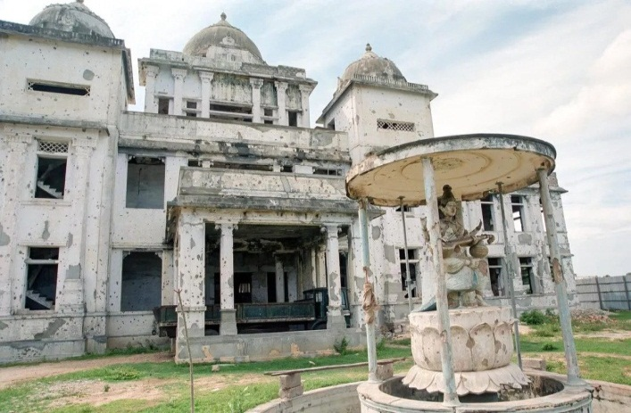
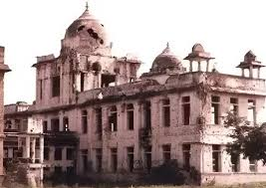

DISCUSSION:
The main reasons for the decline in research productivity during the war period,
a. Destruction of the Jaffna Public Library: Over 90,000 books and ancient palm-leaf manuscripts.
b. Threats to Intellectual Freedom: The assassination of Dr. Rajani Thiranagama, a senior lecturer & human rights activist in FoM, UoJ. (In Scopus 10th productive & impactful author in war period)
‘’Main reason for Publication of her book’’
(The Broken Palmyra, 1989)

Slide 45
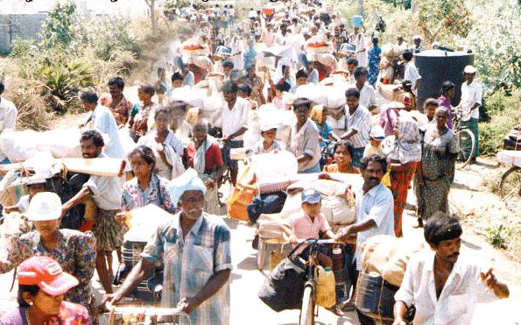
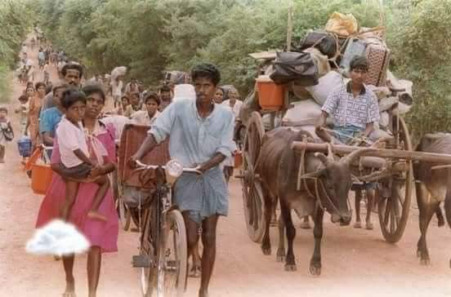
Conti…,
c. Infrastructure Destruction & Displacement:
d. Brain Drain and Human Capital Loss: (Migration of highly skilled academics)
e. Economic Sanctions and Limited Funding: Economic restrictions and blockades resulted in severely limited financial support for University.
f. Psychological Impact of War on Academics: Continuous exposure to conflict, displacement, and loss of loved ones led to severe psychological distress among students and faculty.

Slide 46
Conti…,
Main reasons increasing the research productivity after the war,
Access to Digital Databases,
International Collaborations,
Research Grants,
Increased Government and International Funding,
Technological Advancements & Digital Connectivity,
Diaspora Engagement,
Freedom of speech,

Slide 47
SUGGESTIONS:
Following suggestions are put forwarded,
Strengthen Research Funding Mechanisms - Increase government and private sector investments in research. Encourage international research grants and partnerships.
Expand International Collaborations - Foster joint research projects with top-ranking global Universities. Establish research exchange programs for faculty and students.
Enhance Digital and Research Infrastructure - Invest in modern laboratory facilities and digital research tools. Promote open-access research platforms to increase visibility.
Promote High-Impact Research & Publication - Encourage researchers to publish in high-impact journals. Provide publication support funds to assist with journal fees. Recognize and reward top-performing researchers to boost motivation.
Develop Capacity-Building Programs - Conduct workshops on research methodology, grant writing, and scientometric analysis. Strengthen Ph.D. and postdoctoral research opportunities.

Slide 48
CONCLUSION:
The findings reveal that research activity was significantly constrained during the war but experienced exponential growth post-war period.
In the war period, the University of Jaffna faced major challenges, only 123 publications in Web of Science and 187 in Scopus were recorded, with 3,714 and 5,275 citations, respectively. Research was primarily focused on Physics, Chemistry, and Medicine, addressing immediate societal needs. International collaborations were minimal, with a few co-authorship links mainly with institutions in England, China, and the USA.
In the post-war period, research output, 657 publications in Web of Science and 1,358 in Scopus. Citation increased sharply, with Web of Science 13,599 and Scopus citations 19,825. The h-index improved notably, from 29 to 49 in Web of Science and from 34 to 57 in Scopus.

Slide 49
Conti…,
A shift in research focus was also evident post-war, with growing contributions in Engineering, Computer Science, Environmental Sciences, and Interdisciplinary Research. Engineering became the most dominant field, accounting for 17.66% of Web of Science and 24.37% of Scopus.
International collaborations expanded significantly, with co-authorship links increasing to 580 in Web of Science and 729 in Scopus. Stronger ties were established with institutions in England, the USA, Australia, Canada, and India, integrating the University into the global research network.
Funding, While research during the war was mostly self-funded, the post-war period saw increased financial support from organizations, Approximately 26% of Web of Science publications and 19% of Scopus publications received financial support.

Slide 50
Conti…,
The study also identified key researchers contributing to this transformation. While Ravirajan P. & Somasundaram D. were highly cited during the war, post-war researchers Vignarooban & K., Kannan N., emerged as leading citation contributors.
The findings emphasize the importance of funding, international collaborations, and institutional support in rebuilding research capacity in post-conflict regions.
Future investments in digital infrastructure, capacity-building programs, and interdisciplinary collaborations will be essential in sustaining this positive trajectory.
This study serves as a benchmark for policymakers, librarians and researchers aiming to enhance academic research in Sri Lanka and other post-conflict regions worldwide.

Slide 51
Thank You

