Slide 1
RESEARCH ASSISTANCE OPEN AI TOOLS
By
Dr.N.AMSAVENI
Assistant Professor
Department of Library and Information Science
Bharathidasan University
Trichy – 24
amsaveni.n@bdu.ac.in

Slide 2
What is Research?
Research is a systematic and organized process of collecting, analyzing, and interpreting information (data) to answer questions, solve problems, or generate new knowledge.
Definition
"Research is a systematic investigation to establish facts, principles, or generalizable knowledge.“
Purpose of Research:
Discover new facts
Understand existing knowledge better
Solve real-world problems
Test or develop theories
Review related studies
Collect data (surveys, case studies)
Analyze findings
Conclude and share insights

Slide 3
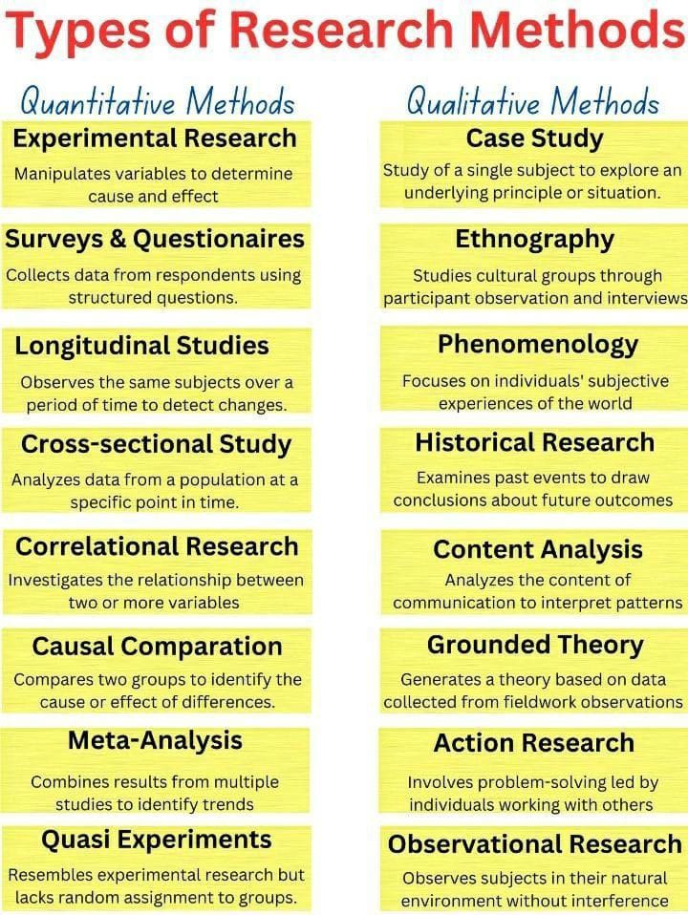

Slide 4
Stage of Research | How AI Helps | Example
Literature Review | Summarizes, classifies, and extracts key findings | Elicit, ChatGPT, Semantic Scholar
Data Collection | Automates sensor input, web scraping, surveys | AI bots collecting real-time data
Data Analysis | Performs statistical analysis, modeling, visualization | Machine learning on large datasets
Hypothesis Generation | Suggests new research questions or patterns | GPT-based pattern discovery
Experimentation | Simulates experiments, manages lab robotics | AI-driven drug discovery labs
Writing & Reporting | Drafts papers, checks grammar, generates citations | ChatGPT, Grammarly, Scite.ai
Peer Review | Assists in reviewing quality, relevance, novelty | AI screening tools for journals

Slide 5
🔬 Research Stage | 🤖 How AI Helps | 💡 Examples
1. Topic Discovery | Suggests emerging research areas, generates hypotheses | ChatGPT suggesting gaps in current studies
2. Literature Review | Summarizes, classifies, and finds relevant papers | Elicit, Semantic Scholar, ChatGPT
3. Data Collection | Automates surveys, scraping, sensor integration | AI bots gathering clinical or field data
4. Data Cleaning | Detects and corrects errors, fills missing data | AI preprocessing for big datasets
5. Data Analysis | Finds patterns, clusters, and trends using ML/AI algorithms | Predictive modeling in epidemiology
6. Visualization | Creates advanced graphs, heatmaps, or interactive dashboards | AI-generated visualizations in Python, R
7. Hypothesis Testing | Simulates experiments, evaluates outcomes faster | AI-driven drug testing simulations
8. Writing & Reporting | Drafts text, suggests citations, checks grammar | ChatGPT, Grammarly, Scite.ai
9. Peer Review Assistance | Flags plagiarism, predicts paper quality | AI-assisted journal screening tools

Slide 6
Artificial Intelligence (AI) is a branch of computer science that focuses on creating systems or machines that can perform tasks that normally require human intelligence.
AI is about building computers or software that can think, learn, and make decisions like a human—or even better in specific tasks.
Types of AI (by Capability)
Narrow AI (Weak AI)
AI that does one task very well
e.g., Siri, spam filters, facial recognition
General AI (Strong AI)
AI with human-like reasoning and understanding (still theoretical)
Superintelligent AI
Beyond human-level intelligence (a topic of debate and future research)
Common AI Technologies:
Machine Learning (ML): Algorithms that learn from data
Deep Learning: A subset of ML using neural networks (e.g., for image or speech recognition)
Natural Language Processing (NLP): Understanding and generating language (e.g., ChatGPT, translation tools)
Computer Vision: Interpreting images and video
Robotics: Combining AI with machines to act in the physical world

Slide 7
AI TOOLS FOR STATISTICAL ANALYSIS IN RESEARCH
Hugging Face – Offers pre-trained models for data processing and statistical analysis.
Ellie AI – A data design platform that enhances statistical modeling and decision-making.
Julius AI – Integrates AI-powered analytics for precise statistical investigations.
Dataiku – A comprehensive AI and machine learning platform for data science workflows.
MonkeyLearn – Provides AI-driven text analysis and statistical insights.
ProbeAI – Specializes in predictive modeling and statistical forecasting.
Google Gemini – AI-powered statistical analysis and data interpretation.
Bing Copilot – Assists with statistical computations and data visualization.
ChatGPT – Can be used for statistical reasoning and data analysis.

Slide 8
AI Tools for Analysis And Interpretation
Consensus – AI-driven research index that extracts key conclusions from peer-reviewed studies.
Julius.ai – A comprehensive data analysis tool for regression, time series, and sentiment analysis.
Elicit – Automates research processes by finding relevant articles and summarizing key points.
SciSpace – AI-powered platform for reading, understanding, and submitting scientific articles.
Scite – Assists in research collaboration by finding supporting evidence and refuting claims.
Bit.ai – Helps researchers organize and manage vast amounts of data efficiently.
Trinka – AI language editor tailored for technical and academic writing.
OpenRead – Interactive literary analysis tool for writing literature reviews.
Semantic Scholar – AI-powered alternative to Google Scholar for scientific research.

Slide 9
AI TOOLS FOR Report Writing In Research
HyperWrite Research Paper Writer – Assists in writing structured research papers with AI-generated content and citations.
Galaxy AI Academic Report Generator – Generates well-structured academic reports with proper formatting and scholarly language.
SciSpace – AI-powered platform for reading, understanding, and submitting scientific articles.
Elicit – Automates research processes by finding relevant articles and summarizing key points.
Consensus – AI-driven research index that extracts key conclusions from peer-reviewed studies.
PaperPal – Streamlines academic writing and journal submission.

Slide 10
POWERPOINT PRESENTATION AI TOOLS FOR RESEARCH
Slidesgo – Offers free research-themed PowerPoint and Google Slides templates for academic presentations.
Canva – Provides customizable research presentation templates with engaging visuals.
SlidesCarnival – Features free PowerPoint and Google Slides themes tailored for research presentations.
Taskade AI Research Presentation Generator – Helps researchers craft visually engaging and structured presentations.
Venngage AI Presentation Tools – Offers AI-powered design features for creating compelling slides.
Plus AI for Google Slides – Uses generative AI to create and edit presentations efficiently.
Slides AI – Transforms text into polished presentations with AI-driven formatting.

Slide 11
AI-POWERED TOOLS DESIGNED FOR DATA ANALYSIS IN EXCEL
Excelmatic – Provides AI-driven insights with simple text commands.
Power BI – Offers advanced visualizations and analytics for Excel.
DataRobot – AI-powered predictive analytics for Excel data.
Alteryx – Automates data blending and analytics.
Zoho Analytics – AI-powered reporting and data visualization.
Tableau – Advanced data visualization for Excel users.
Qlik Sense – Self-service data analytics with AI capabilities.
TIBCO Spotfire – AI-enhanced analytics for complex datasets.
Coefficient AI – Integrates GPT-powered capabilities into Google Sheets.
SheetGod – Generates complex Excel formulas and macros using AI.
Excel Formula Bot – Transforms text instructions into Excel formulas.
GPTExcel – AI-powered formula generation for Excel and Google Sheets.
Powerdrill AI – Enables natural language queries for Excel data analysis.

Slide 12
AI Tools for Word Processing & Research Writing
1. Microsoft Copilot (in Word)
2. Grammarly (with MS Word Add-in)
3. ChatGPT (Using Word + Web or Add-ins)
4. Trinka AI
5. Scribbr AI Citation Generator & Proofreading Tools
6. Wordtune
7. Quillbot
8. Typeset.io
9. Wordvice AI

Slide 13
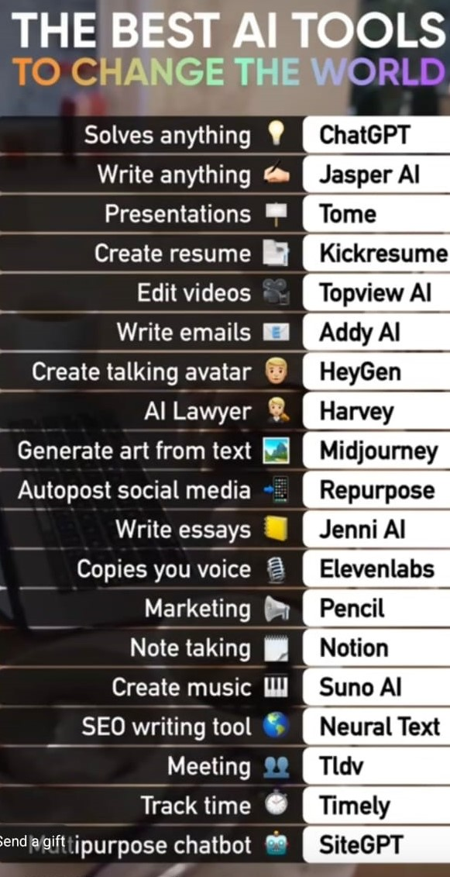

Slide 14
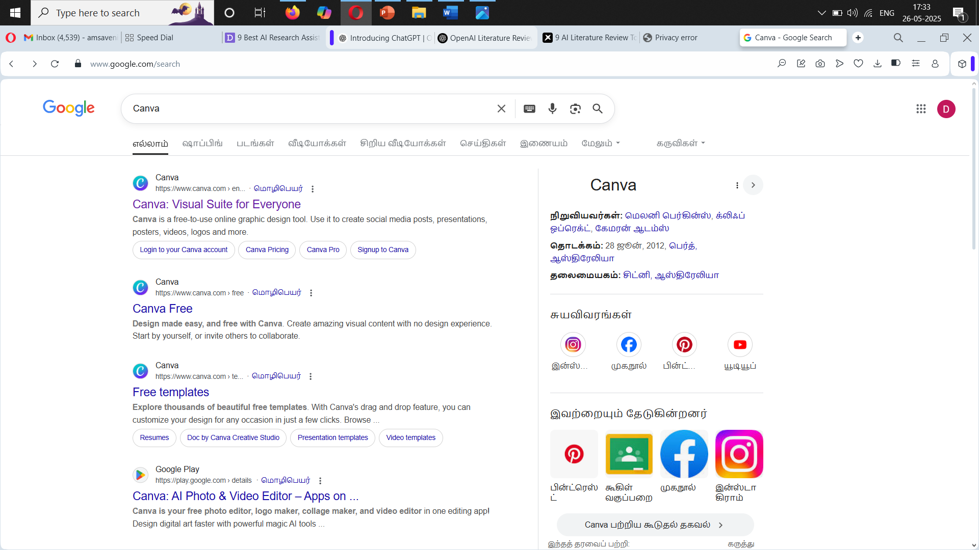

Slide 15
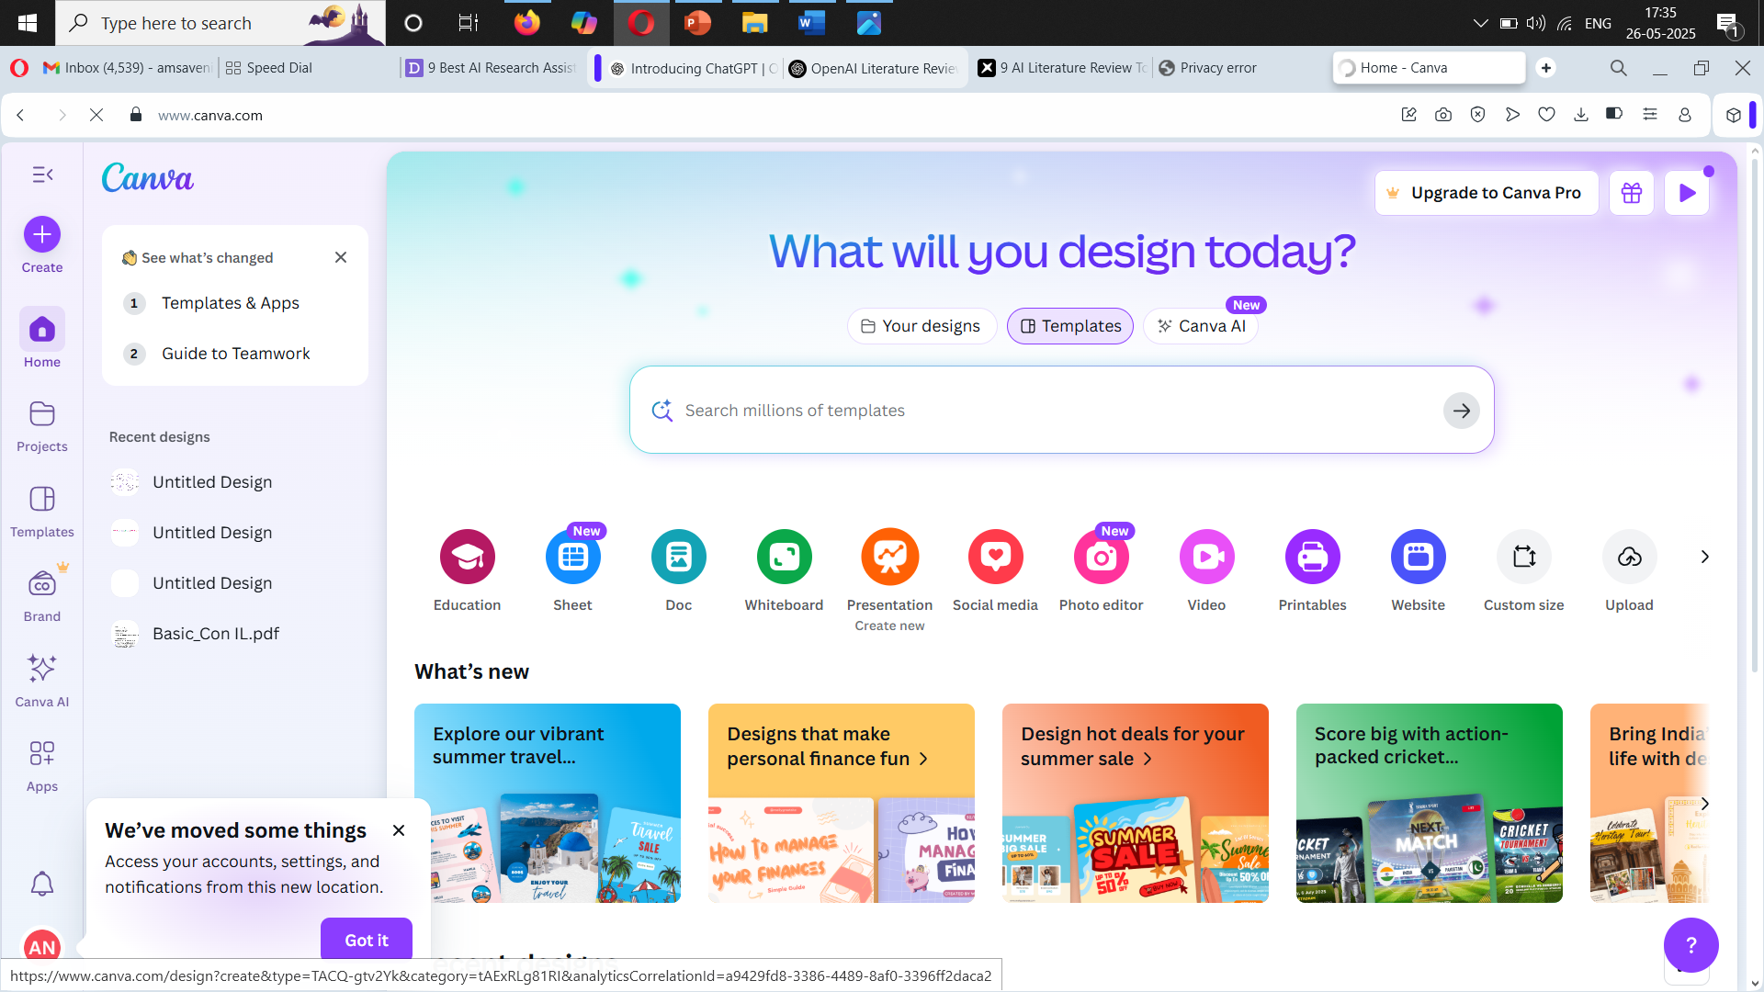

Slide 16
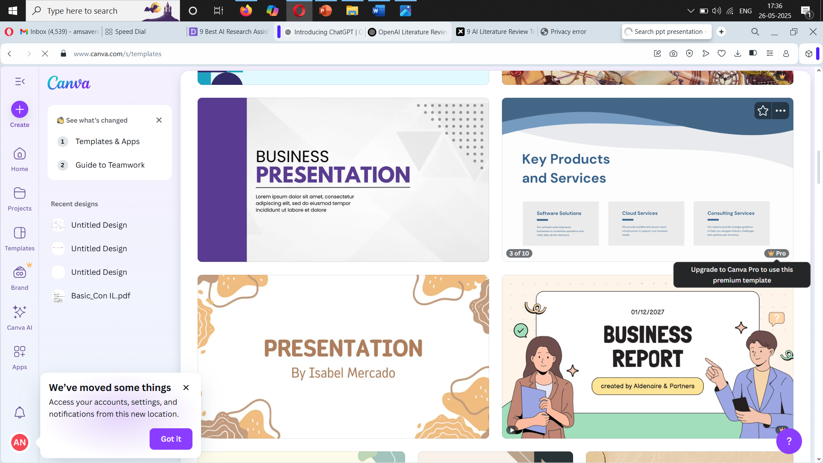

Slide 17
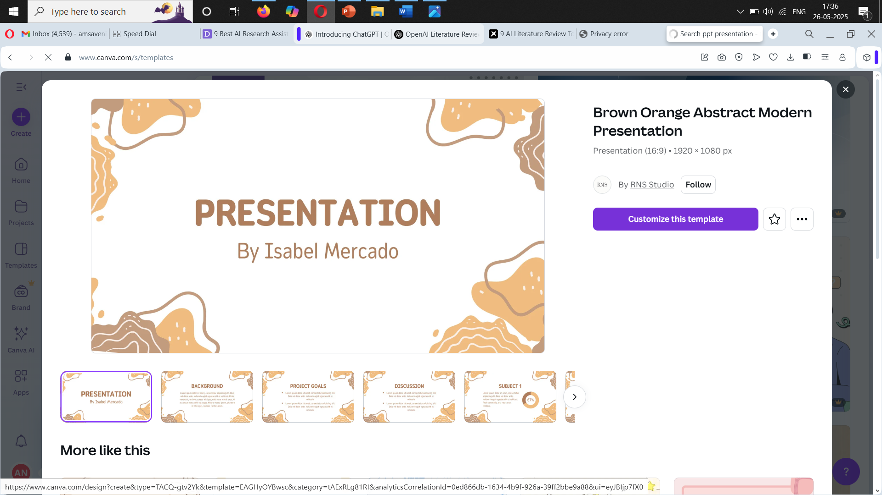

Slide 18
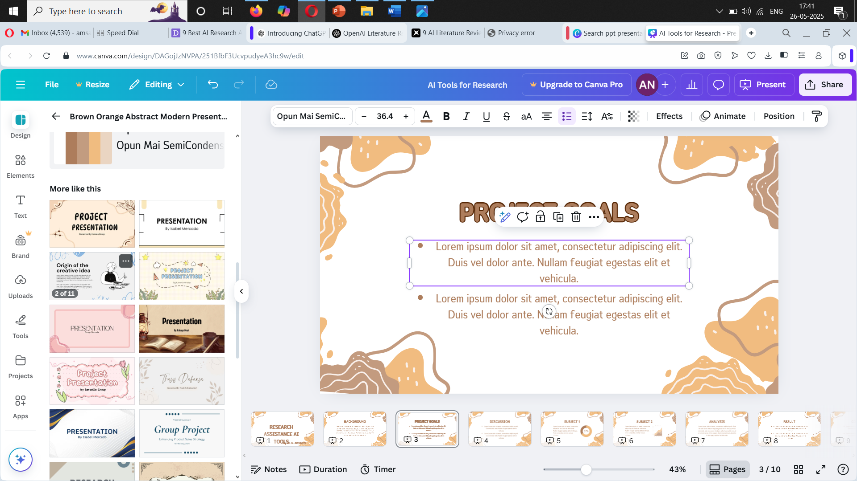

Slide 19
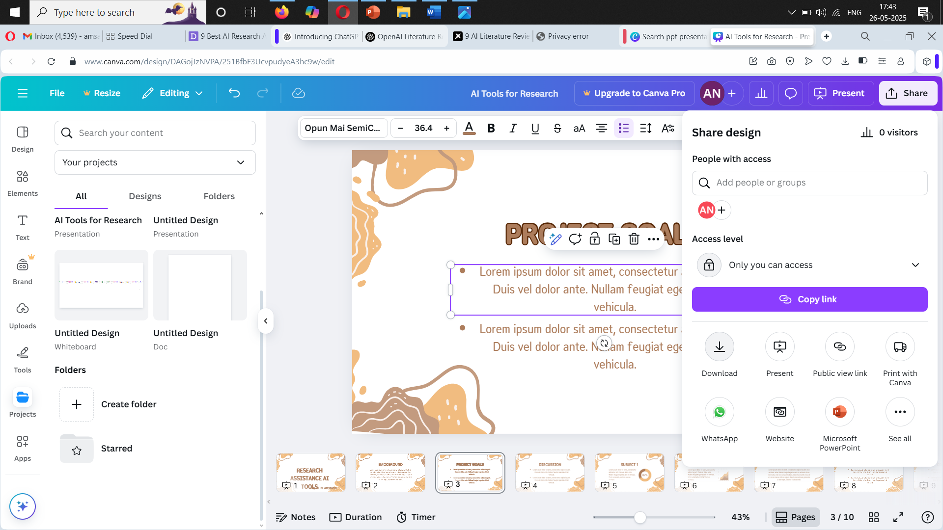

Slide 20
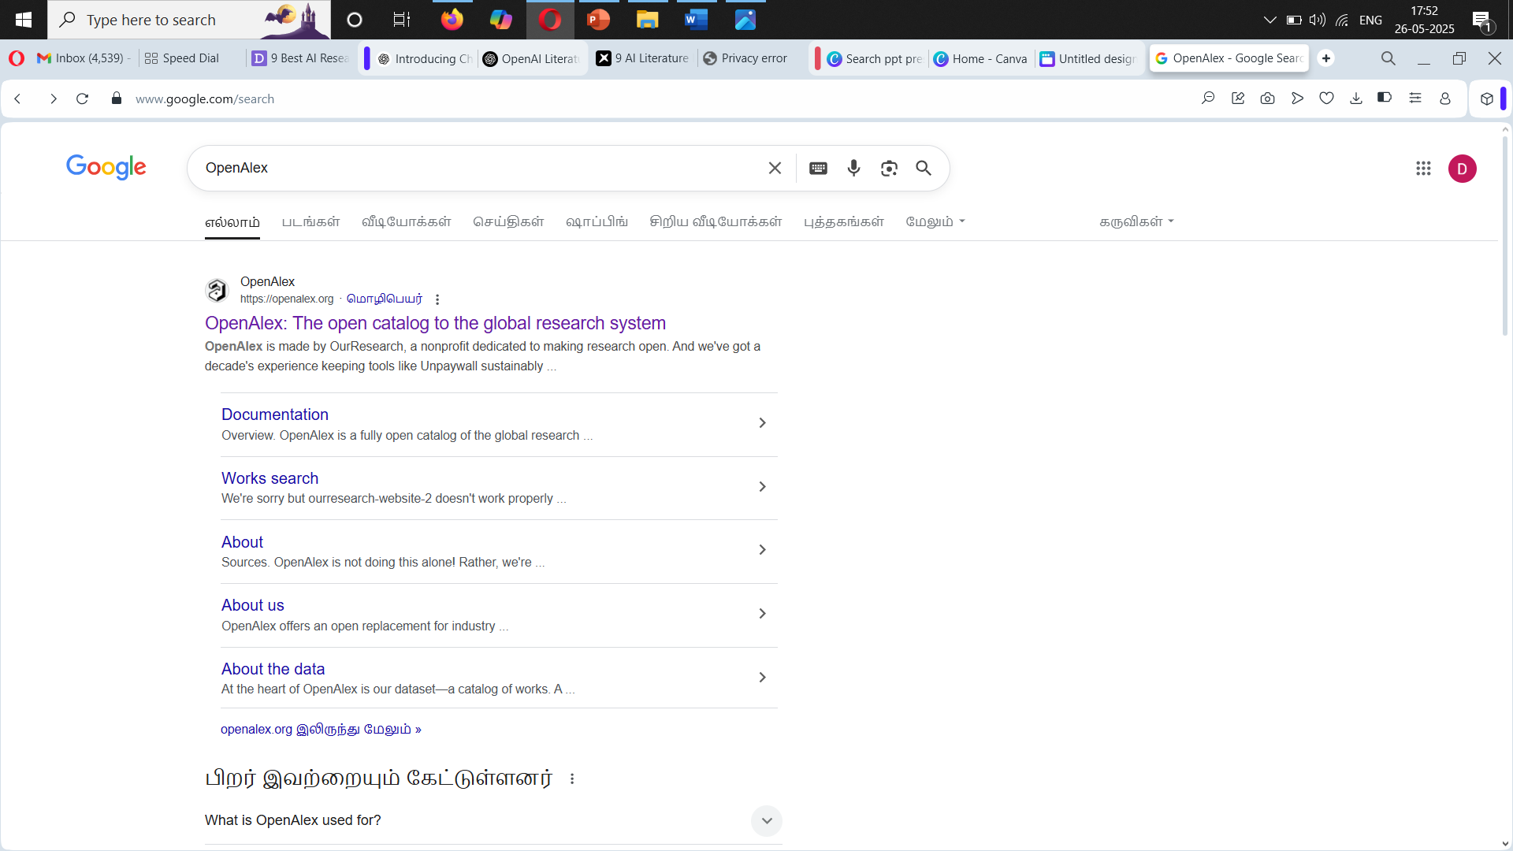
OpenAlex

Slide 21
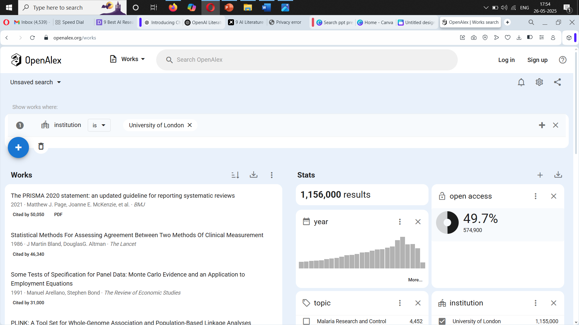

Slide 22
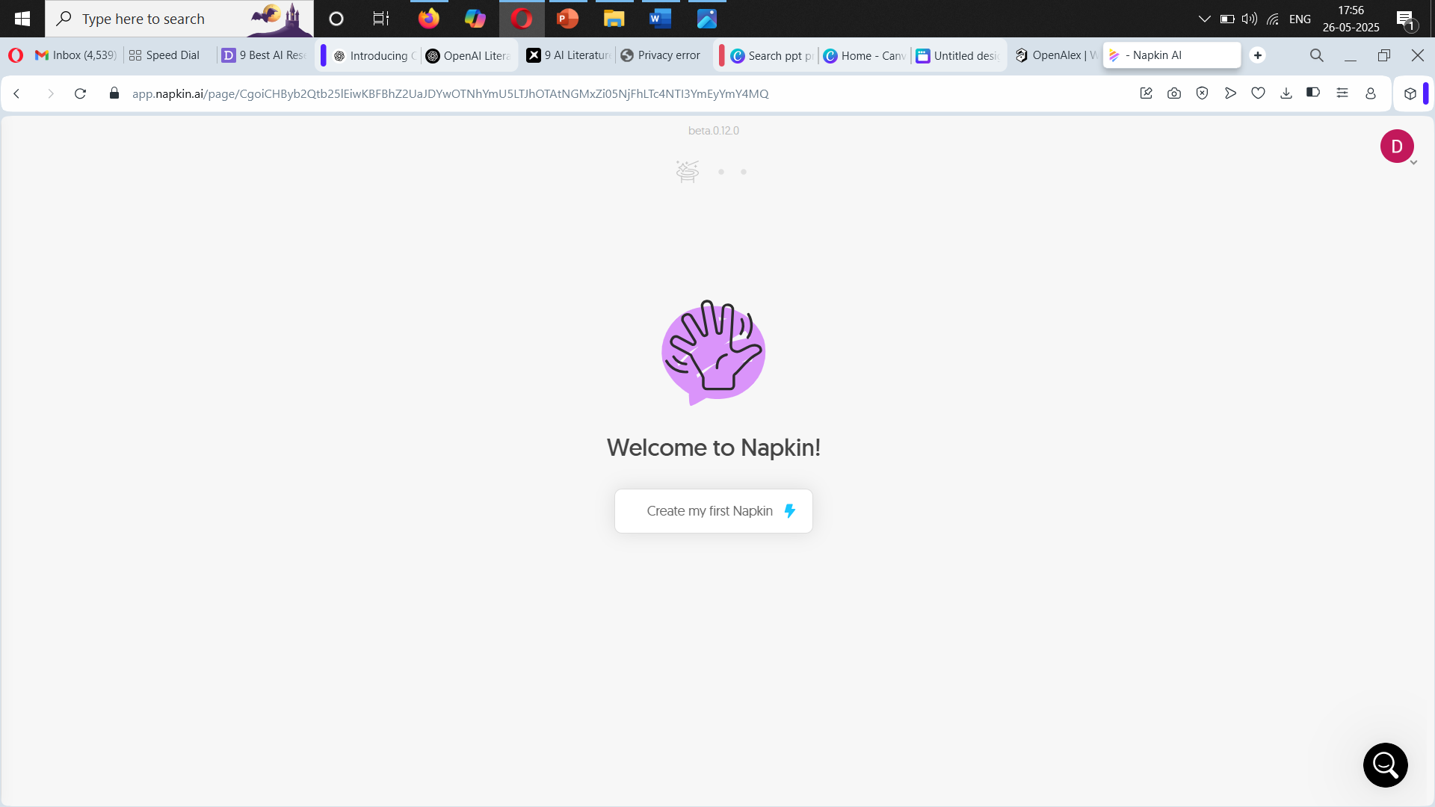
Napkin AI

Slide 23
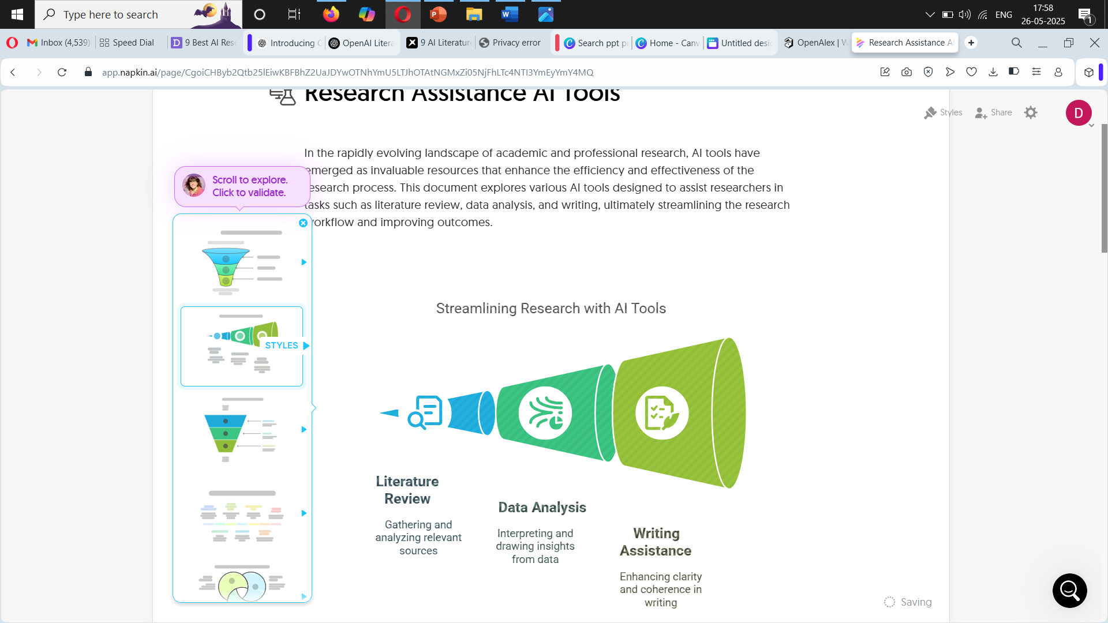

Slide 24
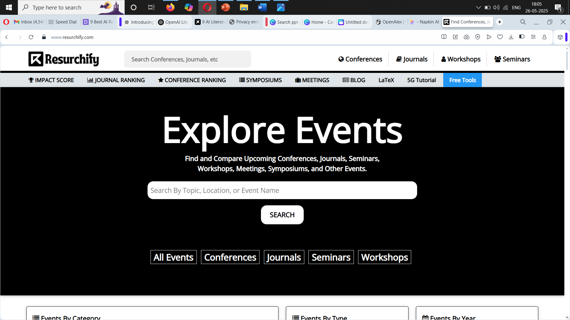
Resurchify

Slide 25
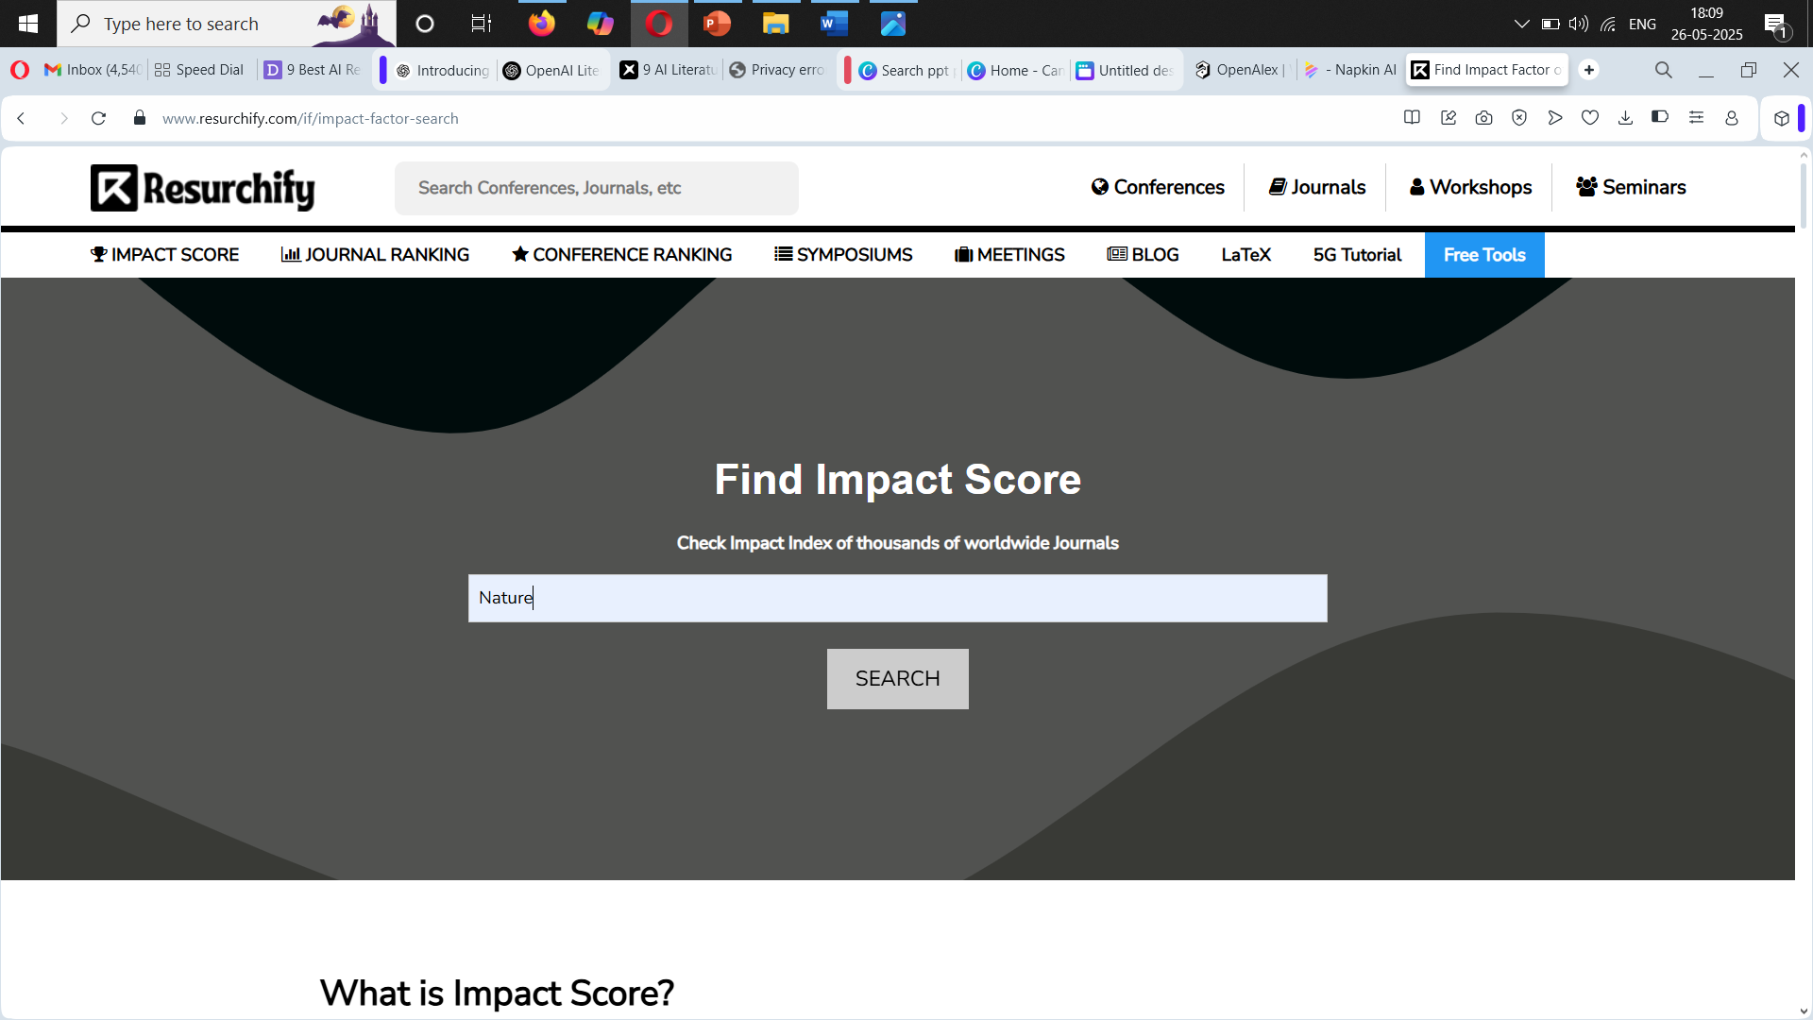

Slide 26
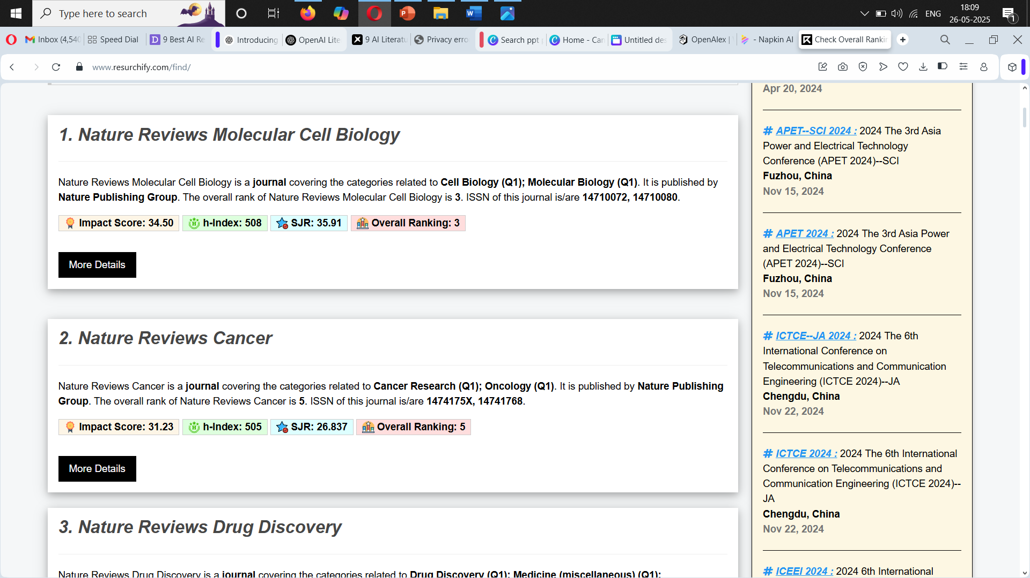

Slide 27
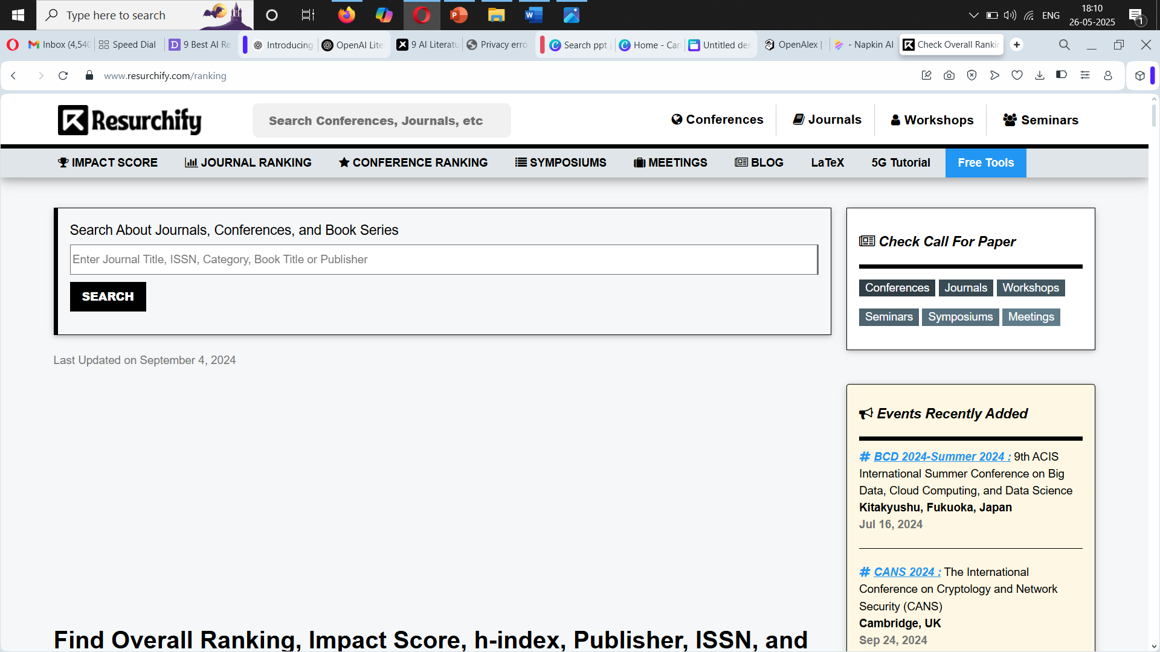

Slide 28
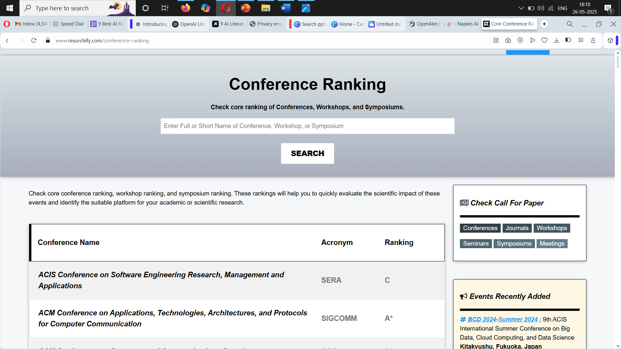

Slide 29
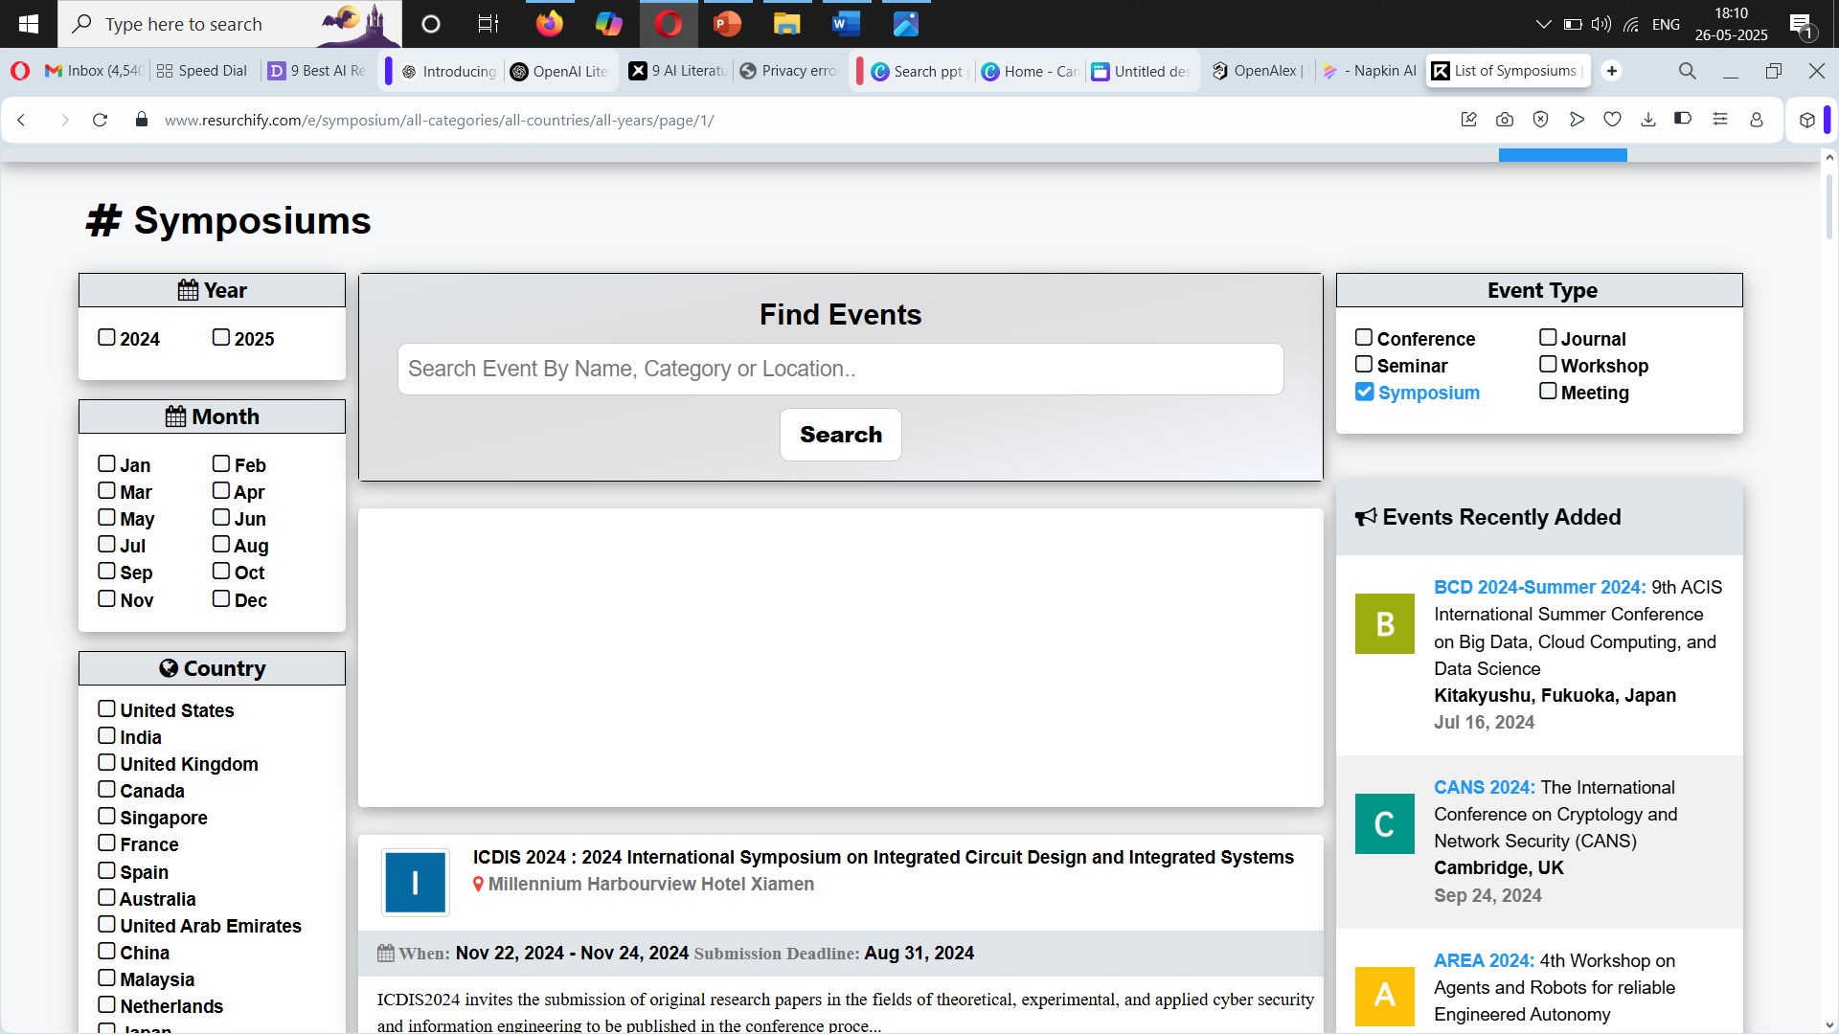

Slide 30
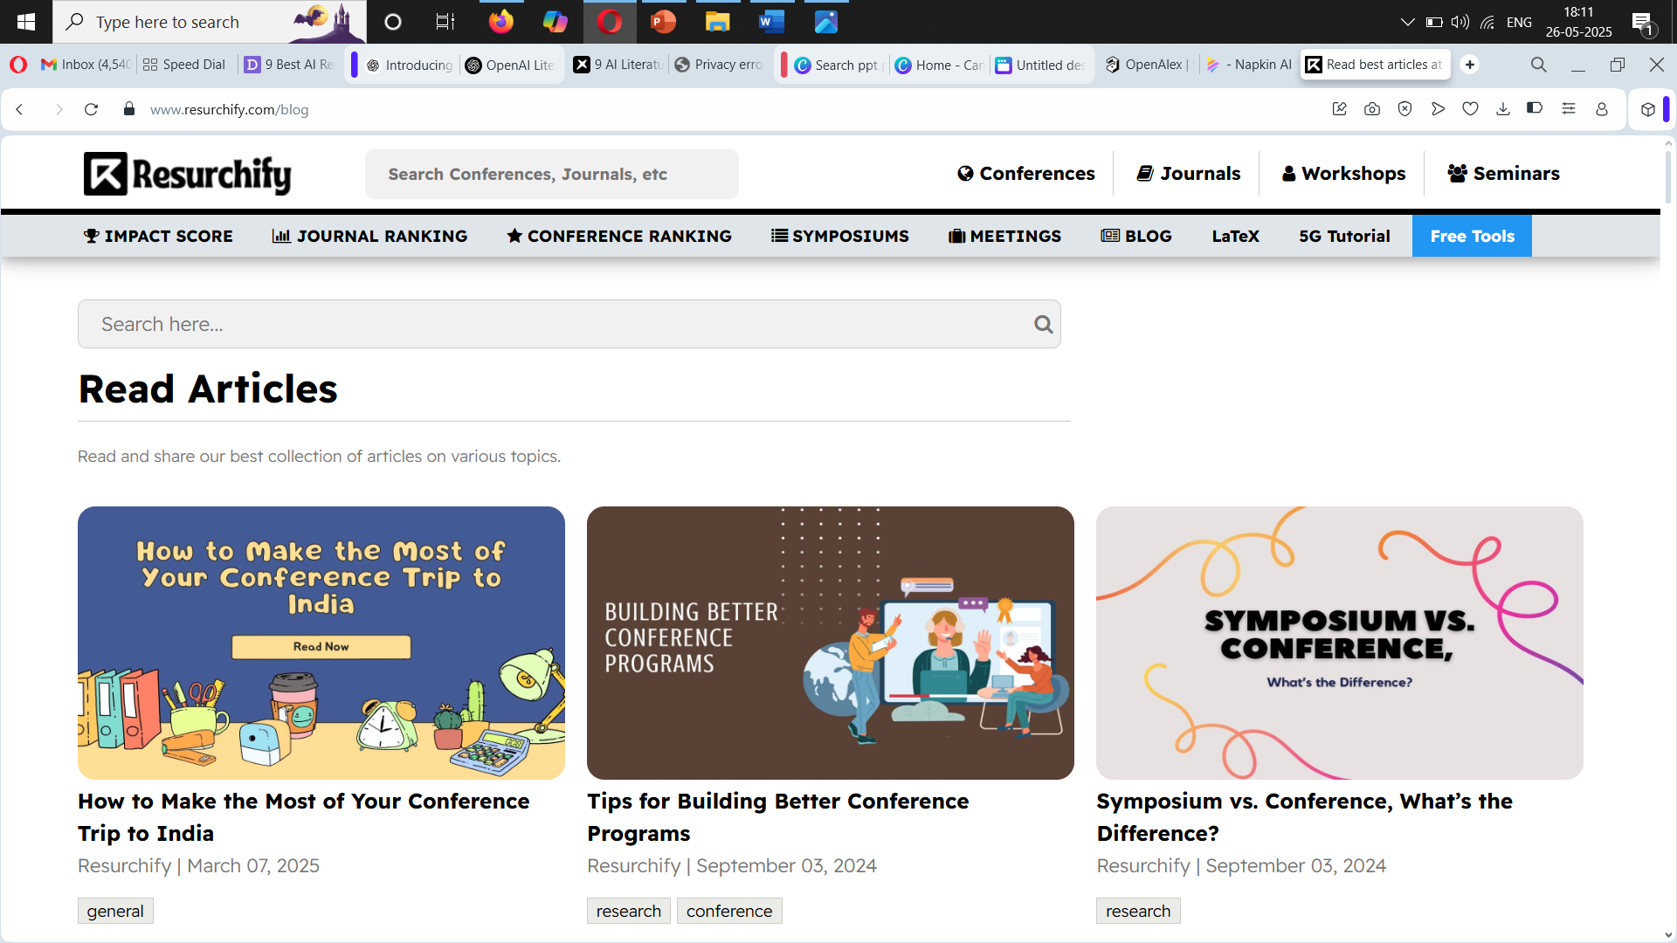

Slide 31
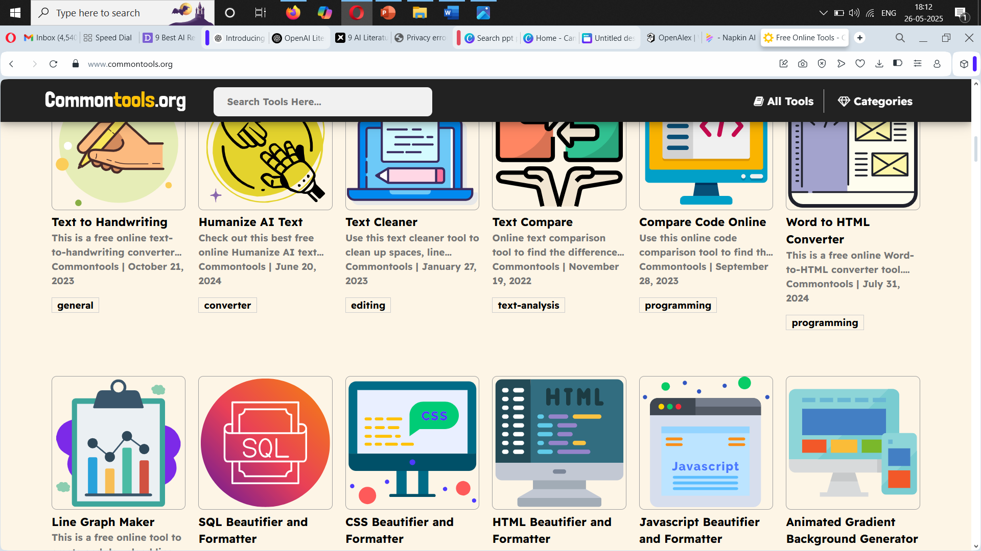

Slide 32
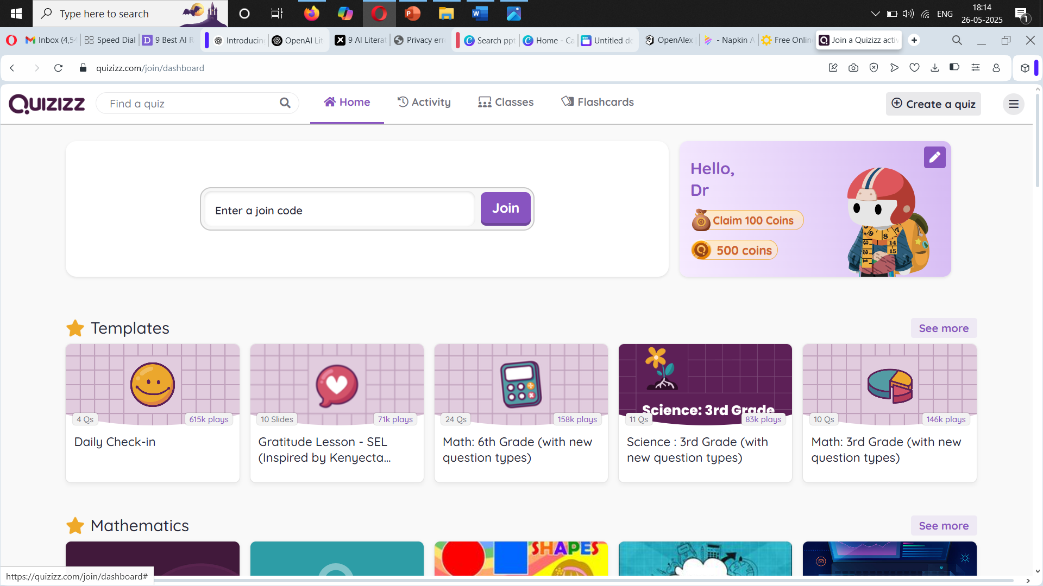
Quizizz

Slide 33
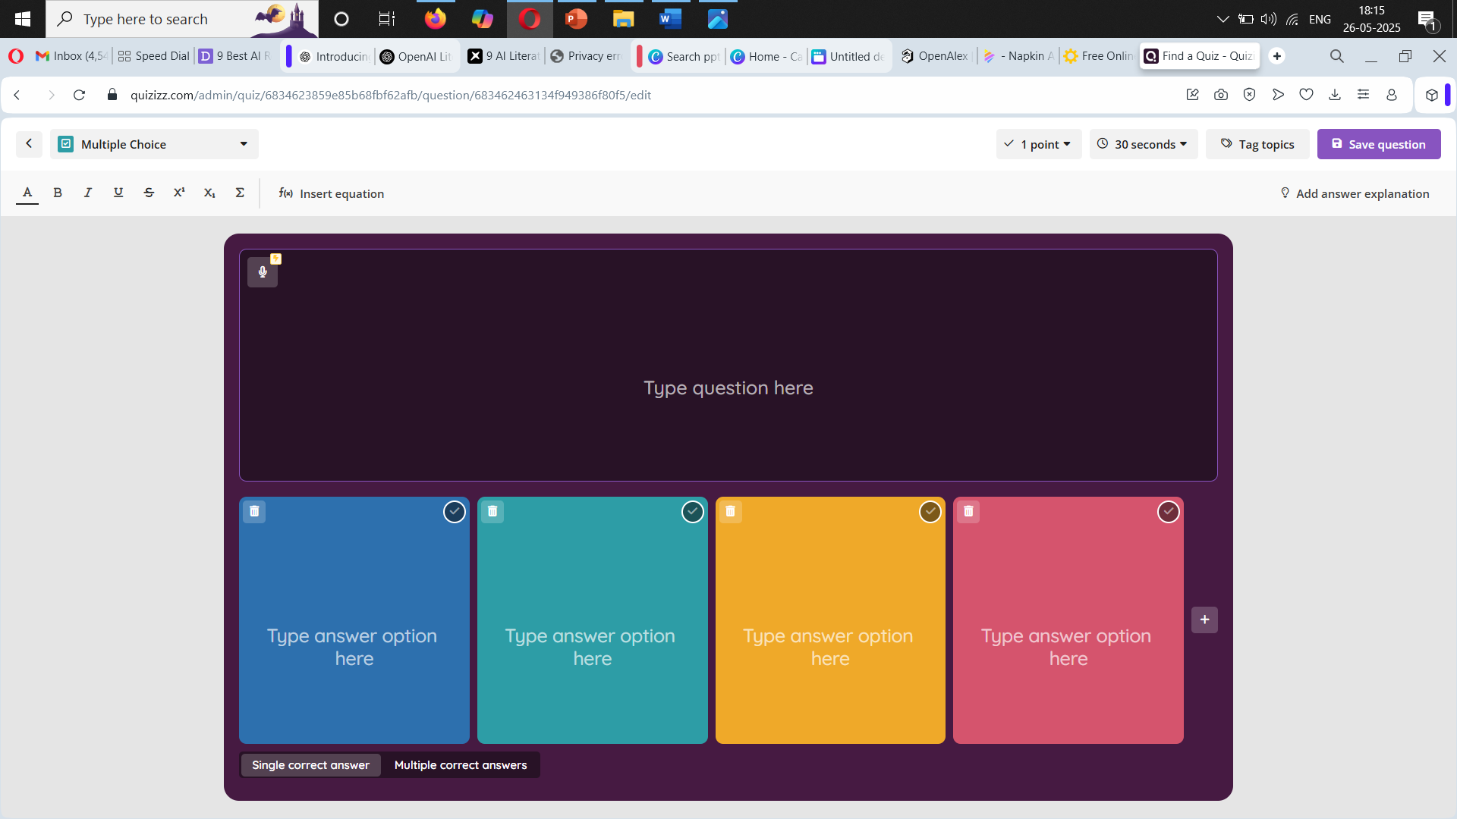

Slide 34
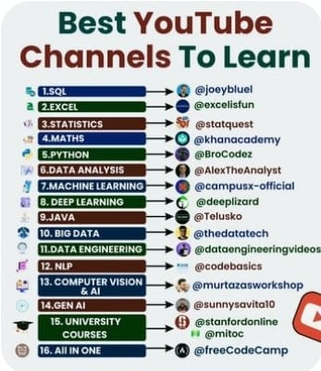

Slide 35
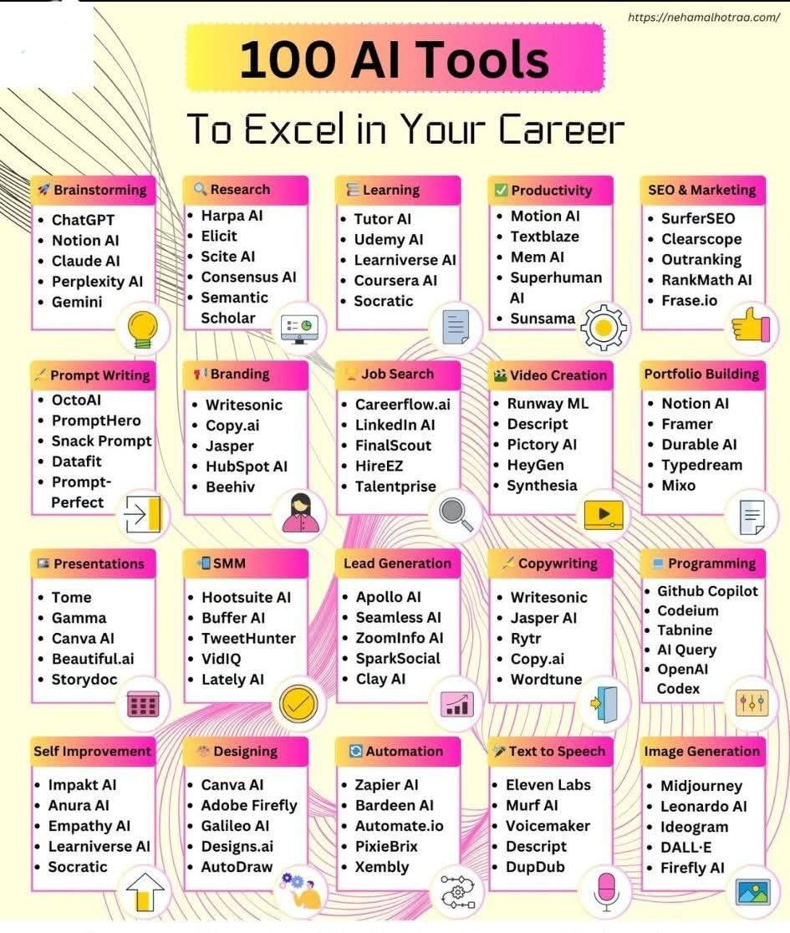

Slide 36
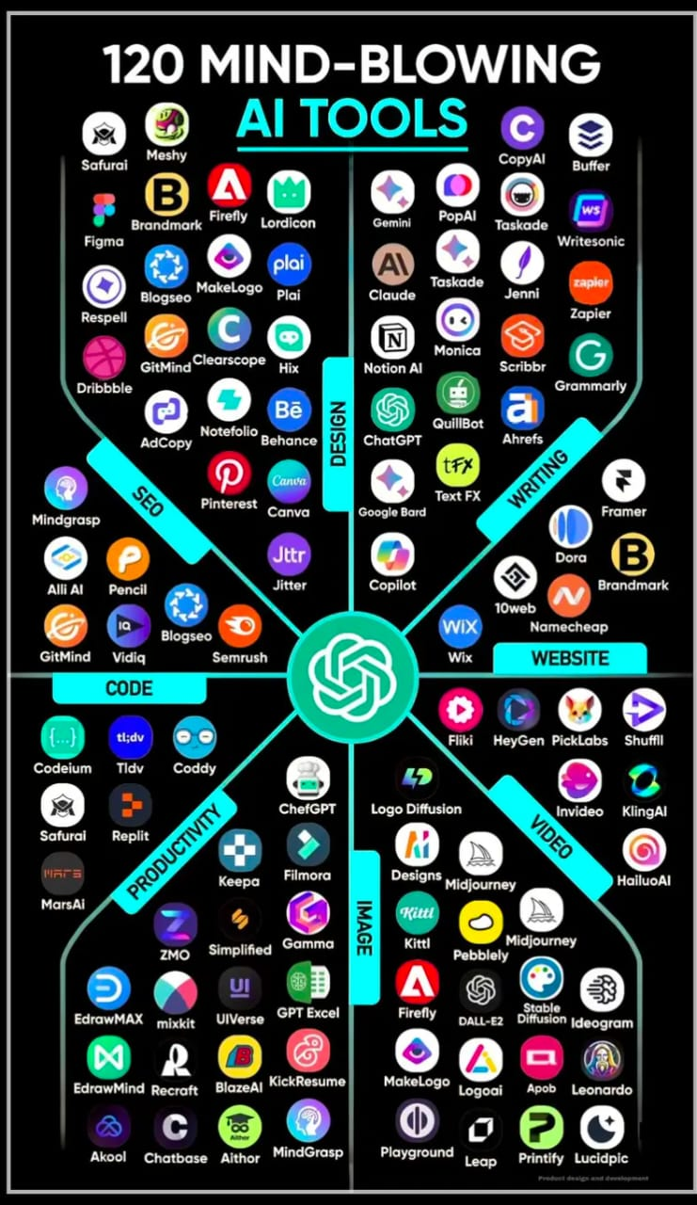

Slide 37
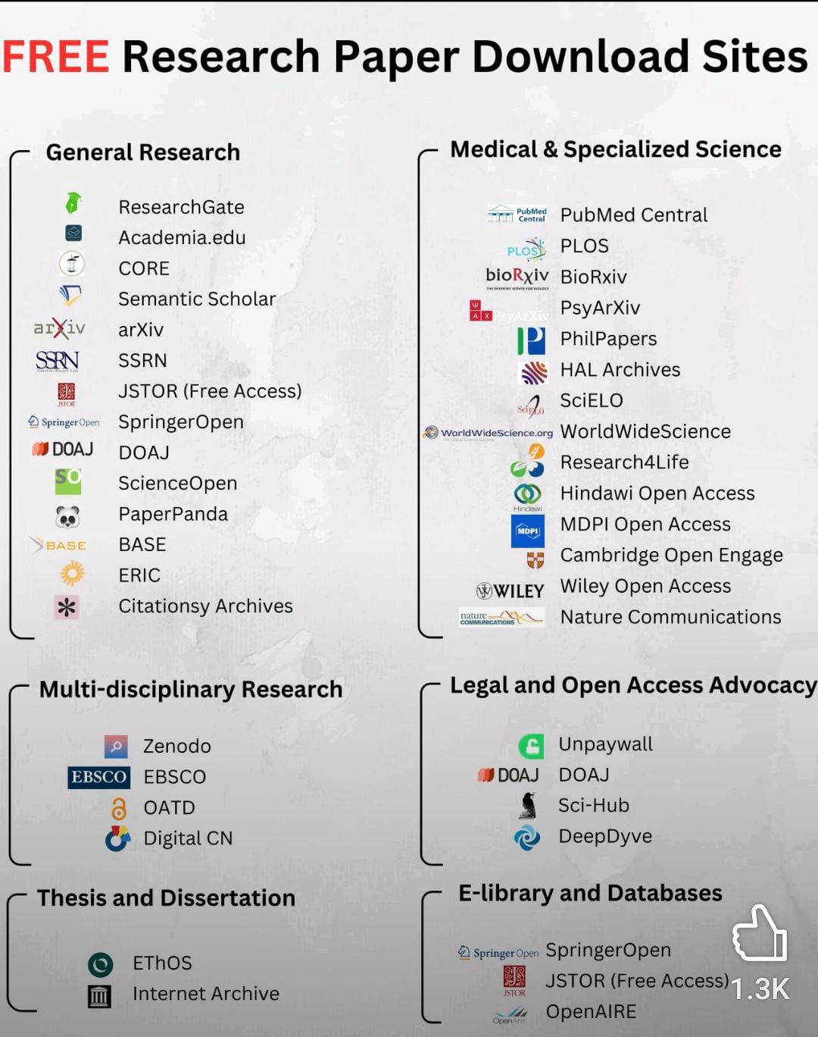

Slide 38
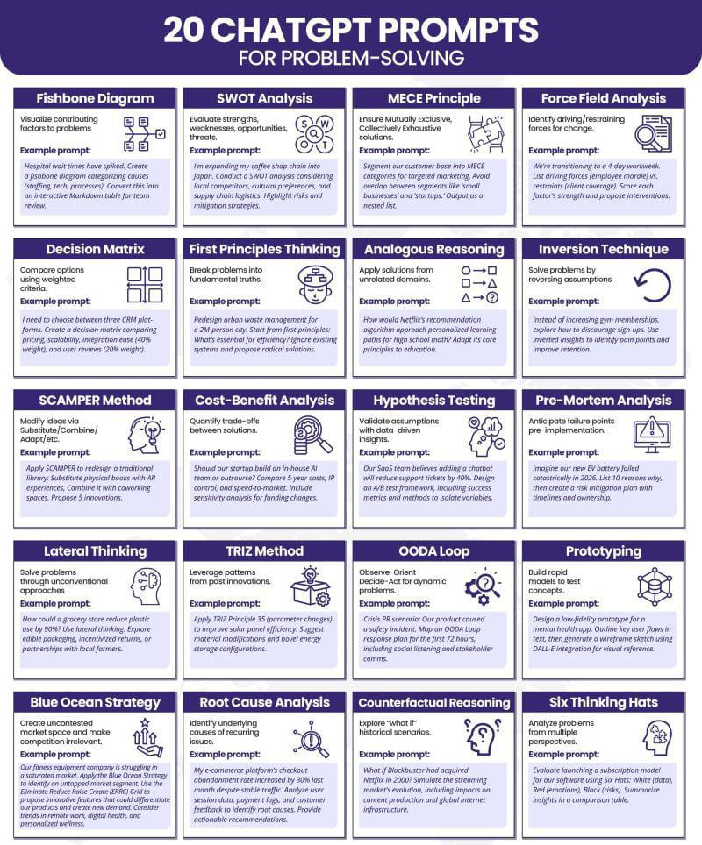

Slide 39
