Slide 1
Assistive Technology in the Classroom
Value-Added Course
Dr.M.Prabavathy
Asst Prof
Centre for Differently Abled Persons
Bharathidasan University
cdapraba@bdu.ac.in

Slide 2
The Power of Assistive Technology
“Technology has great potential in providing access for all learners. Through the use of a variety of assistive technologies, students with disabilities can have the ability to access the general curriculum. When assistive technology is appropriately integrated into the regular classroom, students are provided with multiple means to complete their work”
Janet Jendron
University of South Carolina Assistive Technology Project
“The Power of Assistive Technology”

Slide 3
What is Assistive Technology?
AT is “any item, piece of equipment, or product system, whether acquired commercially off the shelf, modified or customized, that is used to increase, maintain, or improve the functional capabilities of a child with a disability”
- 20 USC 1401(1)
AT can be anything from a simple device, such as a magnifying glass, to a complex device, such as a computerized communication system.

Slide 4
AT Fosters Inclusion
Inclusion: The practice of educating all or most children in the same classroom, including children with physical, mental, and developmental disabilities. (Association for Supervision and Curriculum Development)
AT helps students who have disabilities learn the material in a way that they can understand it
AT helps eliminate barriers students may face that prevent them from being at the same level as their classmates

Slide 5
AT Benefits ALL Students
15-20% of the general population is in need of some type of “cognitive task assistance.”
A large population of “at risk” students need assistance, but because they don’t easily fit into a diagnostic profile, they do not receive assistance; if AT is available to everyone, these students can benefit.
AT aids in all of the subject areas in school.

Slide 6
Definition
Assistive technology has also been defined as “devices and software designed specifically for those with learning or physical disabilities” and “powerful tools that support physically challenged students with equal opportunities to more fully participate in the teachinglearning process ” (Cobb, 2012, p. 47).

Slide 7
Need of AT
“All students require the ability to access the curriculum, and to demonstrate their learning in order to meet their educational potential. Assistive technology (e.g., software, mobile devices, accessible versions of textbooks and media) are critical in providing voice, as well as equitable access for students with special education needs

Slide 8
Use of AT
AT helps students in two key ways:
It helps students learn how to complete a particular task, and
It helps students circumvent certain difficulties that pose as barriers to their learning.

Slide 9
What Is Assistive Technology (AT)?
Assistive technology (AT) refers to the special devices and software that people with disabilities can use to access the environment and gain information.
The law defines an assistive technology device as any item, piece of equipment, or product system (whether acquired commercially, modified, or customized) that is used to increase, maintain, or improve the functional capabilities of individuals with disabilities.

Slide 10
NO one size fits All store
Assistive technology can be as simple as a book stand to hold a textbook at a comfortable position so a student with a visual impairment does not have to bend over the desk to read.
It can be as complex as a computer system with screen reading and voice recognition software for students who have difficulty both seeing the screen and using the keyboard. Most students need a range of both low- and high-tech devices.
For example, hand-held monocular telescopes can help a student with low vision read the menu at an Restaurant; screen magnification software can help that same student read the computer monitor more easily.
There is no "one size fits all" solution; the assistive technology needs of students are as unique as the students themselves.

Slide 11
Promoting Access to the Curriculum
Technology is increasingly being recommended to help students with disabilities achieve curriculum.
Technology that supports students in accessing the curriculum does not need to be expensive or complicated to make a difference in learning.
Both low tech and high tech applications have been used successfully to ensure students' success in the general education curriculum in par with their peers.

Slide 12
Persons with Disabilities have the Right to…
Live independently
Enjoy self determination
Make choices
Benefit from education
Pursue meaningful careers
Enjoy full inclusion and integration in the economic, political, social, cultural and educational mainstream of society

Slide 13
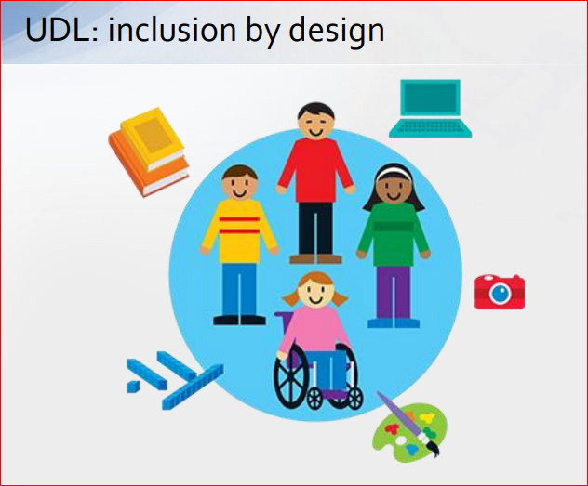
Universal Design for Learning (UDL) is a research-based framework that helps teachers plan learning to meet the diverse and variable needs of all students.
Universal Design is a principle that is borrowed from architecture.
The idea is to “build-in” accessibility, so that as many people as possible can have access.
Notes:
inclusive.tki.org.nz/guides/ universal-design-for-learning

Slide 14
How We Teach
Child behavior
INPUT
PROCESS
OUTPUT
What if the child does not have easy access to the input (sensory) or access to the output (communication/motor)?

Slide 15
Input
80% of learning is through your vision
Vision and hearing are your distance senses
95% of all learning is through your distance senses
90% of learning is incidental
Learning progresses from the known to the unknown

Slide 16
The disability is not the Sensory Impairment
The disability is in
INFORMATION GATHERING
Notes:
All learning is through your senses. Come back to senses. Not all senses are equal. Refer back to post-its.
Vision specialist in early intervention. Deaf in terms of linguistic patterns. SLPs talk about comparative language. Vision specialists talk about schemes. But all this is related. All this is going from the known to the unknown. How we learn, concept development, putting file cabinets in my head.
Do the Spelling test.

Slide 17

Hidden / Invisible Disabilities -Common Myths About Learning Disabilities (LD)
Myth #1: People with learning disabilities have below average intelligence and cannot learn.
Reality: By definition, students with LD must be average or above in intelligence as measured by an individual IQ test and have a significant discrepancy between their ability and achievement. In fact, studies indicate that as many as 33% of students with LD are gifted. Students with LD can learn and succeed in college. It takes proper recognition, intervention and lots of hard work.
Myth #2: Learning disabilities are just an excuse for irresponsible, unmotivated or lazy people.
Reality: Learning disabilities are caused by neurological impairments not character flaws. LD is a permanent disorder that interferes with acquiring, integrating, and demonstrating verbal and nonverbal abilities. Students with LD process information differently. They have a different way of learning.

Slide 18
Hidden / Invisible Disabilities -Common Myths About Learning Disabilities (LD)
Myth #3: Learning disabilities only affect children. Adults grow out of learning disabilities.
Reality: We now know that LD continues throughout the individual’s lifespan. LD may intensify in adulthood as tasks and environmental demands change. Many adults have never been formally diagnosed with a learning disability. The majority of people with learning disabilities are not diagnosed until they reach adulthood.
Myth #4: Students with learning disabilities have dyslexia so they can’t read.
Reality: Dyslexia is simply one a type of learning disability. It is a specific language based disorder affecting a person’s ability to read, write and verbally express themselves. Careless use of the term has expanded it so dyslexia has become equivalent for “learning disability” for many people.

Slide 19
Hidden / Invisible Disabilities -Common Myths About Learning Disabilities (LD)
Myth #5: Students with LD are quick to reveal their status so they can have an advantage in the classroom. Does LD become a way to “work the system?”
Reality: Many students with LD do not self-disclose when they get to college. Self-disclosure is required to receive accommodations. Many students who do disclose wish to remain anonymous in the classroom.
Myth#6: Learning disabilities are only academic in nature. They do not affect other areas of a person’s life.
Reality: Many students with LD also have social problems due to difficulties reading body language and other subtle language cues that help most students understand how to appropriately interact with others. This may cause some students with LD to have trouble asking faculty for clarifications or contributing to classroom discussions.
Myth #7: Accommodations for students with LD are usually quite time-consuming for faculty.
Reality: Many accommodations take little to no time for faculty. They will benefit all students, not only the students legally entitled to them. They can help us reach more students. They can help us question/clarify the pedagogy underlying our requirements.

Slide 20
Additional Challenges
Students with hidden disabilities may have other major challenges in one or more of the following areas:
  Motor coordination
  Time management
  Attention
  Organizational skills
  Processing speed
  Social skills needed to make friends and maintaining relationships
  Verbal expression
  Memory

Slide 21
Common Accommodations for Hidden Disabilities
Extended time on tests.
  Instead of testing how fast a student can process information, extended time (twice the usual amount of time for examinations—100% or 50% extra time) provides a more representative outcome of the student’s knowledge, thinking ability, and expression.
Quiet room for testing.
  Many students may need a quiet room, free of distractions in which to take their examinations.
Notetakers in class.
  Many students cannot process information while taking notes at the same time and require an in-class note taker.

Slide 22
More Accommodations
Access to a Computer to Take Exams
  Students with difficulties in spelling, grammar, graphic-motor integration (dysgraphia) may need computer access.
Multi-Modality Instruction
  Provide information in oral and written form.
  Use visual aids during lectures.
Flexible Assignments
  Give students a range of ways to show their knowledge.
Flexible Deadlines
  Or, receive assignments ahead of time.

Slide 23
“The use of assistive technology to support the needs of special education students has been a revelation and has begun a small revolution in student achievement, so that many students are now able to access, develop and display what they know in ways that have never been possible for them before.”

Slide 24
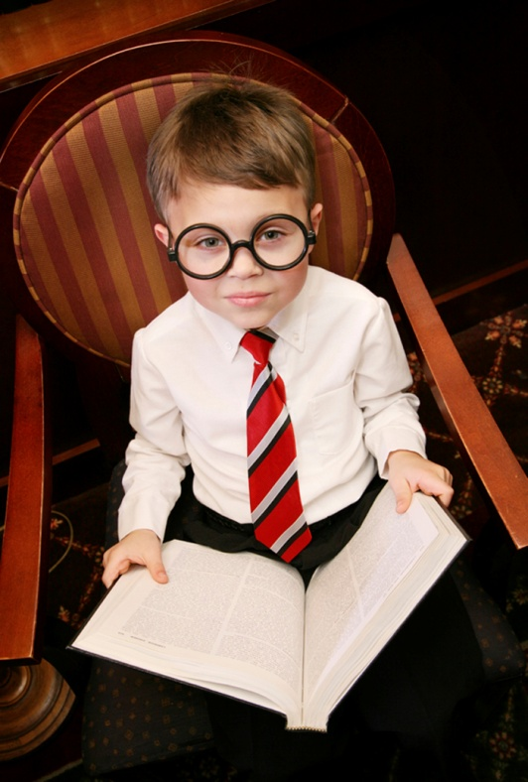
Assistive Technology in the Schools
Legal Aspects of Assistive Technology
  Legislation
  Implications for schools
Implementation in the Schools
  Overview of assistive technology devices/services
  Educational interventions
Resources
Notes:
Providing access to the general curriculum and improving achievement for students with disabilities are primary goals of both IDEA and NCLB –
Many students with disabilities have reading and writing difficulties that make it difficult for them to achieve these goals.
Assistive Technology can be an effective tool in providing educational opportunities -
My purpose is to provide an overview of AT – give you enough information and resource materials so you can pursue more information-
Legal Basis for Assistive Technology and implications
What is looks like in the schools
not just severe students – probably implementing in your classroom
And….Resources

Slide 25

Role of Assistive Technology
Tremendous potential to promote equity for students with disabilities……
  independent
  self-confident
  productive
  integrated into school and society.
Technology is for ALL children – for students with disabilities, it may need to be more personalized.
Notes:
Assistive Tech – levels the playing field for students w/ disabilities – it redefines what is possible for children with disabilities – enabling them to be more….
The IEP is a powerful tool to assist educators, parents and students to develop effective ways of putting AT solutions into educational programs which meet student needs and promote an equitable environment – one in which accommodations are seen as regular, normal and expected.

Slide 26

The Assistive Technology Continuum
No-tech
Low-tech
Medium-tech
Hi-tech

Slide 27

No-Tech Assistive Technology
No-tech solutions make use of procedures, services and existing conditions in the environment that do not involve the use of devices or equipment.
These might include services such as physical therapy, occupational therapy or the services of other specialists.

Slide 28
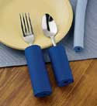

Low Tech Assistive Technology
Low-tech items are less sophisticated and can include devices such as adapted spoon handles, non-tipping drinking cups and Velcro fasteners.

Slide 29
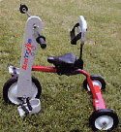
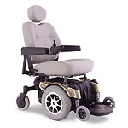

Medium Tech Assistive Technology
Medium-tech devices are relatively complicated mechanical devices, such as wheelchairs.

Slide 30

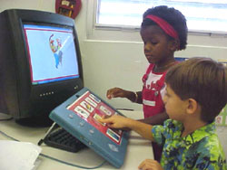

High Tech Assistive Technology
High-tech devices incorporate sophisticated electronics or computers.

Slide 31
Teaching All Students, Reaching All Learners, including Students with Disabilities as Diverse Learners
Augmentative and alternative communication devices
  hearing aid and/or assistive listening device, text to speech, picture to speech
Electric wheelchair
Alerting device
  environmental awareness for people who are deaf/heard of hearing, i.e. alert to file alarm, telephone, doorbell
Mouse alternatives
  track ball, touch pad, head mouse
Keyboard alternatives
  alternative ways of keyboarding, i.e. on-screen keyboard, touch screen
Screen readers
  accessing screen via voice or touch, i.e. JAWS, Window-Eyes, TelleBraille N’ Speak
Screen magnifiers
  magnify and manipulate look of the screen, i.e. built-in computer screen readers, ZoomText
Text to speech: Ureader; Read & Write; Built in on Mac OS; Kurzweil
  write or choose picture and device “speaks”, i.e. Ureader, built-in (MAC), Kurzweil
Voice recognition: Dragon Naturally Speaking; iListen (Mac)
  speak instead of writing or using mouse—Dragon Naturally Speaking, iListen (MAC)
Word prediction programs: Co-Writer; SoothSayer; Telepathic 2000
  speak instead of writing or using mouse—Dragon Naturally Speaking, iListen (MAC)

Slide 32
Types of High-Tech Universal Assistive Technology
Variations in keyboard design
  ergonomic, natural, adjustable, etc.
MP3 player/CD player/Tape Player
  audio players to listen to textbooks and lectures
Optical character recognition/Scanner
  scan books and notes onto PC (also used by individuals, libraries and government to store information)
Tape Recorder/Digital Recorder
  record lectures, books
Word Processor
  access to print, writing, communication
Text Messaging

Slide 33
Categories of Assistive Technology
There are many types of assistive technology to aid individuals in all aspects of life.

Slide 34
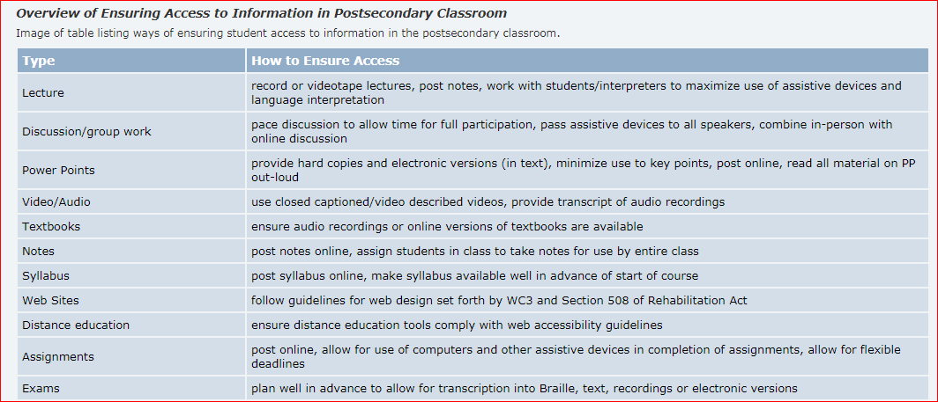

Slide 35
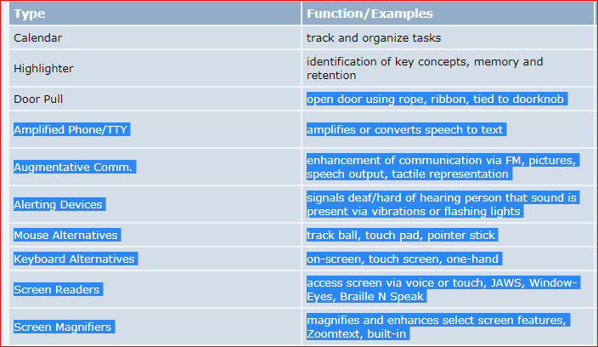

Slide 36
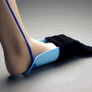
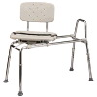

Daily living
Daily Living aids are for use in activities such as eating, bathing, cooking, dressing, toileting, and home maintenance.
Notes:
Example: grab bars and a shower chair for bathing.

Slide 37
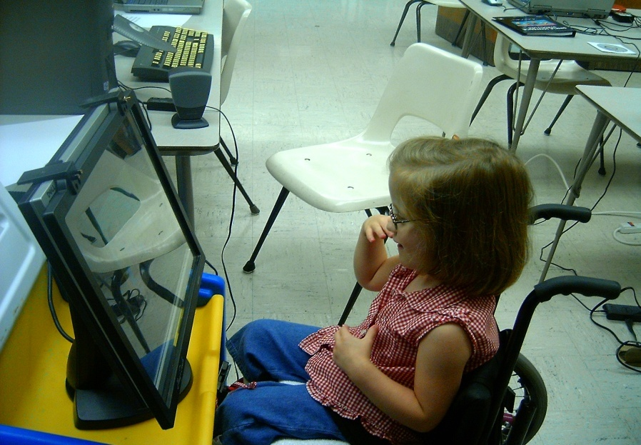
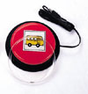

Computer technologies
Computer technologies are input and out- put devices that enable persons with disabilities to use a computer.
Notes:
Example: Voice activated system for computer, allows an individual with limited use of hands to write articles without the need for a keyboard.

Slide 38
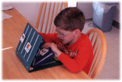
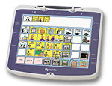
Augmentative Communication
Augmentative Communication devices provide a means for communication for persons with limited speech.

Slide 39


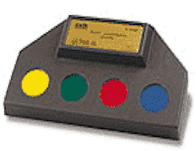
Environment Control Units
ECU’s (electronic systems) enable someone with limited mobility or fine motor skills to control devices in the home or other surroundings.
Notes:
Example: equipping a home with electronic controls for the doors, lights, television and radio to allow greater independent functioning in the home.

Slide 40
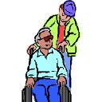
Seating and positioning
Seating and positioning accommodations to a wheelchair or other seating system to provide greater body stability, trunk /head support and an upright posture, and the reduction pressure on the skin surface (cushions, contour seats, lumbar supports).
Notes:
Example: Equipping a wheelchair with straps to prevent injury to lower body, give greater upper body support and to secure while chair is in motion.

Slide 41

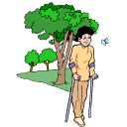

Mobility Aids
Manual and electric wheelchairs, mobile bases for custom chairs, walkers, three wheel scooters and other utility vehicles used for increasing personal mobility.
Notes:
Example: upgrading from a manual wheelchair to a power wheel chair allowing for greater mobility and increased independence.

Slide 42
Prosthetics and orthotics
Replacements, substitutions or augmentation of missing or malfunctioning body parts with artificial limbs or other orthotic aids (splints, braces, etc.)
Notes:
Example: using a leg prosthesis in order to walk.

Slide 43

Home, school and worksite modifications
Home and workplace modifications are structural adaptations, fabrications in the home, worksite or other areas (ramps, lifts, bathroom changes) that remove or reduce physical barriers for an individual with a disability.
Notes:
Example: using stair glide installed in the home to have access to the first and second levels of the home for a person who has difficulty using stairs.

Slide 44

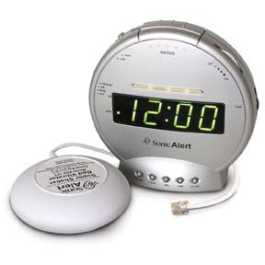
Sensory aids
Sensory assistive technologies enable an individual with hearing, sight, or other sensory impairments.
Notes:
Examples include: magnifiers, speech output devices, telephone amplifiers, text telephones, and tactile objects.

Slide 45

Assistive Technology Tools
Learning and Studying
Print or Picture Schedule
Highlighting Text
Recording Material
Voice Output Reminders
NCR Paper
Low Tech Aids to Identify Materials
Electronic Organizers
Palm Computers
Software
Notes:
There are a variety of tools that can help a student who struggles with the basic tasks of learning and studying. Things like organizing time, organizing information, and retrieving information can be critical to a student’s success. Here are several suggestions that can help the student who struggles with these problems.

Slide 46
Universal Design for Instruction (UDI)
Universal Design
  Design products & environments to meet a wide range of needs
  Ex: ramps, curbs, automatic doors
  Architectural concept
Universal Design for Learning (UDL)
  Make learning goals achievable by wide range of individuals
Built into instructional design/operating systems of educational materials
  Not added on after the fact

Slide 47
In education:
Universal Design means planning ahead in regard to instruction, curriculum, materials, classroom layout, etc. so that children can have seamless or near seamless access.
Technology is a big part of making Universal Design a reality.

Slide 48
Today, we all accept that technology has become a major driving force contributing to the success and quality of life for everyone.

Slide 49
Low-tech Assistive Technology
Pencil grips
Planners
Audiobooks
Digital clocks
Calculators
Mid to Hi-tech Assistive Technology
Digital recorders
Digital books
Graphing calculators
Electronic math worksheets
Portable or adapted keyboards
Mobile technology (e.g., tablets, iPods, iPads, smartphones, MP3 players, etc
Reading systems that utilize a computer, scanner, and software to “read” scanned book pages out loud (e.g., Kurzweil)
Speech recognition software that allows a computer to operate by speaking to it (e.g., Siri)
Speech recognition systems that turn oral language into written text (e.g., Dragon)
Software that predicts and edits words for students who struggle with spelling (e.g., WordQ)
“Talking” calculators that assist students with math challenges
Mind mapping/outlining software
Global Positioning System (GPS)

Slide 50
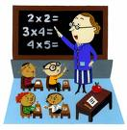
AT in the Service Learning Classroom
Low-Tech
Hard copies of notes provided by the instructor or other student
Outlines, double spaced, with key words provided by the teacher or note taker
Printed materials double-spaced and with larger print
tape recorders
Calculators with voice synthesizer
Books on tape
High-Tech
Lap top computer for note taking
Electronic spelling masters or dictionary with voice output
Word prediction software
Outline software
Reading and scanning software
Voice recognition software

Slide 51
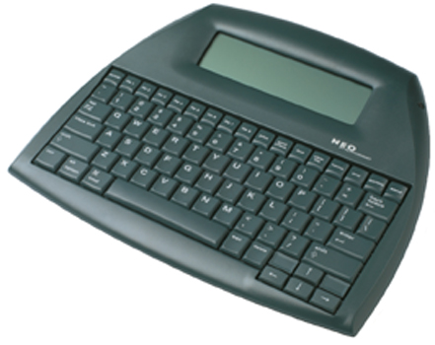

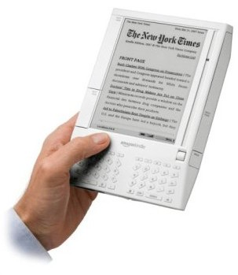
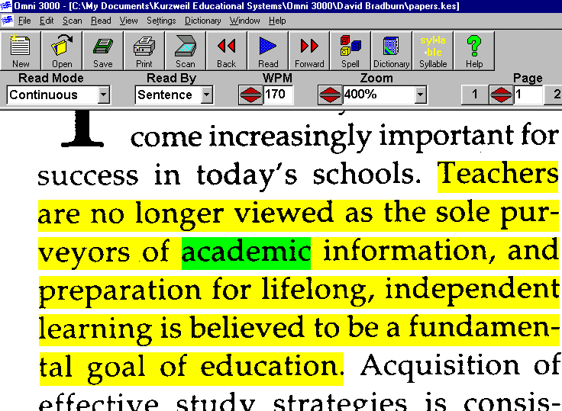
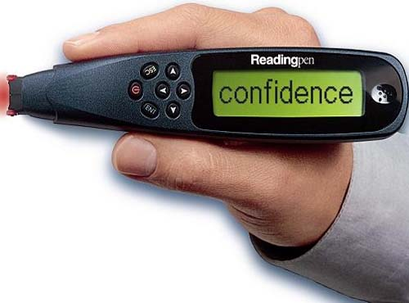
AT in the Service Learning Classroom
Reading and Scanning Software

Slide 52
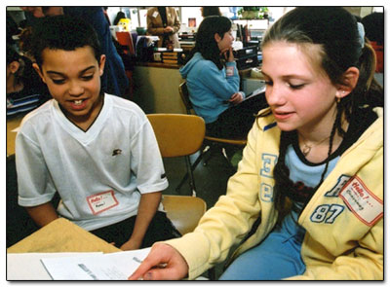

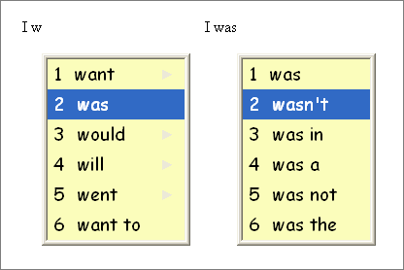

AT in the Service Learning Classroom
Voice Recognition
Writing Tool: outline and organize ideas
Word Prediction Software

Slide 53
AT in the Classroom: What about MATH?
Tech Matrix: developed by Center for Implementing Technology in Education and National Center for Technology Innovation at http://www.techmatrix.org/ .
Can select subject and types of supports needed.

Slide 54
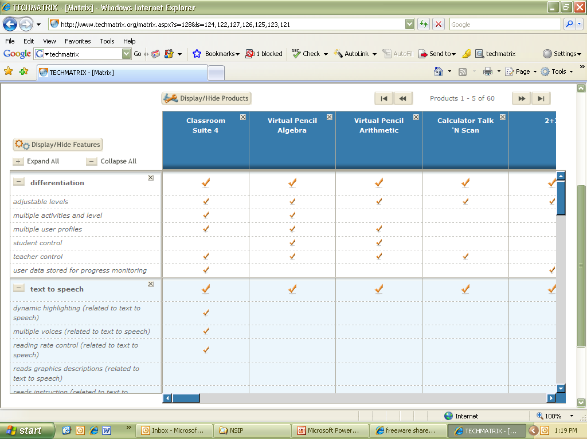
AT in the Classroom: What about MATH?

Slide 55
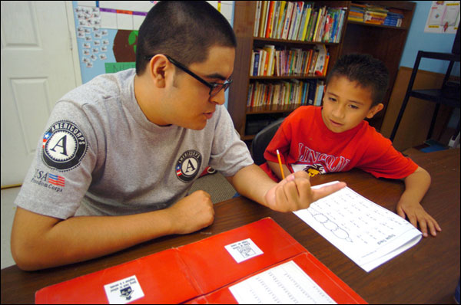
AT in the Service Environment
Low-Tech
To-do lists
Date planner (electronic or paper and pencil) and electronic reminders
Color post-it notes
Quiet space
Telephone with headset
Organized filing system
Clip board
High-Tech
Alternative keyboards and mice
Digital recorder
Ergonomic desk, height adjustable tables
Service-site modifications
Reading and scanning software
Voice recognition software

Slide 56
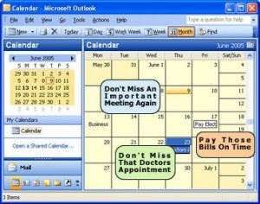
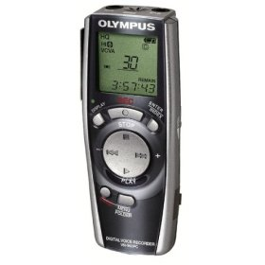
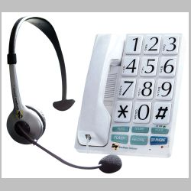
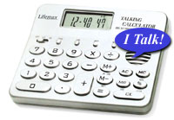
AT in the Service Environments

Slide 57
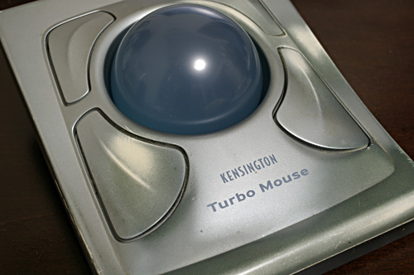
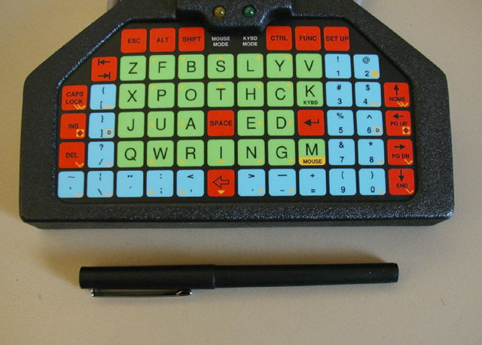
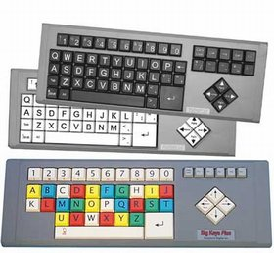
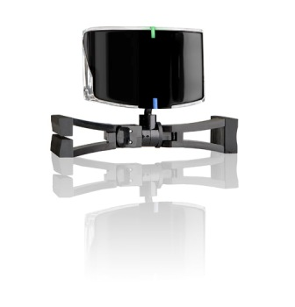
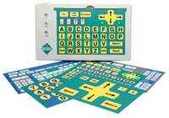
AT in the Service Environments

Slide 58
When students with disabilties are effectively able to use AT, they may experience many benefits, including:
improved academic achievement,
a more positive overall school experience,
greater enthusiasm for school,
enhanced self-esteem,
enhanced self-efficacy, and
increased time spent on academic tasks.

Slide 59
Technology Tips
Consider low-tech solutions first.
Build a network of individuals knowledgeable about equipment and low-tech strategies.
Access local, regional and national resources.
Consider adaptable equipment when purchasing new technology and other educational products.
Systems should be portable.
BE CREATIVE!

Slide 60

TIS Technology Tips
See Equipment Tips Handout
Provide print or tactile copy of screens
Verbal descriptions
Be cognizant of background noise
Lighting enough to see…watch for glare
Choose font, size, color for strong contrast
Paler highlighters
Uncluttered screens
Described and Caption Media Program: http://www.dcmp.org/

Slide 61

Resources
Article: Using Flexible Technology to Meet the Needs of Diverse Learners: What Teachers Can Do
Pathways to Learning for Students with Cognitive Challenges
AT 101: Assistive Technology Glossary
Universal Design for Instruction
Web Resources for Assistive Technology in the Classroom
Assistive Technology Funding in the Schools
TIS TECHNOLOGY TIPS
WVATS Mini-grants

Slide 62







Thank-you!

