Slide 1
Technology to assist the
Elderly Population
COMPILED BY
Dr.M.Prabavathy,
Centre for Differently Abled
Bharathidasan University
cdapraba@bdu.ac.in

Slide 2
Ageing Population is one of the most discussed global phenomena in the present century. Countries with a large population like India have a large number of people now aged 60 years or more. The population over the age of 60 years has tripled in last 50 years in India and will relentlessly increase in the near future. According to census 2001, older people were 7.7% of the total population, which increased to 8.14% in census 2011.

Slide 3
NATIONAL PROGRAM FOR THE HEALTH-CARE FOR THE ELDERLY (NPHCE)
The NPHCE is an articulation of the International and national commitments of the Government as envisaged under the UN Convention on the Rights of Persons with Disabilities, National Policy on Older Persons adopted by the Government of India in 1999 and Section 20 of “The Maintenance and Welfare of Parents and Senior Citizens Act, 2007” dealing with provisions for medical care of Senior Citizen.

Slide 4
Vision of the NPHCE
(1) To provide accessible, affordable, and high-quality long-term, comprehensive and dedicated care services to an ageing population;
(2) Creating a new “architecture” for Ageing;
(3) To build a framework to create an enabling environment for “a Society for all Ages;”
(4) To promote the concept of Active and Healthy Ageing.

Slide 5
Assistive Technology
Assistive technology is any service or tool that helps the elderly or disabled do the activities they have always done but must now do differently.

Slide 6

Assitive technology can be as simple as a grab bar, shower seat or pill dispenser. Or, they can be as complex as a home automation system or in-home monitoring system. Such technology may be something as simple as a walker to make moving around easier or an amplification device to make sounds easier to hear (for talking on the telephone or watching television, for instance).
It could also include a magnifying glass that helps someone who has poor vision read the newspaper or a small motor scooter that makes it possible to travel over distances that are too far to walk. In short, anything that helps the elderly continue to participate in daily activities is considered assistive technology.

Slide 7
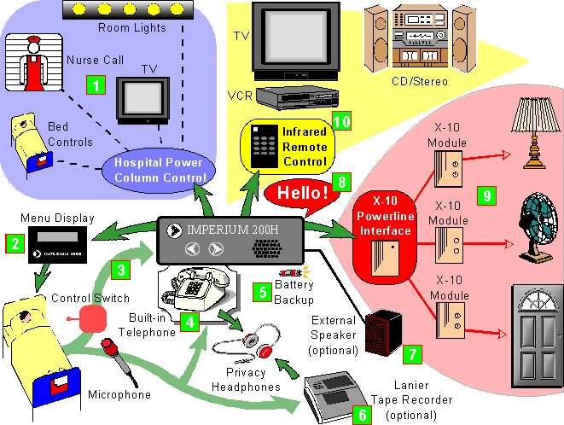
AT-
Environmental
Control Systems

Slide 8
Low-tech Assistive Technology
Grab bars – In the bathroom for toileting and bathing, or anywhere a person might need to steady themselves while performing a tasks or having to lower or raise to sit.
Temperature-activated flow reducer – A big name for a small device that turns off the water if it gets too hot.
Grabbers – A hand-held device that allows someone to reach up or down to collect an item, such as a can from a shelf or a sock from the floor.

Slide 9
Low-tech Assistive Technology
Shower seats – Allows a person to take a shower sitting down, which can be more safe for those who are not able to stand for long periods of time and especially beneficial to prevent falls in the shower.
Lever handles – Lever handles on faucets and doors are easier for everyone to use, especially the elderly or those who have trouble gripping and turning.
Magnifiers – Can be implemented for reading, crafting or watching TV.

Slide 10
Hi-tech Assistive Technology
Cell phones – Cell phones are commonplace for many people in today’s world. They are great for emergencies or staying in touch on the go. Cell phones such as have large text screens, large buttons, simple navigation and are easier to use than standard cell phones.
Automatic counter tops or shelves – These look deceptively like any other counter top or shelf. The difference? They raise & lower (or open and lower) to allow a person easy access to use the counter surface or get to the contents of the shelf.

Slide 11
Hi-tech Assistive Technology
Home automation – Has been used traditionally for stereos, televisions and security. Thankfully, the technology has advanced enough to provide even easier-to-use home security, lights that come on as you enter a room (or dark hallway or stairs at night) and easier environmental controls.
Personal computers – Millions of seniors are online worldwide and are able to keep in touch with family and friends with email, photos, video phones and social networks.
In-home health or activity monitoring – Personal emergency systems have come a long way and have grown into systems that can monitor health conditions, falls or even if the refrigerator has been opened recently.

Slide 12
Hi-tech Assistive Technology
Adaptive switches. Modified switches that seniors can use to adjust air conditioners, computers, telephone answering machines, power wheelchairs, and other types of equipment. These switches might be activated by the tongue or the voice.
Communication equipment. Anything that enables a person to send and receive messages, such as a telephone amplifier.

Slide 13
Computer access. Special software that helps a senior access the Internet, for example, or basic hardware, such as a modified keyboard or mouse, that makes the computer more user friendly.
Education. Audio books or Braille writing tools for the blind come under this category, along with resources that allow people to get additional vocational training.

Slide 14
Home modifications. Construction or remodeling work, such as building a ramp for wheelchair access, that allows a senior to overcome physical barriers and live more comfortably with a disability or recover from an accident or injury.
Tools for independent living. Anything that empowers the elderly to enjoy the normal activities of daily living without assistance from others, such as a handicapped accessible bathroom with grab bars in the bathtub.

Slide 15
Job-related items. Any device or process that a person needs to do his or her job better or easier. Examples might include a special type of chair or pillow for someone who works at a desk or a back brace for someone who does physical labor.
Mobility aids. Any piece of equipment that helps a senior get around more easily, such as a power wheelchair, wheelchair lift, or stair elevator.

Slide 16
Orthotic or prosthetic equipment. A device that compensates for a missing or disabled body part. This could range from orthopedic shoe inserts for someone who has fallen arches to an artificial arm for someone whose limb has been amputated.
Recreational assistance. New methods and tools to enable people who have disabilities to enjoy a wide range of fun activities. Examples include swimming lessons provided by recreational therapists or specially equipped skis for seniors who have lost a limb as a result of accident or illness.

Slide 17
Seating aids. Any modifications to regular chairs, wheelchairs, or motor scooters that help a person stay upright or get up and down unaided or that help to reduce pressure on the skin. This could be something as simple as an extra pillow or as complex as a motorized seat.
Sensory enhancements. Anything that makes it easier for those who are partially or fully blind or deaf to better appreciate the world around them. For instance, a telecaption decoder for a TV set would be an assistive device for a senior who is hard of hearing.

Slide 18
Therapy. Equipment or processes that help someone recover as much as possible from an illness or injury. Therapy might involve a combination of services and technology, such as having a physical therapist use a special massage unit to restore a wider range of motion to stiff muscles.

Slide 19
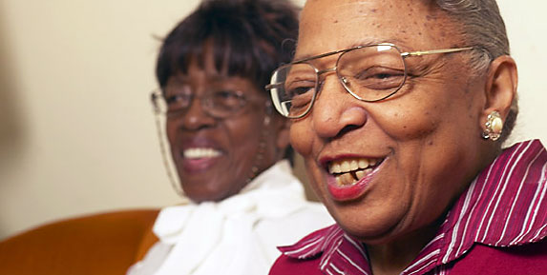
AT for Daily Activities – Seniors and Independent Living
Low-tech
Reacher
Non-slip material
Lever handles
Slide or toggle switches
Utensils with easy-grip handles
Mirror mounted over the range
High-tech
Clapper
Universal remote control
Home automation systems
Environmental control systems
Screen magnification software

Slide 20
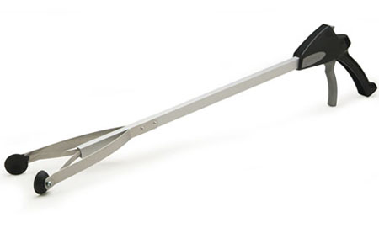
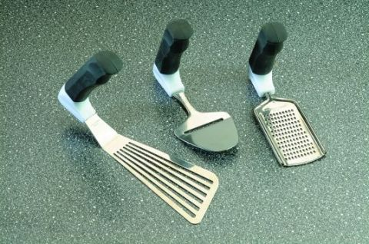
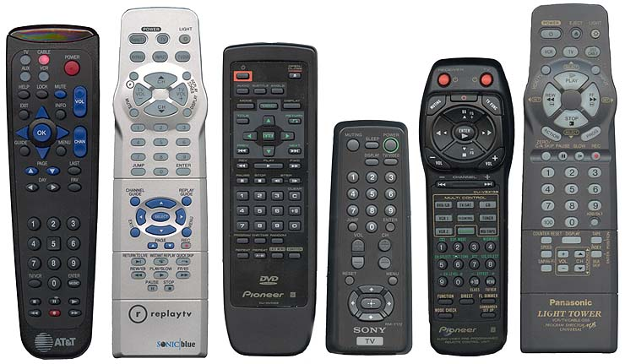
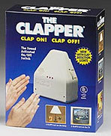
AT for Daily Activities – Seniors and independent living

Slide 21
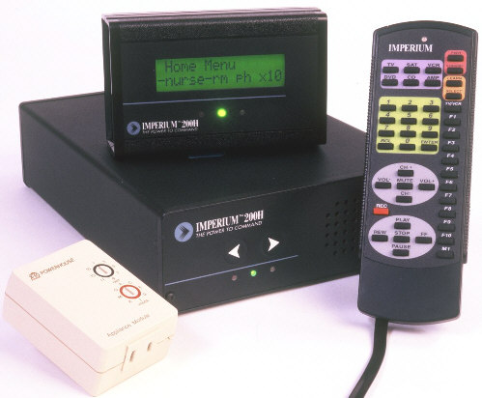
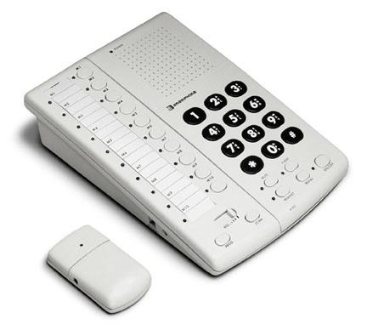

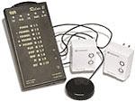
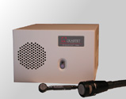
AT in the Home: More Environmental Control Systems

Slide 22
Transportation assistance. Devices for elderly individuals that make it easier for them to get into and out of their cars or trucks and drive more safely, such as adjustable mirrors, seats, and steering wheels. Services that help the elderly maintain and register their vehicles, such as a drive-up window at the department of motor vehicles, would also fall into this category.

Slide 23
Assistive devices and technology can help our elders people to AGE Gracefully and live independently
Thank you!

