Slide 1
NEP- Equity and Inclusion in Higher Education
By
Dr.M.Prabavathy
Director
Centre for Differently Abled Persons
Bharathidasan University, Tiruchirappalli,
Tamil Nadu
cdapraba@bdu.ac.in

Slide 2
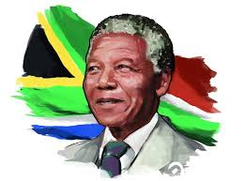
What is the need of NEP-2020
The famous statement of Nelson Mandela is displayed at the entrance of the University of South Africa thus:
"Destroying any nation does not require the use of atomic bombs or the use of long-range missiles. It only requires lowering the quality of education and allowing cheating in the examinations by the students."

Slide 3
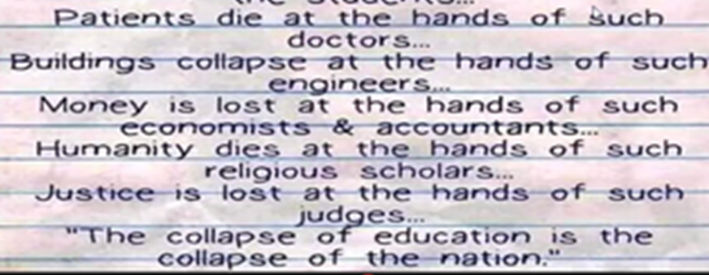
IMPORTANCE OF EDUCATION

Slide 4
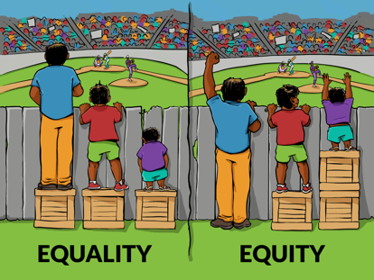

Slide 5
Educational equity is when educators provide all students with the high-quality instruction and support they need to reach and exceed a common standard.
Equity focuses on outcomes for students.

Slide 6
Equity in education demands that we provide the same high expectations for all students, regardless of their
gender,
Ability/disability ,
ethnicity, and
socio-economic background.

Slide 7
Equality suggests providing every student with the same experience.
Equity means working to overcome the historical legacy of discrimination, marginalization, and underinvestment that disadvantages specific groups of people, especially students with disabilties.
Equity requires providing support tailored to the specific needs of students.

Slide 8

Children Who Learn Together Learn To Live Together

Slide 9


EQUITABLE AND INCLUSIVE EDUCATIO
Means
All for Learners For All Learners
If the mission is
Education for all
The goal is
To include all

Slide 10
NEP Emphasizes:
Every citizen has the opportunity to
dream, thrive and contribute to the Nation
Based on:
Human Rights Approach
Aims at:
Creating an inclusive culture Achieving an inclusive society
EQUITABLE AND INCLUSIVE EDUCATION: LEARNING FOR ALL
NEP 2020

Slide 11
GAP VERTICALS
Access
Participation
Learning Outcomes
Participation of SEDGs in schooling process
Discrepant expected and acceptable learning outcomes
Physical
access
Infrastructural access
Learning
access

Slide 12





BRIDGING THE GAP
Learning Outcomes
Access
Removal of
Based on:
individual capacities, needs and learning preferences
Using :
Differentiated instruction and assessment
Competency based continuous assessment
Infrastructural barriers
Attitudinal barriers
Learning barriers
Building school communities, developing school clusters
Participation
Make learning meaningful,
relevant,
age and level
appropriate
Adopting Universal Design of Learning
6

Slide 13
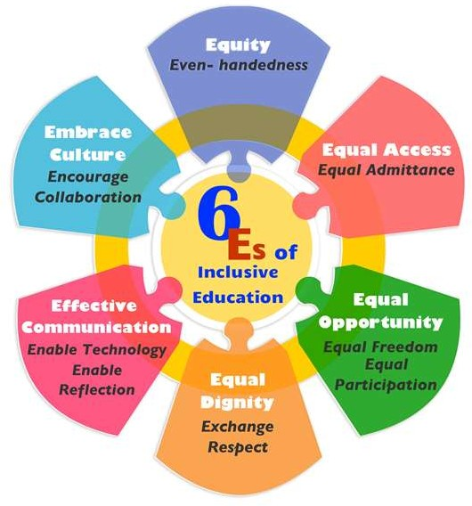
6 ES OF INCLUSIVE EDUCATION

Slide 14

5 Rs of Inclusion
Reach Right
Responsibility Relationship Respect

Slide 15
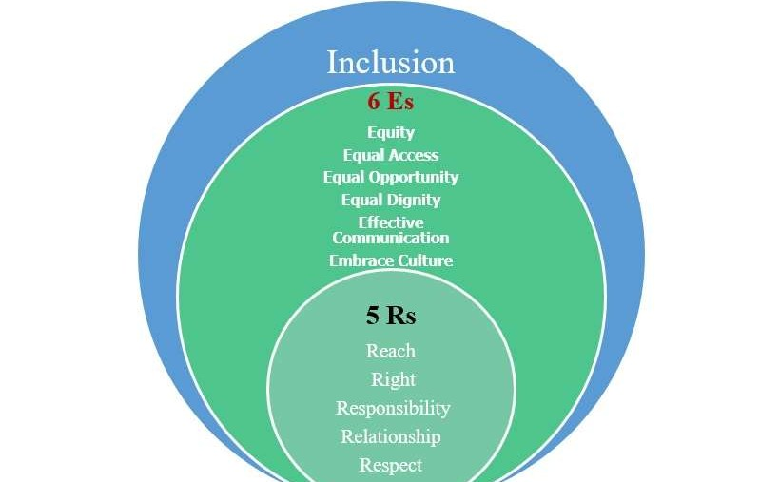
₉

Slide 16
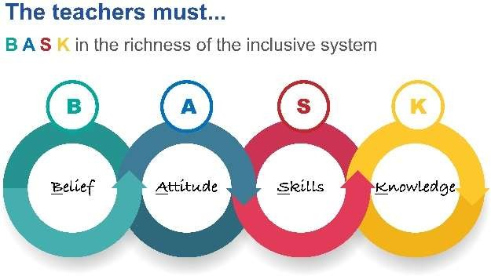
10

Slide 17
◾
Diversity in terms of :
ADDRESSING DIVERSE NEEDS OF LEARNERS
Physical Needs
Academic Needs
Psycho-social Needs
17

Slide 18
PEDAGOGICAL CONCERNS
Differentiation in curricular planning and instruction
Curriculum adaptation
Experiential learning
Flexible child -centered teaching- learning strategies
Competency based learning outcomes & assessment
Continuous Assessment ‘AS’, ‘For’ and ‘Of” learning.
18

Slide 19
All mainstream schools to become capable of educating all children in their local communities
Barrier free access of education for all children across the stages
Address diverse needs of learners in all school activities including Art, Sports and Vocational training
Provide quality education to all learners through assistive devices, technology- based tools, appropriate teaching – learning materials.
Eliminate social exclusion that is a consequence of attitudes and responses to diversity in race, social class, ethnicity, language, gender and ability
CHALLENGES AND OPPORTUNITIES
19

Slide 20
CONTD…
CHALLENGES AND OPPORTUNITIES
Develop teacher competencies and skills
Develop evidence- based practices that “measure what we value” rather than “valuing what we can measure”
Create a system of teaching and learning that is competency based instead of content based
Create an educational culture of collaboration that encourages and supports problem solving
Establish school clusters to develop consensus around inclusive values within school communities
20

Slide 21
CONTD…
CHALLENGES & OPPORTUNITIES
Provide inclusive curriculum that is value oriented and responsive to cultural and linguistic diversity
Create learning environment that embraces diversity- a positive environment that responds to the needs of learners beyond academics
Create Inclusive school culture with the support of trained inclusive
teachers, social workers and counsellors
21

Slide 22
TO ACHIEVE INCLUSION & EQUITY
We need to:
work together
collaborate with each other
tolerate others
because –
“None of us is as smart as all of us.”
Johnson & Johnson

Slide 23
Fundamental Principles of the Policy
Sensitize Teachers and Parents
STUDENTS
Holistic development
Recognize
Identify
Foster
Multi-disciplinary
flexibility
Education is a public service; access to quality education must be considered a basic right of every child;

Slide 24
no hard separations between arts and sciences, between curricular and extra-curricular activities, between vocational and academic streams, etc. in order to eliminate harmful hierarchies among, and silos between different areas of learning.
multidisciplinary and a holistic education across the sciences, social sciences, arts, humanities, and sports for a multidisciplinary world in order to ensure the unity and integrity of all knowledge;
emphasis on conceptual understanding rather than rote learning and learning-for-exams.;
creativity and critical thinking to encourage logical decision-making and innovation;
Fundamental Principles of the Policy

Slide 25
ethics and human & Constitutional values like empathy, respect for others, cleanliness, courtesy, democratic spirit, spirit of service, respect for public property, scientific temper, liberty, responsibility, pluralism, equality, and justice;
promoting multilingualism and the power of language in teaching and learning;
life skills such as communication, cooperation, teamwork, and resilience;
focus on regular formative assessment for learning rather than the summative assessment that encourages today’s ‘coaching culture’;

Slide 26
extensive use of technology in teaching and learning, removing language barriers, increasing access for Divyang students, and educational planning and management;
respect for diversity and respect for the local context in all curriculum, pedagogy, and policy, always keeping in mind that education is a concurrent subject;
full equity and inclusion as the cornerstone of all educational decisions to ensure that all students are able to thrive in the education system;
synergy in curriculum across all levels of education from early childhood care and education to school education to higher education;

Slide 27
teachers and faculty as the heart of the learning process – their recruitment, continuous professional development, positive working environments and service conditions;
a ‘light but tight’ regulatory framework to ensure integrity, transparency, and resource efficiency of the educational system through audit and public disclosure while encouraging innovation and out-of-the-box ideas through autonomy, good governance, and empowerment;
outstanding research as a corequisite for outstanding education and development;

Slide 28
EQUITY AND INCLUSION IN HIGHER EDUCATION
Actions that are specific to higher education shall be adopted by all Governments and HEIs.
Steps to be taken by Governments
(a) Earmark suitable Government funds for the education of SEDGs
(b) Set clear targets for higher GER for SEDGs
(c) Enhance gender balance in admissions to HEIs
(d) Enhance access by establishing more high-quality HEIs in aspirational districts and Special Education Zones
(e) Develop and support high-quality HEIs that teach in local/Indian languages or bilingually
(f) Provide more financial assistance and scholarships to SEDGs in both public and private HEIs
(g) Conduct outreach programs on higher education opportunities and scholarships among SEDGs
(h) Develop and support technology tools for better participation and learning outcomes

Slide 29
Student Diversity and Inclusive Education
India's Higher education (HE) sector has experienced massive expansion to become the second-largest system in the world.
The growth is accompanied by increasing student diversity in the industry.
Student diversity is reflected in terms of an increasing share of students from socially and economically disadvantaged groups.
According to MoE (2020), nearly 57 percent of students come from disadvantaged groups.

Slide 30
Sub-theme I
Understanding Diversity
LEARNER-CENTERED PEDAGOGICAL PRACTICES
Pedagogy - Teacher Centric vs. Learner Centric Methods - Learner Centric Methods; Discussions, Group Work, Tutorials, Practical Exercises, Project Work, and Field Experiences.

Slide 31
Sub-theme II
Linking Diversity to Inclusion
DEVELOPING ANALYTICAL SKILLS AMONG STUDENTS
Information and Knowledge - Information Procession - Knowledge Transmission vs. Knowledge Construction - Inculcating Critical and Analytical Thinking Skills - Developing Creativity.

Slide 32
Sub-theme III
Teacher Competencies towards Diversity & Inclusion
MINIMIZING ACHIEVEMENT GAPS AMONG STUDENTS
Individual Differences; Physical, Cognitive, Social and Emotional Development - Diversified Needs of Students - Inclusive Education.
Session III Technological Tools for Supporting Teachers & Students

Slide 33
Sub-theme IV
Technological Tools for Supporting Teachers & Students
TECHNOLOGICAL PEDAGOGICAL CONTENT KNOWLEDGE
Education 4.0 - Pedagogical Content Knowledge - Technological Pedagogical Content Knowledge.
Session V: Supporting Individual Students

Slide 34
Sub-theme V
Supporting Individual Students
MENTORING OF STUDENTS
Mentor-Mentee System - Mentor-Mentee Rapport - Remedial Teaching - Positive Attitudinal Development.

Slide 35


