Slide 1
Need of Life skills and quality of Life of CHILDREN WITH
DISABILTIES
Dr.M.Prabavathy
Director
Centre for Differently Abled Persons
Bharathidasan University
Tiruchirappalli
cdapraba@bdu.ac.in

Slide 2
Developmental disabilities are a group of conditions due to an impairment in physical, learning, language, or behavior areas
Developmental disability is the broad term used to describe a range of conditions that affect physical and/or mental functioning.

Slide 3
Life skills may be directed toward personal actions or actions toward others, as well as toward actions to change the surrounding environment to make it conducive to health.” according to World Health Organization (WHO).
As per UNICEF, life skills are defined as “a behavior change or behavior development approach designed to address a balance of three areas: knowledge, attitude, and skills

Slide 4
Basic Life Skills curriculum
Emotional
LSC
Social
Intellectual
Success in life

Slide 5
Why Is Basic Life Skills Important?
The Basic Life skills provides readily available tools to deal with challenges/demands of daily lives the youth face, from managing their emotions to make an informed decision.
It also helps develop children’s personality, talents, and mental and physical abilities, and realize their true potential through learning to know oneself and others, and make effective decisions to live harmonically together in the society.

Slide 6
The Education for All (2000) included life skills among the essential learning tool for survival, capacity development and quality life
It also documented that all young people and adults have the “human right to benefit from an education that includes learning to know, to do, to live together.” recognizing the importance of living together as much as acquiring knowledge from an academic environment.

Slide 7
Life skills are behaviors that enable individuals to adapt and deal effectively with the demands and challenges of life. There are many such skills, but 10 core life skills laid down by WHO are:
Self-awareness
Empathy
Critical thinking
Creative thinking
Decision making
Problem Solving
Effective communication
Interpersonal relationship
Coping with stress
Coping with emotions

Slide 8
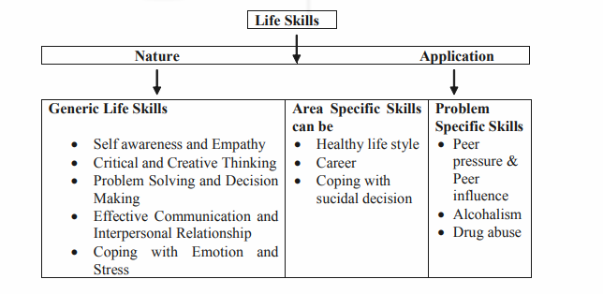

Slide 9
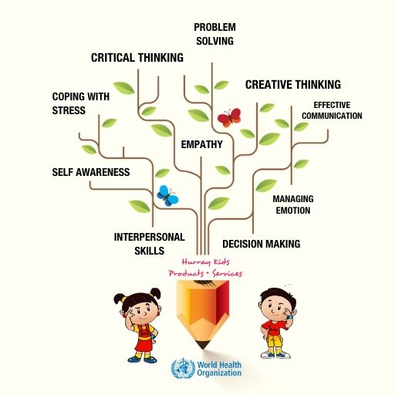
Life Skills for Special Needs Children
Life skills

Slide 10
Life skills for Children with Disabilities
Personal hygiene Communication Social skills Actions related to cooking Creative thinking Food preparation Household skills Improving community skills | Occupational skills Problem solving Basic Maths Basic Reading Community Living Coping with emotions Financial literacy

Slide 11
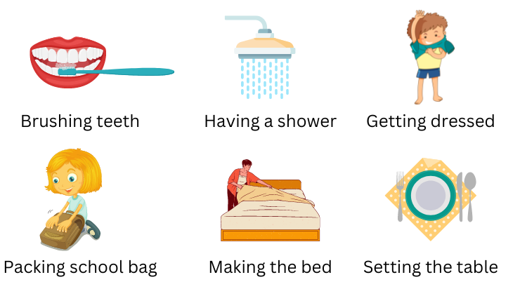

Slide 12
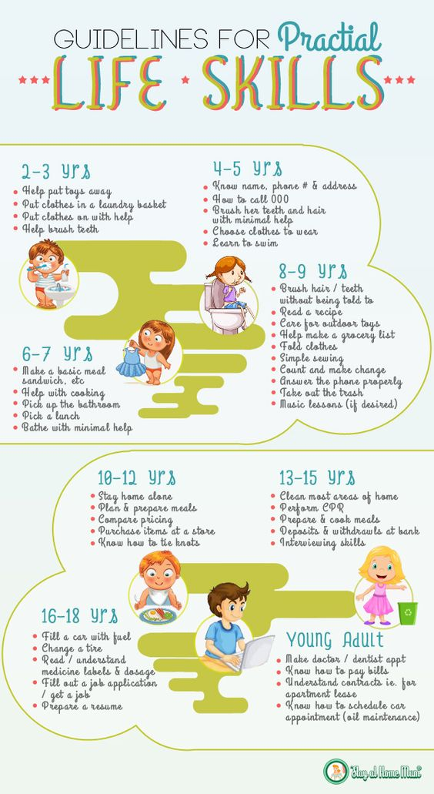

Slide 14
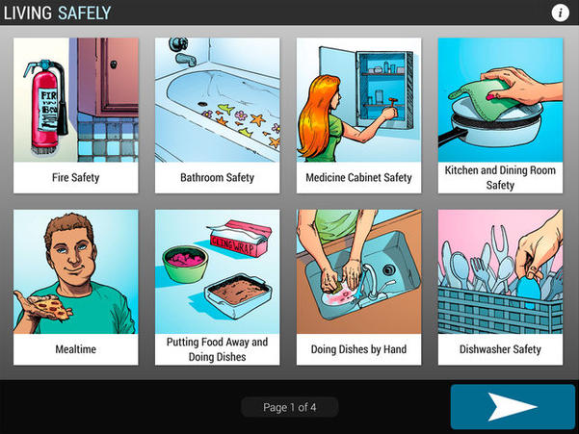

Slide 15
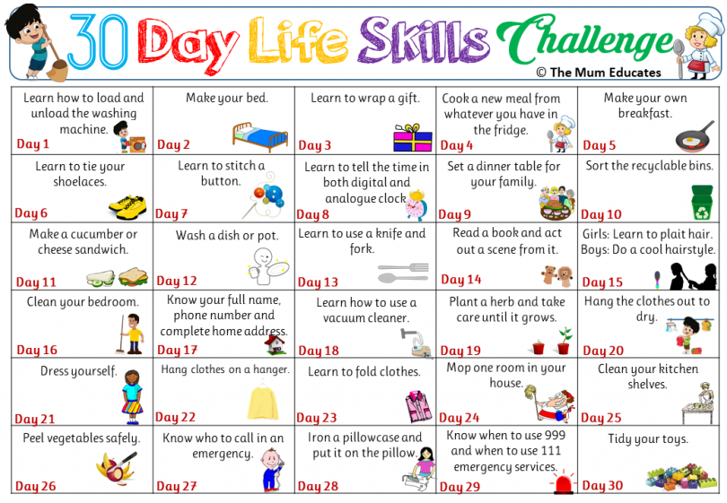

Slide 16
Thank you

