Slide 1

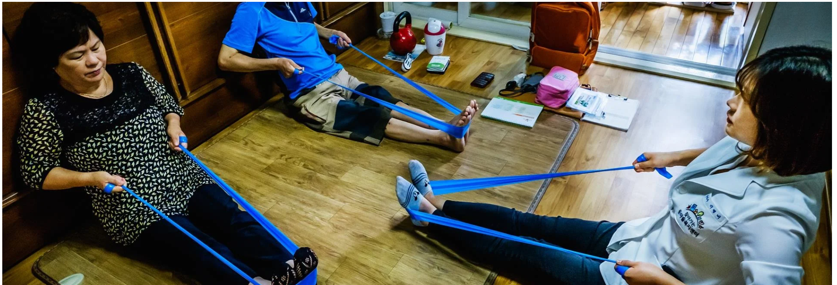
Introduction to
Rehabilitation Social Work
By
Dr.M.Prabavathy
Director
Centre for Differently Abled Persons
Bharathidasan University
Tamil Nadu,India
cdapraba@bdu.ac.in

Slide 2
Introduction
Rehabilitation is defined as “a set of interventions designed to optimize functioning and reduce disability in individuals with health conditions in interaction with their environment”.
Put simply, rehabilitation helps a child, adult or older person to be as independent as possible in everyday activities and enables participation in education, work, recreation and meaningful life roles such as taking care of family.
Rehabilitation is highly person-centred, meaning that the interventions selected for each individual are targeted to their goals and preferences.

Slide 3

Preface
Rehabilitation social work is a vital field that helps individuals with physical, mental, or emotional challenges overcome barriers and achieve their full potential.
By providing holistic support and connecting clients to community resources, rehabilitation social workers empower their clients to lead independent, fulfilling lives.

Slide 4
Misconceptions about rehabilitation
Rehabilitation is not only for people with disabilities or long-term or physical impairments. Rather, rehabilitation is an essential health service for anyone with an acute or chronic health condition, impairment or injury that limits functioning, and as such should be available for anyone who needs it.
Rehabilitation is not a luxury health service that is available only for those who can afford it. Nor is it an optional service to try only when other interventions to prevent or cure a health condition fail.
For the full extent of the social, economic and health benefits of rehabilitation to be realized, timely, high quality and affordable rehabilitation interventions should be available to all.
In many cases, this means starting rehabilitation as soon as a health condition is noted and continuing to deliver rehabilitation alongside other health interventions.

Slide 5
Unmet global need for rehabilitation
Global rehabilitation needs continue to be unmet due to multiple factors, including:
lack of prioritization, funding, policies, and plans for rehabilitation at a national level;
lack of available rehabilitation services outside urban areas, and long waiting times;
high out-of-pocket expenses and non-existent or inadequate means of funding;
lack of trained rehabilitation professionals, with less than 10 skilled practitioners per 1 million population in many low- and middle-income settings;
lack of resources, including assistive technology, equipment, and consumables;
the need for more research and data on rehabilitation; and
ineffective and under-utilized referral pathways to rehabilitation.

Slide 6
Globally, 1 in 3 people may benefit from rehabilitation
The Rehabilitation 2030 initiative draws attention to the profound unmet need for rehabilitation worldwide and highlights the importance of strengthening health systems to provide rehabilitation. The initiative marks a new strategic approach for the global rehabilitation community by emphasizing that:
Rehabilitation should be available for all the population and through all stages of the life course.
Efforts to strengthen rehabilitation should be directed towards supporting the health system and integrating rehabilitation into all levels of health care.
Rehabilitation is an essential health service and crucial for achieving universal health coverage.
With ageing populations and an increase in the number of people living with chronic disease, rehabilitation is a priority health strategy for the 21st century that uniquely contributes to optimizing population functioning.

Slide 7
The Rehabilitation 2030 initiative was launched in February 2017 and introduced a “call for action,” rallying stakeholders towards concerted and coordinated global actions to scale up rehabilitation. To achieve this, 10 priority areas for action were identified:
Creating strong leadership and political support for rehabilitation at subnational, national and global levels.
Strengthening rehabilitation planning and implementation at national and subnational levels, including within emergency preparedness and response.
Improving integration of rehabilitation into the health sector and strengthening intersectoral links to effectively and efficiently meet population needs.
Incorporating rehabilitation in universal health coverage.
Building comprehensive rehabilitation service delivery models to progressively achieve equitable access to quality services, including assistive products, for all the population, including those in rural and remote areas.
Developing a strong multidisciplinary rehabilitation workforce that is suitable for country context, and promoting rehabilitation concepts across all health workforce education.
Expanding financing for rehabilitation through appropriate mechanisms.
Collecting information relevant to rehabilitation to enhance health information systems including system level rehabilitation data and information on functioning utilizing the International Classification of Functioning, Disability and Health (ICF).
Building research capacity and expanding the availability of robust evidence for rehabilitation.
Establishing and strengthening networks and partnerships in rehabilitation, particularly between low-, middle- and high-income countries.

Slide 8

Understanding the Rehabilitation Process
1
Assessment
Comprehensive evaluation of the client's strengths, limitations, and goals to develop a personalized rehabilitation plan.
2
Intervention
Implementation of therapeutic services, counseling, and skill-building activities to address the client's specific needs.
3
Monitoring
Continuous evaluation of the client's progress and adjustment of the rehabilitation plan as needed.

Slide 9

Assessing Client Needs
Physical Needs
Identifying and addressing physical limitations, such as mobility, self-care, and accessibility issues.
Cognitive Needs
Evaluating cognitive abilities, including memory, problem-solving, and decision-making skills.
Emotional Needs
Addressing psychological and emotional challenges, such as depression, anxiety, or trauma.
Social Needs
Promoting social integration, community involvement, and support systems.

Slide 10
Developing Individualized Care Plans
Goal Setting
Intervention Strategies
Ongoing Evaluation
Collaborating with the client to establish realistic, measurable goals that align with their needs and aspirations.
Designing a comprehensive plan that incorporates various therapeutic approaches, skills training, and community resources.
Regularly reviewing and adjusting the care plan to ensure it remains effective and responsive to the client's evolving needs.

Slide 11

Facilitating Access to Community Resources
1
Housing Assistance
2
Employment Services
Connecting clients with affordable and accessible housing options, including supported living arrangements.
Helping clients explore job opportunities, develop job-seeking skills, and secure employment that aligns with their abilities.
3
Educational Programs
4
Healthcare Coordination
Linking clients to educational resources, such as vocational training or continuing education, to enhance their skills and knowledge.
Coordinating with healthcare providers to ensure clients have access to necessary medical, therapeutic, and mental health services.

Slide 12





Advocating for Client Rights and Empowerment
Empowerment
Empowering clients to make informed decisions, exercise their rights, and actively participate in their rehabilitation process.
Legal Advocacy
Ensuring clients have access to legal resources and advocating for their rights, such as fair housing, employment, or disability benefits.
Accessibility
Promoting accessibility and removing barriers to enable clients to fully participate in their communities.
Support Systems
Fostering support networks and community connections to enhance clients' social integration and independence.

Slide 13




Collaborating with Interdisciplinary Teams
Coordinated Care
Information Sharing
Shared Decision-Making
Working closely with physicians, therapists, counselors, and other professionals to ensure a comprehensive, integrated approach to rehabilitation.
Facilitating the exchange of client information and progress updates among team members to optimize treatment and support.
Collaborating with the team to make informed decisions that prioritize the client's needs, goals, and preferences.

Slide 14
Addressing Psychosocial Challenges
Emotional Support
Family Involvement
Community Integration
Providing counseling and therapeutic interventions to help clients cope with the emotional and psychological impact of their condition.
Engaging family members and caregivers to provide emotional and practical support, as well as to address any family-related issues.
Facilitating clients' social and community involvement to reduce isolation, build support networks, and promote overall well-being.

Slide 15

Promoting Independence and Self-Sufficiency
1
Skills Training
Helping clients develop practical, independent living skills, such as personal care, financial management, and task completion.
2
Adaptive Technology
Introducing and training clients on assistive devices and technology to enhance their independence and participation in daily activities.
3
Transition Planning
Collaborating with clients to create a comprehensive plan for transitioning back into the community, including employment, housing, and support systems.

Slide 16

Measuring Outcomes and Evaluating Interventions
Functional Improvement
Measurable gains in the client's physical, cognitive, and daily living skills.
Quality of Life
Positive changes in the client's overall well-being, including emotional, social, and psychological factors.
Community Integration
Successful reintegration and participation in the client's community, such as employment, education, or social activities.
Client Satisfaction
Positive feedback and engagement from the client regarding the rehabilitation services and their overall experience.

Slide 17


