Slide 1

Emerging Paradigms for promoting Inclusion
Dr.M.Prabavathy
Director
Centre for Differently Abled Persons
Bharathidasan University
cdapraba@bdu.ac.in, 7200004044

Slide 2

No society can surely be flourishing and happy,
of which the far greater part of the members are poor and miserable.” (Adam Smith)“

Slide 3

“All human beings are born free and equal in dignity and rights”
The Universal Declaration of Human Rights
The aim of human rights instruments is the protection of those vulnerable to violations of their fundamental human rights.

Slide 4
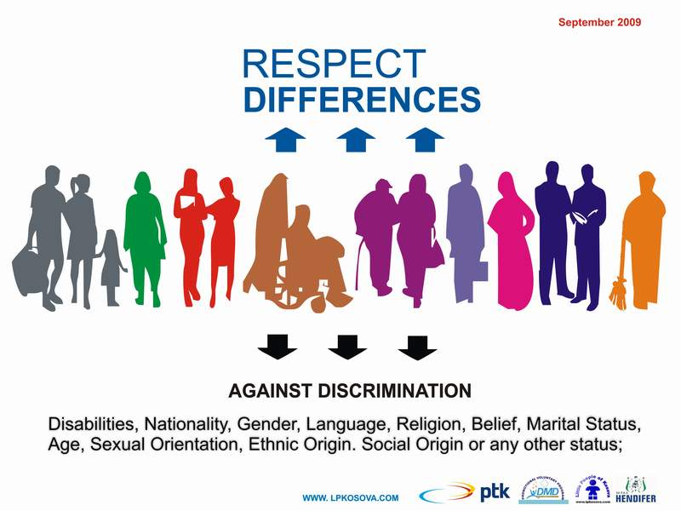

Slide 5


Slide 6


Slide 7
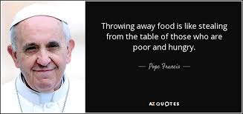

Slide 8


Slide 9

Definition of Inclusive Practices
“Inclusive Practices are academic and behavioral supports and strategies provided to students with disabilities in general education settings.”

Slide 10
THE 3 As of inclusion
ACCESS
ACCOMMODATIONS
ACCOUNTABILITY

Slide 11

Research
Inclusive practices more effective when combined with broader educational reform and restructuring.
Inclusive practices more effective in schools where general education teachers are routinely implementing differentiated instructional strategies.

Slide 12

Goal of Inclusive Practices
Improve outcomes for students with disabilities through implementation of appropriate academic and behavioral supports.

Slide 13

“Inclusion”…. what is it?
A philosophy, a foundation
A process
Equity and equality of opportunity

Slide 14

“Inclusion”….what it isn’t?
Sacrificing needs of general education students
Dumping SWD in general education settings
Watering down the curriculum

Slide 15

When implemented appropriately and responsibly, ‘inclusion’ will meet the needs of all students.

Slide 16

Philosophy of ‘Inclusion’
Shifting paradigms…
Not focusing on the labels of students
Special education teachers identifying themselves as teachers of all students
General education teachers identifying themselves as teachers of all students
SWD identified as students with IEPs

Slide 17

Research
Increased academic and behavior gains
Improved performance on standardized tests
Mastery of IEP goals
Improved class work
Improved report card grades
Increased on-task behavior
Better motivation to learn

Slide 18
Pedagogical Equity & Inclusive Teaching

Slide 19

Teacher Benefits
Being able to share responsibility for improved student outcomes with other teachers
Teachers have more time for explicit teaching and creative lesson plan design and delivery
More opportunities for professional growth

Slide 20

Student Benefits
Placement
Exposed to higher expectations
Increased opportunities for positive social interactions

Slide 21

Collaborative Support Models for Inclusive Practices
Co-teaching Support Model
Consultant Support Model
Paraeducator Support Model

Slide 22


Co-teaching Support Model
As defined by Friend and Cook (2010)…
Co-teaching is a service delivery option for providing special education or related services to students with disabilities or other special needs students while they remain in their general education classes.
Two or more professionals jointly deliver meaningful instruction to a diverse, blended group of students in a single physical space.

Slide 23
Co-taught classrooms….
SpEd teacher partners with GenEd teacher
Shared responsibility for instruction
Jointly planned lessons and lesson delivery styles
Use of a combination of 6 co-teaching approaches
Shared responsibility for assessments
Shared responsibility for parent communication

Slide 24

Consultant Support Model
SpEd teacher provides guidance to GenEd teacher
Adapts lessons
Identifies accommodations and strategies
Modifies materials
Provides alternative assessments
Designs behavior management systems

Slide 25

Paraeducator Support Model
Supports SWD in general education settings
Works under direction of GenEd teacher and guidance of SpEd teacher
Supervises activities introduced by GenEd teacher
Helps implement accommodations
Helps implement behavior intervention plans
Helps collect instructional or behavioral data

Slide 26
Para Supports, cont’d…..
Primary focus is on SpEd students
May provide some support to GenEd students
Primary beneficiary of services and staff paid for with IDEA funds must be SWD
Incidental benefits for other students

Slide 27
Collaborative Support Models
Co-teaching Support Model
Consultant Support Model
Paraeducator Support Model
All are effective
Research emphasizes co-teaching

Slide 28
2 Phases
Planning
Implementation

Slide 29
Phase 1: PLANNING
Occurs at several levels
Essential to effective inclusive practices
All staff involved and sharing responsibilities
On-going communication

Slide 30

Leadership
Strong administrative support is critical
Site leaders are pivotal
Truly believe “all students can learn”
Actions speak louder than words
“Walk the walk, talk the talk”
Inspire and empower teachers to achieve great things for students
Be creative…“think outside the box”

Slide 31
Phase 3: IMPLEMENTATION
Inclusive Practices Leadership Team
Staff awareness and willingness
On-going support to staff
Parents and peer group
Monitoring system

Slide 32
Action Planning
Long range goal(s)
Short range objectives
Specific activities
Responsible parties
Leadership team function
Obstacles and challenges
Solutions to obstacles and challenges

Slide 33
Implementation Matrix
Identify major components
E.g., Organizational Structure, Collaborative Support Models, Co-teaching Approaches, Professional Development, and Collaboration
Identify maximum level of implementation , satisfactory or emerging level of implementation and unsatisfactory level of implementation

Slide 34
Component: Collaborative Support Models
Maximum Level of Implementation | Emerging/Satisfactory Level of Implementation | Unsatisfactory Level of Implementation
All 3 Collaborative Support Models are utilized throughout the curriculum in a variety of classes based on student support needs. | The Consultant and Paraeducator Support Models are used throughout the curriculum and the Co-teaching model is used sometimes. | None of the Collaborative Support Models are used or only the Consultant Support Model.

Slide 35
Implementation Matrix
Allows districts and schools to determine their current level of implementation using a scale based on Maximum, Satisfactory or Unsatisfactory levels of implementation
Allows districts and schools to assess how well they are implementing inclusive practices

Slide 36

Phase 3: RESULTS
The quality of implementation of inclusive practices determines the outcomes that will be evidenced.

Slide 37
Appropriate and responsible implementation of Inclusive Practices results in improved outcomes for all students.
Challenges “one-size fits all” approach

Slide 38
“Achieving real and lasting change requires that everyone
stops, thinks, and works together to make the kinds of changes that need to occur.”

Slide 39


