Slide 1
Semantic web
D. AKILANDESWARI
Guest Faculty
School of Computer Science, Engineering & Applications
Bharathidasan University
Trichy-23

Slide 2
XML Schema
Significantly richer language for defining the structure of XML documents
Tts syntax is based on XML itself
not necessary to write separate tools
Reuse and refinement of schemas
Expand or delete already existent schemas
Sophisticated set of data types, compared to DTDs (which only supports strings)

Slide 3
XML Schema (2)
An XML schema is an element with an opening tag like
<schema "http://www.w3.org/2000/10/XMLSchema"
version="1.0">
Structure of schema elements
Element and attribute types using data types

Slide 4
Element Types
<element name="email"/>
<element name="head" minOccurs="1" maxOccurs="1"/>
<element name="to" minOccurs="1"/>
Cardinality constraints:
minOccurs="x" (default value 1)
maxOccurs="x" (default value 1)
Generalizations of *,?,+ offered by DTDs

Slide 5
Attribute Types
<attribute name="id" type="ID“ use="required"/>
< attribute name="speaks" type="Language"
use="default" value="en"/>
Existence: use="x", where x may be optional or required
Default value: use="x" value="...", where x may be default or fixed

Slide 6
Data Types
There is a variety of built-in data types
Numerical data types: integer, Short etc.
String types: string, ID, IDREF, CDATA etc.
Date and time data types: time, Month etc.
There are also user-defined data types
simple data types, which cannot use elements or attributes
complex data types, which can use these

Slide 7
Data Types (2)
Complex data types are defined from already existing data types by defining some attributes (if any) and using:
sequence, a sequence of existing data type elements (order is important)
all, a collection of elements that must appear (order is not important)
choice, a collection of elements, of which one will be chosen

Slide 8
A Data Type Example
<complexType name="lecturerType">
<sequence>
<element name="firstname" type="string"
minOccurs="0“ maxOccurs="unbounded"/>
<element name="lastname" type="string"/>
</sequence>
<attribute name="title" type="string" use="optional"/>
</complexType>

Slide 9
Data Type Extension
Already existing data types can be extended by new elements or attributes. Example:
<complexType name="extendedLecturerType">
<extension base="lecturerType">
<sequence>
<element name="email" type="string"
minOccurs="0" maxOccurs="1"/>
</sequence>
<attribute name="rank" type="string" use="required"/>
</extension>
</complexType>

Slide 10
Resulting Data Type
<complexType name="extendedLecturerType">
<sequence>
<element name="firstname" type="string"
minOccurs="0" maxOccurs="unbounded"/>
<element name="lastname" type="string"/>
<element name="email" type="string"
minOccurs="0" maxOccurs="1"/>
</sequence>
<attribute name="title" type="string" use="optional"/>
<attribute name="rank" type="string" use="required"/>
</complexType>

Slide 11
Data Type Extension (2)
A hierarchical relationship exists between the original and the extended type
Instances of the extended type are also instances of the original type
They may contain additional information, but neither less information, nor information of the wrong type

Slide 12
Data Type Restriction
An existing data type may be restricted by adding constraints on certain values
Restriction is not the opposite from extension
Restriction is not achieved by deleting elements or attributes
The following hierarchical relationship still holds:
Instances of the restricted type are also instances of the original type
They satisfy at least the constraints of the original type

Slide 13
Example of Data Type Restriction
<complexType name="restrictedLecturerType">
<restriction base="lecturerType">
<sequence>
<element name="firstname" type="string"
minOccurs="1" maxOccurs="2"/>
</sequence>
<attribute name="title" type="string"
use="required"/>
</restriction>
</complexType>

Slide 14
Restriction of Simple Data Types
<simpleType name="dayOfMonth">
<restriction base="integer">
<minInclusive value="1"/>
<maxInclusive value="31"/>
</restriction>
</simpleType>

Slide 15
Data Type Restriction: Enumeration
<simpleType name="dayOfWeek">
<restriction base="string">
<enumeration value="Mon"/>
<enumeration value="Tue"/>
<enumeration value="Wed"/>
<enumeration value="Thu"/>
<enumeration value="Fri"/>
<enumeration value="Sat"/>
<enumeration value="Sun"/>
</restriction>
</simpleType>

Slide 16
XML Schema: The Email Example
<element name="email" type="emailType"/>
<complexType name="emailType">
<sequence>
<element name="head" type="headType"/>
<element name="body" type="bodyType"/>
</sequence>
</complexType>

Slide 17
XML Schema: The Email Example (2)
<complexType name="headType">
<sequence>
<element name="from" type="nameAddress"/>
<element name="to" type="nameAddress"
minOccurs="1" maxOccurs="unbounded"/>
<element name="cc" type="nameAddress"
minOccurs="0" maxOccurs="unbounded"/>
<element name="subject" type="string"/>
</sequence>
</complexType>

Slide 18
XML Schema: The Email Example (3)
<complexType name="nameAddress">
<attribute name="name" type="string" use="optional"/>
<attribute name="address" type="string" use="required"/>
</complexType>
Similar for bodyType

Slide 19
Namespaces
An XML document may use more than one DTD or schema
Since each structuring document was developed independently, name clashes may appear
The solution is to use a different prefix for each DTD or schema
prefix:name

Slide 20
An Example
<vu:instructors xmlns:vu="http://www.vu.com/empDTD"
xmlns:gu="http://www.gu.au/empDTD"
xmlns:uky="http://www.uky.edu/empDTD">
<uky:faculty uky:title="assistant professor"
uky:name="John Smith"
uky:department="Computer Science"/>
<gu:academicStaff gu:title="lecturer"
gu:name="Mate Jones"
gu:school="Information Technology"/>
</vu:instructors>

Slide 21
Namespace Declarations
Namespaces are declared within an element and can be used in that element and any of its children (elements and attributes)
A namespace declaration has the form:
xmlns:prefix="location"
location is the address of the DTD or schema
If a prefix is not specified: xmlns="location" then the location is used by default

Slide 22
Addressing and Querying XML Documents
In relational databases, parts of a database can be selected and retrieved using SQL
Same necessary for XML documents
Query languages: XQuery, XQL, XML-QL
The central concept of XML query languages is a path expression
Specifies how a node or a set of nodes, in the tree representation of the XML document can be reached

Slide 23
XPath
XPath is core for XML query languages
Language for addressing parts of an XML document.
It operates on the tree data model of XML
It has a non-XML syntax

Slide 24
Types of Path Expressions
Absolute (starting at the root of the tree)
Syntactically they begin with the symbol /
It refers to the root of the document (situated one level above the root element of the document)
Relative to a context node

Slide 25
An XML Example
<library location="Bremen">
<author name="Henry Wise">
<book title="Artificial Intelligence"/>
<book title="Modern Web Services"/>
<book title="Theory of Computation"/>
</author>
<author name="William Smart">
<book title="Artificial Intelligence"/>
</author>
<author name="Cynthia Singleton">
<book title="The Semantic Web"/>
<book title="Browser Technology Revised"/>
</author>
</library>

Slide 26
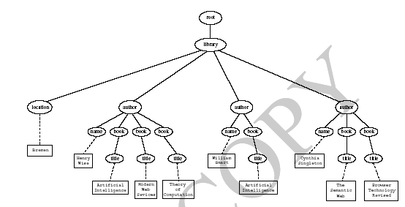
Tree Representation

Slide 27
Examples of Path Expressions in XPath
Address all author elements
/library/author
Addresses all author elements that are children of the library element node, which resides immediately below the root
/t1/.../tn, where each ti+1 is a child node of ti, is a path through the tree representation

Slide 28
Examples of Path Expressions in XPath (2)
Address all author elements
//author
Here // says that we should consider all elements in the document and check whether they are of type author
This path expression addresses all author elements anywhere in the document

Slide 29
Examples of Path Expressions in XPath (3)
Address the location attribute nodes within library element nodes
/library/@location
The symbol @ is used to denote attribute nodes

Slide 30
Examples of Path Expressions in XPath (4)
Address all title attribute nodes within book elements anywhere in the document, which have the value “Artificial Intelligence”
//book/@title="Artificial Intelligence"

Slide 31
Examples of Path Expressions in XPath (5)
Address all books with title “Artificial Intelligence”
/book[@title="Artificial Intelligence"]
Test within square brackets: a filter expression
It restricts the set of addressed nodes.
Difference with query 4.
Query 5 addresses book elements, the title of which satisfies a certain condition.
Query 4 collects title attribute nodes of book elements

Slide 32
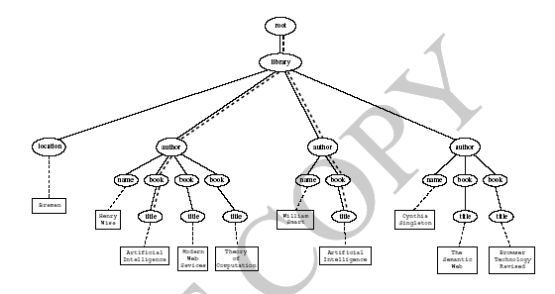
Tree Representation of Query 4

Slide 33
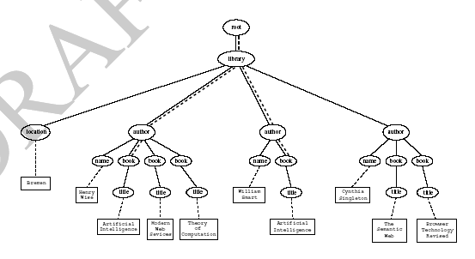
Tree Representation of Query 5

Slide 34
Examples of Path Expressions in XPath (6)
Address the first author element node in the XML document
//author[1]
Address the last book element within the first author element node in the document
//author[1]/book[last()]
Address all book element nodes without a title attribute
//book[not @title]

Slide 35
General Form of Path Expressions
A path expression consists of a series of steps, separated by slashes
A step consists of
An axis specifier,
A node test, and
An optional predicate

Slide 36
General Form of Path Expressions (2)
An axis specifier determines the tree relationship between the nodes to be addressed and the context node
E.g. parent, ancestor, child (the default), sibling, attribute node
// is such an axis specifier: descendant or self

Slide 37
General Form of Path Expressions (3)
A node test specifies which nodes to address
The most common node tests are element names
E.g., * addresses all element nodes
comment() addresses all comment nodes

Slide 38
General Form of Path Expressions (4)
Predicates (or filter expressions) are optional and are used to refine the set of addressed nodes
E.g., the expression [1] selects the first node
[position()=last()] selects the last node
[position() mod 2 =0] selects the even nodes
XPath has a more complicated full syntax.
We have only presented the abbreviated syntax

Slide 39
Displaying XML Documents
<author>
<name>Grigoris Antoniou</name>
<affiliation>University of Bremen</affiliation>
<email>ga@tzi.de</email>
</author>
may be displayed in different ways:
Grigoris Antoniou Grigoris Antoniou
University of Bremen University of Bremen
ga@tzi.de ga@tzi.de

Slide 40
Style Sheets
Style sheets can be written in various languages
E.g. CSS2 (cascading style sheets level 2)
XSL (extensible stylesheet language)
XSL includes
a transformation language (XSLT)
a formatting language
Both are XML applications

Slide 41
XSL Transformations (XSLT)
XSLT specifies rules with which an input XML document is transformed to
another XML document
an HTML document
plain text
The output document may use the same DTD or schema, or a completely different vocabulary
XSLT can be used independently of the formatting language

Slide 42
XSLT (2)
Move data and metadata from one XML representation to another
XSLT is chosen when applications that use different DTDs or schemas need to communicate
XSLT can be used for machine processing of content without any regard to displaying the information for people to read.
In the following we use XSLT only to display XML documents

Slide 43
XSLT Transformation into HTML
<xsl:template match="/author">
<html>
<head><title>An author</title></head>
<body bgcolor="white">
<b><xsl:value-of select="name"/></b><br />
<xsl:value-of select="affiliation"/><br />
<i><xsl:value-of select="email"/></i>
</body>
</html>
</xsl:template>

Slide 44
Style Sheet Output
<html>
<head><title>An author</title></head>
<body bgcolor="white">
<b>Grigoris Antoniou</b><br>
University of Bremen<br>
<i>ga@tzi.de</i>
</body>
</html>

Slide 45
Observations About XSLT
XSLT documents are XML documents
XSLT resides on top of XML
The XSLT document defines a template
In this case an HTML document, with some placeholders for content to be inserted
xsl:value-of retrieves the value of an element and copies it into the output document
It places some content into the template

Slide 46
A Template
<html>
<head><title>An author</title></head>
<body bgcolor="white">
<b>...</b><br>
...<br>
<i>...</i>
</body>
</html>

Slide 47
Auxiliary Templates
We have an XML document with details of several authors
It is a waste of effort to treat each author element separately
In such cases, a special template is defined for author elements, which is used by the main template

Slide 48
Example of an Auxiliary Template
<authors>
<author>
<name>Grigoris Antoniou</name>
<affiliation>University of Bremen</affiliation>
<email>ga@tzi.de</email>
</author>
<author>
<name>David Billington</name>
<affiliation>Griffith University</affiliation>
<email>david@gu.edu.net</email>
</author>
</authors>

Slide 49
Example of an Auxiliary Template (2)
<xsl:template match="/">
<html>
<head><title>Authors</title></head>
<body bgcolor="white">
<xsl:apply-templates select="authors"/>
<!-- Apply templates for AUTHORS children -->
</body>
</html>
</xsl:template>

Slide 50
Example of an Auxiliary Template (3)
<xsl:template match="authors">
<xsl:apply-templates select="author"/>
</xsl:template>
<xsl:template match="author">
<h2><xsl:value-of select="name"/></h2>
Affiliation:<xsl:value-of
select="affiliation"/><br>
Email: <xsl:value-of select="email"/>
<p>
</xsl:template>

Slide 51
Multiple Authors Output
<html>
<head><title>Authors</title></head>
<body bgcolor="white">
<h2>Grigoris Antoniou</h2>
Affiliation: University of Bremen<br>
Email: ga@tzi.de
<p>
<h2>David Billington</h2>
Affiliation: Griffith University<br>
Email: david@gu.edu.net
<p>
</body>
</html>

Slide 52
Explanation of the Example
xsl:apply-templates element causes all children of the context node to be matched against the selected path expression
E.g., if the current template applies to /, then the element xsl:apply-templates applies to the root element
I.e. the authors element (/ is located above the root element)
If the current context node is the authors element, then the element xsl:apply-templates select="author" causes the template for the author elements to be applied to all author children of the authors element

Slide 53
Explanation of the Example (2)
It is good practice to define a template for each element type in the document
Even if no specific processing is applied to certain elements, the xsl:apply-templates element should be used
E.g. authors
In this way, we work from the root to the leaves of the tree, and all templates are applied

Slide 54
Processing XML Attributes
Suppose we wish to transform to itself the element:
<person firstname="John" lastname="Woo"/>
Wrong solution:
<xsl:template match="person">
<person firstname="<xsl:value-of select="@firstname">"
lastname="<xsl:value-of select="@lastname">"/>
</xsl:template>

Slide 55
Processing XML Attributes (2)
Not well-formed because tags are not allowed within the values of attributes
We wish to add attribute values into template
<xsl:template match="person">
<person firstname="{@firstname}"
lastname="{@lastname}"/>
</xsl:template>

Slide 56
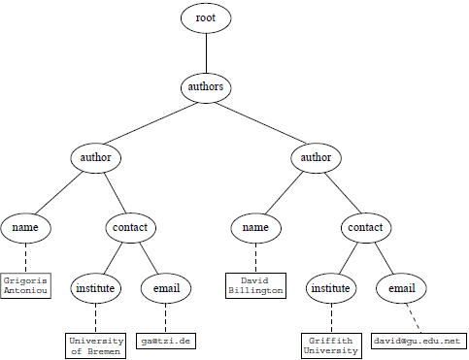
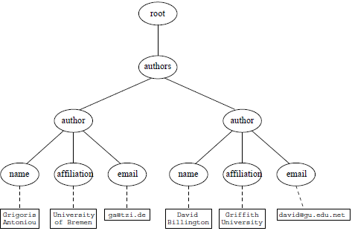
Transforming an XML Document to Another

Slide 57
Transforming an XML Document to Another (2)
<xsl:template match="/">
<?xml version="1.0" encoding="UTF-16"?>
<authors>
<xsl:apply-templates select="authors"/>
</authors>
</xsl:template>
<xsl:template match="authors">
<author>
<xsl:apply-templates select="author"/>
</author>
</xsl:template>

Slide 58
Transforming an XML Document to Another (3)
<xsl:template match="author">
<name><xsl:value-of select="name"/></name>
<contact>
<institution>
<xsl:value-of select="affiliation"/>
</institution>
<email><xsl:value-of select="email"/></email>
</contact>
</xsl:template>

Slide 59
Summary
XML is a metalanguage that allows users to define markup
XML separates content and structure from formatting
XML is the de facto standard for the representation and exchange of structured information on the Web
XML is supported by query languages

Slide 60
Points for Discussion in Subsequent Chapters
The nesting of tags does not have standard meaning
The semantics of XML documents is not accessible to machines, only to people
Collaboration and exchange are supported if there is underlying shared understanding of the vocabulary
XML is well-suited for close collaboration, where domain- or community-based vocabularies are used
It is not so well-suited for global communication.

