Slide 1
PROGRAMMING LANGUAGES
P. Sumathy
Assistant Professor
Department of Computer Science
Bharathidasan University

Slide 2
COMPUTER Basics:
A computer is an electronic device capable of manipulating number and symbols, first taking input, processing it, storing and giving out output under a control of set instructions which is known as a program.
A general purpose computer requires the following hardware components: memory, storage device (hard disk drive), input device (keyboard, mouse etc.), output device (screen, printer etc.) and central processing unit (CPU).
Many other components are involved in addition to the listed components to work together efficiently.

Slide 3
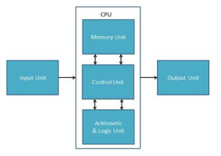
The Basic Structure of Computer:

Slide 4
Input Unit:
This unit contains devices with the help of which we enter data into computer.
This unit makes link between user and computer.
The input devices translate the information into the form understandable by computer.
CPU (Central Processing Unit):
CPU is considered as the brain of the computer. CPU performs all types of data processing operations.
It stores data, intermediate results and instructions(program).
It controls the operation of all parts of computer.
CPU itself has following three components
ALU(Arithmetic Logic Unit)
Memory Unit
Control Unit
Output Unit:
Output unit consists of devices with the help of which we get the information from computer.
This unit is a link between computer and users.
Output devices translate the computer’s output into the form understandable by users.

Slide 5
Computer-System Operation
I/O devices and the CPU can execute concurrently
Each device controller is in charge of a particular device type
Each device controller has a local buffer
CPU moves data from/to main memory to/from local buffers
I/O is from the device to local buffer of controller
Device controller informs CPU that it has finished its operation by causing an interrupt

Slide 6
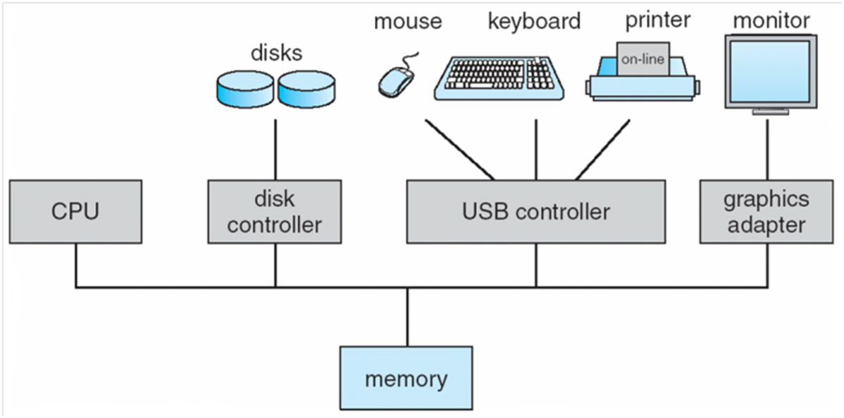
Computer System Organization:

Slide 7
Binding:
A source file has many names whose properties need to be determined.
The meaning of these properties might be determined at different phases of the life cycle of a program.
Examples of such properties include the set of values associated with a type; the type of a variable; the memory location of the compiled function; the value stored in a variable, and so forth.
Binding is the act of associating properties with names. Binding time is the moment in the program's life cycle when this association occurs.

Slide 8
Language Translation Issues:
Language or Programming Language in computer science is an artificial language used to write a sequence of instructions (a computer program) that can be run by a computer.
Similar to natural languages, such as English, programming languages have a vocabulary, grammar, and syntax.
The languages used to program computers must have simple logical structures, and the rules for their grammar, spelling, and punctuation must be precise.

Slide 9
Programming Language Syntax.
Syntax is defined as “the arrangement of words as elements in a sentence to show their relationship”; it also describes the sequence of symbols that make up valid programs. In other wordssyntax is the study of how words combine to make sentences.
The order of words in sentences varies from language to language. Syntax provides significant information needed for understanding a program and provides much needed information toward the translation of the source program into an object program.
There are some other attributes under the semantics that are not always determined in syntax rules such as the use of declarations, operations, sequence control and referencing environments. In other words syntax is a “solved problem”.

Slide 10
Stages in translation.
The process of translation of a program from its original syntax into executable form is central in every programming language implementation. Translation may divide into two major parts: the analysis of the input source program and the synthesis of the executable object program.
Synthesis of the Object Program. The final stages of translation are concerned with the construction of the executable program from the outputs produced by the semantic analyzer.

Slide 11
Thank You

