Slide 1
Unit - 5
WIRELESS APPLICATION PROTOCOL (WAP)
Mrs. M. Lalli
Assistant Professor
Department of Computer Science
Bharathidasan University
Trichy

Slide 2
WAP - Wireless Application Protocol
Goals
  deliver Internet content and enhanced services to mobile devices and users (mobile phones, PDAs)
  independence from wireless network standards
  open for everyone to participate, protocol specifications will be proposed to standardization bodies
  applications should scale well beyond current transport media and device types and should also be applicable to future developments
Platforms
  e.g., GSM (900, 1800, 1900), CDMA IS-95, TDMA IS-136, 3rd generation systems (IMT-2000, UMTS, W-CDMA, cdma2000 1x EV-DO, …)
Forum
  was: WAP Forum, co-founded by Ericsson, Motorola, Nokia, Unwired Planet
  now: Open Mobile Alliance

Slide 3
WAP: Main Features
Browser
  “Micro browser”, similar to existing web browsers
Markup language
  Similar to HTML, adapted to mobile devices
Script language
  Similar to Javascript, adapted to mobile devices
Gateway
  Transition from wireless to wired world
Server
  “Wap/Origin server”, similar to existing web servers
Protocol layers
  Transport layer, security layer, session layer etc.
Telephony application interface
  Access to telephony functions

Slide 4
WAP Specifies
Wireless Application Environment
  WML Microbrowser
  WMLScript Virtual Machine
  WMLScript Standard Library
  Wireless Telephony Application Interface (WTAI)
  WAP content types
Wireless Protocol Stack
  Wireless Session Protocol (WSP)
  Wireless Transport Layer Security (WTLS)
  Wireless Transaction Protocol (WTP)
  Wireless Datagram Protocol (WDP)
  Wireless network interface definitions

Slide 5
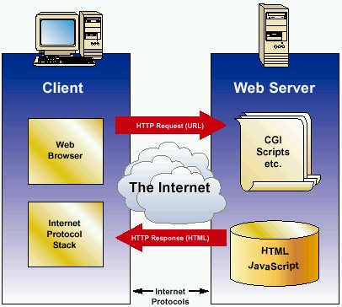
Internet Model
HTML
HTTP
TLS/SSL
TCP/IP

Slide 6
WAP Architecture
Client
Web Server
WAP Gateway
WML
CGI
Scripts
etc.
WML Encoder
WML-Script
WSP/WTP
HTTP
WML Decks
with WML-Script
WMLScript
Compiler
WTAI
Protocol Adapters
Content
Etc.
Source: WAP Forum

Slide 7
WAP Application Server
Client
WAP Application Server
WML
WML Encoder
Application
Logic
WML-Script
WSP/WTP
WMLScript
Compiler
WML Decks
with WML-Script
WTAI
Protocol Adapters
Content
Etc.
Source: WAP Forum

Slide 8
WAP 1.x - reference model and protocols
Internet
A-SAP
WAP
HTML, Java
Application Layer (WAE)
additional services
and applications
S-SAP
HTTP
Session Layer (WSP)
TR-SAP
Transaction Layer (WTP)
SEC-SAP
SSL/TLS
Security Layer (WTLS)
T-SAP
TCP/IP,
UDP/IP,
media
Transport Layer (WDP)
WCMP
Bearers (GSM, CDPD, ...)
WAE comprises WML (Wireless Markup Language), WML Script, WTAI etc.

Slide 9
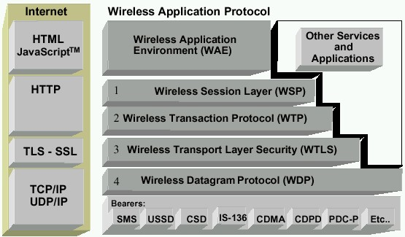
WAP Stack
Runs on top of WDP
Provided lightweight X-oriented service
Unreliable 1-way request
Reliable 1-way/2-way req./response
MicroBrowser (WML, WMLScript, WTA, WTAI)
Lightweight SSL
Uses WIM/PKI-Cards
Datagram service on different bearers
Convergence between bearer services
Different Wireless Tech.
Source: WAP Forum

Slide 10
WAP - network elements
fixed network
wireless network
Internet
WML
WAP
proxy
Binary WML
HTML
filter
HTML
WML
HTML
filter/
WAP
proxy
Binary WML
web
server
HTML
WTA
server
Binary WML
PSTN
Binary WML: binary file format for clients

Slide 11
WDP: Wireless Datagram Protocol
Goals
  create a worldwide interoperable transport system by adapting WDP to the different underlying technologies
  transmission services, such as SMS in GSM might change, new services can replace the old ones
WDP
  Transport layer protocol within the WAP architecture
  uses the Service Primitive
    T-UnitData.req .ind
  uses transport mechanisms of different bearer technologies
  offers a common interface for higher layer protocols
  allows for transparent communication despite different technologies
  addressing uses port numbers
  WDP over IP is UDP/IP

Slide 12
WDP: Service Primitives
T-SAP
T-SAP
T-DUnitdata.req
(DA, DP, SA, SP, UD)
T-DUnitdata.ind
(SA, SP, UD)
T-DUnitdata.req
(DA, DP, SA, SP, UD)
T-DError.ind
(EC)
SAP: Service Access Point
DA: Destination Address
DP: Destination Port
SA: Source Address
SP: Source Port
UD: User Data
EC: Error Code

Slide 13
WTLS:Wireless Transport Layer Security
Goals
  Provide mechanisms for secure transfer of content, for applications needing privacy, identification, message integrity and non-repudiation
  Provide support for protection against denial-of-service attacks
WTLS
  is based on the TLS/SSL (Transport Layer Security) protocol
  optimized for low-bandwidth communication channels
  provides
    privacy (encryption)
    data integrity (MACs)
    authentication (public-key and symmetric)
  Employs special adapted mechanisms for wireless usage
    Long lived secure sessions
    Optimised handshake procedures
    Provides simple data reliability for operation over datagram bearers

Slide 14
WTLS Internal Architecture
Transaction Protocol (WTP)
Handshake Protocol
Alert Protocol
Application Protocol
Change Cipher Spec Protocol
WTLS
Record Protocol
Record protocol
Datagram Protocol (WDP/UDP)
Bearer networks
Notes:
Note to translator:
Here I am going to explain and talk about each of the protocol elements in the WTLS layer

Slide 15
WTLS: Secure session, Full handshake
originator
SEC-SAP
peer
SEC-SAP
SEC-Create.req
(SA, SP, DA, DP, KES, CS, CM)
SEC-Create.ind
(SA, SP, DA, DP, KES, CS, CM)
SEC-Create.res
(SNM, KR, SID, KES‘, CS‘, CM‘)
SEC-Create.cnf
(SNM, KR, SID, KES‘, CS‘, CM‘)
SEC-Exchange.req
KES: Key Exchange Suite
CS: Cipher Suite
CM: Compression Mode
SNM: Sequence Number Mode
KR: Key Refresh Cycle
SID: Session Identifier
CC: Client Certificate
SEC-Exchange.ind
SEC-Exchange.res
(CC)
SEC-Commit.req
SEC-Exchange.cnf
(CC)
SEC-Commit.ind
SEC-Commit.cnf

Slide 16
WTLS: Transferring Datagrams
sender
SEC-SAP
receiver
SEC-SAP
SEC-Unitdata.req
(SA, SP, DA, DP, UD)
SEC-Unitdata.ind
(SA, SP, DA, DP, UD)

Slide 17
WTP: Wireless Transaction Protocol
Goals
  different transaction services that enable applications to select reliability, efficiency levels
  low memory requirements, suited to simple devices (< 10kbyte )
  efficiency for wireless transmission
WTP
  supports peer-to-peer, client/server and multicast applications
  efficient for wireless transmission
  support for different communication scenarios
  class 0: unreliable message transfer
    unconfirmed Invoke message with no Result message
    a datagram that can be sent within the context of an existing Session
  class 1: reliable message transfer without result message
    confirmed Invoke message with no Result message
    used for data push, where no response from the destination is expected
  class 2: reliable message transfer with exactly one reliable result message
    confirmed Invoke message with one confirmed Result message
    a single request produces a single reply

Slide 18
WTP Services and Protocols
WTP (Transaction)
  provides reliable data transfer based on request/reply paradigm
    no explicit connection setup or tear down
    optimized setup (data carried in first packet of protocol exchange)
    seeks to reduce 3-way handshake on initial request
  supports
    header compression
    segmentation /re-assembly
    retransmission of lost packets
    selective-retransmission
    port number addressing (UDP ports numbers)
    flow control
  message oriented (not stream)
  supports an Abort function for outstanding requests
  supports concatenation of PDUs
  supports User acknowledgement or Stack acknowledgement option
    acks may be forced from the WTP user (upper layer)
    default is stack ack

Slide 19
WTP Services and Protocols
uses the service primitives
  T-TRInvoke.req .cnf. .ind .res
  T-TRResult.req .cnf .ind .res
  T-Abort.req .ind
Client
(PDUs)
Server
T-TRInvoke.req
Invoke
T-TRInvoke.ind
T-TRInvoke.cnf
Ack
T-TRInvoke.res
Result
T-TRResult.ind
T-TRResult.req
T-TRResult.res
Ack
T-TRResult.cnf
Notes:
Ack may be piggybacked on a Result packet, therefore the Ack is shown with a dotted line.

Slide 20
WTP Class 0 Transaction
initiator
TR-SAP
responder
TR-SAP
TR-Invoke.req
(SA, SP, DA, DP, A, UD, C=0, H)
TR-Invoke.ind
(SA, SP, DA, DP, A, UD, C=0, H‘)
Invoke PDU
A: Acknowledgement Type (WTP/User)
C: Class (0,1,2)
H: Handle (socket alias)

Slide 21
WTP Class 1 Transaction, no user ack & user ack
initiator
TR-SAP
responder
TR-SAP
TR-Invoke.req
(SA, SP, DA, DP, A, UD, C=1, H)
TR-Invoke.ind
(SA, SP, DA, DP, A, UD, C=1, H‘)
Invoke PDU
TR-Invoke.cnf
(H)
Ack PDU
initiator
TR-SAP
responder
TR-SAP
TR-Invoke.req
(SA, SP, DA, DP, A, UD, C=1, H)
TR-Invoke.ind
(SA, SP, DA, DP, A, UD, C=1, H‘)
Invoke PDU
TR-Invoke.res
(H‘)
TR-Invoke.cnf
(H)
Ack PDU

Slide 22
WTP Class 2 Transaction, no user ack, no hold on
initiator
TR-SAP
responder
TR-SAP
TR-Invoke.req
(SA, SP, DA, DP, A, UD, C=2, H)
TR-Invoke.ind
(SA, SP, DA, DP, A, UD, C=2, H‘)
Invoke PDU
TR-Result.req
(UD*, H‘)
TR-Invoke.cnf
(H)
Result PDU
TR-Result.ind
(UD*, H)
TR-Result.res
(H)
Ack PDU
TR-Result.cnf
(H‘)

Slide 23
WTP Class 2 Transaction, user ack
initiator
TR-SAP
responder
TR-SAP
TR-Invoke.req
(SA, SP, DA, DP, A, UD, C=2, H)
TR-Invoke.ind
(SA, SP, DA, DP, A, UD, C=2, H‘)
Invoke PDU
TR-Invoke.res
(H‘)
TR-Invoke.cnf
(H)
Ack PDU
TR-Result.req
(UD*, H‘)
TR-Result.ind
(UD*, H)
Result PDU
TR-Result.res
(H)
Ack PDU
TR-Result.cnf
(H‘)

Slide 24
WTP Class 2 Transaction, hold on, no user ack
initiator
TR-SAP
responder
TR-SAP
TR-Invoke.req
(SA, SP, DA, DP, A, UD, C=2, H)
TR-Invoke.ind
(SA, SP, DA, DP, A, UD, C=2, H‘)
Invoke PDU
TR-Invoke.cnf
(H)
Ack PDU
TR-Result.req
(UD*, H‘)
TR-Result.ind
(UD*, H)
Result PDU
TR-Result.res
(H)
Ack PDU
TR-Result.cnf
(H‘)

Slide 25
WSP - Wireless Session Protocol
Goals
  HTTP 1.1 functionality
    Request/reply, content type negotiation, ...
  support of client/server transactions, push technology
  key management, authentication, Internet security services
WSP Services
  provides shared state between client and server, optimizes content transfer
  session management (establish, release, suspend, resume)
  efficient capability negotiation
  content encoding
  push
WSP/B (Browsing)
  HTTP/1.1 functionality - but binary encoded
  exchange of session headers
  push and pull data transfer
  asynchronous requests

Slide 26
WSP Overview
Header Encoding
  compact binary encoding of headers, content type identifiers and other well-known textual or structured values
  reduces the data actually sent over the network
Capabilities (are defined for):
  message size, client and server
  protocol options: Confirmed Push Facility, Push Facility, Session Suspend Facility, Acknowledgement headers
  maximum outstanding requests
  extended methods
  header code pages
Suspend and Resume
  server knows when client can accept a push
  multi-bearer devices
  dynamic addressing
  allows the release of underlying bearer resources

Slide 27
WSP Sessions
Session Context and Push
  push can take advantage of session headers
  server knows when client can accept a push
Connection-mode
  long-lived communication, benefits of the session state, reliability
Connectionless-mode
  stateless applications, no session creation overhead, no reliability overhead

Slide 28
WSP/B session establishment
client
S-SAP
server
S-SAP
S-Connect.req
(SA, CA, CH, RC)
Connect PDU
S-Connect.ind
(SA, CA, CH, RC)
S-Connect.res
(SH, NC)
S-Connect.cnf
(SH, NC)
ConnReply PDU
CH: Client Header
RC: Requested Capabilities
SH: Server Header
NC: Negotiated Capabilities
WTP Class 2
transaction

Slide 29
WSP/B session suspend/resume
client
S-SAP
server
S-SAP
S-Suspend.req
S-Suspend.ind
(R)
Suspend PDU
S-Suspend.ind
(R)
WTP Class 0
transaction
~
~
R: Reason for disconnection
S-Resume.req
(SA, CA)
Resume PDU
S-Resume.ind
(SA, CA)
S-Resume.res
Reply PDU
S-Resume.cnf
WTP Class 2
transaction

Slide 30
WSP/B session termination
client
S-SAP
server
S-SAP
S-Disconnect.req
(R)
S-Disconnect.ind
(R)
Disconnect PDU
S-Disconnect.ind
(R)
WTP Class 0
transaction

Slide 31
WSP/B method invoke
client
S-SAP
server
S-SAP
S-MethodInvoke.req
(CTID, M, RU)
Method PDU
S-MethodInvoke.ind
(STID, M, RU)
S-MethodInvoke.res
(STID)
S-MethodInvoke.cnf
(CTID)
S-MethodResult.req
(STID, S, RH, RB)
S-MethodResult.ind
(CTID, S, RH, RB)
Reply PDU
S-MethodResult.res
(CTID)
S-MethodResult.cnf
(STID)
CTID: Client Transaction ID
M: Method Invoked
RU: Request URI
STID: Server Transaction ID
S: Response Status
RH: Response Header
RB: Response Body
WTP Class 2
transaction

Slide 32
WSP/B over WTP - method invocation
client
S-SAP
initiator
TR-SAP
responder
TR-SAP
server
S-SAP
S-MethodInvoke.req
TR-Invoke.req
Invoke(Method)
TR-Invoke.ind
S-MethodInvoke.ind
TR-Invoke.res
S-MethodInvoke.res
Ack PDU
S-MethodInvoke.cnf
TR-Invoke.cnf
TR-Result.req
S-MethodResult.req
Result(Reply)
S-MethodResult.ind
TR-Result.ind
S-MethodResult.res
TR-Result.res
Ack PDU
TR-Result.cnf
S-MethodResult.cnf

Slide 33
WSP/B over WTP - asynchronous, unordered requests
client
S-SAP
server
S-SAP
S-MethodInvoke_1.req
S-MethodInvoke_2.req
S-MethodInvoke_2.ind
S-MethodInvoke_1.ind
S-MethodInvoke_3.req
S-MethodResult_1.req
S-MethodInvoke_3.ind
S-MethodResult_1.ind
S-MethodResult_3.req
S-MethodResult_3.ind
S-MethodResult_2.req
S-MethodInvoke_4.req
S-MethodInvoke_4.ind
S-MethodResult_4.ind
S-MethodResult_4.req
S-MethodResult_2.ind

Slide 34
WSP/B - confirmed/non-confirmed push
client
S-SAP
server
S-SAP
S-Push.req
(PH, PB)
S-Push.ind
(PH, PB)
Push PDU
WTP Class 0
transaction
PH: Push Header
PB: Push Body
SPID: Server Push ID
CPID: Client Push ID
client
S-SAP
server
S-SAP
S-ConfirmedPush.req
(SPID, PH, PB)
S-ConfirmedPush.ind
(CPID, PH, PB)
ConfPush PDU
S-ConfirmedPush.res
(CPID)
S-ConfirmedPush.cnf
(SPID)
WTP Class 1
transaction

Slide 35
WSP/B over WDP
client
S-SAP
server
S-SAP
S-Unit-MethodInvoke.req
(SA, CA, TID, M, RU)
Method PDU
S-Unit-MethodInvoke.ind
(SA, CA, TID, M, RU)
S-Unit-MethodResult.req
(CA, SA, TID, S, RH, RB)
S-Unit-MethodResult.ind
(CA, SA, TID, S, RH, RB)
Reply PDU
S-Unit-Push.req
(CA, SA, PID, PH, PB)
S-Unit-Push.ind
(CA, SA, PID, PH, PB)
Push PDU
WDP Unitdata
service

Slide 36
Wireless Application Environment (WAE)
Goals
  device and network independent application environment
  for low-bandwidth, wireless devices
  considerations of slow links, limited memory, low computing power, small display, simple user interface (compared to desktops)
  integrated Internet/WWW programming model
  high interoperability

Slide 37
WAE Components
Architecture
  Application model, Microbrowser, Gateway, Server
User Agents
  WML/WTA/Others
  content formats: vCard, vCalendar, Wireless Bitmap, WML, ...
WML
  XML-Syntax, based on card stacks, variables, ...
WMLScript
  procedural, loops, conditions, ... (similar to JavaScript)
WTA
  telephone services, such as call control, text messages, phone book, ... (accessible from WML/WMLScript)
Proxy (Method/Push)

Slide 38
WAE: Logical Model
Origin Servers
Gateway
Client
Method proxy
WTA
user agent
web
server
response
with
content
encoded
response
with
content
Push proxy
WML
user agent
other content
server
push
content
encoded
push
content
encoders
&
decoders
other
WAE
user agents
request
encoded
request

Slide 39
Wireless Telephony Application (WTA)
Collection of telephony specific extensions
  designed primarily for network operators
Example
  calling a number (WML)
  wtai://wp/mc;07216086415
  calling a number (WMLScript)
  WTAPublic.makeCall("07216086415");
Implementation
  Extension of basic WAE application model
  Extensions added to standard WML/WMLScript browser
  Exposes additional API (WTAI)

Slide 40
WTA Features
Extension of basic WAE application model
  network model for interaction
    client requests to server
    event signaling: server can push content to the client
  event handling
    table indicating how to react on certain events from the network
    client may now be able to handle unknown events
  telephony functions
    some application on the client may access telephony functions
WTAI includes:
  Call control
  Network text messaging
  Phone book interface
  Event processing
Security model: segregation
  Separate WTA browser
  Separate WTA port

Slide 41
WTA Logical Architecture
other telephone networks
WTA Origin Server
WML
Scripts
Client
mobile
network
WTA
user agent
WTA & WML
server
WML
decks
WAE
services
WTA
services
WAP Gateway
encoders
&
decoders
network operator
trusted domain
other WTA
servers
third party
origin servers
firewall

Slide 42
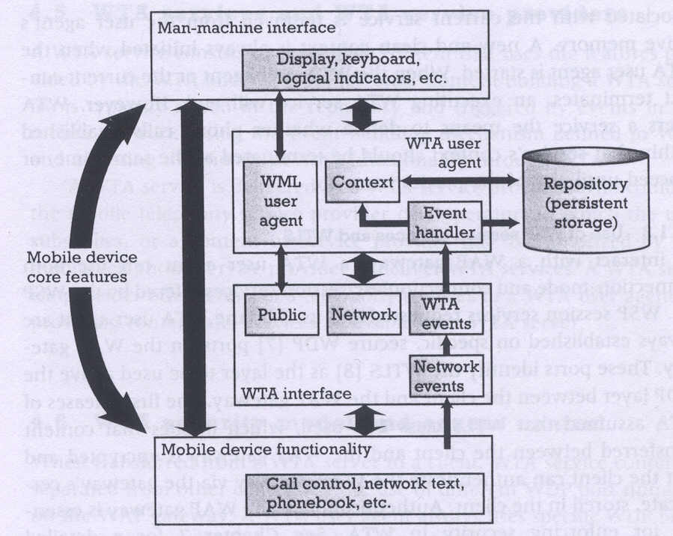
WTA Framework Components

Slide 43
WTA User Agent
WTA User Agent
  WML User agent with extended functionality
  can access mobile device’s telephony functions through WTAI
  can store WTA service content persistently in a repository
  handles events originating in the mobile network
WTA User Agent Context
  Abstraction of execution space
  Holds current parameters, navigation history, state of user agent
  Similar to activation record in a process address space
Uses connection-mode and connectionless services offered by WSP
Specific, secure WDP ports on the WAP gateway

Slide 44
WTA Events and Repository
WTA Events
  Network notifies device of event (such as incoming call)
  WTA events map to device’s native events
  WTA services are aware of and able to act on these events
  example: incoming call indication, call cleared, call connected
WTA Repository
  local store for content related to WTA services (minimize network traffic)
  Channels: define the service
    content format defining a WTA service stored in repository
    XML document specifying eventid, title, abstract, and resources that implement a service
  Resources: execution scripts for a service
    could be WML decks, WML Scripts, WBMP images..
    downloaded from WTA server and stored in repository before service is referenced
  Server can also initiate download of a channel

Slide 45
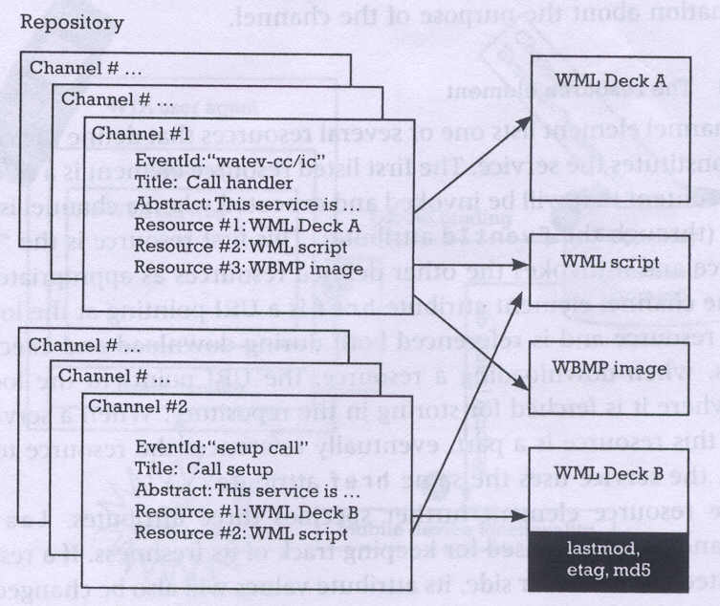
WTA Channels and Resources

Slide 46
WTA Interface (public)
WTA Interface
  generic, high-level interface to mobile’s telephony functions
  setting up phone calls, reading and writing entries in phonebook..
Public WTAI
  for third party WML content providers
  restricted set of telephony functions available to any WAE User Agent
  library functions
    make call: allows application to setup call to a valid tel number
    send DTMF tones: send DTMF tones through the setup call
  user notified to grant permission for service execution
  cannot be triggered by network events
  example: Yellow pages service with “make call” feature

Slide 47
WTA Interface (network)
Network Common WTAI
  WTA service provider is in operator’s domain
  all WTAI features are accessible, including the interface to WTA events
  library functions
    Voice-call control: setup call, accept, release, send DTMF tones
    Network text: send text, read text, remove text (SMS)
    Phonebook: write, read, remove phonebook entry
    Call logs: last dialed numbers, missed calls, received calls
    Miscellaneous: terminate WTA user agent, protect context
  user can give blanket permission to invoke a function
  example: Voice mail service
Network Specific WTAI
  specific to type of bearer network
  example:
    GSM: call reject, call hold, call transfer, join multiparty, send USSD

Slide 48
WTA Event Handling
Event occurrence
  WTA user agent could be executing and expecting the event
  WTA user agent could be executing and a different event occurs
  No service is executing
Event handling
  channel for each event defines the content to be processed upon reception of that event
Event binding
  association of an event with the corresponding handler (channel)
  Global binding:
    channel corresponding to the event is stored in the repository
    event causes execution of resources defined by the channel
    example: voice mail service
  Temporary binding:
    resources to be executed are defined by the already executing service
    example: yellow pages lookup and call establishment

Slide 49
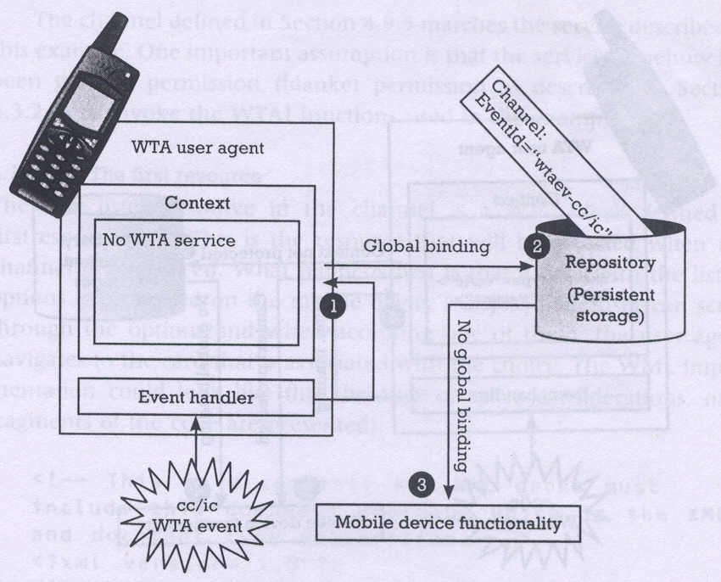
Event Handling (no service in execution)

Slide 50
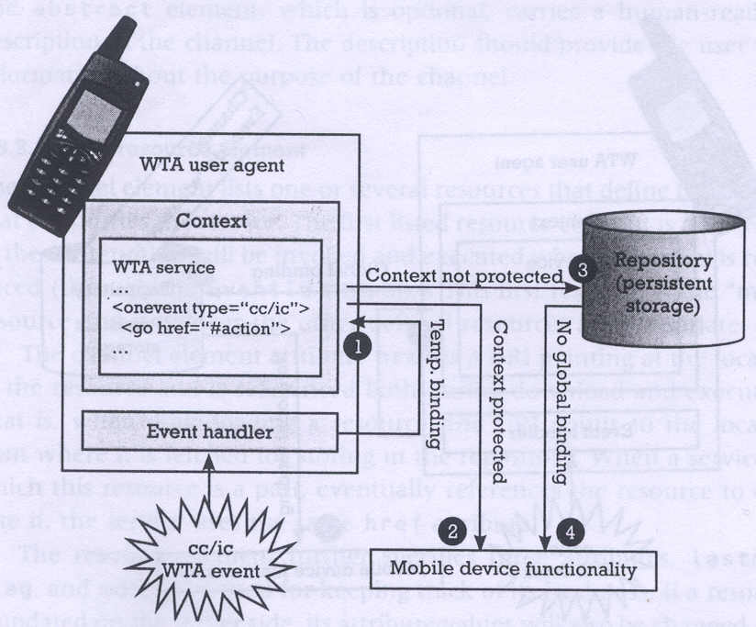
Event Handling (service already execution)
1: Temporary binding exists
2. No temporary binding and context is protected
3: No temporary binding and context is not protected

Slide 51
WTA: Voice mail Example
WTA client
WTA server
mobile network
voice mail server
incoming voice
message
indicate new voice message
generate
new deck
push deck
display deck;
user selects
request
wait for call
translate
play requested voice message
setup call
call indication
setup call
accept call
accept call
accept call
voice connection

Slide 52
WTA Application: Example (using WML)
<WML>
<CARD>
<DO TYPE="ACCEPT" TASK="GO" URL="#voteChamp"/>
Please vote for your champion!
</CARD>
<CARD NAME="voteChamp">
<DO TYPE="ACCEPT" TASK="GO" URL="wtai://cc/sc;$voteNo;1"/>
Please choose:
<SELECT KEY="voteNo">
<OPTION VALUE="6086415">Mickey</OPTION>
<OPTION VALUE="6086416">Donald</OPTION>
<OPTION VALUE="6086417">Pluto</OPTION>
</SELECT>
</CARD>
</WML>

Slide 53
WTA: Example with WML and WMLScript
function voteCall(Nr) {
var j = WTACallControl.setup(Nr,1);
if (j>=0) {
WMLBrowser.setVar("Message", "Called");
WMLBrowser.setVar("No", Nr);
}
else {
WMLBrowser.setVar("Message", "Error!");
WMLBrowser.setVar("No", j);
}
WMLBrowser.go("showResult");
}

Slide 54
WTA: Example with WML and WMLScript
<WML>
<CARD>
<DO TYPE="ACCEPT" TASK="GO" URL="#voteChamp"/>
Please vote for your champion!
</CARD>
<CARD NAME="voteChamp">
<DO TYPE="ACCEPT" TASK="GO" URL="/script#voteCall($voteNo)"/>
Please choose:
<SELECT KEY="voteNo">
<OPTION VALUE="6086415">Mickey</OPTION>
<OPTION VALUE="6086416">Donald</OPTION>
<OPTION VALUE="6086417">Pluto</OPTION>
</SELECT>
</CARD>
<CARD NAME="showResult">
Status of your call: $Message $No
</CARD>
</WML>

Slide 55
Overview of WAP
Internet
A-SAP
WAP
HTML, Java
Application Layer (WAE)
additional services
and applications
S-SAP
HTTP
Session Layer (WSP)
TR-SAP
Transaction Layer (WTP)
SEC-SAP
SSL/TLS
Security Layer (WTLS)
T-SAP
TCP/IP,
UDP/IP,
media
Transport Layer (WDP)
WCMP
Bearers (GSM, CDPD, ...)
WAE comprises WML (Wireless Markup Language), WML Script, WTAI etc.

Slide 56
THANK YOU !!!!

