Slide 1
Management information system
Presented by
Dr. K.elangovan
Lecturer
School of computer science , applications and engineering
Bharathidasan university
Trichirappalli-23

Slide 2
Overview
Introduction
What is MIS?
IS and Decision Making
IS and Technology
IS and Business
MIS Careers
IS Opportunities and Challenges

Slide 3
Computer Literacy
“To err is human, but to really foul things up requires a computer”
- Anonymous

Slide 4
What is MIS?
Identifying the information that is needed for effective decision making in organizations
Developing information systems to satisfy those needs

Slide 5
What is MIS?
In other words…..
“ MIS is using technology to
create business value.”

Slide 6
What do MIS professionals do?
BUSINESS
MIS
TECHNOLOGY
Bridge the gap between business and technical minds

Slide 7
Information Systems (IS)
A set of interrelated components that collect (or retrieve), process, store, and distribute information to support decision making and control in an organization

Slide 8
Activities in an IS
INPUT
PROCESS
OUTPUT
FEEDBACK

Slide 9
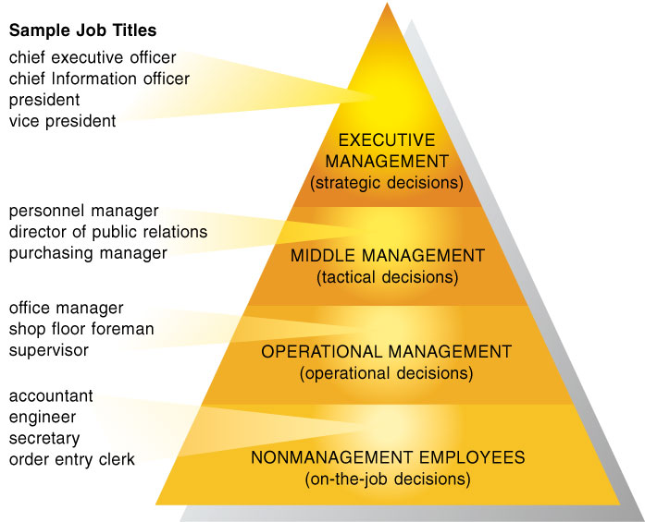
IS and Decision Making

Slide 10
Managerial Levels
Senior managers: long-range strategic decisions about products and services
Middle managers: Carry out the programs and plans of senior management
Operational managers: monitor the firm’s daily activities

Slide 11
Data versus Information
To make good decisions, accurate data can be transformed into information.
Information Processing Cycle
Input → Process → Output → Storage
(Data) (Information)

Slide 12
Characteristics of Good Information
Subjective Value
Relevant
Timely
Accurate
Meaningful Format
Complete
Accessible

Slide 13
IS and Technology
Hardware, software, databases, networks and other related components
Computers and other technologies are used to build information systems
What technology should be used?

Slide 14
Information Systems in Business
Functional Areas of Business
Sales and Marketing
Manufacturing / Service
Finance / Accounting
Human Resource
Cross Functional

Slide 15
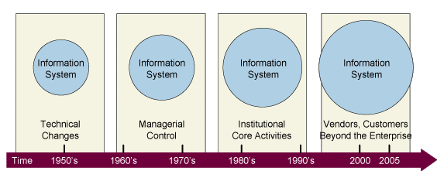
Widening Scope of IS

Slide 16
Careers in MIS
What does it take to succeed?
SOFT SKILLS
Communication
Teamwork
Patience
Creativity
Decision Making
TECHNICAL SKILLS
Technical Curiosity
Problem Solving
Analytical
Programming
Synthesis
BUSINESS SKILLS!

Slide 17
Careers in MIS
Project Managers / CIO
System Design
Software Design
Internet
Database
Network / Telecommunications
System Analyst

Slide 18
MIS Career Outlook – GREAT! Pays well too!
Network systems & data communications analysts
- Computer software engineers, applications
- Personal financial advisors
- Financial analysts
- Substance abuse and behavioral counselors

Slide 19
IS Opportunities
Increase worker productivity
Enhance decision making
Improve team collaboration
Create business partnerships and alliances
Enhance global competitiveness
Support corporate strategy
Improve quality of goods and services
Rapidly changing technology

Slide 20
IS Challenges
Workforce downsizing
Information overload
Employee mistrust
Difficult to build
Security breaches
Rapidly changing technology

