Slide 1
Information Security
Mrs. M. Lalli
Assistant Professor
Department of Computer Science
Bharathidasan University
Trichy

Slide 2
In 1980 a computer cracked a 3-character password within one minute.
DID YOU KNOW?
In 1999 a team of computers cracked a 56-character password within one day.
In 2004 a computer virus infected 1 million computers within one hour.

Slide 3
Objectives
Why we secure information?
What are the vulnerabilities?
How to secure information?

Slide 4
Attack Sophistication vs. Intruder Technical Knowledge
Cross site scripting
Intruder
Knowledge
Tools
“stealth” / advanced scanning techniques
High
Staged attack
packet spoofing
denial of service
sniffers
distributed
attack tools
sweepers
www attacks
automated probes/scans
GUI
back doors
disabling audits
network mgmt. diagnostics
hijacking
sessions
Attack
Sophistication
burglaries
exploiting known vulnerabilities
password cracking
self-replicating code
Attackers
Low
password guessing
1980
1985
1990
1995
2000

Slide 5
Security Objectives
Confidentiality: prevent/detect/deter improper disclosure of information
Integrity: prevent/detect/deter improper modification of information
Availability: prevent/detect/deter improper denial of access to services

Slide 6
Definition of IS
Information security means protecting information and information systems from unauthorized access (That is modification, inspection, recording or destruction).
Information Security is interrelated with the common goals of protecting the confidentiality, integrity and availability of information.

Slide 7



Friends and enemies: Alice, Bob, Trudy
well-known in network security world
Bob, Alice (lovers!) want to communicate “securely”
Trudy (intruder) may intercept, delete, add messages
Alice
Bob
channel
data, control messages
secure
sender
secure
sender
secure
receiver
data
data
Trudy

Slide 8
Attacks
An attack is any action that violates security.
To analyze the security, it will depend upon the Three factors they are,
Vulnerability – Weakness in the security system
Threats – Set of circumstances that has
potential to cause loss or harm
Controls – Reduces the vulnerability

Slide 9
Types of Vulnerabilities
Hardware Vulnerabilities – Physical damage
Software Vulnerabilities – Deletion, modification & theft
Example :(Logic Bomb, Salami Attack, Trojan horse )
Data Vulnerabilities – Confidentiality, Integrity and Availability

Slide 10
Military Example
Confidentiality: target coordinates of a missile should not be improperly disclosed
Integrity: target coordinates of missile should be correct
Availability: missile should fire when proper command is issued

Slide 11
Commercial Example
Confidentiality: patient’s medical information should not be improperly disclosed
Integrity: patient’s medical information should be correct
Availability: patient’s medical information can be accessed when needed for treatment

Slide 12
Fourth Objective
Securing computing resources: prevent/detect/deter improper use of computing resources
Hardware
Software
Data
Network

Slide 13
Achieving Security
Policy
What to protect?
Mechanism
How to protect?
Assurance
How good is the protection?

Slide 14
Security Policy
Organizational
Policy
Computerized
Information System
Policy

Slide 15
Security Mechanism
Prevention
Detection
Tolerance/Recovery

Slide 16
Types of Attacks (1)
Interruption – an asset is destroyed, unavailable or unusable (availability)
Interception – unauthorized party gains access to an asset (confidentiality)
Modification – unauthorized party tampers with asset (integrity)
Fabrication – unauthorized party inserts counterfeit object into the system (authenticity)
Denial – person denies taking an action (authenticity)

Slide 17
Types of Attacks (2)
Passive attacks:
Eavesdropping
Monitoring
Active attacks:
Masquerade – one entity pretends to be a different entity
Replay – passive capture of information and its retransmission
Modification of messages – legitimate message is altered
Denial of service – prevents normal use of resources

Slide 18
Malicious Attacks
Method: skills, knowledge, tools, information, etc.
Opportunity: time and access
Motive: reason to perform the action

Slide 19
Computer Criminals
Amateurs: regular users, who exploit the vulnerabilities of the computer system
Motivation: easy access to vulnerable resources
Crackers: attempt to access computing facilities for which they do not have the authorization
Motivation: enjoy challenge, curiosity
Career criminals: professionals who understand the computer system and its vulnerabilities
Motivation: personal gain (e.g., financial)

Slide 20
Methods of Defense
Prevent: block attack
Deter: make the attack harder
Deflect: make other targets more attractive
Detect: identify misuse
Tolerate: function under attack
Recover: restore to correct state

Slide 21
Encryption and Decryption
Encryption : (Encoding a message)
Original message (or) Plain Text is converted to cipher text
Decryption: (Decoding a message)
Cipher text is converted to Plain text
Plain Text Cipher Text Original Msg
Encryption
Decryption

Slide 22
Encryption Technique ( Caesar Cipher)
C_{i} = E(p_{i}) = P_{i} + 3
Plain Text = A B C D E F G H I J K L M N O . .
CipherText = d e f g h i j k l m n o p q r . .

Slide 23
Example for caesar cipher
The Original Message is,
“TREATY IMPOSSIBLE”
The encrypted message is,
T R E A T Y I M P O S S I B L E
w u h d w b l p s r v v l e o h

Slide 24
Firewalls
Firewalls control the flow of network traffic
Firewalls have applicability in networks where there is no internet connectivity
Firewalls operate on number of layers
Can also act as VPN gateways
Active content filtering technologies

Slide 25
Firewall Environments
There are different types of environments where a firewall can be implemented.
Simple environment can be a packet filter firewall
Complex environments can be several firewalls and proxies

Slide 26
DMZ Environment
Can be created out of a network connecting two firewalls
Boundary router filter packets protecting server
First firewall provide access control and protection from server if they are hacked

Slide 27
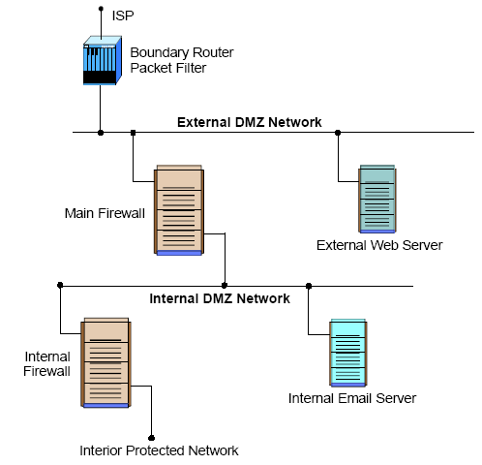
DMZ ENV

Slide 28
VPN
VPN is used to provide secure network links across networks
VPN is constructed on top of existing network media and protocols
On protocol level IPsec is the first choice
Other protocols are PPTP, L2TP

Slide 29
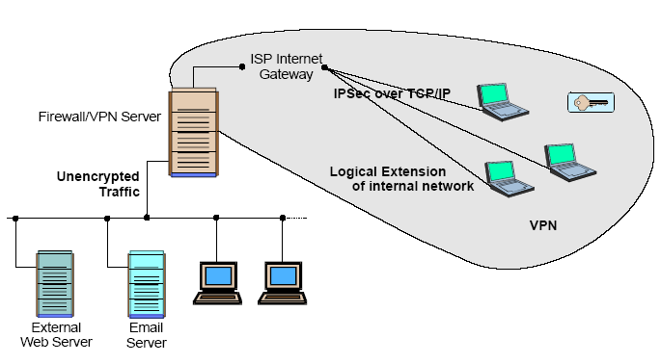
VPN

Slide 30
Intranets
An intranet is a network that employs the same types of services, applications, and protocols present in an Internet implementation, without involving external connectivity
Intranets are typically implemented behind firewall environments.

Slide 31
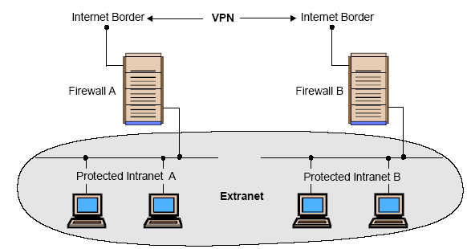
Intranets

Slide 32
Extranets
Extranet is usually a business-to-business intranet
Controlled access to remote users via some form of authentication and encryption such as provided by a VPN
Extranets employ TCP/IP protocols, along with the same standard applications and services

Slide 33
Type is Firewalls
Firewalls fall into four broad categories
Packet filters
Circuit level
Application level
Stateful multilayer

Slide 34
Packet Filter
Work at the network level of the OSI model
Each packet is compared to a set of criteria before it is forwarded
Packet filtering firewalls is low cost and low impact on network performance

Slide 35
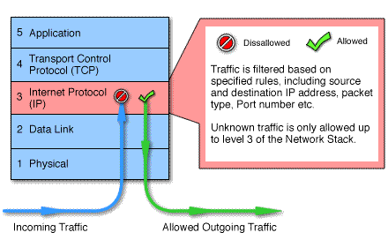
Packet Filtering

Slide 36
Circuit level
Circuit level gateways work at the session layer of the OSI model, or the TCP layer of TCP/IP
Monitor TCP handshaking between packets to determine whether a requested session is legitimate.

Slide 37
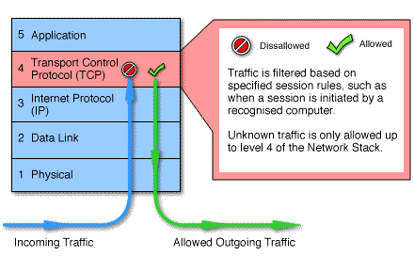
Circuit Level

Slide 38
Application Level
Application level gateways, also called proxies, are similar to circuit-level gateways except that they are application specific
Gateway that is configured to be a web proxy will not allow any ftp, gopher, telnet or other traffic through

Slide 39
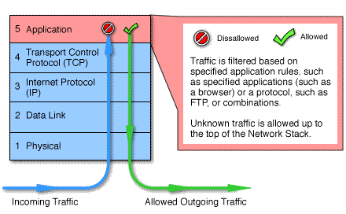
Application Level

Slide 40
Stateful Multilayer
Stateful multilayer inspection firewalls combine the aspects of the other three types of firewalls
They filter packets at the network layer, determine whether session packets are legitimate and evaluate contents of packets at the application layer

Slide 41
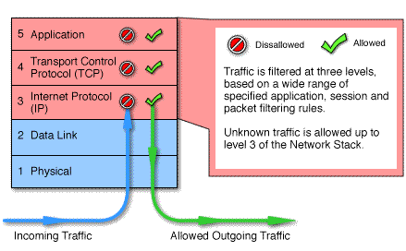
Stateful Multilayer

Slide 42
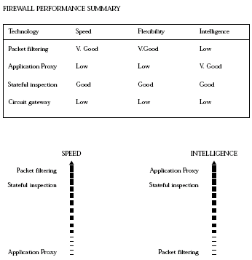
General Performance

Slide 43
Future of Firewalls
Firewalls will continue to advance as the attacks on IT infrastructure become more and more sophisticated
More and more client and server applications are coming with native support for proxied environments
Firewalls that scan for viruses as they enter the network and several firms are currently exploring this idea, but it is not yet in wide use

Slide 44
Conclusion
It is clear that some form of security for private networks connected to the Internet is essential
A firewall is an important and necessary part of that security, but cannot be expected to perform all the required security functions.

Slide 46
Outline
Introduction
A Frame for Intrusion Detection System
Intrusion Detection Techniques
Ideas for Improving Intrusion Detection

Slide 47
What is the Intrusion Detection
Intrusions are the activities that violate the security policy of system.
Intrusion Detection is the process used to identify intrusions.

Slide 48
Types of Intrusion Detection System(1)
Based on the sources of the audit information used by each IDS, the IDSs may be classified into
Host-base IDSs
Distributed IDSs
Network-based IDSs

Slide 49
Types of Intrusion Detection System(2)
Host-based IDSs
Get audit data from host audit trails.
Detect attacks against a single host
Distributed IDSs
Gather audit data from multiple host and possibly the network that connects the hosts
Detect attacks involving multiple hosts
Network-Based IDSs
Use network traffic as the audit data source, relieving the burden on the hosts that usually provide normal computing services
Detect attacks from network.

Slide 50
Intrusion Detection Techniques
Misuse detection
Catch the intrusions in terms of the characteristics of known attacks or system vulnerabilities.
Anomaly detection
Detect any action that significantly deviates from the normal behavior.

Slide 51
Misuse Detection
Based on known attack actions.
Feature extract from known intrusions
Integrate the Human knowledge.
The rules are pre-defined
Disadvantage:
Cannot detect novel or unknown attacks

Slide 52
Misuse Detection Methods & System
Method | System
Rule-based Languages | RUSSEL,P-BEST
State Transition Analysis | STAT family(STAT,USTAT,NSTAT,NetSTAT)
Colored Petri Automata | IDIOT
Expert System | IDES,NIDX,P-BEST,ISOA
Case Based reasoning | AutiGUARD

Slide 53
Anomaly Detection
Based on the normal behavior of a subject. Sometime assume the training audit data does not include intrusion data.
Any action that significantly deviates from the normal behavior is considered intrusion.

Slide 54
Anomaly Detection Methods & System
Method | System
Statistical method | IDES, NIDES, EMERALD
Machine Learning techniques Time-Based inductive Machine Instance Based Learning Neural Network …
Data mining approaches | JAM, MADAM ID

Slide 55
Anomaly Detection Disadvantages
Based on audit data collected over a period of normal operation.
When a noise(intrusion) data in the training data, it will make a mis-classification.
How to decide the features to be used. The features are usually decided by domain experts. It may be not completely.

Slide 56
Misuse Detection vs. Anomaly Detection
 | Advantage | Disadvantage
Misuse Detection | Accurately and generate much fewer false alarm | Cannot detect novel or unknown attacks
Anomaly Detection | Is able to detect unknown attacks based on audit | High false-alarm and limited by training data.

Slide 57
The Frame for Intrusion Detection

Slide 58
Intrusion Detection Approaches
Define and extract the features of behavior in system
Define and extract the Rules of Intrusion
Apply the rules to detect the intrusion
Audit Data
3
Training
Audit Data
Features
Rules
Pattern matching
or Classification
1
2
3

Slide 59
Thinking about The Intrusion Detection System
Intrusion Detection system is a pattern discover and pattern recognition system.
The Pattern (Rule) is the most important part in the Intrusion Detection System
Pattern(Rule) Expression
Pattern(Rule) Discover
Pattern Matching & Pattern Recognition.

Slide 61
Rule Discover Method
Expert System
Measure Based method
Statistical method
Information-Theoretic Measures
Outlier analysis
Discovery Association Rules
Classification
Cluster

Slide 62
Pattern Matching & Pattern Recognition Methods
Pattern Matching
State Transition & Automata Analysis
Case Based reasoning
Expert System
Measure Based method
Statistical method
Information-Theoretic Measures
Outlier analysis
Association Pattern
Machine Learning method

Slide 63
Intrusion Detection Techniques

Slide 64
Intrusion Detection Techniques
Pattern Matching
Measure Based method
Data Mining method
Machine Learning Method

Slide 65
Pattern Matching
KMP-Multiple patterns matching Algorithm
Using keyword tree to search
Building failure link to guarantee linear time searching
Shift-And(Or) pattern matching Algorithm
A classical approximate pattern matching algorithm
Karp-Rabin fingerprint method
Using the Modular arithmetic and Remainder theorem to match pattern
… (Such as regular expression pattern matching)

Slide 66
Measure Based Method Statistical Methods & Information-Theoretic Measures
Define a set of measures to measure different aspects of a subject of behavior. (Define Pattern)
Generate an overall measure to reflect the abnormality of the behavior. For example:
statistic T²= M₁²+M₂² +…+M_{n}²
weighted intrusion score = Σ M_{i}*W_{i}
Entropy: H(X|Y)= Σ Σ P(X|Y) (-log(P(X|Y)))
Define the threshold for the overall measure

Slide 67

Association Pattern Discover
Goal is to derive multi-feature (attribute) correlations from a set of records.
An expression of an association pattern:
The Pattern Discover Algorithm:
Apriori Algorithm
FP(frequent pattern)-Tree

Slide 68
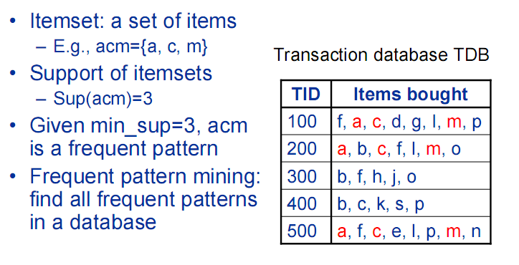
Association Pattern Example

Slide 69
Association Pattern Detecting
Statistics Approaches
Constructing temporal statistical features from discovered pattern.
Using measure-based method to detect intrusion
Pattern Matching
Nobody discuss this idea.

Slide 70
Machine Learning Method
Time-Based Inductive Machine
Like Bayes Network, use the probability and a direct graph to predict the next event
Instance Based Learning
Define a distance to measure the similarity between feature vectors
Neural Network
…

Slide 71
Classification
This is supervised learning. The class will be predetermined in training phase.
Define the character of classes in training phase.
A common approach in pattern recognition system

Slide 72
Clustering
This is unsupervised learning. There are not predetermined classes in data.
Given a set of measurement, the aim is that establishes the class or group in the data. It will output the character of each class or group.
In the detection phase, this method will get more time cost (O(n²)). I suggest this method only use in pattern discover phase

Slide 73
Ideas for improving Intrusion Detection

Slide 74
Idea 1: Association Pattern Detecting
Using the pattern matching algorithm to match the pattern in sequent data for detecting intrusion. No necessary to construct the measure.
But its time cost is depend on the number of association patterns.
It possible constructs a pattern tree to improve the pattern matching time cost to linear time

Slide 75
Idea 2: Discover Pattern from Rules
The exist rules are the knowledge from experts knowledge or other system.
The different methods will measure different aspects of intrusions.
Combine these rules may find other new patterns of unknown attack.
For example:
Snort has a set of rule which come from different people. The rules may have different aspects of intrusions.
We can use the data mining or machine learning method to discover the pattern from these rule.

Slide 77
Reference
Lee, W., & Stolfo, S.J. (2000). A framework for constructing features and models for intrusion detection systems. ACM Transactions on Information and System Security, 3 (4) (pp. 227-261).
Jian Pei,Data Mining for Intrusion Detection:Techniques,Applications and Systems, Proceedings of the 20th International Conference on Data Engineering (ICDE 04)
Peng Ning and Sushil Jajodia,Intrusion Detection Techniques. From http://discovery.csc.ncsu.edu/Courses/csc774-S03/IDTechniques.pdf
Snort---The open source intrusion detection system. (2002). Retrieved February 13, 2003, from http://www.snort.org.

Slide 79
Intrusion Detection Sytems
What is an IDS?
Definition
Characteristics
Examples of existing IDS
Strengths/weaknesses of IDS

Slide 80
What is an IDS?
Definition:
A piece of software
Monitors a computer system to detect:
Intrusion: unauthorized attempts to use the system
Misuse: abuse of existing privileges
Responds:
Log activity
Notify a designated authority
Take appropriate countermeasures

Slide 81
Why Use an IDS?
Security is often expensive/cumbersome:
Cost
Restrictions on users/functionality
Designers try to offer users “reasonable” levels of security
Security breaches will still occur
Detection allows:
Finding and fixing the most serious security holes
Perhaps holding intruders responsible for their actions
Limiting the amount of damage an attacker can do

Slide 82
Goals of an IDS
Run continually
Be fault tolerant
Resist subversion
Minimize overhead
Be easily configurable
Cope with changing system behavior
Be difficult to fool
Minimize false positives and false negatives

Slide 83
IDS Characteristics
Detection Model
Misuse detection vs. anomaly detection
Scope
Host based, multihost based, network based
Operation
Off-line vs. real-time
Architecture
Centralized vs. distributed

Slide 84
IDS Detection Model
Misuse detection - recognize known attacks
Define a set of attack signatures
Detect actions that match a signature
Add new signatures often
Examples: ARMD, ASIM, Bro, CSM, CyberCop, GRIDS, Stalker, Tripwire
Anomaly detection - recognize atypical behavior
Define a set of metrics for the system
Build a statistical model for those metrics during “normal” operation
Detect when metrics differ significantly from normal
Examples: AAFID, MIDAS, NADIR, UNICORN
Hybrid
Examples: CMDS, DIDS, EMERALD, INBOUNDS, NIDES, RealSecure

Slide 85
IDS Scope
Host based
Scrutinize data from a single host
Examples: ARMD, MIDAS, Tripwire
Multihost based
Analyze data from multiple hosts
Examples: AAFID, DIDS, CMDS, CSM, NIDES, Stalker
Network based
Examine network traffic (and possibly data from the connected hosts)
Examples: ASIM, Bro, CyberCop, EMERALD, GRIDS, INBOUNDS, NADIR, RealSecure, UNICORN

Slide 86
IDS Operation
Off-line
Inspect system logs at set intervals
Report any suspicious activity that was logged
Examples: ASIM, NADIR, Stalker, Tripwire
Real-time
Monitor the system continuously
Report suspicious activity as soon as it is detected
Examples: AAFID, ARMD, Bro, CMDS, CSM, CyberCop, DIDS, EMERALD, GRIDS, INBOUNDS, MIDAS, NIDES, RealSecure, UNICORN

Slide 87
IDS Architecture
Centralized
Data collected from single or multiple hosts
All data shipped to a central location for analysis
Examples: ARMD, ASIM, Bro, CMDS, CSM, CyberCop, DIDS,
MIDAS, NADIR, NIDES, RealSecure, Stalker, Tripwire, UNICORN
Hierarchical
Data collected from multiple hosts
Data is analyzed as it is passed up through the layers
Examples: EMERALD, INBOUNDS
Distributed
Data collected at each host
Distributed analysis of the data
Examples: AAFID, CSM, GRIDS

Slide 88
Thank you!

