Slide 1
Chapter 1
Is There a Security Problem in Computing?
Mrs. M. Lalli
Assistant Professor
Department of Computer Science
Bharathidasan University
Trichy

Slide 2
In This Chapter
The risks involved in computing
The goal of secure computing: confidentiality, integrity, availability
The threats to security in computing: interception, interruption, modifications, fabrication
Controls available to address these threats: encryption, programming controls, operating systems, network controls, administrative controls, laws and ethics

Slide 3
Information Security Services
Confidentiality
Integrity
Authentication
Nonrepudiation
Access Control
Availability

Slide 4
Information Security Services
Confidentiality
Maintaining the privacy of data
Integrity
Detecting that the data is not tampered with
Authentication
Establishing proof of identity
Nonrepudiation
Ability to prove that the sender actually sent the data
Access Control
Access to information resources are regulated
Availability
Computer assets are available to authorized parties when needed
SERVICES
Notes:
Confidentiality
Integrity
Authentication
Ensures that the origin of a message is correctly identified, with an assurance that the identity is not false
Nonrepudiation
Neither the sender nor the receiver of a message is able to deny the transmission
Access Control
Availability

Slide 5
HACKER MOTIVATIONS
Money, profit
Access to additional resources
Experimentation and desire to learn
“Gang” mentality
Psychological needs
Self-gratification
Personal vengeance
Emotional issues
Desire to embarrass the target

Slide 6
What Does “Secure” Mean?
Are you Secure?
What makes you feel secure?
Example: Banks
Yesterday – learning from the past
Today
Protecting Valuables
Protecting Money Vs. Protecting Information
Size and Portability (large vs. small)
Ability to Avoid Physical Contact (lots vs. little)
Value of Asset (very high vs. variable)

Slide 7
Developing an Understanding
Examine the risk of security in computing
Consider available countermeasures or controls
Stimulate thought about uncovered vulnerabilities
Identify areas where more work is needed

Slide 8
Characteristics of Computer Intrusion
Any computer system can be a target:
Hardware, Software, Storage, Data, People/User
Any system is most vulnerable at its weakest point.
Principle of Easiest Penetration - An intruder must be expected to use any available means of penetration. Penetration may not necessarily be by the most obvious means, nor via the one we have the most defense against.
Consider all the means of penetration
Checked repeated times
Don’t underestimate the attacker/think like an attacker
Strengthening one thin might weaken another

Slide 9
Attacks
The components to attack:
Hardware
Software
Data
Vulnerability – a weakness in the security system that could be exploited to cause harm or loss.
Threat – a set of circumstances that has the potential to cause loss or harm.
Wall holding back water
Threat to get wet
Vulnerability is a crack in the wall

Slide 10
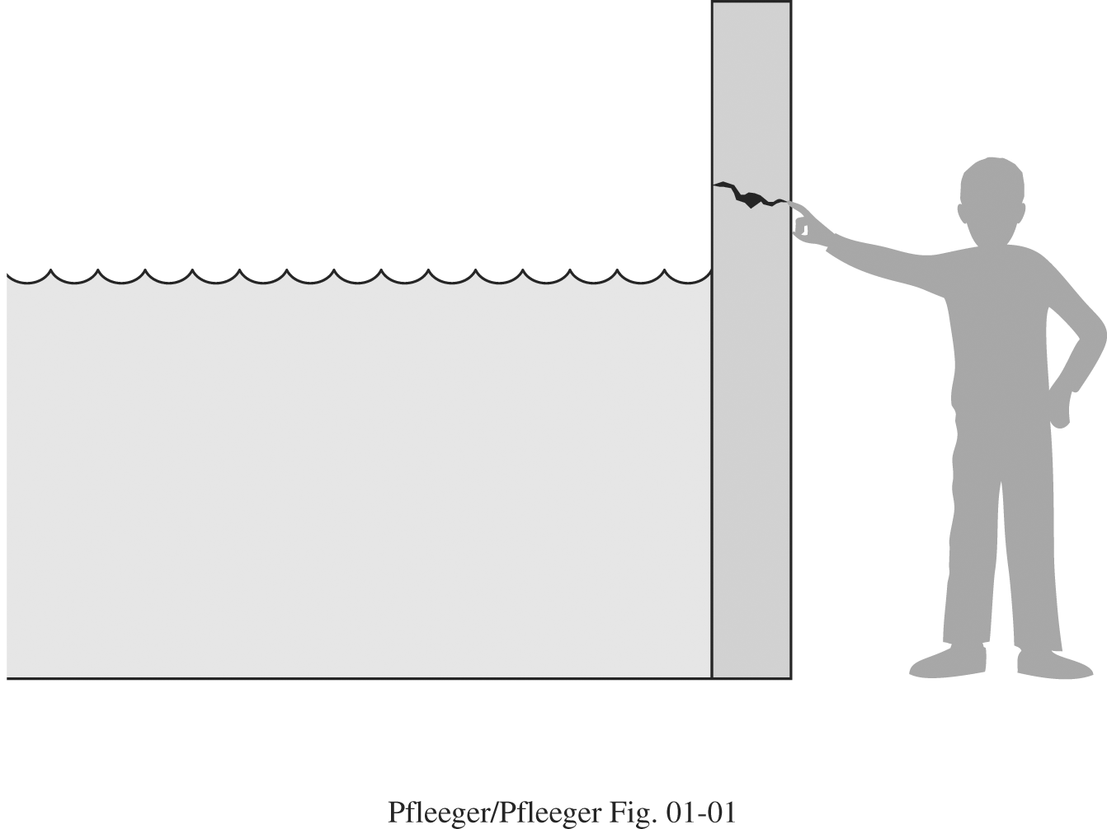

Slide 11
Attack – human who exploits a vulnerability
Control – a protective measure against an attack
A threat is blocked by control of vulnerability
Type of System Security Threats in computing
Interception
Interruption
Modification
Fabrication

Slide 12
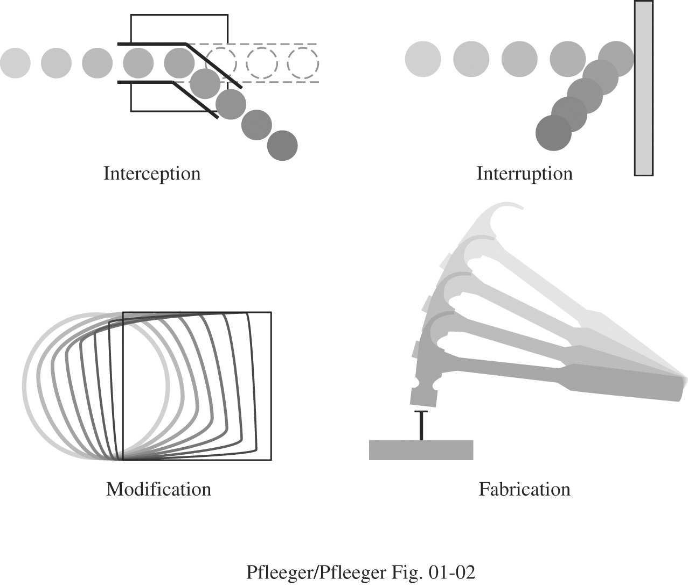

Slide 13
Method, Opportunity & Motive
Why? Who? What? When? Where?
Attacker must have three things:
Method – the skill, knowledge and tool
Opportunity – the time and access
Motive – a reason to want to perform an attack

Slide 14
Security Goals
Secure is:
Confidentiality (Secrecy or Privacy)- assets accessed only by authorized parties
Not only reading but viewing, printing or knowing about the asset
Integrity – assets modified only by authorized parties
Includes writing, changing, changing the status, deleting or creating
Availability – assets are accessible to authorized parties at appropriate times.
Denial of Service

Slide 15
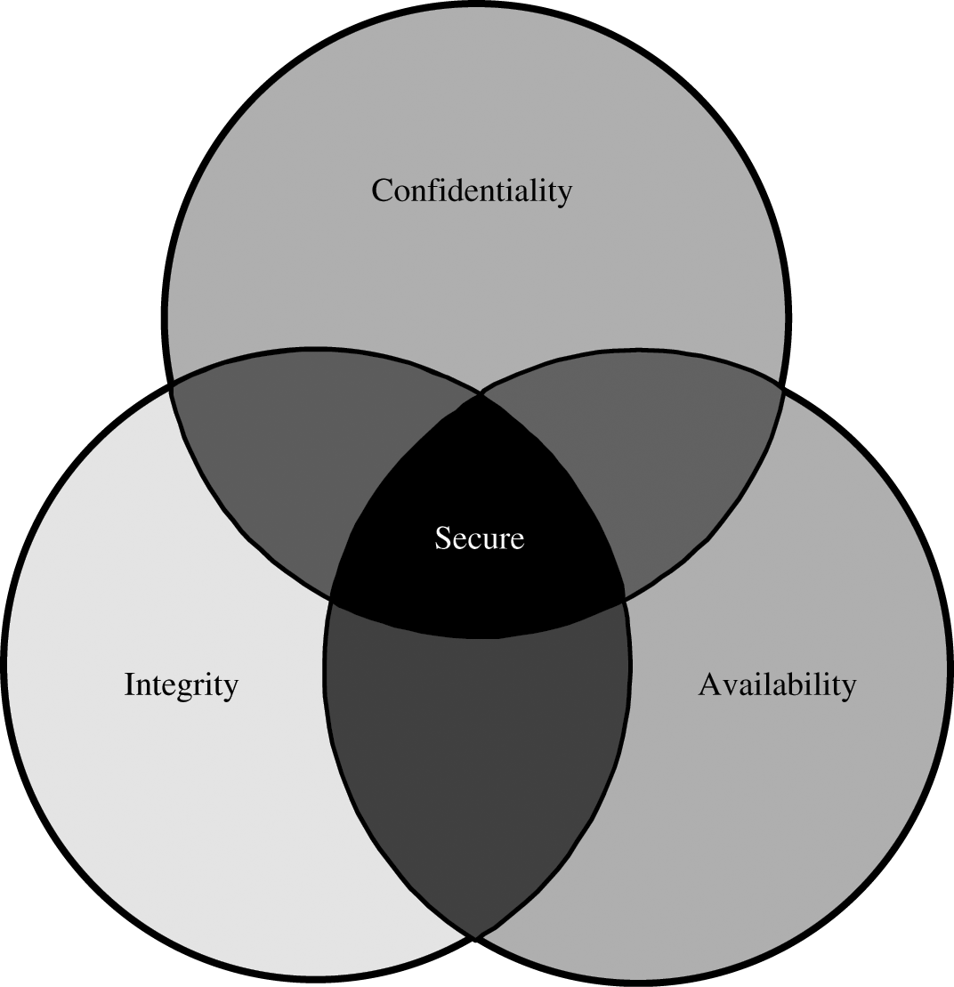

Slide 16
Vulnerabilities
Hardware
It is very visible
Easy to attack
Water, burned, frozen, gassed and electrocuted, dust, time, rodents, environment
Voluntary Machine Slaughter or Machinicide
Software
Software Deletion
Software Modification
Software Theft

Slide 17
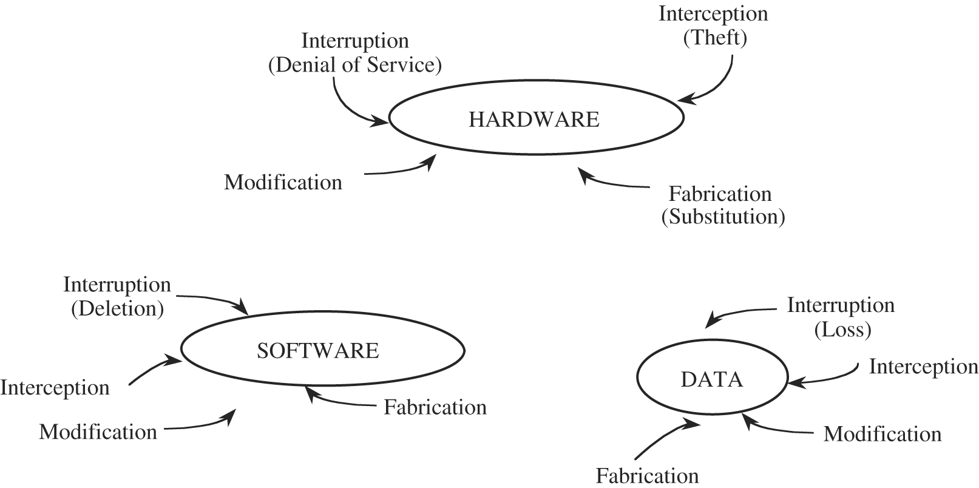

Slide 18
Malicious Modification of Software
Logic Bomb
Trojan Horse
Virus
Trapdoor
Information leaks
Data Vulnerabilities
Effects everyone
Data is more than just an electronic file
Principle of Adequate Protection – Computer items must be protected only until they lose their value.
Data Confidentiality
Data Integrity
Other Exposed Assets
Networks
Access
Key People

Slide 19
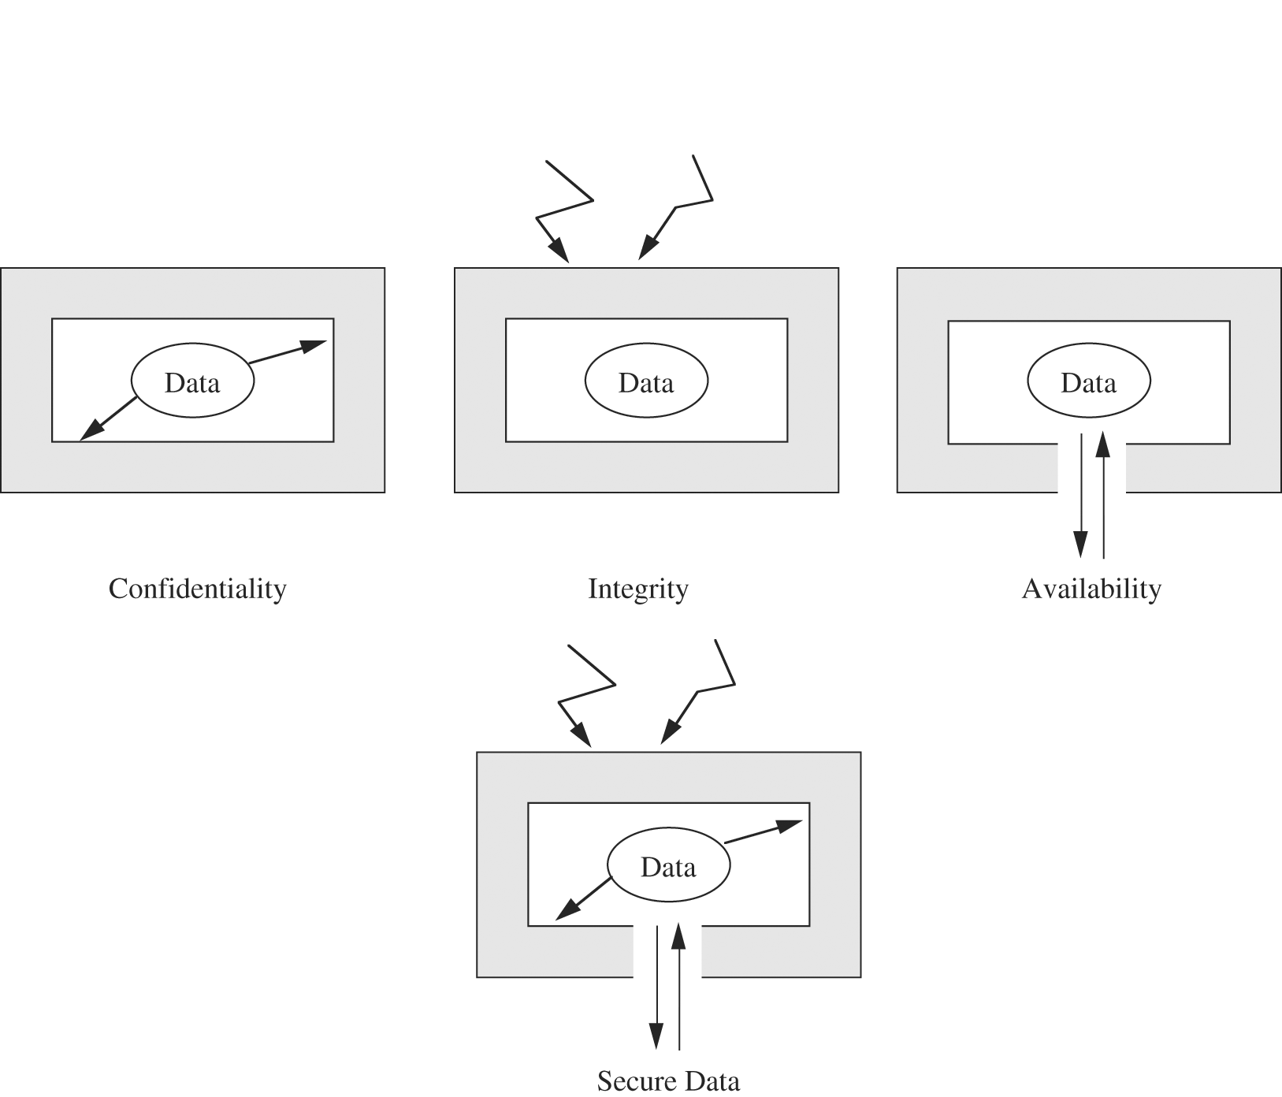

Slide 20
Computer Criminals
Amateurs
Crackers or Hackers
Career Criminal
Terrorists

Slide 21
Methods of Defense
Harm occurs when a threat is realized against a vulnerability
Risk – the possibility of harm
Dealing with Harm
Prevent it
Deter it,
Deflect it,
Detect it,
And Recover from it.

Slide 22
Controls
Control – attempt to prevent the exploitation of a vulnerability
Computer Security has lots of controls
Simple or Difficulty
Inexpensive or Expensive
Type of Control
Encryption – formal name for the scrambling process
deals with confidentially and integrity
Does not solve computer security problems.
Cleartext
Ciphertext
Protocols

Slide 23
Software Controls
Programs must be secure to prevent attacks
Program Controls:
Internal Program Controls
Operating System and Network System Controls
Independent Control Programs (virus checker)
Development Controls (quality standards in construction)
Software controls effect the user
Hardware Controls
Smart cards, locks, devices to ID users, firewalls, intrusion detection systems, circuitry control
Policies and Procedures
Policies – an agreement of way things are done
Must be written and training provided
Physical Controls – locks/security officer/backups

Slide 24
Effectiveness of Controls
Controls must be properly used!
Awareness of Problem
Likelihood of Use
Principles of Effectiveness - Control must be used-and used properly- to be effective. They must be efficient, easy to use, and appropriate.
Overlapping Controls (good)
Periodic Review – controls are not permanent
Principle of Weakest Link – Security can be no stronger than its weakest link.

Slide 25
Conclusion
The risks involved in computing
The goal of secure computing: confidentiality, integrity, availability
The threats to security in computing: interception, interruption, modifications, fabrication
Controls available to address these threats: encryption, programming controls, operating systems, network controls, administrative controls, laws and ethics

Slide 26
Recap
What is our goal in this course?
Identify security and privacy issues
Design systems that are more protective of security and privacy
What is security?
Confidentiality, Integrity, Availability
What is privacy?
Informational self-determination

Slide 27
Recap
Who are the adversaries?
Learn to think like an attacker
Assets, vulnerabilities, threats, attacks and controls
You control a vulnerability to prevent an attack and block a threat.
Methods of defence
Cryptography, software controls, hardware controls, physical controls, policies and procedures

Slide 28
Next time
Program security
Flaws, faults, and failures
Types of security flaws
Unintentional security flaws
Buffer overflows
Incomplete mediation

