Slide 1
Cryptography
Mrs. M. Lalli
Assistant Professor
Department of Computer Science
Bharathidasan University
Trichy

Slide 2
Announcement
Grading adjusted
  10% participation and two exams 20% each
Newsgroup up
Assignment upload webpage up
Homework 1 will be released over the weekend

Slide 3
Review
What is security: history and definition
Security policy, mechanisms and services
Security models

Slide 4
Outline
Overview of Cryptography
Classical Symmetric Cipher
Modern Symmetric Ciphers (DES)

Slide 5
Basic Terminology
plaintext - the original message
ciphertext - the coded message
cipher - algorithm for transforming plaintext to ciphertext
key - info used in cipher known only to sender/receiver
encipher (encrypt) - converting plaintext to ciphertext
decipher (decrypt) - recovering ciphertext from plaintext
cryptography - study of encryption principles/methods
cryptanalysis (codebreaking) - the study of principles/ methods of deciphering ciphertext without knowing key
cryptology - the field of both cryptography and cryptanalysis
Notes:
Briefly review some terminology used throughout the course.

Slide 6
Classification of Cryptography
Number of keys used
  Hash functions: no key
  Secret key cryptography: one key
  Public key cryptography: two keys - public, private
Type of encryption operations used
  substitution / transposition / product
Way in which plaintext is processed
  block / stream

Slide 7
Secret Key vs. Secret Algorithm
Secret algorithm: additional hurdle
Hard to keep secret if used widely:
  Reverse engineering, social engineering
Commercial: published
  Wide review, trust
Military: avoid giving enemy good ideas

Slide 8
Cryptanalysis Scheme
Ciphertext only:
  Exhaustive search until “recognizable plaintext”
  Need enough ciphertext
Known plaintext:
  Secret may be revealed (by spy, time), thus <ciphertext, plaintext> pair is obtained
  Great for monoalphabetic ciphers
Chosen plaintext:
  Choose text, get encrypted
  Useful if limited set of messages

Slide 9
Unconditional vs. Computational Security
Unconditional security
  No matter how much computer power is available, the cipher cannot be broken
  The ciphertext provides insufficient information to uniquely determine the corresponding plaintext
  Only one-time pad scheme qualifies
Computational security
  The cost of breaking the cipher exceeds the value of the encrypted info
  The time required to break the cipher exceeds the useful lifetime of the info
Notes:
Unconditional security would be nice, but the only known such cipher is the one-time pad (later). For all reasonable encryption algorithms, have to assume computational security where it either takes too long, or is too expensive, to bother breaking the cipher.

Slide 10
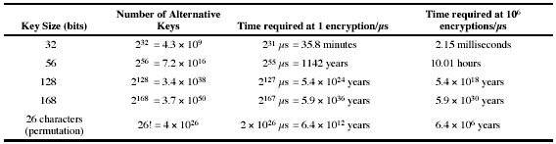
Brute Force Search
Always possible to simply try every key
Most basic attack, proportional to key size
Assume either know / recognise plaintext

Slide 11
Outline
Overview of Cryptography
Classical Symmetric Cipher
  Substitution Cipher
  Transposition Cipher
Modern Symmetric Ciphers (DES)

Slide 12
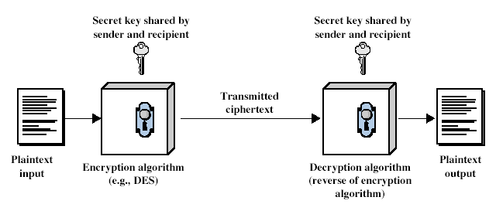
Symmetric Cipher Model
Notes:
Detail 5 ingredients of the symmetric cipher model:
plaintext
encryption algorithm – performs substitutions/transformations on plaintext
secret key – control exact substitutions/transformations used in encryption algorithm
ciphertext
decryption algorithm – inverse of encryption algorithm

Slide 13
Requirements
Two requirements for secure use of symmetric encryption:
  a strong encryption algorithm
  a secret key known only to sender / receiver
Y = E_{K}(X)
X = D_{K}(Y)
Assume encryption algorithm is known
Implies a secure channel to distribute key
Notes:
Generally assume that the algorithm is known.
This allows easy distribution of s/w and h/w implementations.
Hence assume just keeping key secret is sufficient to secure encrypted messages.
Have plaintext X, ciphertext Y, key K, encryption alg Ek, decryption alg Dk.

Slide 14
Classical Substitution Ciphers
Letters of plaintext are replaced by other letters or by numbers or symbols
Plaintext is viewed as a sequence of bits, then substitution replaces plaintext bit patterns with ciphertext bit patterns
Notes:
In this section and the next, we examine a sampling of what might be called classical encryption
techniques. A study of these techniques enables us to illustrate the basic approaches to
symmetric encryption used today and the types of cryptanalytic attacks that must be anticipated.
The two basic building blocks of all encryption techniques: substitution and transposition.
We examine these in the next two sections. Finally, we discuss a system that combine both
substitution and transposition.

Slide 15
Caesar Cipher
Earliest known substitution cipher
Replaces each letter by 3rd letter on
Example:
meet me after the toga party
PHHW PH DIWHU WKH WRJD SDUWB
Notes:
Substitution ciphers form the first of the fundamental building blocks. The core idea is to replace one basic unit (letter/byte) with another. Whilst the early Greeks described several substitution ciphers, the first attested use in military affairs of one was by Julius Caesar, described by him in Gallic Wars (cf. Kahn pp83-84). Still call any cipher using a simple letter shift a caesar cipher, not just those with shift 3.
Note: when letters are involved, the following conventions are used in this course: Plaintext is always in lowercase; ciphertext is in uppercase; key values are in italicized lowercase.

Slide 16
Caesar Cipher
Define transformation as:
a b c d e f g h i j k l m n o p q r s t u v w x y z
D E F G H I J K L M N O P Q R S T U V W X Y Z A B C
Mathematically give each letter a number
a b c d e f g h i j k l m
0 1 2 3 4 5 6 7 8 9 10 11 12
n o p q r s t u v w x y Z
13 14 15 16 17 18 19 20 21 22 23 24 25
Then have Caesar cipher as:
C = E(p) = (p + k) mod (26)
p = D(C) = (C – k) mod (26)
Notes:
This mathematical description uses modulo arithmetic (ie clock arithmetic). Here, when you reach Z you go back to A and start again. Mod 26 implies that when you reach 26, you use 0 instead (ie the letter after Z, or 25 + 1 goes to A or 0).
Example: howdy (7,14,22,3,24) encrypted using key f (5) is MTBID

Slide 17
Cryptanalysis of Caesar Cipher
Only have 25 possible ciphers
  A maps to B,..Z
Given ciphertext, just try all shifts of letters
Do need to recognize when have plaintext
E.g., break ciphertext "GCUA VQ DTGCM"
Notes:
With a caesar cipher, there are only 26 possible keys, of which only 25 are of any use, since mapping A to A etc doesn't really obscure the message! cf. basic rule of cryptanalysis "check to ensure the cipher operator hasn't goofed and sent a plaintext message by mistake"!
Can try each of the keys (shifts) in turn, until can recognise the original message. See Stallings Fig 2.3 for example of search.
Note: as mentioned before, do need to be able to recognise when have an original message (ie is it English or whatever). Usually easy for humans, hard for computers. Though if using say compressed data could be much harder.
Example "GCUA VQ DTGCM" when broken gives "easy to break", with a shift of 2 (key C).

Slide 18
Monoalphabetic Cipher
Rather than just shifting the alphabet
Could shuffle (jumble) the letters arbitrarily
Each plaintext letter maps to a different random ciphertext letter
Key is 26 letters long
Plain: abcdefghijklmnopqrstuvwxyz
Cipher: DKVQFIBJWPESCXHTMYAUOLRGZN
Plaintext: ifwewishtoreplaceletters
Ciphertext: WIRFRWAJUHYFTSDVFSFUUFYA

Slide 19
Monoalphabetic Cipher Security
Now have a total of 26! = 4 x 10²⁶ keys
Is that secure?
Problem is language characteristics
  Human languages are redundant
  Letters are not equally commonly used

Slide 20
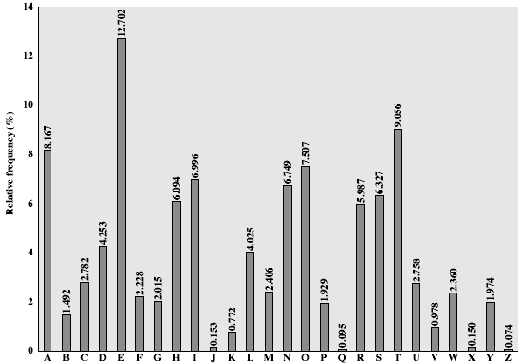
English Letter Frequencies
Notes:
This graph is based on counts done at ADFA in the late 1980's, and used to develop the tables published in Seberry & Pieprzyk [SEBE89].
Note that all human languages have varying letter frequencies, though the number of letters and their frequencies varies.
Seberry & Pieprzyk [SEBE89] Appendix A has graphs for 20 languages (most European & Japanese & Malay).

Slide 21
Example Cryptanalysis
Given ciphertext:
UZQSOVUOHXMOPVGPOZPEVSGZWSZOPFPESXUDBMETSXAIZ
VUEPHZHMDZSHZOWSFPAPPDTSVPQUZWYMXUZUHSX
EPYEPOPDZSZUFPOMBZWPFUPZHMDJUDTMOHMQ
Count relative letter frequencies (see text)
Guess P & Z are e and t
Guess ZW is th and hence ZWP is the
Proceeding with trial and error finally get:
it was disclosed yesterday that several informal but
direct contacts have been made with political
representatives of the viet cong in moscow

Slide 22
One-Time Pad
If a truly random key as long as the message is used, the cipher will be secure - One-Time pad
E.g., a random sequence of 0’s and 1’s XORed to plaintext, no repetition of keys
Unbreakable since ciphertext bears no statistical relationship to the plaintext
For any plaintext, it needs a random key of the same length
  Hard to generate large amount of keys
Have problem of safe distribution of key
Notes:
The One-Time Pad is an evolution of the Vernham cipher, which was invented by Gilbert Vernham in 1918, and used a long tape of random letters to encrypt the message. An Army Signal Corp officer, Joseph Mauborgne, proposed an improvement using a random key that was truly as long as the message, with no repetitions, which thus totally obscures the original message.
Since any plaintext can be mapped to any ciphertext given some key, there is simply no way to determine which plaintext corresponds to a specific instance of ciphertext.

Slide 23
Transposition Ciphers
Now consider classical transposition or permutation ciphers
These hide the message by rearranging the letter order, without altering the actual letters used
Can recognise these since have the same frequency distribution as the original text
Notes:
Transposition Ciphers form the second basic building block of ciphers. The core idea is to rearrange the order of basic units (letters/bytes/bits) without altering their actual values.

Slide 24
Rail Fence cipher
Write message letters out diagonally over a number of rows
Then read off cipher row by row
E.g., write message out as:
m e m a t r h t g p r y
e t e f e t e o a a t
Giving ciphertext
MEMATRHTGPRYETEFETEOAAT
Notes:
Example message is: "meet me after the toga party" with a rail fence of depth 2.

Slide 25
Product Ciphers
Ciphers using substitutions or transpositions are not secure because of language characteristics
Hence consider using several ciphers in succession to make harder, but:
  Two substitutions make a more complex substitution
  Two transpositions make more complex transposition
  But a substitution followed by a transposition makes a new much harder cipher
This is bridge from classical to modern ciphers

Slide 26
Outline
Overview of Cryptography
Classical Symmetric Cipher
Modern Symmetric Ciphers (DES)

Slide 27
Block vs Stream Ciphers
Block ciphers process messages in into blocks, each of which is then en/decrypted
Like a substitution on very big characters
  64-bits or more
Stream ciphers process messages a bit or byte at a time when en/decrypting
Many current ciphers are block ciphers, one of the most widely used types of cryptographic algorithms
Notes:
Block ciphers work a on block / word at a time, which is some number of bits. All of these bits have to be available before the block can be processed. Stream ciphers work on a bit or byte of the message at a time, hence process it as a “stream”.

Slide 28
Block Cipher Principles
Most symmetric block ciphers are based on a Feistel Cipher Structure
Block ciphers look like an extremely large substitution
Would need table of 2⁶⁴ entries for a 64-bit block
Instead create from smaller building blocks
Using idea of a product cipher
Notes:
An arbitrary reversible substitution cipher for a large block size is not practical, however, from an implementation and performance point of view. In general, for an n-bit general substitution block cipher, the size of the key is n x 2^{n}. For a 64-bit block, which is a desirable length to thwart statistical attacks, the key size is 64 x 2⁶⁴ = 2⁷⁰ = 10²¹ bits.

Slide 29
Substitution-Permutation Ciphers
Substitution-permutation (S-P) networks [Shannon, 1949]
  modern substitution-transposition product cipher
These form the basis of modern block ciphers
S-P networks are based on the two primitive cryptographic operations
  substitution (S-box)
  permutation (P-box)
provide confusion and diffusion of message
Notes:
Claude Shannon’s 1949 paper has the key ideas that led to the development of modern block ciphers. Critically, it was the technique of layering groups of S-boxes separated by a larger P-box to form the S-P network, a complex form of a product cipher. He also introduced the ideas of confusion and diffusion, notionally provided by S-boxes and P-boxes (in conjunction with S-boxes).

Slide 30
Confusion and Diffusion
Cipher needs to completely obscure statistical properties of original message
A one-time pad does this
More practically Shannon suggested S-P networks to obtain:
Diffusion – dissipates statistical structure of plaintext over bulk of ciphertext
Confusion – makes relationship between ciphertext and key as complex as possible
Notes:
Every block cipher involves a transformation of a block of plaintext into a block of ciphertext, where the transformation depends on the key. The mechanism of diffusion seeks to make the statistical relationship between the plaintext and ciphertext as complex as possible in order to thwart attempts to deduce the key. confusion seeks to make the relationship between the statistics of the ciphertext and the value of the encryption key as complex as possible, again to thwart attempts to discover the key.
So successful are diffusion and confusion in capturing the essence of the desired attributes of a block cipher that they have become the cornerstone of modern block cipher design.

Slide 31
Feistel Cipher Structure
Feistel cipher implements Shannon’s S-P network concept
  based on invertible product cipher
Process through multiple rounds which
  partitions input block into two halves
  perform a substitution on left data half
  based on round function of right half & subkey
  then have permutation swapping halves
Notes:
Horst Feistel, working at IBM Thomas J Watson Research Labs devised a suitable invertible cipher structure in early 70's.
One of Feistel's main contributions was the invention of a suitable structure which adapted Shannon's S-P network in an easily inverted structure. Essentially the same h/w or s/w is used for both encryption and decryption, with just a slight change in how the keys are used. One layer of S-boxes and the following P-box are used to form the round function.

Slide 32
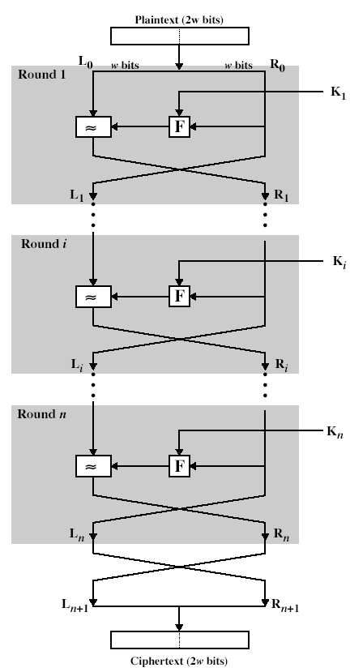
Feistel Cipher Structure

Slide 33
DES (Data Encryption Standard)
Published in 1977, standardized in 1979.
Key: 64 bit quantity=8-bit parity+56-bit key
  Every 8th bit is a parity bit.
64 bit input, 64 bit output.
64 bit M
64 bit C
DES
Encryption
56 bits
Notes:
33

Slide 34
DES Top View
56-bit Key
64-bit Input
48-bit K1
Generate keys
Permutation
Initial Permutation
48-bit K1
Round 1
48-bit K2
Round 2
…...
48-bit K16
Round 16
Swap
Swap 32-bit halves
Permutation
Final Permutation
64-bit Output

Slide 35
Bit Permutation (1-to-1)
1 2 3 4 32
…….
Input:
0 0 1 0 1
1 bit
Output
……..
1 0 1 1 1
22 6 13 32 3
Notes:
35

Slide 36
Per-Round Key Generation
Initial Permutation of DES key
C _{i-1}
28 bits
D _{i-1}
28 bits
Circular Left Shift
Circular Left Shift
One
round
Permutation
with Discard
Round 1,2,9,16:
single shift
Others: two bits
48 bits
K_{i}
C _{i}
28 bits
D _{i}
28 bits
Notes:
36

Slide 37
A DES Round
32 bits L_{n}
32 bits R_{n}
E
One Round
Encryption
48 bits
Mangler
Function
48 bits
K_{i}
S-Boxes
P
32 bits
32 bits L_{n+1}
32 bits R_{n+1}
Notes:
37

Slide 38
Bits Expansion (1-to-m)
1 2 3 4 5 32
Input:
…….
0 0 1 0 1 1
Output
……..
1 0 0 1 0 1 0 1 1 0
1 2 3 4 5 6 7 8 48
Notes:
38

Slide 39
S-Box Examples
Each row and column contain different numbers.
0 1 2 3 4 5 6 7 8 9…. 15
0 14 4 13 1 2 15 11 8 3
1 0 15 7 4 14 2 13 1 10
2 4 1 14 8 13 6 2 11 15
3 15 12 8 2 4 9 1 7 5
Example: input: 100110 output: ???
Notes:
39

Slide 40
DES Standard
Cipher Iterative Action :
  Input: 64 bits
  Key: 48 bits
  Output: 64 bits
Key Generation Box :
  Input: 56 bits
  Output: 48 bits
One round (Total 16 rounds)
Notes:
40

Slide 41
DES Box Summary
Simple, easy to implement:
  Hardware/gigabits/second, software/megabits/second
56-bit key DES may be acceptable for non-critical applications but triple DES (DES3) should be secure for most applications today
Supports several operation modes (ECB CBC, OFB, CFB) for different applications
Notes:
41

