Slide 1
Overview of Big Data
Dr. P. Sumathy
Assistant Professor
Department Of Computer Science
Bharathidasan University

Slide 2
Topics Covered
What is Big data?
History of Data Management
Evolution of Big data
Elements of Big data
Carriers in Big Data
Future of Big Data
Use of Big Data in Social Networking
Introducing Technologies for handling Big data
Hadoop -Cloud Computing and Big Data

Slide 3
What’s Big Data?
No single definition; here is from Wikipedia:
Big data is the term for a collection of data sets so large and complex that it becomes difficult to process using on-hand database management tools or traditional data processing applications.
The challenges include capture, curation, storage, search, sharing, transfer, analysis, and visualization.
The trend to larger data sets is due to the additional information derivable from analysis of a single large set of related data, as compared to separate smaller sets with the same total amount of data, allowing correlations to be found to "spot business trends, determine quality of research, prevent diseases, link legal citations, combat crime, and determine real-time roadway traffic conditions.”

Slide 4
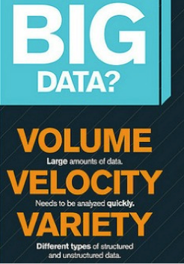
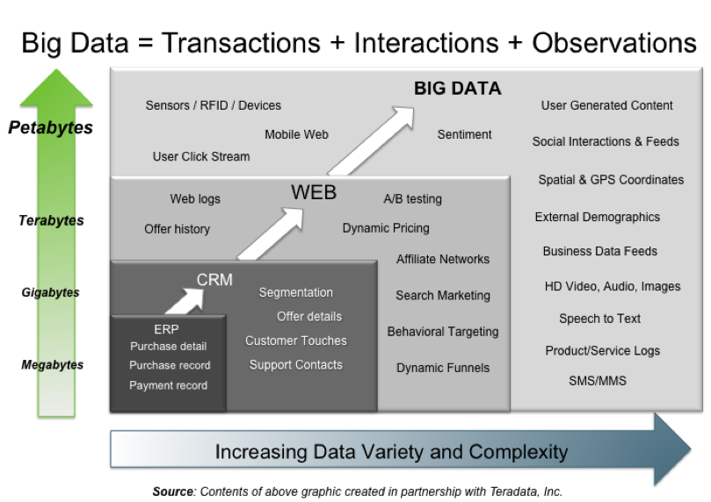
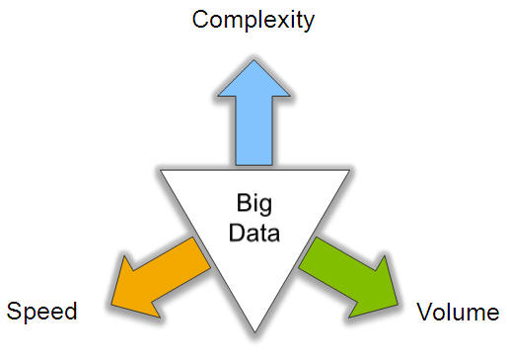
Big Data: 3V’s

Slide 5
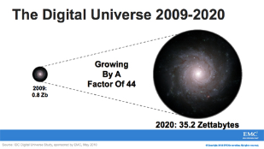
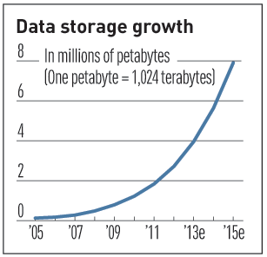

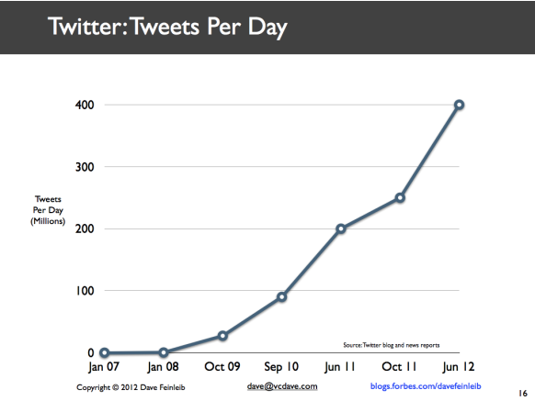
Volume (Scale)
Data Volume
44x increase from 2009 2020
From 0.8 zettabytes to 35zb
Data volume is increasing exponentially
Exponential increase in collected/generated data

Slide 6



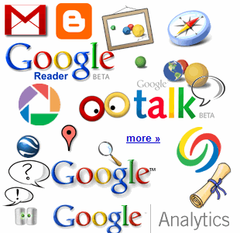

4.6 billion camera phones world wide
30 billion RFID tags today (1.3B in 2005)
12+ TBs of tweet data every day
100s of millions of GPS enabled devices sold annually
? TBs of data every day
25+ TBs of log data every day
2+ billion people on the Web by end 2011
76 million smart meters in 2009… 200M by 2014

Slide 7
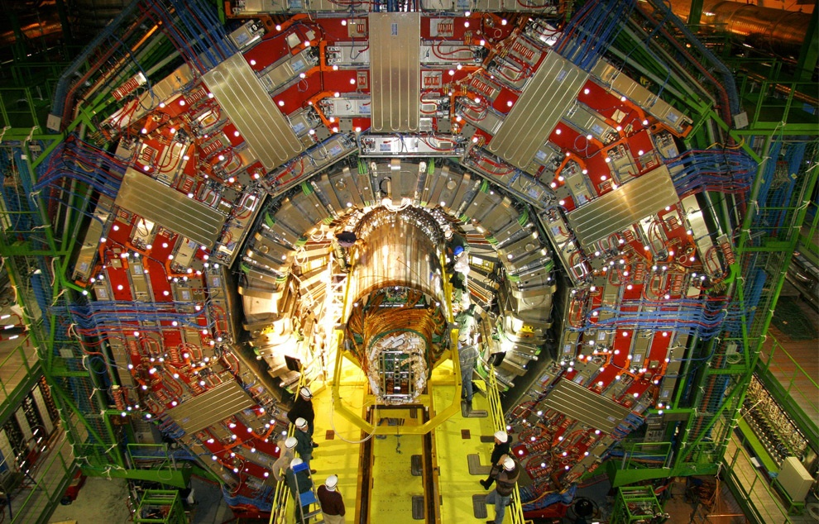
CERN’s Large Hydron Collider (LHC) generates 15 PB a year
Maximilien Brice, © CERN

Slide 8
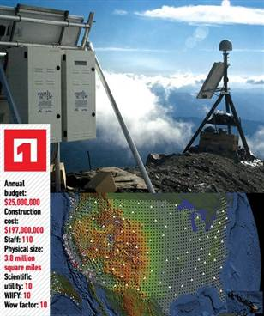
The Earthscope
1.
The Earthscope is the world's largest science project. Designed to track North America's geological evolution, this observatory records data over 3.8 million square miles, amassing 67 terabytes of data. It analyzes seismic slips in the San Andreas fault, sure, but also the plume of magma underneath Yellowstone and much, much more. (http://www.msnbc.msn.com/id/44363598/ns/technology_and_science-future_of_technology/#.TmetOdQ--uI)

Slide 9
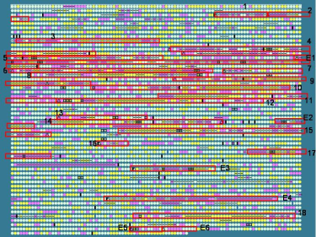
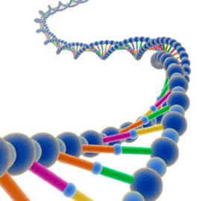
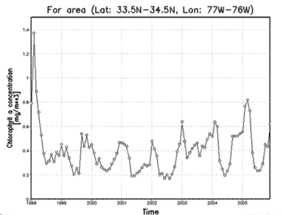
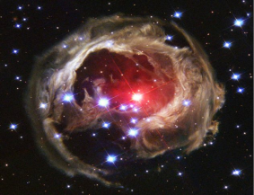
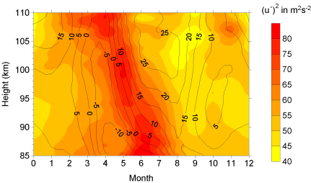
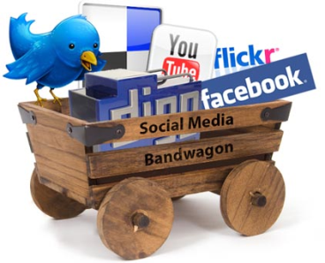
Variety (Complexity)
Relational Data (Tables/Transaction/Legacy Data)
Text Data (Web)
Semi-structured Data (XML)
Graph Data
Social Network, Semantic Web (RDF), …
Streaming Data
You can only scan the data once
A single application can be generating/collecting many types of data
Big Public Data (online, weather, finance, etc)
To extract knowledge➔ all these types of data need to linked together

Slide 10









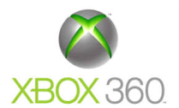







A Single View to the Customer
Social Media
Banking
Finance
Gaming
Our
Known
History
Customer
Entertain
Purchase

Slide 11

Velocity (Speed)
Data is begin generated fast and need to be processed fast
Online Data Analytics
Late decisions ➔ missing opportunities
Examples
E-Promotions: Based on your current location, your purchase history, what you like ➔ send promotions right now for store next to you
Healthcare monitoring: sensors monitoring your activities and body ➔ any abnormal measurements require immediate reaction

Slide 12


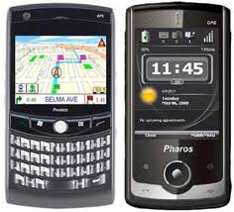
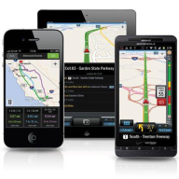

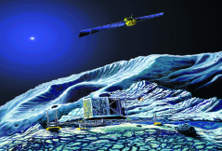
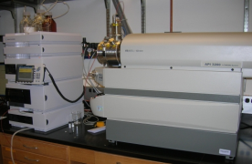
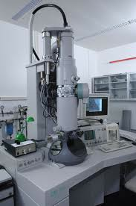
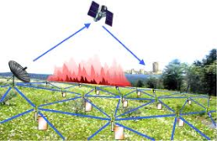
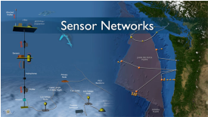
Real-time/Fast Data
Mobile devices
(tracking all objects all the time)
Social media and networks
(all of us are generating data)
Scientific instruments
(collecting all sorts of data)
Sensor technology and networks
(measuring all kinds of data)
The progress and innovation is no longer hindered by the ability to collect data
But, by the ability to manage, analyze, summarize, visualize, and discover knowledge from the collected data in a timely manner and in a scalable fashion

Slide 13
Real-Time Analytics/Decision Requirement
Product
Recommendations
that are Relevant
& Compelling
Learning why Customers
Switch to competitors
and their offers; in
time to Counter
Influence
Behavior
Customer
Friend Invitations
to join a
Game or Activity
that expands
business
Improving the
Marketing
Effectiveness of a
Promotion while it
is still in Play
Preventing Fraud
as it is Occurring
& preventing more
proactively

Slide 14
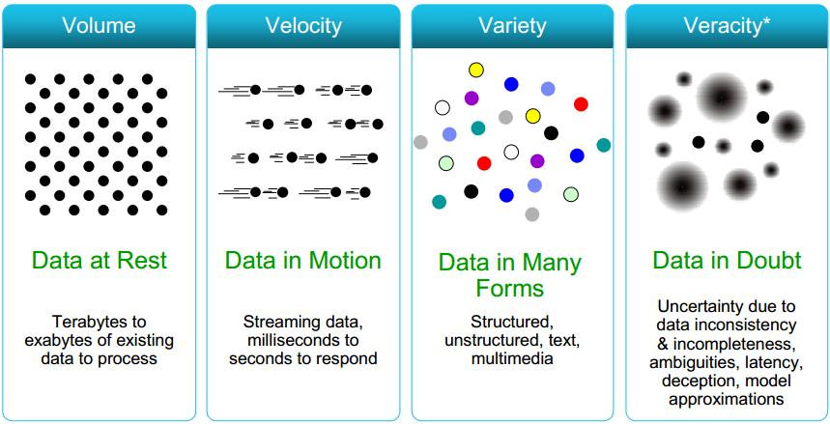
Some Make it 4V’s

Slide 15
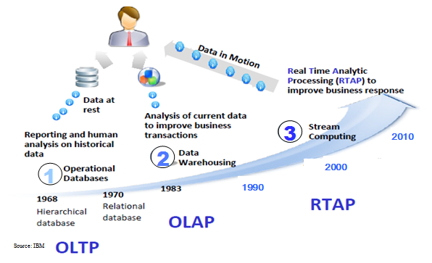
Harnessing Big Data
OLTP: Online Transaction Processing (DBMSs)
OLAP: Online Analytical Processing (Data Warehousing)
RTAP: Real-Time Analytics Processing (Big Data Architecture & technology)

Slide 16
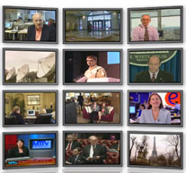

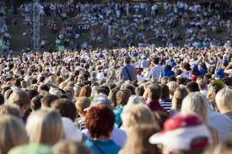

The Model Has Changed…
The Model of Generating/Consuming Data has Changed
Old Model: Few companies are generating data, all others are consuming data
New Model: all of us are generating data, and all of us are consuming data

Slide 17
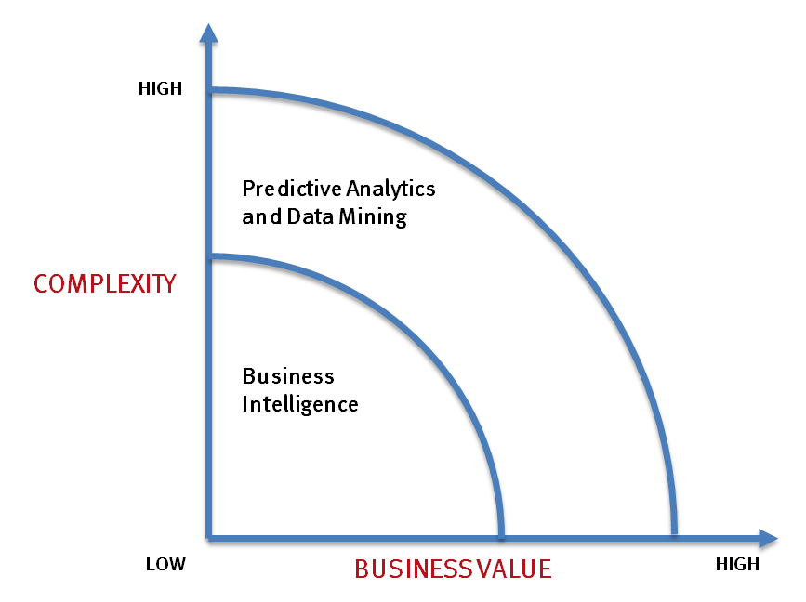
What’s driving Big Data
- Optimizations and predictive analytics
- Complex statistical analysis
- All types of data, and many sources
- Very large datasets
- More of a real-time
- Ad-hoc querying and reporting
- Data mining techniques
- Structured data, typical sources
- Small to mid-size datasets

Slide 18
The Evolution of Business Intelligence
Interactive Business Intelligence &
In-memory RDBMS
QliqView, Tableau, HANA
Big Data:
Real Time &
Single View
Graph Databases
Speed
Scale
BI Reporting
OLAP &
Dataware house
Business Objects, SAS, Informatica, Cognos other SQL Reporting Tools
Big Data:
Batch Processing &
Distributed Data Store
Hadoop/Spark; HBase/Cassandra
Scale
Speed
1990’s
2000’s
2010’s

Slide 19
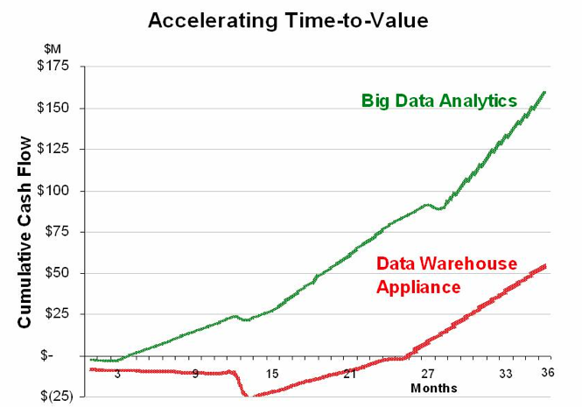
Big Data Analytics
Big data is more real-time in nature than traditional DW applications
Traditional DW architectures (e.g. Exadata, Teradata) are not well-suited for big data apps
Shared nothing, massively parallel processing, scale out architectures are well-suited for big data apps

Slide 20
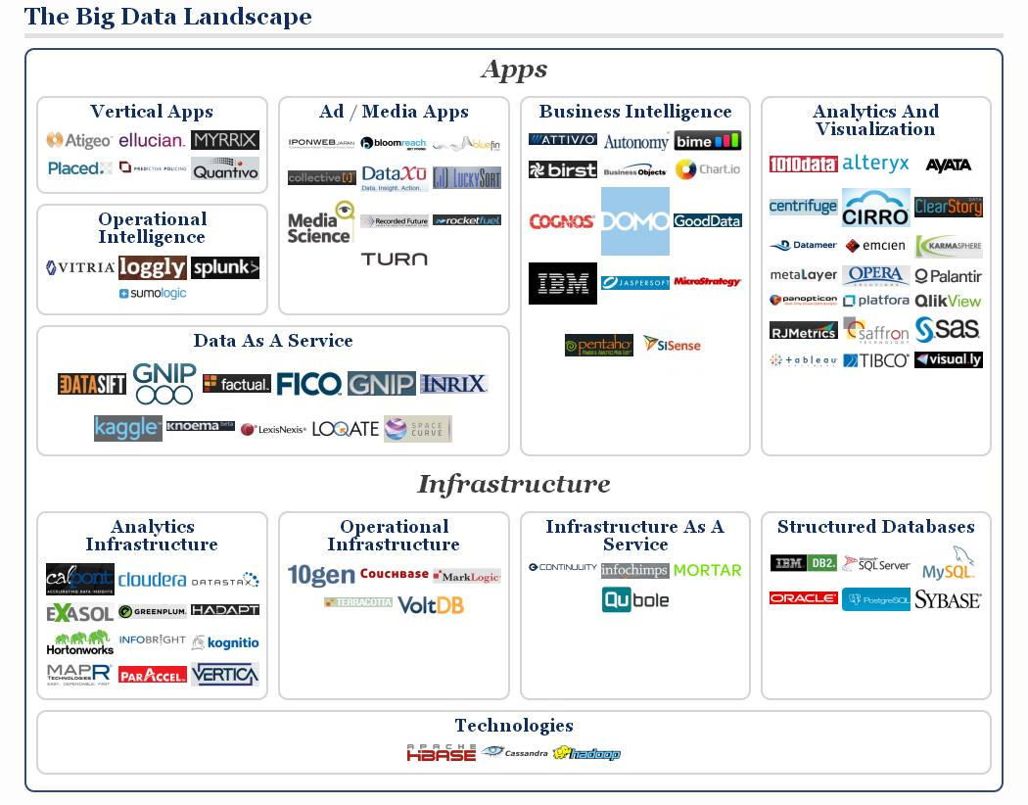

Slide 21
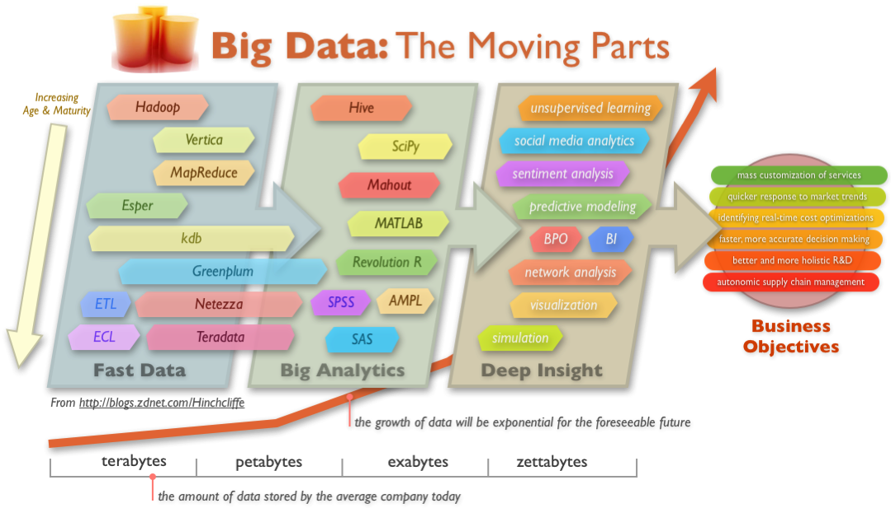
Big Data Technology

Slide 22
Introducing Technologies for handling Big data
Distributed and parallel Computing
Introducing Hadoop
Cloud Computing for Big data

Slide 23
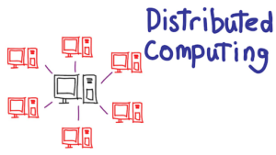
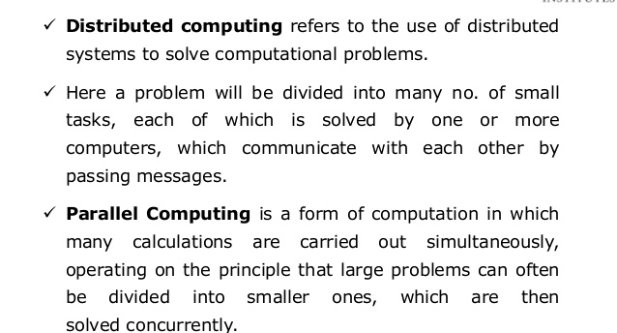

Slide 24
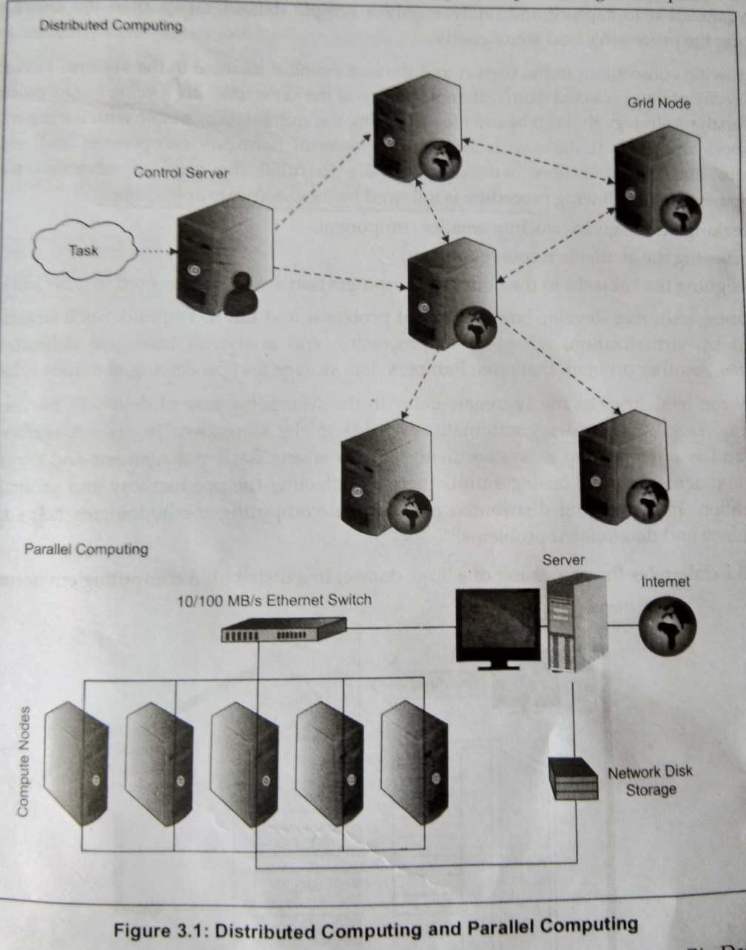

Slide 25
Differences
 | Parallel Systems | Distributed Systems
Memory | Tightly coupled shared memory UMA, NUMA | Distributed memory Message passing, RPC, and/or used of distributed shared memory
Control | Global clock control SIMD, MIMD | No global clock control Synchronization algorithms needed
Processor interconnection | Order of Tbps Bus, mesh, tree, mesh of tree, and hypercube (-related) network | Order of Gbps Ethernet(bus), token ring and SCI (ring), myrinet(switching network)
Main focus | Performance Scientific computing | Performance(cost and scalability) Reliability/availability Information/resource sharing

Slide 26
Techniques for parallel Computing
Cluster or Grid computing
Connection of multiple server in a network
Cluster may either homogeneous or heterogeneous
Servers shares the workload
Cost effective storage option
Massively Parallel Processing
Single machine working in a grid
MPP – capable of handling the activities of storage, memory and computing
EMC, greenplum and ParAccel
High Performance Computing
High performance and scalability by using IMC
Suitable for processing floating point data at high speeds
Used for research and business organizations

Slide 27
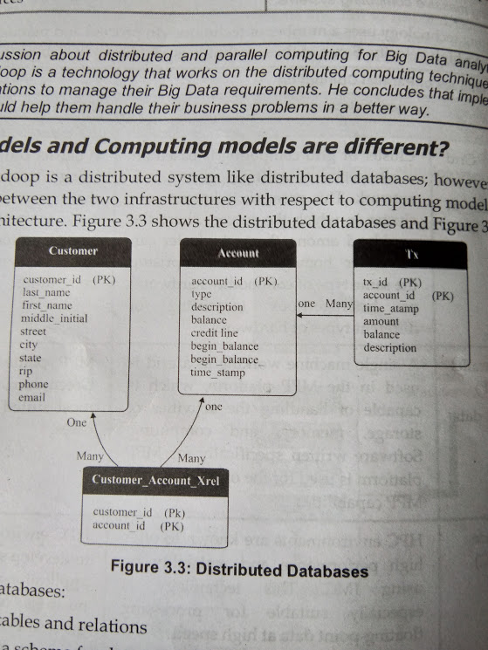
Hadoop
How data models and computing models are different?
Hadoop is a distributed system like distributed databases
Distributed databases:
Deal with tables and relations
Must have a schema for data
Implements data fragmentation
Hadoop:
Deals with flat files in any format
Operates on no schema for data
Divides files automatically into blocks

Slide 28
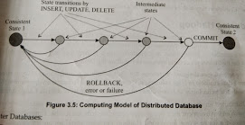
Computing Model
Distributed Database
Generate notion of a transaction
Implement ACID transaction properties
Allow distributed transactions
Hadoop
Generate notations of a job divided into tasks
Implements MapReduce computing Model
Considers every task as either map or reduce

Slide 29
Introducing Hadoop
Traditional technologies – not capable
Need to combine no. of technologies and products in to a system
One of the technologies designed to process big data
Hadoop is a
Open source platform
Provides analytical technologies and computational power
Handles both structured and unstructured
Create and run distributed systems quickly
Hadoop cluster
Cotains single master node and mutiple worker nodes
Master nodes – Namenode and Jobtracker
Workernode – Datanode and Task tracker
Requires JRE

Slide 30
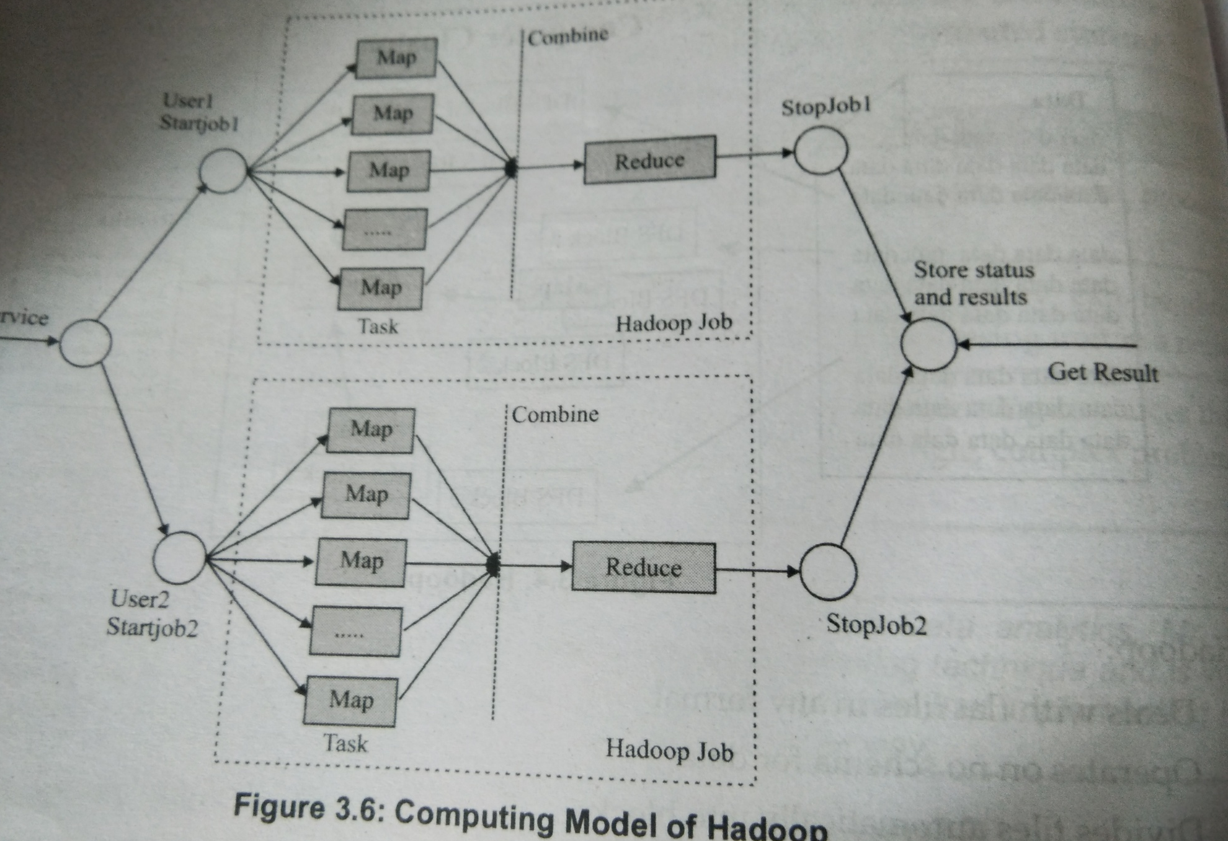

Slide 31
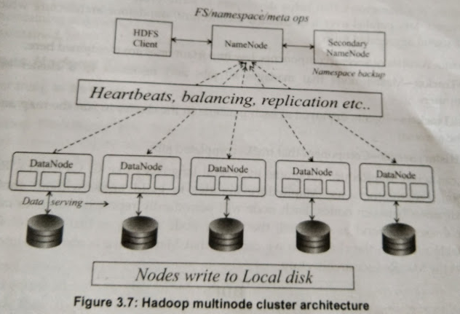

Slide 32
HDFS and Mapreduce
Two main components of Apache
HDFS(distributed file system) – for storage
MapReduce(Parallel Processing) – for processing
HDFS:
Fault tolerant storage
Store TB to PB across different terminals
Attains reliability by replicating the data over multiple hosts
Default replication is 3
Two on the same rack and one in the different rack
Spilt 64 to 128 MB each block is replicated independently at multiple nodes
Name node – monitors replica of block(3 times)
Data Node is failed namenode creates other replica

Slide 33
MapReduce
Framework that helps developers to write program
Components
JobTracker – Master node that manage all jobs and resources in cluster or combined
TaskTracker- Agents to run map & reduce
JobHistoryServer – components that tracks completed task

Slide 34
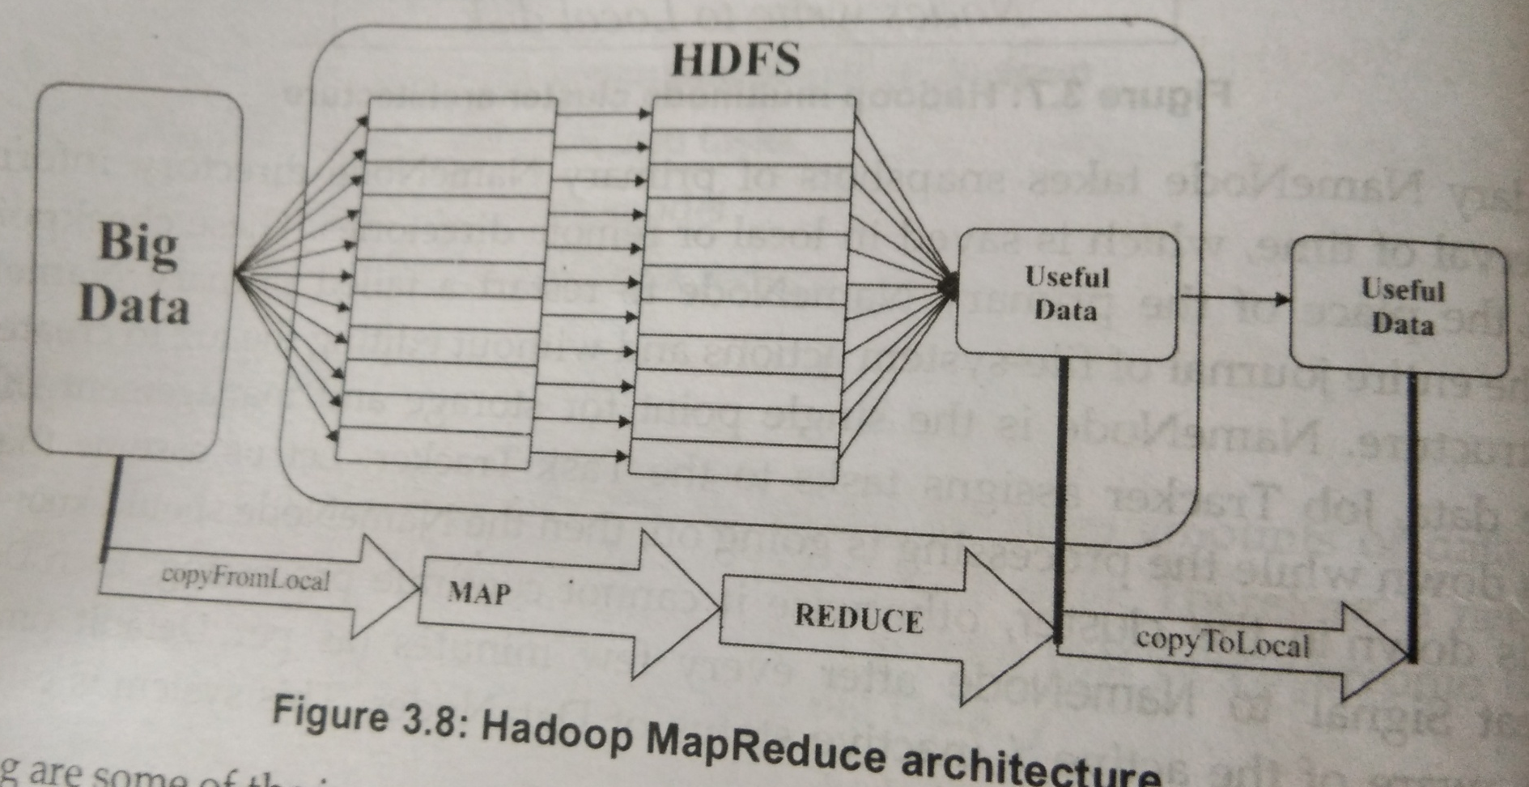
Hadoop MapReduce Architecture
MR program in several languges: C, C++, Java, Ruby, Perl and Python
Each node periodically report its status to master node if node doesnot respond
Master node reassigns that piece of job to other available node
MR also fault tolerant

Slide 35
Important features of Hadoop
Perform well with several nodes without requiring shared memory
Efficiency related issue in context of storage and access to data is solved automatically
Follows client-server architecture based
Master node also performs the tasks job controlling disk management and work allocation
Data stored across various node can be tracked in Hadoop NameNode
It improves data processing by running computing tasks on all available processors
Keeps multiple copies of data to improve resilence

Slide 36
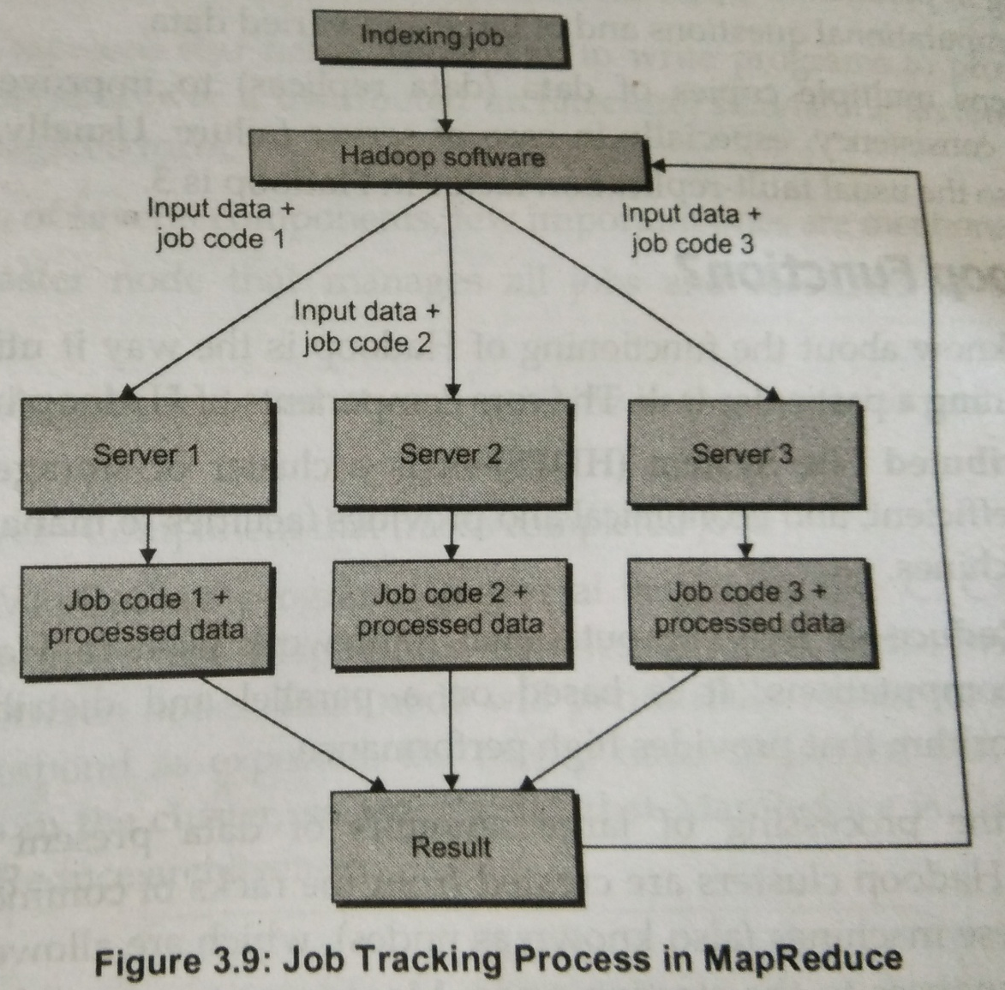
How does Hadoop Function?
Utilize multple computing resources
Core Components
HDFS
Hadoop MR
Hadoop Facilities
Hadoop Operations
MapReduce Algorithm
Job Indexing

Slide 37
Cloud Computing and Big Data
Organization face the vital issue – storage and management
Required – huge amount of investment – h/w setup and s/w package
Setup may be over utilized or underutilized
To overcome these challenges – by providing a set of computing resources
Cloud Computing
Computing resources can be shared through cloud
Includes applications, storage, computational units, networks, development and deployment platform, business process etc.
Cloud computing and big data use the distributed computing model

Slide 38
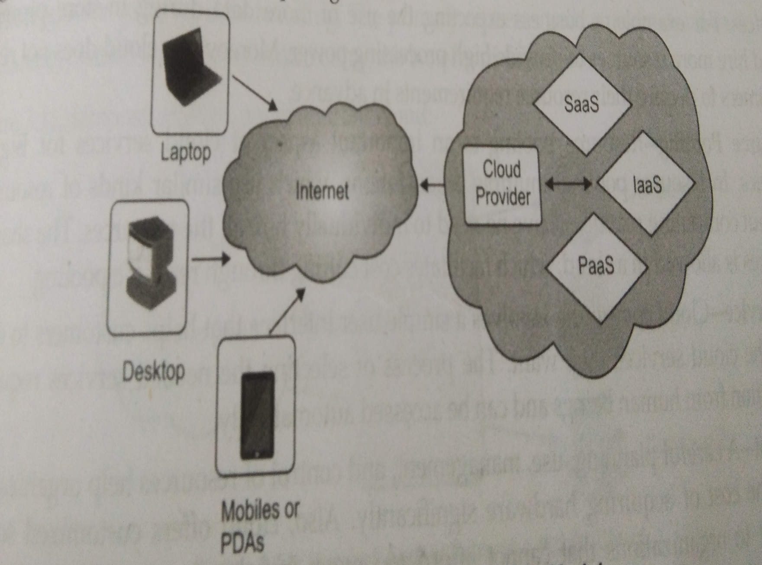
Cloud Computing Model

Slide 39
Features of cloud computing
Scalability
Needs to replace the existing h/w with new h/w setup to improve data mgt & processing activities
Elasticity
Hiring certain resources when required and paying
Resource Pooling
Multiple orgn uses similar kind of resources - RP
No need to hire resources individually
Self Service
Process of selecting the needed services requires no intervention from human being
Low Cost
Reduce the cost of acquiring hardware significantly
Fault Tolerance
Offering uninterrupted services to customers in case of component failure

Slide 40
Cloud deployment models
Public cloud
Private cloud
Community cloud
Hybrid cloud
Public Cloud ( End User level cloud)
Cloud is owned and managed by a company
Example: Savvis, Verizon, Amazon Web Services and Rackspace
Optimize this cloud for handling large volumes
Level of Accessibility in Public Cloud
Cloud services (Iaas/Paas/Saas)
Public cloud
Company X
Company Y
Company Z

Slide 41
Private Cloud(Enterprise level cloud)
Designed for single organization
Not for multiple organization
Cloud is used by its employers, partners and customers
Private cloud integrates all the processes, requirements and policies
Objectives of private cloud is not for sale
Cloud services (Iaas/Paas/Saas)
Private Cloud

Slide 42
Community Cloud
Shared among various organization with common tie
Managed by third party – made available on or off premises
Example
Community cloud may be provided for all govt. organizations data of all citizens of the state can be easily managed by govt. organization

Slide 43
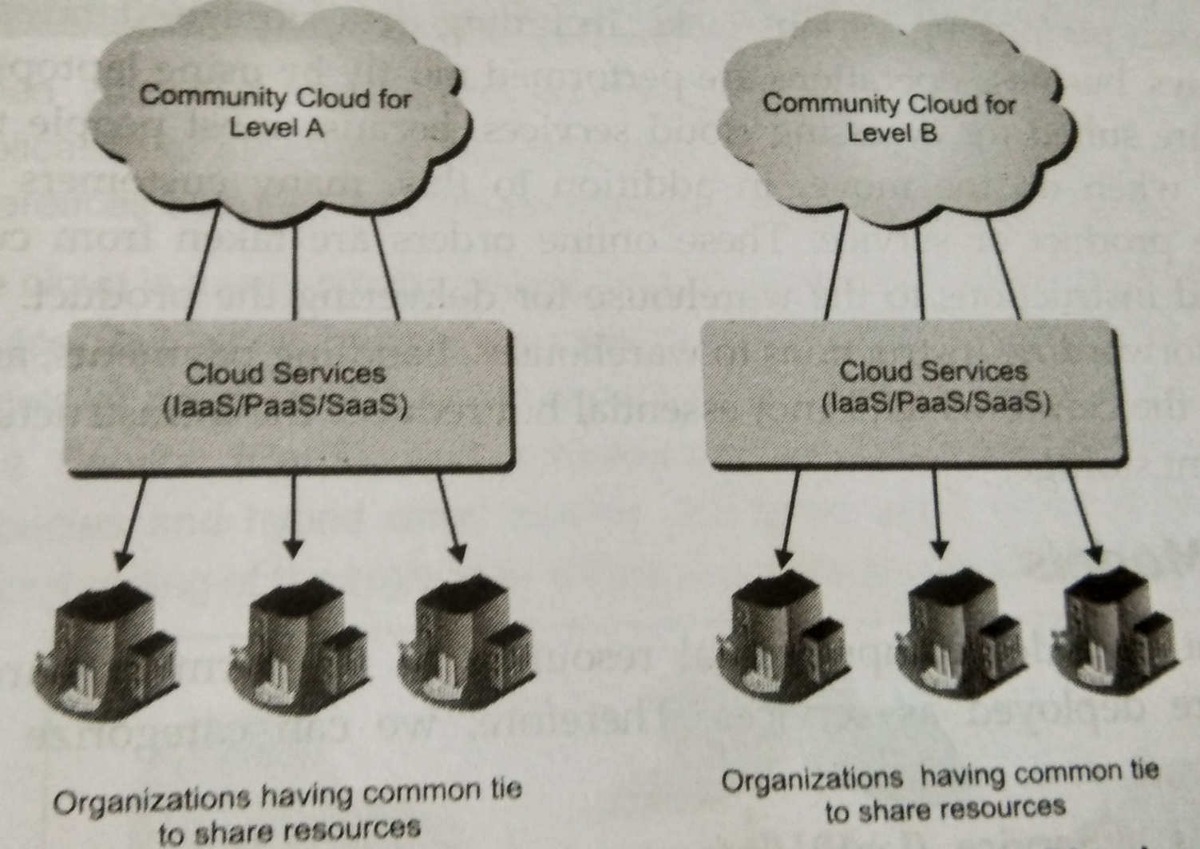
Levels of Accessibility in Community Cloud

Slide 44
Hybrid Cloud
Various internal and external service providers offer services to many organization
Organization hosts application which require high level of security and are critical
Hybrid orgn use both public and private
Hybrid cloud – manage all internal private cloud for general use and migrates the entire part of application to the public cloud for peak periods

Slide 45
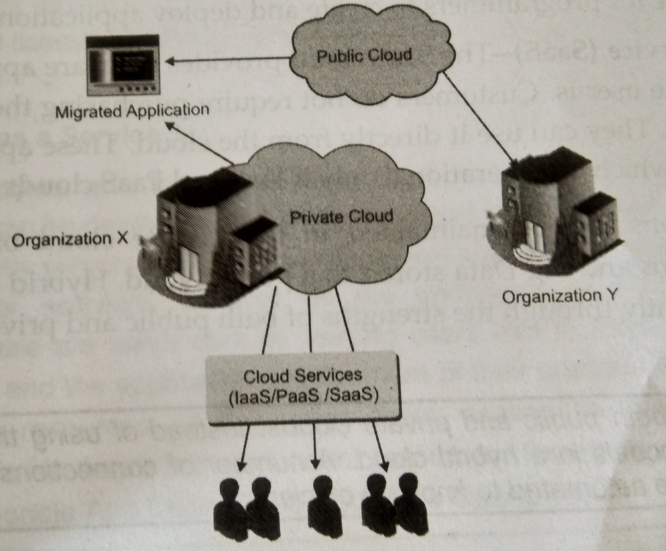
Implementation of Hybrid Cloud

Slide 46
Cloud Delivery models
Infrastructure as a service (IaaS)
Elements includes: n/w, h/w and storage
Example: VM, Lb and network attached storage
Platform as a service (PaaS)
Provide platform for writing code
Execute through PaaS e.g: GAE(Google App Engine)
Software as a service(SaaS)
Provide software application that accessible from wherever the user is
Customer not purchasing s/w & installing in their own machine
Apps are hired through annual contracts

Slide 47
Cloud Service for Big data
In big data the IaaS, PaaS and SaaS used in the following Manner:
IaaS
Huge storage and computational power is required
Limitless storage and computing ability obtained by IaaS
PaaS
Adding various big data platforms: Includes MapReduce and Hadoop
No need to maintain hardware and software components
SaaS
Analyzing the voice of customer in social media platform
Data provided by SaaS vendors in social media and platform

Slide 48
Cloud providers in big data market
Amazon
EC2
Elastic MapReduce
DynamoDB
Amazon S3
HPC
RedShift
Google
Google Compute Engine
Google BigQuery
Google over prediction

Slide 49
Cloud Computing
IT resources provided as a service
Compute, storage, databases, queues
Clouds leverage economies of scale of commodity hardware
Cheap storage, high bandwidth networks & multicore processors
Geographically distributed data centers
Offerings from Microsoft, Amazon, Google, …

Slide 50
wikipedia:Cloud Computing

Slide 51
Benefits
Cost & management
Economies of scale, “out-sourced” resource management
Reduced Time to deployment
Ease of assembly, works “out of the box”
Scaling
On demand provisioning, co-locate data and compute
Reliability
Massive, redundant, shared resources
Sustainability
Hardware not owned

Slide 52
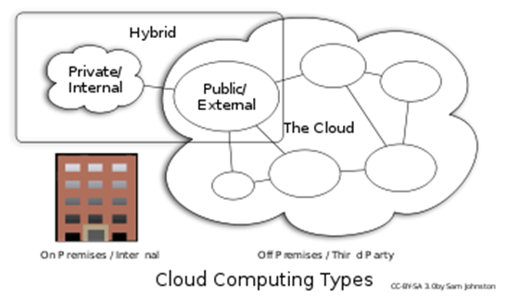
Types of Cloud Computing
Public Cloud: Computing infrastructure is hosted at the vendor’s premises.
Private Cloud: Computing architecture is dedicated to the customer and is not shared with other organisations.
Hybrid Cloud: Organisations host some critical, secure applications in private clouds. The not so critical applications are hosted in the public cloud
Cloud bursting: the organisation uses its own infrastructure for normal usage, but cloud is used for peak loads.
Community Cloud

Slide 53
Classification of Cloud Computing based on Service Provided
Infrastructure as a service (IaaS)
Offering hardware related services using the principles of cloud computing. These could include storage services (database or disk storage) or virtual servers.
Amazon EC2, Amazon S3, Rackspace Cloud Servers and Flexiscale.
Platform as a Service (PaaS)
Offering a development platform on the cloud.
Google’s Application Engine, Microsofts Azure, Salesforce.com’s force.com .
Software as a service (SaaS)
Including a complete software offering on the cloud. Users can access a software application hosted by the cloud vendor on pay-per-use basis. This is a well-established sector.
Salesforce.coms’ offering in the online Customer Relationship Management (CRM) space, Googles gmail and Microsofts hotmail, Google docs.

Slide 54
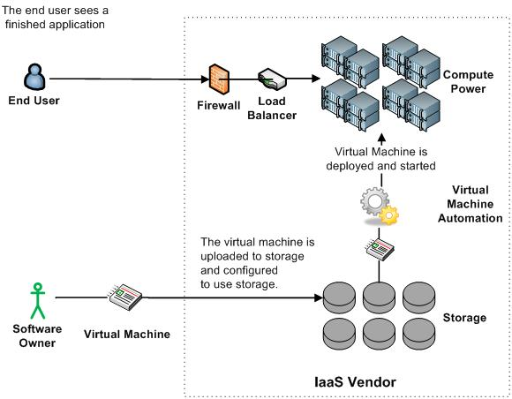
Infrastructure as a Service (IaaS)

Slide 55
More Refined Categorization
Storage-as-a-service
Database-as-a-service
Information-as-a-service
Process-as-a-service
Application-as-a-service
Platform-as-a-service
Integration-as-a-service
Security-as-a-service
Management/
Governance-as-a-service
Testing-as-a-service
Infrastructure-as-a-service
InfoWorld Cloud Computing Deep Dive

Slide 56
Key Ingredients in Cloud Computing
Service-Oriented Architecture (SOA)
Utility Computing (on demand)
Virtualization (P2P Network)
SAAS (Software As A Service)
PAAS (Platform AS A Service)
IAAS (Infrastructure AS A Servie)
Web Services in Cloud

Slide 57
Everything as a Service
Utility computing = Infrastructure as a Service (IaaS)
Why buy machines when you can rent cycles?
Examples: Amazon’s EC2, Rackspace
Platform as a Service (PaaS)
Give me nice API and take care of the maintenance, upgrades, …
Example: Google App Engine
Software as a Service (SaaS)
Just run it for me!
Example: Gmail, Salesforce

Slide 58
The Obligatory Timeline Slide (Mike Culver @ AWS)
COBOL, Edsel
Amazon.com
ARPANET
Internet
Darkness
Web Awareness
Web as a Platform
Web Services, Resources Eliminated
1959
1969
1982
1996
1997
2001
2004
2006
Dot-Com Bubble
Web 2.0
Web Scale
Computing

Slide 59
Topics Overview

Slide 60
Data Analytics & Data Mining
Exploratory Data Analysis
Linear Classification (Perceptron & Logistic Regression)
Linear Regression
C4.5 Decision Tree
Apriori
K-means Clustering
EM Algorithm
PageRank & HITS
Collaborative Filtering

Slide 61
Hadoop/MapReduce Programming & Data Processing
Architecture of Hadoop, HDFS, and Yarn
Programming on Hadoop
Basic Data Processing: Sort and Join
Information Retrieval using Hadoop
Data Mining using Hadoop (Kmeans+Histograms)
Machine Learning on Hadoop (EM)
Hive/Pig
HBase and Cassandra

