Slide 1
NoSQL and Big Data Processing
Hbase, Hive and Pig, etc.
Dr. P. Sumathy
Assistant Professor
Department Of Computer Science
Bharathidasan University

Slide 2
History
Relational Databases – mainstay of business
Web-based applications caused spikes
  Especially true for public-facing e-Commerce sites
Developers begin to front RDBMS with memcache or integrate other caching mechanisms within the application (ie. Ehcache)
Notes:
-> For the longest time (and still true today), the big relational database vendors such as Oracle, IBM, Sybase, and a lesser extent Microsoft were the mainstay of how data was stored.
-> During the Internet boom, startups looking for low-cost RDBMS alternatives turned to MySQL and PostgreSQL.
-> The ‘Slashdot Effect’ occurs when a popular website links to a smaller site, causing a massive increase in traffic.
-> Hooking your RDBMS to a web-based application was a recipe for headaches, they are OLTP in nature. Could have hundreds of thousands of visitors in a short-time span.
-> To mitigate, began to front the RDBMS with a read-only cache such as memcache to offload a considerable amount of the read traffic.
-> As datasets grew, the simple memcache/MySQL model (for lower-cost startups) started to become problematic.

Slide 3
Scaling Up
Issues with scaling up when the dataset is just too big
RDBMS were not designed to be distributed
Began to look at multi-node database solutions
Known as ‘scaling out’ or ‘horizontal scaling’
Different approaches include:
  Master-slave
  Sharding
Notes:
-> Best way to provide ACID and a rich query model is to have the dataset on a single machine.
-> However, there are limits to scaling up (Vertical Scaling).
-> Past a certain point, an organization will find it is cheaper and more feasible to scale out (horizontal scaling) by adding smaller, more inexpensive (relatively) servers rather than investing in a single larger server.
-> A number of different approaches to scaling out (Horizontal Scaling).
-> DBAs began to look at master-slave and sharding as a strategy to overcome some of these issues.

Slide 4
Scaling RDBMS – Master/Slave
Master-Slave
  All writes are written to the master. All reads performed against the replicated slave databases
  Critical reads may be incorrect as writes may not have been propagated down
  Large data sets can pose problems as master needs to duplicate data to slaves

Slide 5
Other ways to scale RDBMS
Multi-Master replication
INSERT only, not UPDATES/DELETES
No JOINs, thereby reducing query time
  This involves de-normalizing data
In-memory databases
Notes:
-> The multi-master replication system is responsible for propagating data modifications made by each member to the rest of the group, and resolving any conflicts that might arise between concurrent changes made by different members.
-> For INSERT-only, data is versioned upon update.
-> Data is never DELETED, only inactivated.
-> JOINs are expensive with large volumes and don’t work across partitions.
-> Denormalization leads to even larger databases, reduces query time.
-> Consistency is the responsibility of the application.
-> In-memory databases have not caught on mainstream and regular RDBMS are more disk-intensive that memory-intensive. Vendors looking to fix this.

Slide 6
What is NoSQL?
Stands for Not Only SQL
Class of non-relational data storage systems
Usually do not require a fixed table schema nor do they use the concept of joins
All NoSQL offerings relax one or more of the ACID properties (will talk about the CAP theorem)
Notes:
-> NoSQL was a term coined by Eric Evans. He states that ‘… but the whole point of seeking alternatives is that you need to solve a problem that relational databases are a bad fit for. …
-> This is why people are continually interpreting nosql to be anti-RDBMS, it's the only rational conclusion when the only thing some of these projects share in common is that they are not relational databases.’
-> Emil Elfrem stated it is not a ‘NO’ SQL but more of a ‘Not Only” SQL.

Slide 7
Why NoSQL?
For data storage, an RDBMS cannot be the be-all/end-all
Just as there are different programming languages, need to have other data storage tools in the toolbox
A NoSQL solution is more acceptable to a client now than even a year ago
  Think about proposing a Ruby/Rails or Groovy/Grails solution now versus a couple of years ago
Notes:
-> Too often as consultants, when we talk about data storage, we immediately reach for a relational database.
-> Relational databases offer a very good general purpose solution to many different data storage needs.
-> In other words, it is the safe choice and will work in many situations.
-> Need to have some knowledge of alternatives, if nothing else to know when a NoSQL solution needs further investigation.

Slide 8
How did we get here?
Explosion of social media sites (Facebook, Twitter) with large data needs
Rise of cloud-based solutions such as Amazon S3 (simple storage solution)
Just as moving to dynamically-typed languages (Ruby/Groovy), a shift to dynamically-typed data with frequent schema changes
Open-source community
Notes:
-> However, the people with the largest datasets (terrabyte/petabyte) began to realize that sharding was putting a bandage on their issues. The more aggressive thought leaders (Google, Facebook, Twitter) began to explore alternative ways to store data. This became especially true in 2008/2009.
-> These datasets have high read/write rates.
-> With the advent of Amazon S3, a large respected vendor made the statement that maybe is was okay to look at alternative storage solutions other that relational.
-> All of the NoSQL options with the exception of Amazon S3 (Amazon Dynamo) are open-source solutions. This provides a low-cost entry point to ‘kick the tires’.

Slide 9
Dynamo and BigTable
Three major papers were the seeds of the NoSQL movement
  BigTable (Google)
  Dynamo (Amazon)
    Gossip protocol (discovery and error detection)
    Distributed key-value data store
    Eventual consistency
  CAP Theorem (discuss in a sec ..)
Notes:
-> BigTable: http://labs.google.com/papers/bigtable.html
-> Dynamo: http://www.allthingsdistributed.com/2007/10/amazons_dynamo.html and http://www.allthingsdistributed.com/files/amazon-dynamo-sosp2007.pdf
-> Amazon and consistency
* http://www.allthingsdistributed.com/2010/02
* http://www.allthingsdistributed.com/2008/12

Slide 10
The Perfect Storm
Large datasets, acceptance of alternatives, and dynamically-typed data has come together in a perfect storm
Not a backlash/rebellion against RDBMS
SQL is a rich query language that cannot be rivaled by the current list of NoSQL offerings
Notes:
-> So you have reached a point where a read-only cache and write-based RDBMS isn’t delivering the throughput necessary to support a particular application.
-> You need to examine alternatives and what alternatives are out there.
-> The NoSQL databases are a pragmatic response to growing scale of databases and the falling prices of commodity hardware.
-> Most likely, 10 years from now, the majority of data is still stored in RDBMS.

Slide 11
CAP Theorem
Three properties of a system: consistency, availability and partitions
You can have at most two of these three properties for any shared-data system
To scale out, you have to partition. That leaves either consistency or availability to choose from
  In almost all cases, you would choose availability over consistency
Notes:
-> Proposed by Eric Brewer (talk on Principles of Distributed Computing July 2000).
-> Partitionability: divide nodes into small groups that can see other groups, but they can't see everyone.
-> Consistency: write a value and then you read the value you get the same value back. In a partitioned system there are windows where that's not true.
-> Availability: may not always be able to write or read. The system will say you can't write because it wants to keep the system consistent.
-> To scale you have to partition, so you are left with choosing either high consistency or high availability for a particular system. You must find the right
overlap of availability and consistency.
-> Choose a specific approach based on the needs of the service.
-> For the checkout process you always want to honor requests to add items to a shopping cart because it's revenue producing.
In this case you choose high availability. Errors are hidden from the customer and sorted out later.
-> When a customer submits an order you favor consistency because several services--credit card processing, shipping and handling, reporting—
are simultaneously accessing the data.

Slide 12
The CAP Theorem
Availability
Consistency
Partition tolerance
Notes:
12
PODC:ACM Symposium on Principles of Distributed Computing(PODC)International Conference

Slide 13
The CAP Theorem
Once a writer has written, all readers will see that write
Availability
Consistency
Partition tolerance

Slide 14
Consistency
Two kinds of consistency:
  strong consistency – ACID(Atomicity Consistency Isolation Durability)
  weak consistency – BASE(Basically Available Soft-state Eventual consistency )
Notes:
Cluster里面至少有一个replica是最新的，其他的replica最终会达到一致

Slide 15
ACID Transactions
A DBMS is expected to support “ACID transactions,” processes that are:
  Atomic : Either the whole process is done or none is.
  Consistent : Database constraints are preserved.
  Isolated : It appears to the user as if only one process executes at a time.
  Durable : Effects of a process do not get lost if the system crashes.

Slide 16
Atomicity
A real-world event either happens or does not happen
  Student either registers or does not register
Similarly, the system must ensure that either the corresponding transaction runs to completion or, if not, it has no effect at all
  Not true of ordinary programs. A crash could leave files partially updated on recovery

Slide 17
Commit and Abort
If the transaction successfully completes it is said to commit
  The system is responsible for ensuring that all changes to the database have been saved
If the transaction does not successfully complete, it is said to abort
  The system is responsible for undoing, or rolling back, all changes the transaction has made

Slide 18
Database Consistency
Enterprise (Business) Rules limit the occurrence of certain real-world events
  Student cannot register for a course if the current number of registrants equals the maximum allowed
Correspondingly, allowable database states are restricted
  cur_reg <= max_reg
These limitations are called (static) integrity constraints: assertions that must be satisfied by all database states (state invariants).

Slide 19
Database Consistency
(state invariants)
Other static consistency requirements are related to the fact that the database might store the same information in different ways
  cur_reg = |list_of_registered_students|
  Such limitations are also expressed as integrity constraints
Database is consistent if all static integrity constraints are satisfied

Slide 20
Transaction Consistency
A consistent database state does not necessarily model the actual state of the enterprise
  A deposit transaction that increments the balance by the wrong amount maintains the integrity constraint balance ≥ 0, but does not maintain the relation between the enterprise and database states
A consistent transaction maintains database consistency and the correspondence between the database state and the enterprise state (implements its specification)
  Specification of deposit transaction includes balance′ = balance + amt_deposit , (balance′ is the next value of balance)

Slide 21
Dynamic Integrity Constraints
(transition invariants)
Some constraints restrict allowable state transitions
  A transaction might transform the database from one consistent state to another, but the transition might not be permissible
  Example: A letter grade in a course (A, B, C, D, F) cannot be changed to an incomplete (I)
Dynamic constraints cannot be checked by examining the database state

Slide 22
Transaction Consistency
Consistent transaction: if DB is in consistent state initially, when the transaction completes:
  All static integrity constraints are satisfied (but constraints might be violated in intermediate states)
    Can be checked by examining snapshot of database
  New state satisfies specifications of transaction
    Cannot be checked from database snapshot
  No dynamic constraints have been violated
    Cannot be checked from database snapshot

Slide 23
Isolation
Serial Execution: transactions execute in sequence
  Each one starts after the previous one completes.
    Execution of one transaction is not affected by the operations of another since they do not overlap in time
  The execution of each transaction is isolated from all others.
If the initial database state and all transactions are consistent, then the final database state will be consistent and will accurately reflect the real-world state, but
Serial execution is inadequate from a performance perspective

Slide 24
Isolation
Concurrent execution offers performance benefits:
  A computer system has multiple resources capable of executing independently (e.g., cpu’s, I/O devices), but
  A transaction typically uses only one resource at a time
  Hence, only concurrently executing transactions can make effective use of the system
  Concurrently executing transactions yield interleaved schedules

Slide 25
Concurrent Execution
begin trans
..
op_{1,1}
..
op_{1,2}
..
commit
sequence of db
operations output by T₁
T₁
op_{1,1} op_{1.2}
local computation
DBMS
op_{1,1} op_{2,1} op_{2.2} op_{1.2}
T₂
op_{2,1} op_{2.2}
interleaved sequence of db
operations input to DBMS
local variables

Slide 26
Durability
The system must ensure that once a transaction commits, its effect on the database state is not lost in spite of subsequent failures
  Not true of ordinary programs. A media failure after a program successfully terminates could cause the file system to be restored to a state that preceded the program’s execution

Slide 27
Implementing Durability
Database stored redundantly on mass storage devices to protect against media failure
Architecture of mass storage devices affects type of media failures that can be tolerated
Related to Availability: extent to which a (possibly distributed) system can provide service despite failure
    Non-stop DBMS (mirrored disks)
    Recovery based DBMS (log)

Slide 28
Consistency Model
A consistency model determines rules for visibility and apparent order of updates.
For example:
  Row X is replicated on nodes M and N
  Client A writes row X to node N
  Some period of time t elapses.
  Client B reads row X from node M
  Does client B see the write from client A?
  Consistency is a continuum with tradeoffs
  For NoSQL, the answer would be: maybe
  CAP Theorem states: Strict Consistency can't be achieved at the same time as availability and partition-tolerance.
Notes:
-> http://cloudera-todd.s3.amazonaws.com/nosql.pdf

Slide 29
Eventual Consistency
When no updates occur for a long period of time, eventually all updates will propagate through the system and all the nodes will be consistent
For a given accepted update and a given node, eventually either the update reaches the node or the node is removed from service
Known as BASE (Basically Available, Soft state, Eventual consistency), as opposed to ACID
Notes:
-> http://en.wikipedia.org/wiki/Eventual_consistency
-> http://www.allthingsdistributed.com/2008/12/eventually_consistent.html
The types of large systems based on CAP aren't ACID they are BASE (http://queue.acm.org/detail.cfm?id=1394128):
* Basically Available - system seems to work all the time
* Soft State - it doesn't have to be consistent all the time
* Eventually Consistent - becomes consistent at some later time
Everyone who builds big applications builds them on CAP and BASE: Google, Yahoo, Facebook, Amazon, eBay, etc

Slide 30
The CAP Theorem
System is available during software and hardware upgrades and node failures.
Availability
Consistency
Partition tolerance

Slide 31
Availability
Traditionally, thought of as the server/process available five 9’s (99.999 %).
However, for large node system, at almost any point in time there’s a good chance that a node is either down or there is a network disruption among the nodes.
  Want a system that is resilient in the face of network disruption

Slide 32
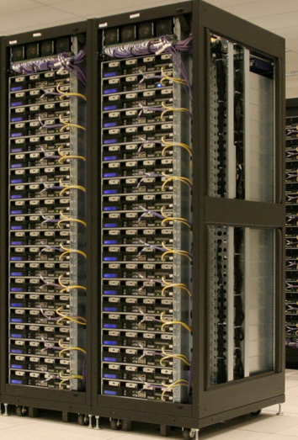
The CAP Theorem
A system can continue to operate in the presence of a network partitions.
Availability
Consistency
Partition tolerance

Slide 33
The CAP Theorem
Theorem: You can have at most two of these properties for any shared-data system
Availability
Consistency
Partition tolerance

Slide 34
What kinds of NoSQL
NoSQL solutions fall into two major areas:
  Key/Value or ‘the big hash table’.
    Amazon S3 (Dynamo)
    Voldemort
    Scalaris
    Memcached (in-memory key/value store)
    Redis
  Schema-less which comes in multiple flavors, column-based, document-based or graph-based.
    Cassandra (column-based)
    CouchDB (document-based)
    MongoDB(document-based)
    Neo4J (graph-based)
    HBase (column-based)
Notes:
-> Not an exhaustive list, just some of the more well-known.
-> HBase is the data storage solution for Hadoop.
-> Graph: is a network database that uses edges and nodes to represent and store data.
-> Document: views are stored as rows which are kept sorted by key. Can adapt to variations in document structure.

Slide 35
Key/Value
Pros:
  very fast
  very scalable
  simple model
  able to distribute horizontally
Cons:
  - many data structures (objects) can't be easily modeled as key value pairs
Notes:
-> http://chariotsolutions.blogspot.com/2010/01/why-you-need-nosql-in-your-toolbox.html

Slide 36
Schema-Less
Pros:
  - Schema-less data model is richer than key/value pairs
  eventual consistency
  many are distributed
  still provide excellent performance and scalability
Cons:
  - typically no ACID transactions or joins

Slide 37
Common Advantages
Cheap, easy to implement (open source)
Data are replicated to multiple nodes (therefore identical and fault-tolerant) and can be partitioned
  Down nodes easily replaced
  No single point of failure
Easy to distribute
Don't require a schema
Can scale up and down
Relax the data consistency requirement (CAP)
Notes:
-> As the data is written, the latest version is on at least one node. The data is then versioned/replicated to other nodes within the system.
-> Eventually, the same version is on all nodes.

Slide 38
What am I giving up?
joins
group by
order by
ACID transactions
SQL as a sometimes frustrating but still powerful query language
easy integration with other applications that support SQL
Notes:
-> No JDBC
-> Data integrity at the application layer

Slide 39
Big Table and Hbase
(C+P)
Notes:
HBase is strongly consistent. Each row is hosted by a single region server at a time, and a combination of row locks and multiversion concurrency control is used to provide consistency within a row. During failover, we take care to not allow writes from a new regionserver until the previous one has been blocked out. There are currently a couple of rare bugs where this doesn't work quite right (see HBASE-2231 for example) but they are all blockers for the next release. Replication is taken care of at the HDFS layer. In the next release of HBase it will also be completely durable - no edit will be acked to the client until it has been flushed to three HDFS replicas.

Slide 40
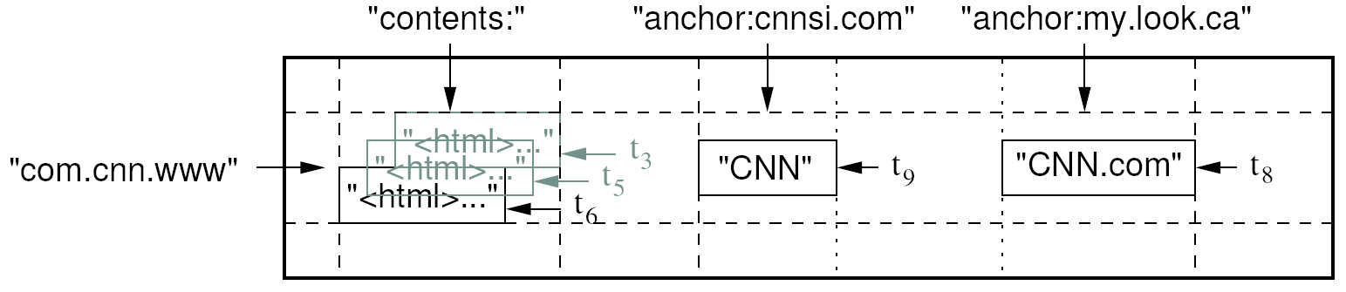
Data Model
A table in Bigtable is a sparse, distributed, persistent multidimensional sorted map
Map indexed by a row key, column key, and a timestamp
  (row:string, column:string, time:int64) → uninterpreted byte array
Supports lookups, inserts, deletes
  Single row transactions only
Image Source: Chang et al., OSDI 2006

Slide 41
Rows and Columns
Rows maintained in sorted lexicographic order
  Applications can exploit this property for efficient row scans
  Row ranges dynamically partitioned into tablets
Columns grouped into column families
  Column key = family:qualifier
  Column families provide locality hints
  Unbounded number of columns

Slide 42
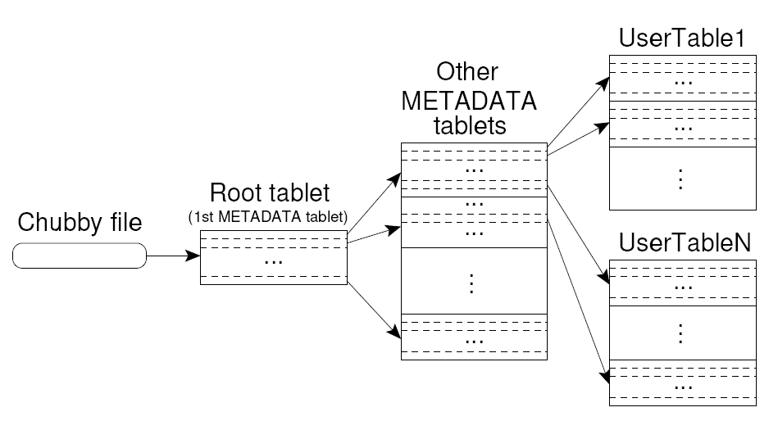
Tablet Location
Upon discovery, clients cache tablet locations
Image Source: Chang et al., OSDI 2006

Slide 43
Tablet Assignment
Master keeps track of:
  Set of live tablet servers
  Assignment of tablets to tablet servers
  Unassigned tablets
Each tablet is assigned to one tablet server at a time
  Tablet server maintains an exclusive lock on a file in Chubby
  Master monitors tablet servers and handles assignment
Changes to tablet structure
  Table creation/deletion (master initiated)
  Tablet merging (master initiated)
  Tablet splitting (tablet server initiated)

Slide 44
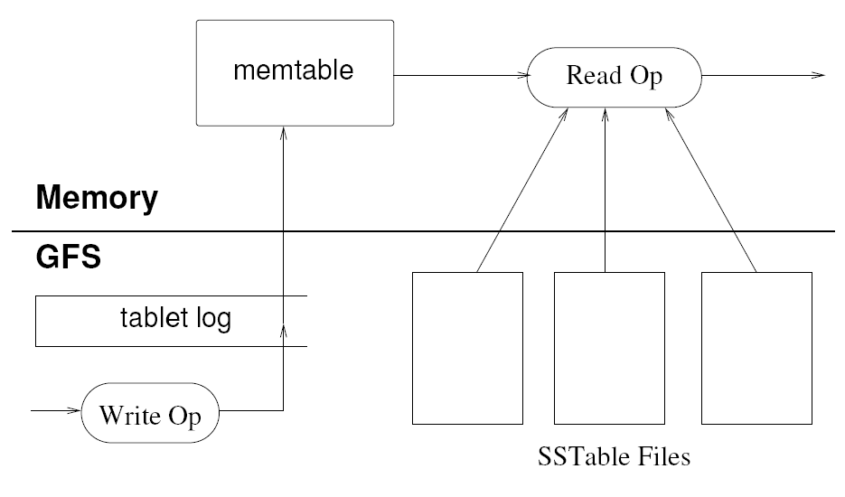
Tablet Serving
“Log Structured Merge Trees”
Image Source: Chang et al., OSDI 2006

Slide 45
Compactions
Minor compaction
  Converts the memtable into an SSTable
  Reduces memory usage and log traffic on restart
Merging compaction
  Reads the contents of a few SSTables and the memtable, and writes out a new SSTable
  Reduces number of SSTables
Major compaction
  Merging compaction that results in only one SSTable
  No deletion records, only live data

Slide 46
Bigtable Applications
Data source and data sink for MapReduce
Google’s web crawl
Google Earth
Google Analytics

Slide 47
HBase is an open-source, distributed, column-oriented database built on top of HDFS based on BigTable!

Slide 48
HBase is ..
A distributed data store that can scale horizontally to 1,000s of commodity servers and petabytes of indexed storage.
Designed to operate on top of the Hadoop distributed file system (HDFS) or Kosmos File System (KFS, aka Cloudstore) for scalability, fault tolerance, and high availability.

Slide 49
Benefits
Distributed storage
Table-like in data structure
  multi-dimensional map
High scalability
High availability
High performance

Slide 50
Backdrop
Started toward by Chad Walters and Jim
2006.11
  Google releases paper on BigTable
2007.2
  Initial HBase prototype created as Hadoop contrib.
2007.10
  First useable HBase
2008.1
  Hadoop become Apache top-level project and HBase becomes subproject
2008.10~
  HBase 0.18, 0.19 released

Slide 51
HBase Is Not …
Tables have one primary index, the row key.
No join operators.
Scans and queries can select a subset of available columns, perhaps by using a wildcard.
There are three types of lookups:
  Fast lookup using row key and optional timestamp.
  Full table scan
  Range scan from region start to end.

Slide 52
HBase Is Not …(2)
Limited atomicity and transaction support.
  HBase supports multiple batched mutations of single rows only.
  Data is unstructured and untyped.
No accessed or manipulated via SQL.
  Programmatic access via Java, REST, or Thrift APIs.
  Scripting via JRuby.

Slide 53
Why Bigtable?
Performance of RDBMS system is good for transaction processing but for very large scale analytic processing, the solutions are commercial, expensive, and specialized.
Very large scale analytic processing
  Big queries – typically range or table scans.
  Big databases (100s of TB)

Slide 54
Why Bigtable? (2)
Map reduce on Bigtable with optionally Cascading on top to support some relational algebras may be a cost effective solution.
Sharding is not a solution to scale open source RDBMS platforms
  Application specific
  Labor intensive (re)partitionaing

Slide 55
Why HBase ?
HBase is a Bigtable clone.
It is open source
It has a good community and promise for the future
It is developed on top of and has good integration for the Hadoop platform, if you are using Hadoop already.
It has a Cascading connector.

Slide 56
HBase benefits than RDBMS
No real indexes
Automatic partitioning
Scale linearly and automatically with new nodes
Commodity hardware
Fault tolerance
Batch processing

Slide 57
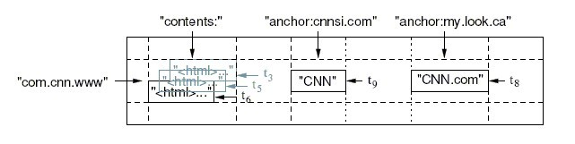
Data Model
Tables are sorted by Row
Table schema only define it’s column families .
  Each family consists of any number of columns
  Each column consists of any number of versions
  Columns only exist when inserted, NULLs are free.
  Columns within a family are sorted and stored together
Everything except table names are byte[]
(Row, Family: Column, Timestamp) → Value
Column Family
Row key
TimeStamp
value

Slide 58
Members
Master
  Responsible for monitoring region servers
  Load balancing for regions
  Redirect client to correct region servers
  The current SPOF
regionserver slaves
  Serving requests(Write/Read/Scan) of Client
  Send HeartBeat to Master
  Throughput and Region numbers are scalable by region servers

Slide 59
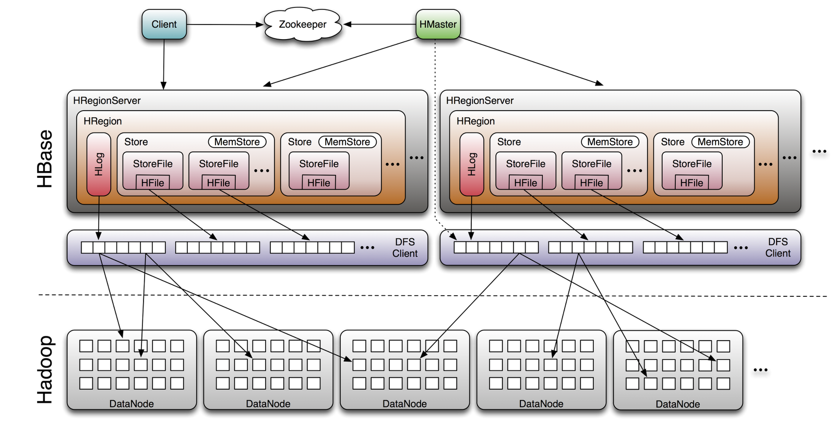
Architecture

Slide 60
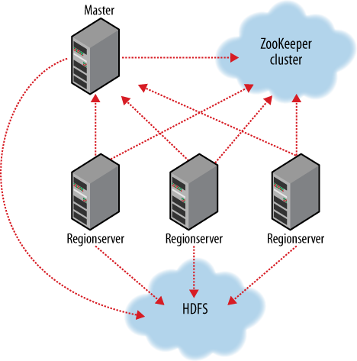
ZooKeeper
HBase depends on ZooKeeper and by default it manages a ZooKeeper instance as the authority on cluster state

Slide 61
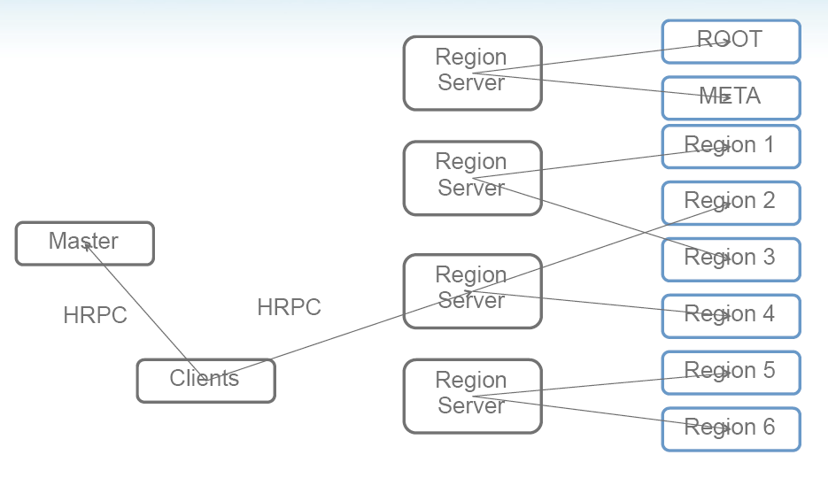
Operation
The -ROOT- table holds the list of .META. table regions
The .META. table holds the list of all user-space regions.

Slide 62
Installation (1)
START Hadoop…
$ wget http://ftp.twaren.net/Unix/Web/apache/hadoop/hbase/hbase-0.20.2/hbase-0.20.2.tar.gz
$ sudo tar -zxvf hbase-*.tar.gz -C /opt/
$ sudo ln -sf /opt/hbase-0.20.2 /opt/hbase
$ sudo chown -R $USER:$USER /opt/hbase
$ sudo mkdir /var/hadoop/
$ sudo chmod 777 /var/hadoop

Slide 63
Setup (1)
$ vim /opt/hbase/conf/hbase-env.sh
export JAVA_HOME=/usr/lib/jvm/java-6-sun
export HADOOP_CONF_DIR=/opt/hadoop/conf
export HBASE_HOME=/opt/hbase
export HBASE_LOG_DIR=/var/hadoop/hbase-logs
export HBASE_PID_DIR=/var/hadoop/hbase-pids
export HBASE_MANAGES_ZK=true
export HBASE_CLASSPATH=$HBASE_CLASSPATH:/opt/hadoop/conf
$ cd /opt/hbase/conf
$ cp /opt/hadoop/conf/core-site.xml ./
$ cp /opt/hadoop/conf/hdfs-site.xml ./
$ cp /opt/hadoop/conf/mapred-site.xml ./

Slide 64
Setup (2)
<configuration>
<property>
<name> name </name>
<value> value </value>
</property>
</configuration>
Name | value
hbase.rootdir | hdfs://secuse.nchc.org.tw:9000/hbase
hbase.tmp.dir | /var/hadoop/hbase-${user.name}
hbase.cluster.distributed | true
hbase.zookeeper.property.clientPort | 2222
hbase.zookeeper.quorum | Host1, Host2
hbase.zookeeper.property.dataDir | /var/hadoop/hbase-data

Slide 65
Startup & Stop
$ start-hbase.sh
$ stop-hbase.sh

Slide 66
Testing (4)
$ hbase shell
> create 'test', 'data'
0 row(s) in 4.3066 seconds
> list
test
1 row(s) in 0.1485 seconds
> put 'test', 'row1', 'data:1', 'value1'
0 row(s) in 0.0454 seconds
> put 'test', 'row2', 'data:2', 'value2'
0 row(s) in 0.0035 seconds
> put 'test', 'row3', 'data:3', 'value3'
0 row(s) in 0.0090 seconds
> scan 'test'
ROW COLUMN+CELL
row1 column=data:1, timestamp=1240148026198, value=value1
row2 column=data:2, timestamp=1240148040035, value=value2
row3 column=data:3, timestamp=1240148047497, value=value3
3 row(s) in 0.0825 seconds
> disable 'test'
09/04/19 06:40:13 INFO client.HBaseAdmin: Disabled test
0 row(s) in 6.0426 seconds
> drop 'test'
09/04/19 06:40:17 INFO client.HBaseAdmin: Deleted test
0 row(s) in 0.0210 seconds
> list
0 row(s) in 2.0645 seconds

Slide 67
Connecting to HBase
Java client
  get(byte [] row, byte [] column, long timestamp, int versions);
Non-Java clients
  Thrift server hosting HBase client instance
Sample ruby, c++, & java (via thrift) clients
  REST server hosts HBase client
TableInput/OutputFormat for MapReduce
  HBase as MR source or sink
HBase Shell
  JRuby IRB with “DSL” to add get, scan, and admin
  ./bin/hbase shell YOUR_SCRIPT

Slide 68
Thrift
$ hbase-daemon.sh start thrift
$ hbase-daemon.sh stop thrift
a software framework for scalable cross-language services development.
By facebook
seamlessly between C++, Java, Python, PHP, and Ruby.
This will start the server instance, by default on port 9090
The other similar project “rest”

Slide 69
References
Introduction to Hbase
trac.nchc.org.tw/cloud/raw-attachment/wiki/.../hbase_intro.ppt

Slide 70
ACID
Atomic: Either the whole process of a transaction is done or none is.
Consistency: Database constraints (application-specific) are preserved.
Isolation: It appears to the user as if only one process executes at a time. (Two concurrent transactions will not see on another’s transaction while “in flight”.)
Durability: The updates made to the database in a committed transaction will be visible to future transactions. (Effects of a process do not get lost if the system crashes.)

Slide 71
CAP Theorem
Consistency: Every node in the system contains the same data (e.g. replicas are never out of data)
Availability: Every request to a non-failing node in the system returns a response
Partition Tolerance: System properties (consistency and/or availability) hold even when the system is partitioned (communicate lost) and data is lost (node lost)

Slide 72
Hive and Pig

Slide 73
Need for High-Level Languages
Hadoop is great for large-data processing!
  But writing Java programs for everything is verbose and slow
  Not everyone wants to (or can) write Java code
Solution: develop higher-level data processing languages
  Hive: HQL is like SQL
  Pig: Pig Latin is a bit like Perl

Slide 74


Hive and Pig
Hive: data warehousing application in Hadoop
  Query language is HQL, variant of SQL
  Tables stored on HDFS as flat files
  Developed by Facebook, now open source
Pig: large-scale data processing system
  Scripts are written in Pig Latin, a dataflow language
  Developed by Yahoo!, now open source
  Roughly 1/3 of all Yahoo! internal jobs
Common idea:
  Provide higher-level language to facilitate large-data processing
  Higher-level language “compiles down” to Hadoop jobs

Slide 75
Hive: Background
Started at Facebook
Data was collected by nightly cron jobs into Oracle DB
“ETL” via hand-coded python
Grew from 10s of GBs (2006) to 1 TB/day new data (2007), now 10x that
Source: cc-licensed slide by Cloudera

Slide 76
Hive Components
Shell: allows interactive queries
Driver: session handles, fetch, execute
Compiler: parse, plan, optimize
Execution engine: DAG of stages (MR, HDFS, metadata)
Metastore: schema, location in HDFS, SerDe
Source: cc-licensed slide by Cloudera

Slide 77
Data Model
Tables
  Typed columns (int, float, string, boolean)
  Also, list: map (for JSON-like data)
Partitions
  For example, range-partition tables by date
Buckets
  Hash partitions within ranges (useful for sampling, join optimization)
Source: cc-licensed slide by Cloudera

Slide 78
Metastore
Database: namespace containing a set of tables
Holds table definitions (column types, physical layout)
Holds partitioning information
Can be stored in Derby, MySQL, and many other relational databases
Source: cc-licensed slide by Cloudera

Slide 79
Physical Layout
Warehouse directory in HDFS
  E.g., /user/hive/warehouse
Tables stored in subdirectories of warehouse
  Partitions form subdirectories of tables
Actual data stored in flat files
  Control char-delimited text, or SequenceFiles
  With custom SerDe, can use arbitrary format
Source: cc-licensed slide by Cloudera

Slide 80
Hive: Example
Hive looks similar to an SQL database
Relational join on two tables:
  Table of word counts from Shakespeare collection
  Table of word counts from the bible
SELECT s.word, s.freq, k.freq FROM shakespeare s
JOIN bible k ON (s.word = k.word) WHERE s.freq >= 1 AND k.freq >= 1
ORDER BY s.freq DESC LIMIT 10;
the 25848 62394
I 23031 8854
and 19671 38985
to 18038 13526
of 16700 34654
a 14170 8057
you 12702 2720
my 11297 4135
in 10797 12445
is 8882 6884
Source: Material drawn from Cloudera training VM

Slide 81
Hive: Behind the Scenes
SELECT s.word, s.freq, k.freq FROM shakespeare s
JOIN bible k ON (s.word = k.word) WHERE s.freq >= 1 AND k.freq >= 1
ORDER BY s.freq DESC LIMIT 10;
(Abstract Syntax Tree)
(TOK_QUERY (TOK_FROM (TOK_JOIN (TOK_TABREF shakespeare s) (TOK_TABREF bible k) (= (. (TOK_TABLE_OR_COL s) word) (. (TOK_TABLE_OR_COL k) word)))) (TOK_INSERT (TOK_DESTINATION (TOK_DIR TOK_TMP_FILE)) (TOK_SELECT (TOK_SELEXPR (. (TOK_TABLE_OR_COL s) word)) (TOK_SELEXPR (. (TOK_TABLE_OR_COL s) freq)) (TOK_SELEXPR (. (TOK_TABLE_OR_COL k) freq))) (TOK_WHERE (AND (>= (. (TOK_TABLE_OR_COL s) freq) 1) (>= (. (TOK_TABLE_OR_COL k) freq) 1))) (TOK_ORDERBY (TOK_TABSORTCOLNAMEDESC (. (TOK_TABLE_OR_COL s) freq))) (TOK_LIMIT 10)))
(one or more of MapReduce jobs)

Slide 82
Hive: Behind the Scenes
STAGE DEPENDENCIES:
Stage-1 is a root stage
Stage-2 depends on stages: Stage-1
Stage-0 is a root stage
STAGE PLANS:
Stage: Stage-1
Map Reduce
Alias -> Map Operator Tree:
s
TableScan
alias: s
Filter Operator
predicate:
expr: (freq >= 1)
type: boolean
Reduce Output Operator
key expressions:
expr: word
type: string
sort order: +
Map-reduce partition columns:
expr: word
type: string
tag: 0
value expressions:
expr: freq
type: int
expr: word
type: string
k
TableScan
alias: k
Filter Operator
predicate:
expr: (freq >= 1)
type: boolean
Reduce Output Operator
key expressions:
expr: word
type: string
sort order: +
Map-reduce partition columns:
expr: word
type: string
tag: 1
value expressions:
expr: freq
type: int
Stage: Stage-2
Map Reduce
Alias -> Map Operator Tree:
hdfs://localhost:8022/tmp/hive-training/364214370/10002
Reduce Output Operator
key expressions:
expr: _col1
type: int
sort order: -
tag: -1
value expressions:
expr: _col0
type: string
expr: _col1
type: int
expr: _col2
type: int
Reduce Operator Tree:
Extract
Limit
File Output Operator
compressed: false
GlobalTableId: 0
table:
input format: org.apache.hadoop.mapred.TextInputFormat
output format: org.apache.hadoop.hive.ql.io.HiveIgnoreKeyTextOutputFormat
Stage: Stage-0
Fetch Operator
limit: 10
Reduce Operator Tree:
Join Operator
condition map:
Inner Join 0 to 1
condition expressions:
0 {VALUE._col0} {VALUE._col1}
1 {VALUE._col0}
outputColumnNames: _col0, _col1, _col2
Filter Operator
predicate:
expr: ((_col0 >= 1) and (_col2 >= 1))
type: boolean
Select Operator
expressions:
expr: _col1
type: string
expr: _col0
type: int
expr: _col2
type: int
outputColumnNames: _col0, _col1, _col2
File Output Operator
compressed: false
GlobalTableId: 0
table:
input format: org.apache.hadoop.mapred.SequenceFileInputFormat
output format: org.apache.hadoop.hive.ql.io.HiveSequenceFileOutputFormat

Slide 83
Example Data Analysis Task
Find users who tend to visit “good” pages.
Visits
Pages
user | url | time
Amy | www.cnn.com | 8:00
Amy | www.crap.com | 8:05
Amy | www.myblog.com | 10:00
Amy | www.flickr.com | 10:05
Fred | cnn.com/index.htm | 12:00
url | pagerank
www.cnn.com | 0.9
www.flickr.com | 0.9
www.myblog.com | 0.7
www.crap.com | 0.2
. . .
. . .
Pig Slides adapted from Olston et al.

Slide 84
Conceptual Dataflow
Load
Visits(user, url, time)
Load
Pages(url, pagerank)
Canonicalize URLs
Join
url = url
Group by user
Compute Average Pagerank
Filter
avgPR > 0.5
Pig Slides adapted from Olston et al.

Slide 85
System-Level Dataflow
Visits
Pages
. . .
. . .
load
load
canonicalize
join by url
. . .
group by user
. . .
compute average pagerank
filter
the answer
Pig Slides adapted from Olston et al.

Slide 86
Pig Latin Script
Visits = load ‘/data/visits’ as (user, url, time);
Visits = foreach Visits generate user, Canonicalize(url), time;
Pages = load ‘/data/pages’ as (url, pagerank);
VP = join Visits by url, Pages by url;
UserVisits = group VP by user;
UserPageranks = foreach UserVisits generate user, AVG(VP.pagerank) as avgpr;
GoodUsers = filter UserPageranks by avgpr > ‘0.5’;
store GoodUsers into '/data/good_users';
Pig Slides adapted from Olston et al.

Slide 87
Java vs. Pig Latin
1/20 the lines of code
1/16 the development time
Performance on par with raw Hadoop!
Pig Slides adapted from Olston et al.

Slide 88
Pig takes care of…
Schema and type checking
Translating into efficient physical dataflow
  (i.e., sequence of one or more MapReduce jobs)
Exploiting data reduction opportunities
  (e.g., early partial aggregation via a combiner)
Executing the system-level dataflow
  (i.e., running the MapReduce jobs)
Tracking progress, errors, etc.

Slide 89
Hive + HBase?

Slide 90
Integration
Reasons to use Hive on HBase:
  A lot of data sitting in HBase due to its usage in a real-time environment, but never used for analysis
  Give access to data in HBase usually only queried through MapReduce to people that don’t code (business analysts)
  When needing a more flexible storage solution, so that rows can be updated live by either a Hive job or an application and can be seen immediately to the other
Reasons not to do it:
  Run SQL queries on HBase to answer live user requests (it’s still a MR job)
  Hoping to see interoperability with other SQL analytics systems

Slide 91

Integration
How it works:
  Hive can use tables that already exist in HBase or manage its own ones, but they still all reside in the same HBase instance
Hive table definitions
HBase
Points to an existing table
Manages this table from Hive

Slide 92
Integration
How it works:
  When using an already existing table, defined as EXTERNAL, you can create multiple Hive tables that point to it
Hive table definitions
HBase
Points to some column
Points to other columns, different names

Slide 93
Integration
How it works:
  Columns are mapped however you want, changing names and giving types
Hive table definition
HBase table
persons
people
name STRING
d:fullname
age INT
d:age
siblings MAP<string, string>
d:address
f:
Notes:
a column name was changed, one isn’t used, and a map points to a family

Slide 94
Queries

