Slide 1
UNIT – IV
Building real world Enterprise applications using Web Services
Web Services
Dr.V.Jayaraj
Professor
Dept Of CS & ENGG
BDU
TRICHY

Slide 2
Building Real World Enterprise Applications Using Web Services
Web services, a major new trend in standards-based software technology, is made up of pieces of custom-developed code that lets two or more Web-based applications talk to each other.
Those services can pull a single piece of data (such as a stock quote) or an entire business process (such as checking a customer’s credit and giving him a credit score).
Down the road, advocates say, Web services will allow organizations to integrate and reuse software that they or others have already built.

Slide 3
Building Real World Enterprise Applications Using Web Services(Cont...)
Instead of owning and maintaining all their own hardware and software, companies will buy IT systems as services provided over the Internet.
The hope is that through the use of Web services, the blood, sweat and tears now involved in systems integration will dissipate, leaving both companies and consumers better able to use and exchange a wide range of capabilities and information over the Internet.

Slide 4
Building Real World Enterprise Applications Using Web Services(Cont...)
Web services can help companies integrate disparate systems for less money than traditional methods. EDI has helped companies exchange data for years, but it lacks flexibility and is costly to maintain.
And where an enterprise application integration package can run into the hundreds of thousands of dollars, Web services that can meet comparable business goals can be built for tens of thousands of dollars.

Slide 5
Sample Source Codes To Develop Web Services
The Web Service - a programmatic definition
A Web Service is a software component with the following features:
    It is accessible through a SOAP (Simple Object Access Protocol) interface.
    It's interface is described in a WSDL (Web Service Description Language) document.

Slide 6
Implementing a Simple Web Service
Create the Web Service business logic. First we need to write a Java class that implements the Web Service business logic. In this case, our business logic will be a simple Java class that simulates a stock quote service.
Deploy the Java class to the SOAP server. Next we need to turn the Java class into a Web Service. We'll show how to deploy the Java class to a SOAP server using the WASP deployment tool.
Generate client access classes. A client application uses a proxy object to access a Web Service. At request time, the proxy accepts a Java method call from the application and translates it into an XML message. At response time, the proxy receives the SOAP reply message, translates it into Java objects, and returns the results to the client application.
Client application development. The client application treats the proxy as a standard Java object that facilitates the communication with a Web Service.

Slide 7
Web Service code (StockQuoteService.java)
public class StockQuoteService
{
public double getQuote(String symbol)
{
if(symbol!=null && symbol.equalsIgnoreCase("SUNW"))
return 10;
if(symbol!=null && symbol.equalsIgnoreCase("MSFT"))
return 50;
return 0; }
public java.util.LinkedList getAvailableStocks()
{
java.util.LinkedList list = new java.util.LinkedList();
list.add("SUNW"); list.add("MSFT"); return list; } }

Slide 8
Generated WSDL file (StockQuoteService.wsdl)
<?xml version='1.0'?>
<wsdl:definitions name='com.systinet.demos.stock.StockQuoteService' targetNamespace='http://idoox.com/wasp/tools/java2wsdl/output/com/systinet/demos/stock/‘ xmlns:SOAP-ENC='http://schemas.xmlsoap.org/soap/encoding/'> <wsdl:message name='StockQuoteService_getQuote_Request'> <wsdl:part name='p0' type='xsd:string'/> </wsdl:message> <wsdl:message name='StockQuoteService_getAvailableStocks_Request'/> <wsdl:message name='StockQuoteService_getAvailableStocks_Response'> <soap:operation soapAction='' style='rpc'/> <wsdl:input name='getAvailableStocks'> </wsdl:input> <wsdl:output name='getAvailableStocks'> </wsdl:output> </wsdl:operation> <wsdl:operation name='getQuote'> <soap:operation soapAction='' style='rpc'/> <wsdl:input name='getQuote'> </wsdl:input> <wsdl:output name='getQuote'> <soap:body use='encoded' encodingStyle='http://schemas.xmlsoap.org/soap/encoding/' namespace='http://idoox.com/wasp/tools/java2wsdl/output/com/systinet/demos/stock/'/> </wsdl:output> </wsdl:operation> </wsdl:binding> <wsdl:service name='JavaService'> <wsdl:port name='StockQuoteService' binding='tns:StockQuoteService'> <soap:address location='http://localhost:6061/StockQuoteService/'/> </wsdl:port> </wsdl:service> </wsdl:definitions>

Slide 9
Web Service Client Code
import org.idoox.webservice.client.WebServiceLookup;
public class StockClient
{
public static void main( String[] args ) throws Exception
{
WebServiceLookup lookup=WebServiceLookup)Context.getInstance(Context.WEBSERVICE_LOOKUP);
StockQuoteServiceProxy quoteService = (StockQuoteServiceProxy)lookup.lookup( "http://localhost:6060/StockQuoteService/", StockQuoteServiceProxy.class );
System.out.println("Getting available stocks");
java.util.LinkedList list = quoteService.getAvailableStocks();
java.util.Iterator iter = list.iterator(); while(iter.hasNext())
{ System.out.println(iter.next()); } System.out.println(""); System.out.println("Getting SUNW quote");
System.out.println("SUNW "+quoteService.getQuote("SUNW")); System.out.println("");
}
}

Slide 10
SOAP messages
==== INPUT ==== http://localhost:6060/StockQuoteService/ ==== 11/7/01 3:45 PM =
<?xml version="1.0" encoding="UTF-8"?> <ns0:Envelope xmlns:ns0="http://schemas.xmlsoap.org/soap/envelope/"> <ns0:Body ns0:encodingStyle="http://schemas.xmlsoap.org/soap/encoding/" xmlns:xsd="http://www.w3.org/2001/XMLSchema" xmlns:xsi="http://www.w3.org/2001/XMLSchema-instance" xmlns:SOAP-ENC="http://schemas.xmlsoap.org/soap/encoding/"> <ns0:getAvailableStocks xmlns:ns0="http://idoox.com/wasp/tools/java2wsdl/output/com/systinet/demos/stock/"/> </ns0:Body> </ns0:Envelope> ==== CLOSE ===================================================================== ==== OUTPUT ==== http://localhost:6060/StockQuoteService/ ======================
<?xml version="1.0" encoding="UTF-8"?> <ns0:Envelope xmlns:ns0="http://schemas.xmlsoap.org/soap/envelope/"> <ns0:Body ns0:encodingStyle="http://schemas.xmlsoap.org/soap/encoding/" xmlns:xsd="http://www.w3.org/2001/XMLSchema" xmlns:xsi="http://www.w3.org/2001/XMLSchema-instance" xmlns:SOAP-ENC="http://schemas.xmlsoap.org/soap/encoding/"> <ns0:getAvailableStocksResponse xmlns:ns0="http://idoox.com/wasp/tools/java2wsdl/output/com/systinet /demos/stock/"> <response xsi:type="ns1:LinkedList" xmlns:ns1="http://idoox.com/containers"> <item xsi:type="xsd:string">SUNW</item> <item xsi:type="xsd:string">MSFT</item</response> </ns0:getAvailableStocksResponse> </ns0:Body> </ns0:Envelope> ==== CLOSE ===================================================================== ====

Slide 11
Steps To Build & Deploy Web Services
simple steps to create and deploy simple Web Service and Web Service Client inEclipse IDE.
Step-1
Install Apache Tomcat and add it to Eclipse in Server Tab.

Slide 12
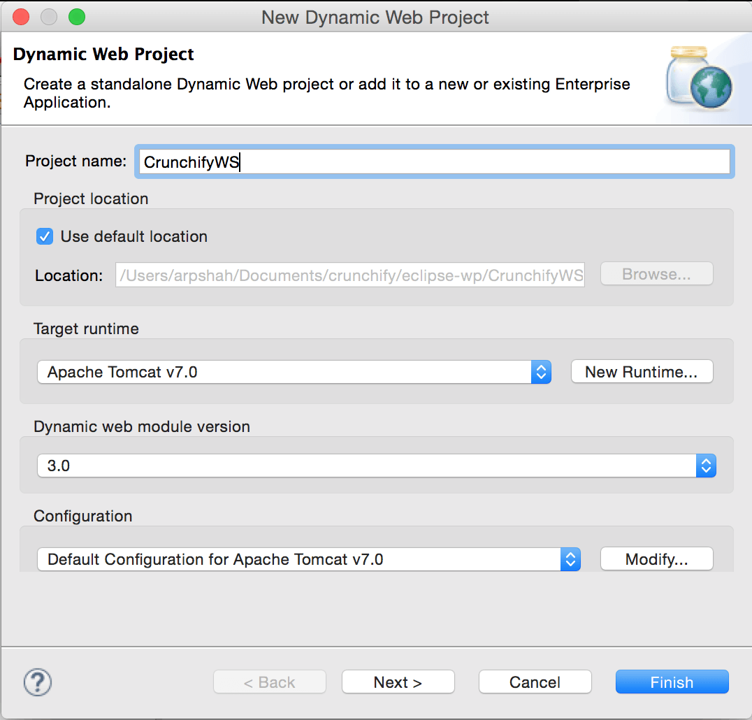
Step-2
Create a dynamic Web Project

Slide 13
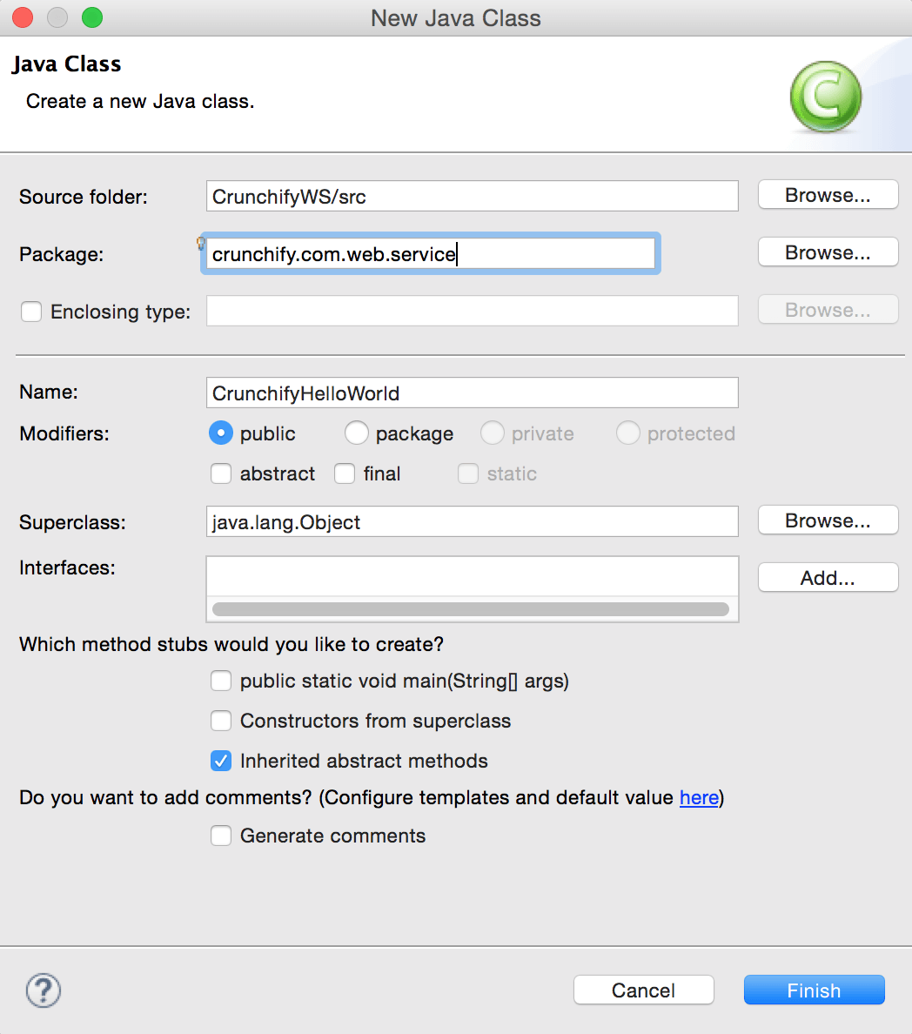
Step-3
Package: crunchify.com.web.service
Name: CrunchifyHelloWorld.java

Slide 14
Step-4
Open CrunchifyHelloWorld.java file
CrunchifyHelloWorld.javaJava
package crunchify.com.web.service;
public class CrunchifyHelloWorld
{
public float addValue(float value)
{
return (value + 10);
}
public float subtractValue(float value)
{
return (value - 10);
}
}

Slide 15
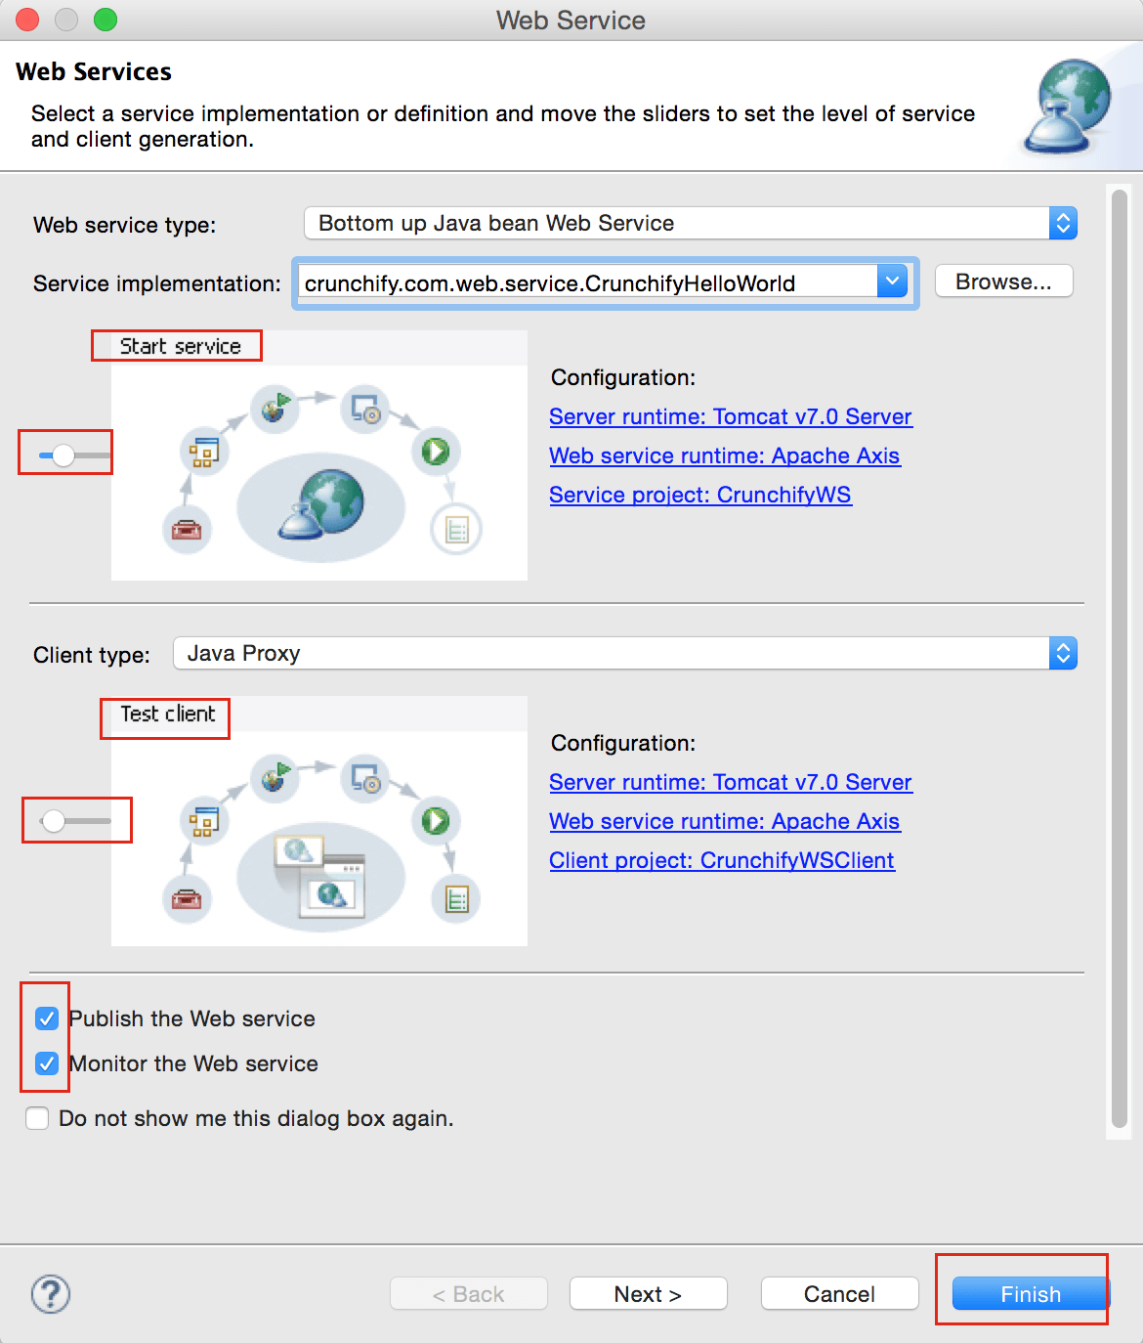
Step-5
Right Click on file CrunchifyHelloWorld.java -> Web Services -> Create Web Service
Select options as mentioned in below diagram Click finish

Slide 16
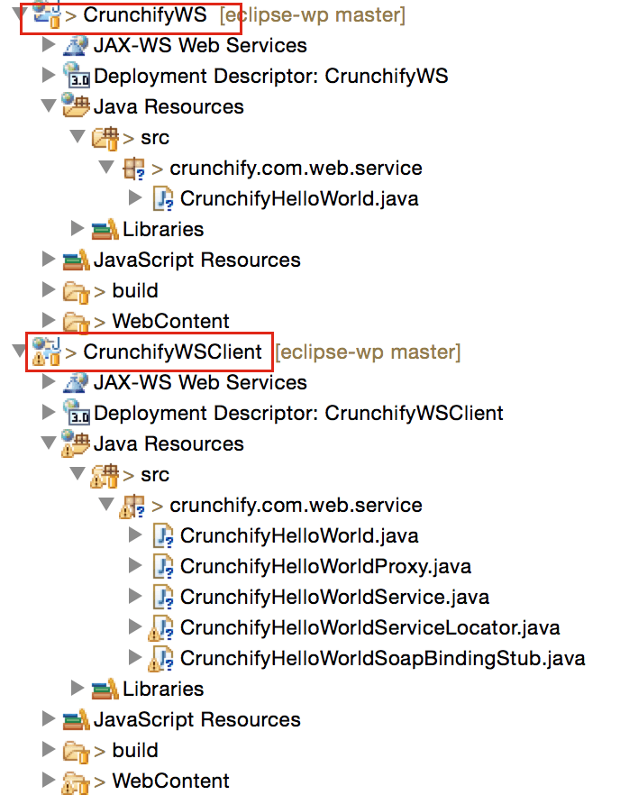
Step-6
It may take some time to finish all processes and you should see new project “CrunchifyWSClient” created. Here is a final project structure:

Slide 17
Step-7
CrunchifyWS and CrunchifyWSClient both projects should be automatically deployed to server.

Slide 18
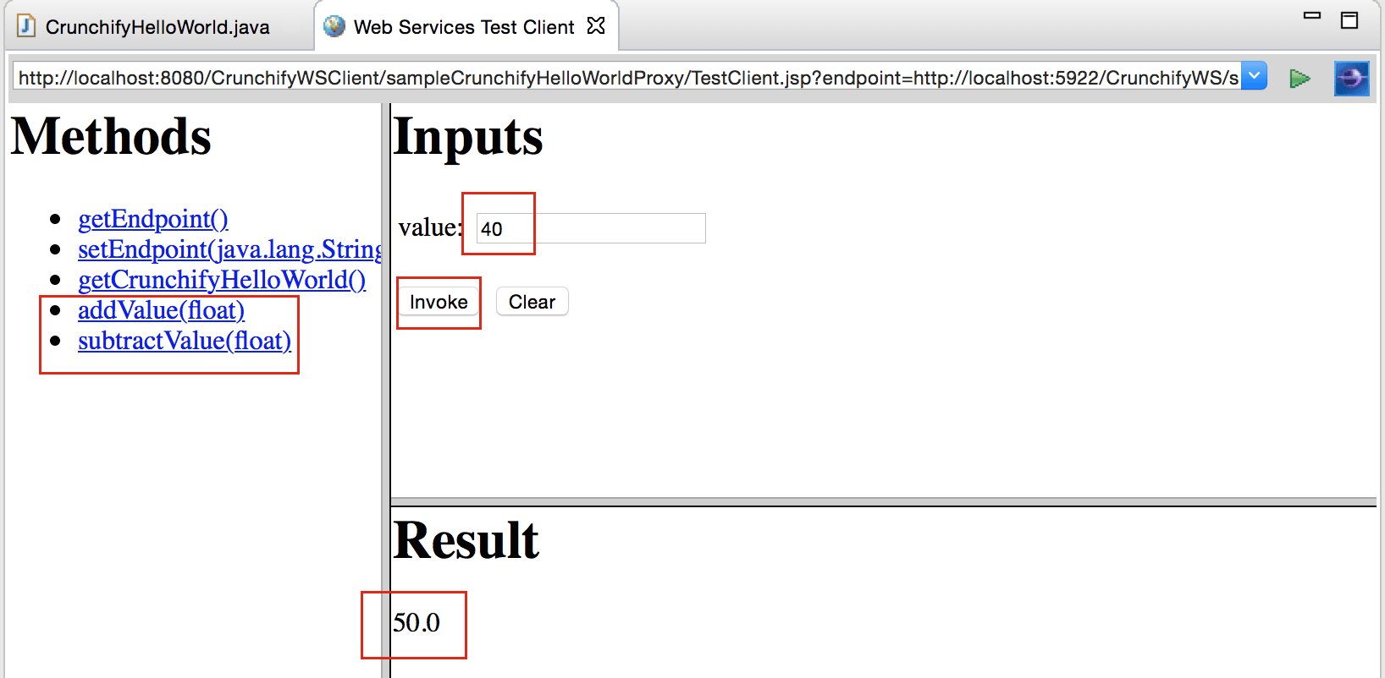
Step-8
Now click on addValue(float), subtractValue(float) and provide an input to check updated result.

Slide 19
Client Applications To Meet Customer Requirements, Easier Develpoment Customization & Maintenance, Transactional Requirements
Web services enable us to build distributed systems where application components on a network can be accessed in a platform-neutral, language-agnostic, and implementation-independent way.
It doesn't matter how an application is developed, what language it uses, or what OS platform it runs on. If it is available as a Web service and designed addressing interoperability issues,application, developed in any language or platform, will be able to utilize its services. That's the main concept of Web services.

Slide 20
Technologies & Standards
To achieve the platform-neutral and implementation-independent accessibility of Web services, the software industry has agreed on a few technologies as standards. Some of them are:
XML: The default data format used across all layers of Web services environment.
SOAP: The default protocol for packaging and exchanging messages. When first introduced, it was an acronym for Simple Object Access Protocol. But now SOAP is considered a proper noun, a name in itself, as most people now realize it is a misnomer: SOAP is not really for accessing objects. Plus, it is not simple any more.
WSDL (Web Services Description Language): The language that describes Web services. Although based on XML and understandable by humans, WSDL is mainly for machine consumption, to be read and understood by client programs.

Slide 21
Seamless Porting To Multiple
Devices & Platforms
  Enable smooth integration of different services from a user perspective
  Expand the value chain including higher value services
  Build on existing MNO assets (authentication, charging,..) to create a competitive advantage in service deployments
  Enable access to services from a large device base
  Flexible concept to include 3rd party services
  Keep CAPEX and OPEX low
  while deploying multiple new services

Slide 22
Seamless Porting To Multiple
Devices & Platforms (Cont.....)
IMS enables the operator to build up new IP-based mobile services and applications under his control (e.g. Push to Talk)
IMS provides the capability to offer any mixture of peer to peer real-time and non-real-time services (Rich Voice, Data, Video,…) to increase ARPU and reduce churn rate
The IMS based highly scalable common service control infrastructure helps the operator to keep OPEX low while deploying new services rapidly (central user admin, standardized interfaces, …)
Using an IP-transport network supports the fix/mobile convergence of those services by enabling access over any network (UMTS, WLAN, wired network,..)

