Slide 1
Introduction to Web Services
Unit I
Web Services
Dr. V.Jayaraj
Professor
Department of CS & Engg
BDU
Trichy

Slide 2
Web Services
A simple definition:
  “a Web Service is an application component accessible over open protocols”.
A more precise definition:
  An application component that:
    Communicates via open protocols (HTTP, SMTP, etc.)
    Processes XML messages framed using SOAP
    Describes its messages using XML Schema
    Provides an endpoint description using WSDL
    Can be discovered using UDDI

Slide 3
Web Services Components
XML – eXtensible Markup Language – A uniform data representation and exchange mechanism.
SOAP – Simple Object Access Protocol – A standard way for communication.
UDDI – Universal Description, Discovery and Integration specification – A mechanism to register and locate WS based application.
WSDL – Web Services Description Language – A standard meta language to described the services offered.

Slide 4
The Web Service Model
The Web Services architecture is based upon the interactions between three roles:
  Service provider
  Service registry
  Service requestor
The interactions involve the:
  Publishing – making a service available
  Finding – locating web services
  Binding – using web services

Slide 5
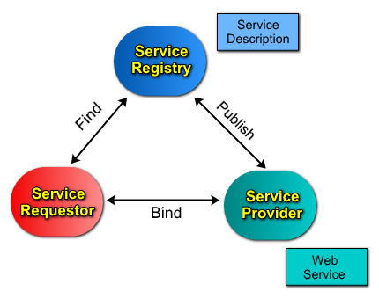
The Web Service Model (cont)
The Web Services model follows the publish, find, and bind paradigm.

Slide 6
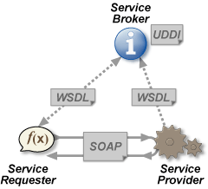
Web Services Architecture

Slide 7
Underlying standards
Web services evolved from previous technologies that served the same purpose such as RPC, ORPC (DCOM, CORBA and JAVA RMI).
Web services deals with inter-organisation communication these must be universal standards.
The basic standards for web services are:
XML (Extensible Markup Language)
SOAP (simple object access protocol)
WSDL (web services description language)
UDDI (universal description, discovery and integration)

Slide 8
XML
XML stands for EXtensible Markup Language.
XML is a markup language much like HTML.
XML was designed to describe data.
XML tags are not predefined. We must define your own tags.
All Web Services documents are written in XML.
XML Schema are used to define the elements used in Web Services communication.
The prefect choice for enabling cross-platform data communication in Web Services.

Slide 9
SOAP
Actually used to communicate with the Web Service.
Both the request and the response are SOAP messages.
The body of the message (whose grammar is defined by the WSDL) is contained within a SOAP “envelope”.
“Binds” the client to the web service.

Slide 10
SOAP Characteristics
SOAP has three major characteristics:
  Extensibility – security and WS-routing are among the extensions under development.
  Neutrality - SOAP can be used over any transport protocol such as HTTP, SMTP or even TCP.
  Independent - SOAP allows for any programming model .

Slide 11
WSDL
Describes the Web Service and defines the functions that are exposed in the Web Service
Defines the XML grammar to be used in the messages.
  Uses the W3C Schema language
In addition to describing message contents, WSDL defines where the service is available and what communications protocol is used to talk to the service.

Slide 12
UDDI
UDDI stands for Universal Description, Discovery and Integration.
UDDI is a directory for storing information about web services , like yellow pages.
UDDI is a directory of web service interfaces described by WSDL.

Slide 13
How does XML differ from HTML?
HTML is a presentation markup language – provides no information about content.
There is only one standard definition of all of the tags used in HTML.
XML can define both presentation style and give information about content.
XML relies on custom documents defining the meaning of tags.

Slide 14
What is a Schema?
A schema is the definition of the meaning of each of the tags within a XML document.
Analogy: A HTML style sheet can be seen as a limited schema which only specifies the presentational style of HTML which refers to it.
Example: in HTML the tag <strong> pre-defined. In XML you would need to define this in the context of your document.

Slide 15
A minimal XML document
value
<?xml version=“1.0” ?>
<document name=“first”>Jim</document>
A tag
An attribute
Closing tag

Slide 16
Valid and well formed
A correct XML document must be both valid and well formed.
Well formed means that the syntax must be correct and all tags must close correctly (eg <…> </…>).
Valid means that the document must conform to some XML definition ( a DTD or Schema).
(Otherwise there can be no definition of what the tags mean)

Slide 17
Importance of Web Services
Web services provide certain functionalities as a service and these can be used during the application development.
It is true that web service is an evolution of distributed computing. Even CORBA, DCOM etc tried to provide a distributed computing background across heterogeneous environments.
Web services provide anybody to anybody communication.
Thus, web services are interoperable and platform-hardware-location-programming language independent.
Moreover, need for human intervention is removed in case of web services for data transfer between applications on service provider and service requestor ends. Web services thus help to enable great business relationships between companies that can be changed as and when required.

Slide 18
Web Application Architecture
Industry Standard Interfaces
Proprietary Interfaces & Custom Development
End Users
Web Application Business LowWgic
Web Application Business LowWgic
Web Application Business Logic
Web Application User Interface
The Web

Slide 19
Web Services Architecture
Industry standard Interfaces
WWeb Application Busines LowWgic
Web Application User Interface
End Users
Web Application Business LowWgic
Web Application Business LowWgic
Web Service Architecture
Standard Application
The Web
Web Application Business LowWgic
Another Web Service

Slide 20
Web Services and Enterprises
Web services enable the flow of data and business processes between business partners-between enterprises as well as between multiple organizations or groups within an enterprise.
Web Services enable companies to drive topline growth by integrating together different services and introduce new revenue-generating services.
Web Services simplify integration,reducing time-to-market and costs.

