Slide 1
Telecommunications systems
Global System for Mobile Communication
(GSM)
Dr.M.Balamurugan
Professor and Head of the Department
School of Computer Science and Engineering
Bharathidasan University

Slide 2
GSM Overview
Formerly: Groupe Spéciale Mobile (founded 1982)
Now: Global System for Mobile Communication
Pan-European standard (ETSI, European Telecommunications Standardisation Institute)
Simultaneous introduction of essential services in three phases by the European telecommunication administrations
Seamless roaming within Europe possible
Today many providers all over the world use GSM (more than 180 countries in Asia, Africa, Europe, Australia, America)
More than 900 million subscribers
More than 70% of all digital mobile phones use GSM

Slide 3
Performance Characteristics of GSM
Communication - mobile, wireless communication; support for voice and data services
Total mobility - international access, chip-card enables use of access points of different providers
Worldwide connectivity - one number, the network handles localization
High capacity - better frequency efficiency, smaller cells, more customers per cell
High transmission quality - high audio quality and reliability for wireless, uninterrupted phone calls at higher speeds (e.g., from cars, trains)
Security functions - access control, authentication via chip-card and PIN

Slide 4
Mobile Services
GSM permits the integration of different voice and data services and the interworking with existing networks.
GSM offers
– several types of connections: voice connections, data connections, short message service
– multi-service options (combination of basic services)
GSM uses a variation of time division multiple access (TDMA)
Categories of services:
Bearer Service
Tele Service and
Supplementary Services.

Slide 5
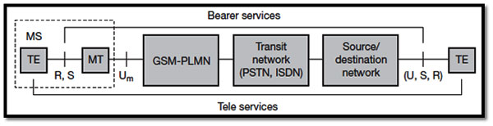
Bearer Services
GSM specifies different mechanisms for data transmission, the original GSM allowing for data rates of up to 9600 bit/s for non-voice services. Bearer services permit transparent and non-transparent, synchronous or asynchronous data transmission. Transparent bearer services only use the functions of the physical layer (layer 1) to transmit data. Data transmission has a constant delay and throughput if no transmission errors occur.

Slide 6
Bearer Services
The only mechanism to increase transmission quality is the use of forward error correction (FEC), which codes redundancy into the data stream and helps to reconstruct the original data in case of transmission errors.
Different Data Rates:
Data service (circuit switched)
– synchronous: 2.4, 4.8 or 9.6 kbit/s
– asynchronous: 300 - 1200 bit/s
Data service (packet switched)
– synchronous: 2.4, 4.8 or 9.6 kbit/s
– asynchronous: 300 - 9600 bit/s

Slide 7
Tele Services
Telecommunication services that enable voice communication via mobile phones
All these basic services have to obey cellular functions, security measurements etc.
Offered services
– mobile telephony
primary goal of GSM was to enable mobile telephony offering the
traditional bandwidth of 3.1 kHz
– Emergency number
common number throughout Europe (112); mandatory for all
service providers; free of charge, without contract; connection with
the highest priority (preemption of other connections possible)

Slide 8
Supplementary Services
Services in addition to the basic services, cannot be offered stand-alone
Similar to ISDN services besides lower bandwidth due to the radio link
May differ between different service providers, countries and protocol versions
Important services
– identification: forwarding of caller number
– suppression of number forwarding
– automatic call-back
– conferencing with up to 7 participants
– locking of the mobile terminal (incoming or outgoing calls)

Slide 9
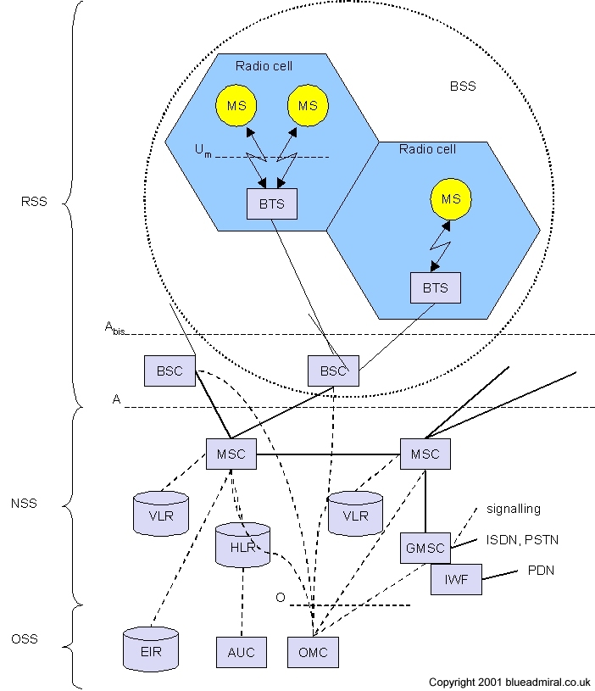
System Architecture

Slide 10
Radio Subsystem
RSS - Radio Subsystem: covers all radio aspects
MS (Mobile Station) - Mobile terminal equipment. The MS comprises all user equipment and software needed for communication with a GSM network. An MS consists of user independent hard- and software and of the subscriber identity module (SIM), which stores all user-specific data that is relevant to GSM.
BSC (Base Station Controller) - Management of several BTS and MS. It reserves radio frequencies, handles the handover from one BTS to another within the BSS, and performs paging of the MS. The BSC also multiplexes the radio channels onto the fixed network connections at the A interface.
BTS (Base Transceiver Station) - Transmitter, receiver and antennas. A BTS comprises all radio equipment, i.e., antennas, signal processing, amplifiers necessary for radio transmission.
BSS (Base station subsystem) - A GSM network comprises many BSSs, each controlled by a base station controller (BSC).

Slide 11
Network and Switching Subsystem (NSS)
NSS - Network Subsystem: switching, mobility management, interconnection to other networks, system control.
The “heart” of the GSM system is formed by the network and switching subsystem (NSS). The NSS connects the wireless network with standard public networks, performs handovers between different BSSs, comprises functions for worldwide localization of users and supports charging, accounting, and roaming of users between different providers in different countries.
􀂉 MSC - Mobile Switching Centre - Management of all connections
􀂉 HLR - Home Location Register - Associated to each PLMN
􀂉 VLR - Visitor Location Register - Associated to each MSC
􀂉 GMSC - Gateway MSC - MSC providing interconnection to other networks

Slide 12
Operation Subsystem
OSS - Operation Subsystem: centralized operation, management, and maintenance of all GSM subsystems
􀂉 OMC - Operation and Management Centre subsystems - Control of the radio and network. Typical OMC management functions are traffic monitoring, status reports of network entities, subscriber and security management, or accounting and billing. OMCs use the concept of telecommunication management network (TMN) as standardized by the ITU-T.
􀂉 AuC - Authentication Centre - Security functions. A separate AuC has been defined to protect user identity and data transmission. The AuC contains the algorithms for authentication as well as the keys for encryption and generates the values needed for user authentication in the HLR.
􀂉 EIR - Equipment Identity Register - Mobile station Registration. The EIR is a database for all IMEIs, i.e., it stores all device identifications registered for this network. As MSs are mobile, they can be easily stolen. With a valid SIM, anyone could use the stolen MS. The EIR has a blacklist of stolen (or locked) devices.

Slide 13
Radio Interface
The radio interface is the interface between the mobile stations and the fixed infrastructure. It is probably the most important interface of the GSM system, as it is the key element to enable mobility and wireless access. One of the main objectives of GSM is roaming1. Therefore, in order to obtain a complete compatibility between mobile stations and networks of different manufacturers and operators, the radio interface must be completely defined.
The spectrum efficiency depends on the radio interface and the transmission, more particularly in aspects such as the capacity of the system and the techniques used in order to decrease the interference and to improve the frequency reuse scheme. The specification of the radio interface has then an important influence on the spectrum efficiency.

Slide 14
Logical channels
Logical channels are multiplexed into the physical channels. Logical channels are, so to speak, laid over the grid of physical channels. Each logic channel performs a specific task. Consequently the data of a logical channel is transmitted in the corresponding timeslots of the physical channel. During this process, logical channels can occupy a part of the physical channel or even the entire channel.
There are two different types of logical channel within the GSM system:
Traffic channels (TCHs) - Traffic channels carry user information such as encoded speech or user data. Traffic channels are defined by using a 26-frame multiframe.
Control channels (CCHs) - Control channels carry system signalling and synchronisation data for control procedures such as location registration, mobile station synchronisation, paging, random access etc. between base station and mobile station.

Slide 15
Frame Hierarchy
This logical frame hierarchy continues, combining 26 multiframes with 51 frames or 51 multiframes with 26 frames to form a superframe. 2,048 superframes build a hyperframe with a duration of almost 3.5 hours. Altogether, 2,715,648 TDMA frames form a hyperframe.

Slide 16
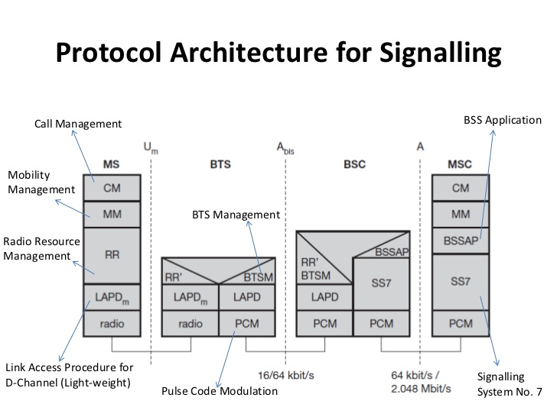
Protocols

Slide 17
GSM Protocol Layer for Signaling
CM (Connection Management)
call control, short message service and supplementary service
MM (Mobility Management)
registration, authentication, location and handover management
RR (Radio Resource Management)
setup, maintenance and release of radio channels
control of radio transmission quality
LAPDm (“Link Access Protocol D-channel” modified)
modified version of ISDN LAPD protocol
BTSM (Base Transceiver Station Management)
radio resources control messages between BSC and BTS
BSSAP (Base Station System Application Part)
control of BSC by MSC

Slide 18
Localization and Calling
One fundamental feature of the GSM system is the automatic, worldwide localization of users. The system always knows where a user currently is, and the same phone number is valid worldwide. To provide this service, GSM performs periodic location updates even if a user does not use the mobile station.
Mobile station international ISDN number (MSISDN): The MSISDN follows the ITU-T standard E.164 for addresses as it is also used in fixed ISDN networks. Ex: +49 179 1234567, country code (CC)-49, national destination code (NDC)-179, and the subscriber number (SN)-1234567.
International mobile subscriber identity (IMSI): GSM uses the IMSI for internal unique identification of a subscriber. mobile country code (MCC)-240 for Sweden, 208 for France, the mobile network code (MNC)-code of the network provider), and finally the mobile subscriber identification number (MSIN).
Temporary mobile subscriber identity (TMSI): To hide the IMSI, which would give away the exact identity of the user signalling over the air interface, GSM uses the 4 byte TMSI for local subscriber identification.
Mobile station7 roaming number (MSRN): Another temporary address that hides the identity and location of a subscriber is MSRN.

Slide 19
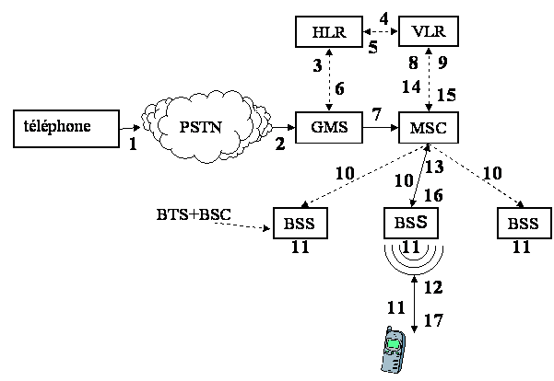
Mobile Terminated Call (MTC)
1: calling a GSM subscriber 2: forwarding call to GMSC 3: signal call setup to HLR 4, 5: get routing info (MSRN) from VLR 6: forward routing info to GMSC 7: route call to current MSC 8, 9: get current status of MS (LAI + TMSI) 10, 11: paging of MS in location area 12, 13: MS answers paging and authentication request 14, 15: security checks 16, 17: set up connection

Slide 20
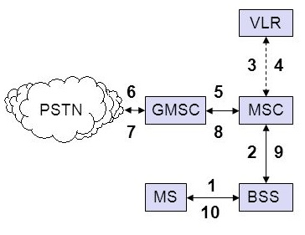
Mobile Originated Call (MOC)
1, 2: connection and authentication request 3, 4: security check 5-8: check resources (free circuit) 9-10: set up call

Slide 21
Message flow for MTC and MOC
MS
MTC
BTS
MS
MOC
BTS
Paging request Channel request Immediate assignment Paging response Authentication request Authentication response Ciphering command Ciphering complete Setup Call confirmed Assignment command Assignment complete Alerting Connect Connect acknowledge Data/speech exchange
Channel request Immediate assignment Service request Authentication request Authentication response Ciphering command Ciphering complete Setup Call confirmed Assignment command Assignment complete Alerting Connect Connect acknowledge Data/speech exchange

Slide 22
Handover
Cellular systems require handover procedures, as single cells do not cover the whole service area. There are two basic reasons for a handover
The mobile station moves out of the range of a BTS or a certain antenna of a BTS respectively. The received signal level decreases continuously until it falls below the minimal requirements for communication. The error rate may grow due to interference, the distance to the BTS may be too high (max. 35 km) etc. – all these effects may diminish the quality of the radio link and make radio transmission impossible in the near future.
The wired infrastructure (MSC, BSC) may decide that the traffic in one cell is too high and shift some MS to other cells with a lower load (if possible). Handover may be due to load balancing.

Slide 23
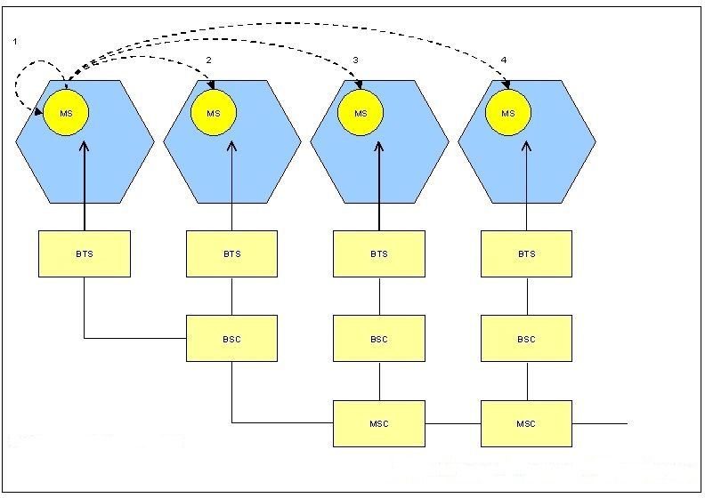
Types of Handover in GSM
1 - between different sectors of the same cell 2 - between different cells within the same BSC domain 3 - between different BSC domains within the same MSC domain 4 - between different MSC domains

Slide 24
Security
GSM offers several security services using confidential information stored in the AuC and in the individual SIM.
The SIM stores personal, secret data and is protected with a PIN against unauthorized use.
Three Security Services:
Access Control and Authentication – Valid User for the SIM & Secret PIN to access the SIM.
Confidentiality – All user-related data is encrypted.
Anonymity – Provide user anonymity.
Three Algorithms:
A3-Authentication, A5-encryption, and A8-cipher key generation.

Slide 25
New Data Services
To enhance the data transmission capabilities of GSM, two basic approaches are possible.
HSCSD: A straightforward improvement of GSM’s data transmission capabilities is high speed circuit switched data (HSCSD), which is available with some providers. In this system, higher data rates are achieved by bundling several TCHs. A MS requests one or more TCHs from the GSM network.
GPRS: The general packet radio service (GPRS) provides packet mode transfer for applications that exhibit traffic patterns such as frequent transmission of small volumes (e.g., typical web requests) or infrequent transmissions of small or medium volumes (e.g., typical web responses) according to the requirement specification. Compared to existing data transfer services, GPRS should use the existing network resources more efficiently for packet mode applications, and should provide a selection of QoS parameters for the service requesters. GPRS should also allow for broadcast, multicast, and unicast service.

Slide 26
Digital Enhanced Cordless Telecommunications (DECT)
Fully digital cellular network is the digital enhanced cordless telecommunications (DECT) system specified by ETSI. DECT is mainly used in offices, on campus, at trade shows, or in the home. Access points to the PSTN can be established within, e.g., railway stations, large government buildings and hospitals, offering a much cheaper telephone service compared to a GSM system. DECT could also be used to bridge the last few hundred meters between a new network operator and customers. Using this ‘small range’ local loop, new companies can offer their service without having their own lines installed in the streets. DECT systems offer many different interworking units, e.g., with GSM, ISDN, or data networks. Currently.
A big difference between DECT and GSM exists in terms of cell diameter and cell capacity.

Slide 27
System Architecture
A DECT system, may have various different physical implementation depending on its actual use. Different DECT entities can be integrated into one physical unit; entities can be distributed, replicated etc. Global networks could be integrated services digital networks (ISDN), public switched telephone networks (PSTN), public land mobile networks (PLMN), e.g., GSM, or packet switched public data network (PSPDN). The services offered by these networks include transportation of data and the translation of addresses and routing of data between the local networks.
Local networks in the DECT context offer local telecommunication services that can include everything from simple switching to intelligent call forwarding, address translation etc. As the core of the DECT system itself is quite simple, all typical network functions have to be integrated in the local or global network, where the databases home data base (HDB) and visitor data base (VDB) are also located. Both databases support mobility with functions that are similar to those in the HLR and VLR in GSM systems. Incoming calls are automatically forwarded to the current subsystem responsible for the DECT user, and the current VDB informs the HDB about changes in location.

Slide 28
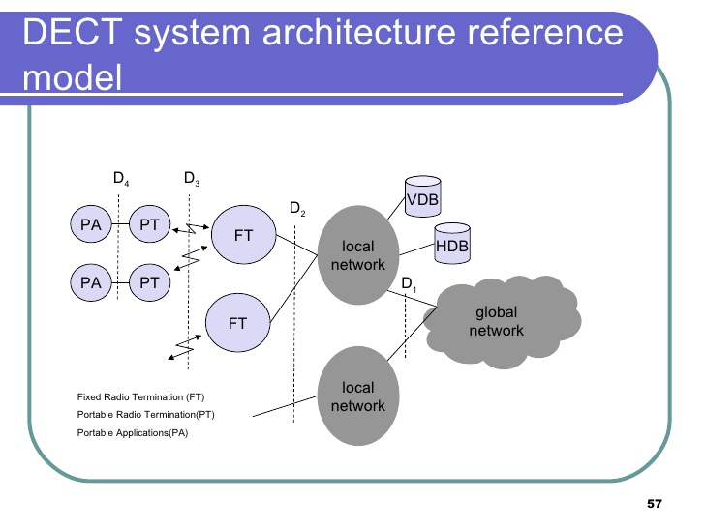
System Architecture Diagram

Slide 29
Terrestrial Trunked Radio (TETRA)
Trunked radio systems constitute another method of wireless data transmission. These systems use many different radio carriers but only assign a specific carrier to a certain user for a short period of time according to demand. While, for example, taxi services, transport companies with fleet management systems and rescue teams all have their own unique carrier frequency in traditional systems, they can share a whole group of frequencies in trunked radio systems for better frequency reuse via FDM and TDM techniques. These types of radio systems typically offer 134 Mobile communications interfaces to the fixed telephone network, i.e., voice and data services, but are not
publicly accessible.

