Slide 1

Software Engineering
Dr.B.Smitha

Slide 2
What is Software?
Software is: (1) instructions (computer programs) that when executed provide desired features, function, and performance; (2) data structures that enable the programs to adequately manipulate information and (3) documentation that describes the operation and use of the programs.

Slide 3
What is Software?
Software is developed or engineered, it is not manufactured in the classical sense.
Software doesn't "wear out."
Although the industry is moving toward component-based construction, most software continues to be custom-built.

Slide 4
Software Engineering
Some realities:
a concerted effort should be made to understand the problem before a software solution is developed
design becomes a pivotal activity
software should exhibit high quality
software should be maintainable
The seminal definition:
[Software engineering is] the establishment and use of sound engineering principles in order to obtain economically software that is reliable and works efficiently on real machines.

Slide 5
Software Engineering
The IEEE definition:
Software Engineering: (1) The application of a systematic, disciplined, quantifiable approach to the development, operation, and maintenance of software; that is, the application of engineering to software. (2) The study of approaches as in (1).

Slide 6
Life Cycle Models

Slide 7
Definition of Software Process
A framework for the activities, actions, and tasks that are required to build high-quality software.
SP defines the approach that is taken as software is engineered.
Is not equal to software engineering, which also encompasses technologies that populate the process– technical methods and automated tools.

Slide 8
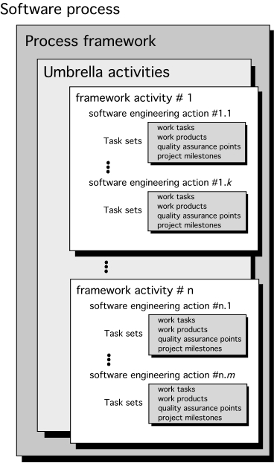
A Generic Process Model

Slide 9
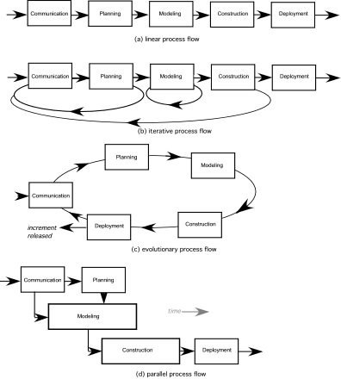
Process Flow

Slide 10
Software Life Cycle Models
The goal of Software Engineering is to provide models and processes that lead to the production of well-documented maintainable software in a manner that is predictable.

Slide 11
Software Life Cycle Models
“The period of time that starts when a software product is conceived and ends when the product is no longer available for use. The software life cycle typically includes a requirement phase, design phase, implementation phase, test phase, installation and check out phase, operation and maintenance phase, and sometimes retirement phase”.

Slide 12
Build & Fix Model
Product is constructed without specifications or any attempt at design
Build Code
Adhoc approach and not well defined
Simple two phase model
Fix

Slide 13
Build & Fix Model
Suitable for small programming exercises of 100 or 200 lines
Unsatisfactory for software for any reasonable size
Code soon becomes unfixable & unenhanceable
No room for structured design
Maintenance is practically not possible

Slide 14









































































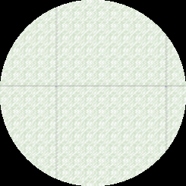









Waterfall Model
Requirement
Analysis & Specification
This model is named “waterfall
model” because its diagrammatic
representation resembles a cascade of
Design
waterfalls.
Implementation and unit testing
Integr ation and system testing
Operation and maintenance

Slide 15
Waterfall Model
This model is easy to understand and reinforces the notion of “define before design” and “design before code”.
The model requirements unrealistic
expects complete & accurate early in the
process, which is

Slide 16
Waterfall Model
Problems of waterfall model
It is difficult to define all requirements at the beginning of a project
This model is not suitable for accommodating any change
A working version of the system is not seen until late in the project’s life
It does not scale up well to large projects.
Real projects are rarely sequential.

Slide 17

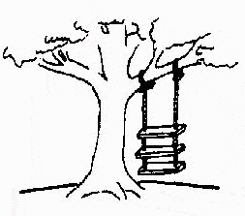
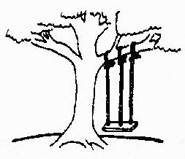

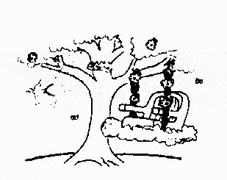
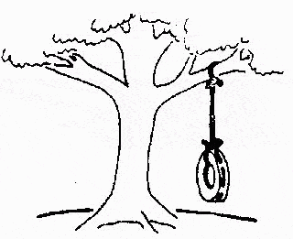
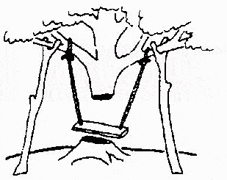
The Rapid Application Development (RAD) Model
Developed by IBM in 1980
User participation is essential
This is how the
The requirements specification was defined like this
The developers understood it in that way
problem is solved now
This is how the problem was solved before.
This is how the program is described by marketing department
This, in fact, is what the customer wanted …
That is the program after debugging

Slide 18
The Rapid Application Development (RAD) Model
Build a rapid prototype
Give it to user for evaluation & obtain feedback
Prototype is refined
With active participation of users
Requirements
Planning
User
Description
Construction
Cut over

Slide 19
The Rapid Application Development (RAD) Model
Not an appropriate model in the absence of user participation.
Reusable components are required to reduce development time.
Highly specialized & skilled developers are required and such developers are not easily available.

Slide 20
Evolutionary Process Models
Evolutionary process model resembles iterative enhancement model. The same phases as defined for the waterfall model occur here in a cyclical fashion. This model differs from iterative enhancement model in the sense that this does not require a useable product at the end of each cycle. In evolutionary development, requirements are implemented by category rather than by priority.
This model is useful for projects using new technology that is not well understood. This is also used for complex projects where all functionality must be delivered at one time, but the requirements are unstable or not well understood at the beginning.

Slide 21









Evolutionary Process Model
Concurrent activities
Specification
Initial version
Outline description
Development
Intermediate
versions
Validation
Final version

Slide 22
Prototyping Model
The prototype may be a usable program but is not suitable as the final software product.
The code for the prototype is thrown away. However experience gathered helps in developing the actual system.
The development of a prototype might involve extra cost, but overall cost might turnout to be lower than that of an equivalent system developed using the waterfall model.

Slide 23
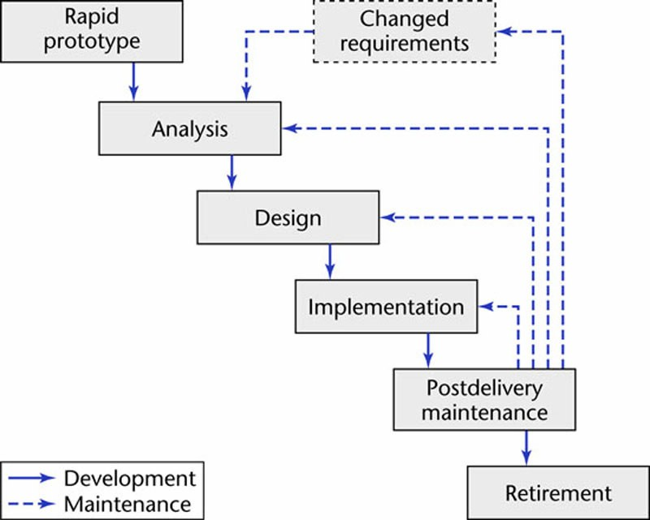
Prototyping Model
Linear mode
“Rapid”
l

Slide 24
Spiral Model
Models do not deal with uncertainly which is inherent to software projects.
Important software projects have failed because project risks were neglected & nobody was prepared when something unforeseen happened.
Barry Boehm recognized this and tired to incorporate the “project risk” factor into a life cycle model.
The result is the spiral model, which was presented in 1986.

Slide 25
Spiral Model
The radial dimension of the model represents the cumulative costs. Each path around the spiral is indicative of increased costs. The angular dimension represents the progress made in completing each cycle. Each loop of the spiral from X-axis clockwise through 360º represents one phase. One phase is split roughly into four sectors of major activities.
Planning: Determination of objectives, alternatives & constraints.
Risk Analysis: Analyze alternatives and attempts to identify and resolve the risks involved.
Development: Product development and testing product.
Assessment: Customer evaluation

Slide 26
Spiral Model
An important feature of the spiral model is that each phase is completed with a review by the people concerned with the project (designers and programmers)
The advantage of this model is the wide range of options to accommodate the good features of other life cycle models.
It becomes equivalent to another life cycle model in
appropriate situations.
The spiral model has some difficulties that need to be resolved before it can be a universally applied life cycle model. These difficulties include lack of explicit process guidance in determining
objectives, constraints, alternatives; relying on risk assessment expertise; and provides more flexibility than required for many applications.

Slide 27
The Waterfall Model
It is the oldest paradigm for SE. When requirements are well defined and reasonably stable, it leads to a linear fashion.
The classic life cycle suggests a systematic, sequential approach to software development.

Slide 28
The Incremental Model

Slide 29
The Incremental Model
When initial requirements are reasonably well defined, but the overall scope of the development effort precludes a purely linear process. A compelling need to expand a limited set of new functions to a later system release.
It combines elements of linear and parallel process flows. Each linear sequence produces deliverable increments of the software.
The first increment is often a core product with many supplementary features. Users use it and evaluate it with more modifications to better meet the needs.

Slide 30
Evolutionary Models
Software system evolves over time as requirements often change as development proceeds. Thus, a straight line to a complete end product is not possible. However, a limited version must be delivered to meet competitive pressure.
Usually a set of core product or system requirements is well understood, but the details and extension have yet to be defined.
You need a process model that has been explicitly designed to accommodate a product that evolved over time.
It is iterative that enables you to develop increasingly more complete version of the software.
Two types are introduced, namely Prototyping and Spiral models.

Slide 31
Evolutionary Models: Prototyping
When to use: Customer defines a set of general objectives but does not identify detailed requirements for functions and features. Or Developer may be unsure of the efficiency of an algorithm, the form that human computer interaction should take.
What step: Begins with communication by meeting with stakeholders to define the objective, identify whatever requirements are known, outline areas where further definition is mandatory. A quick plan for prototyping and modeling (quick design) occur. Quick design focuses on a representation of those aspects the software that will be visible to end users. ( interface and output). Design leads to the construction of a prototype which will be deployed and evaluated. Stakeholder’s comments will be used to refine requirements.
Both stakeholders and software engineers like the prototyping paradigm. Users get a feel for the actual system, and developers get to build something immediately. However, engineers may make compromises in order to get a prototype working quickly. The less-than-ideal choice may be adopted forever after you get used to it.

Slide 32
Evolutionary Models: Prototyping
Quick
plan
communication
Modeling
Quick design
Deployment
delivery &
feedback
Construction
of prototype
Construction
of prototype

Slide 33
Evolutionary Models: The Spiral
It couples the iterative nature of prototyping with the controlled and systematic aspects of the waterfall model and is a risk-driven process model generator that is used to guide multi-stakeholder concurrent engineering of software intensive systems.
Two main distinguishing features: one is cyclic approach for incrementally growing a system’s degree of definition and implementation while decreasing its degree of risk. The other is a set of anchor point milestones for ensuring stakeholder commitment to feasible and mutually satisfactory system solutions.
A series of evolutionary releases are delivered. During the early iterations, the release might be a model or prototype. During later iterations, increasingly more complete version of the engineered system are produced.
The first circuit in the clockwise direction might result in the product specification; subsequent passes around the spiral might be used to develop a prototype and then progressively more sophisticated versions of the software. Each pass results in adjustments to the project plan. Cost and schedule are adjusted based on feedback. Also, the number of iterations will be adjusted by project manager.
Good to develop large-scale system as software evolves as the process progresses and risk should be understood and properly reacted to. Prototyping is used to reduce risk.
However, it may be difficult to convince customers that it is controllable as it demands considerable risk assessment expertise.

Slide 34
Evolutionary Models: The Spiral

Slide 35
Three Concerns on Evolutionary Processes
First concern is that prototyping poses a problem to project planning because of the uncertain number of cycles required to construct the product.
Second, it does not establish the maximum speed of the evolution. If the evolution occur too fast, without a period of relaxation, it is certain that the process will fall into chaos. On the other hand if the speed is too slow then productivity could be affected.
Third, software processes should be focused on flexibility and extensibility rather than on high quality. We should prioritize the speed of the development over zero defects. Extending the development in order to reach high quality could result in a late delivery of the product when the opportunity niche has disappeared.

Slide 36
Rapid Application Model (RAD)
Requirements planning phase (a workshop utilizing structured discussion of business problems)
User description phase – automated tools capture information from users
Construction phase – productivity tools, such as code generators, screen generators, etc. inside a time-box. (“Do until done”)
Cutover phase -- installation of the system, user acceptance testing and user training

Slide 37
RAD Strengths
Reduced cycle time and improved productivity with fewer people means lower costs
Time-box approach mitigates cost and schedule risk
Customer involved throughout the complete cycle minimizes risk of not achieving customer satisfaction and business needs
Focus moves from documentation to code (WYSIWYG).
Uses modeling concepts to capture information about business, data, and processes.

Slide 38
RAD Weaknesses
Accelerated development process must give quick responses to the user
Risk of never achieving closure
Hard to use with legacy systems
Requires a system that can be modularized
Developers and customers must be committed to rapid-fire activities in an abbreviated time frame.

Slide 39
When to use RAD
Reasonably well-known requirements
User involved throughout the life cycle
Project can be time-boxed
Functionality delivered in increments
High performance not required
Low technical risks
System can be modularized

Slide 40
Architectural Design

Slide 41
Software Architecture
The software architecture of a program or computing system is the structure or structures of the system, which comprise the software components, the externally visible properties of those components, and the relationships among them.

Slide 42
Why Architecture?
Architecture is a representation of a system that enables the software engineer to:
analyze the effectiveness of the design in meeting its stated requirements,
consider architectural alternatives at a stage when making design changes is still relatively easy, and
reduce the risks associated with the construction of the software.

Slide 43
Data Design
Architectural level → Database design
data mining
data warehousing
Component level → Data structure design

Slide 44
Architectural Styles
Each style describes a system category that encompassesa perform set of components (e.g., a database, computational modules) that a function required by a system,
a set of connectors that enable “communication, coordination, and cooperation” among components,
constraints that define how components can be integrated to form the system, and
semantic models that enable a designer to understand the overall properties of a system.

Slide 45
Specific Styles
Data-centered architecture
Data flow architecture
Call and return architecture
Object-oriented architecture
Layered architecture

Slide 46
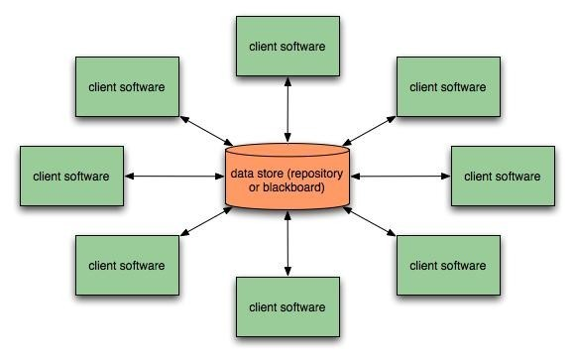
Data-Centered Architecture

Slide 47
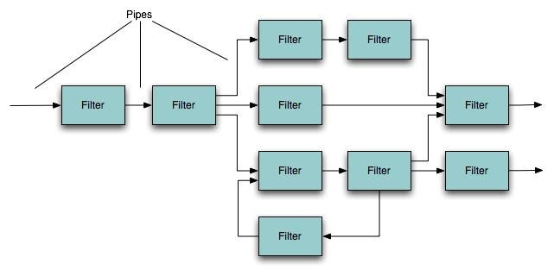
Data-Flow Architecture

Slide 48
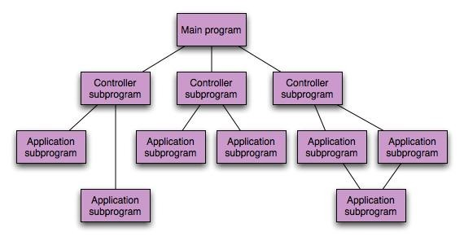
Call and Return Architecture

Slide 49
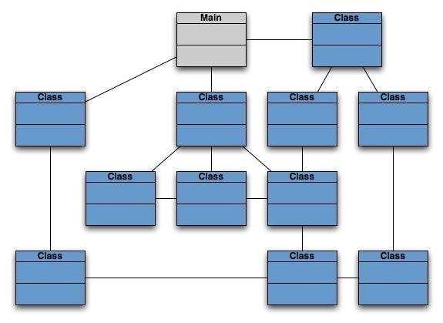
Object-Oriented Architecture

Slide 50
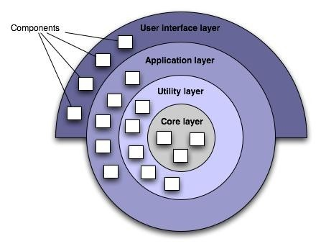
Layered Architecture

Slide 51
Architectural Patterns
Concurrency
operating system process management
task scheduler
Persistence
database management system
application level persistence
Distribution
broker

Slide 52
Architectural Design
Architectural context diagrams model how software interacts with external entities
Archetypes are classes or patterns that represent an abstraction critical to the system
Architectural components are derived from the application domain, the infrastructure, and the interface.

Slide 53
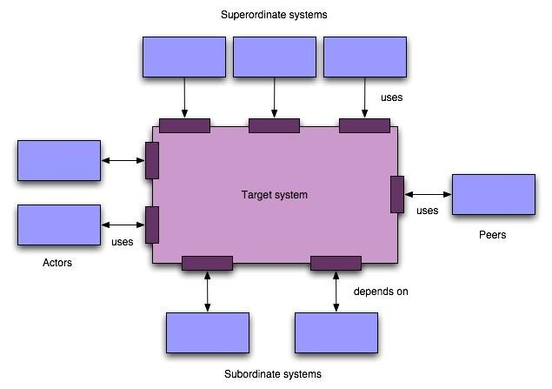
Context Diagram

Slide 54
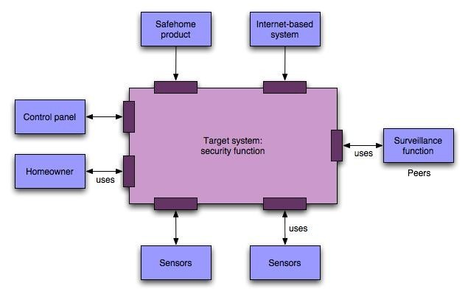
SafeHome ACD

Slide 55
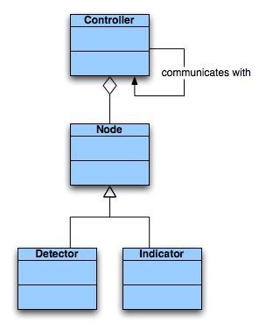
SafeHome Archetype

Slide 56
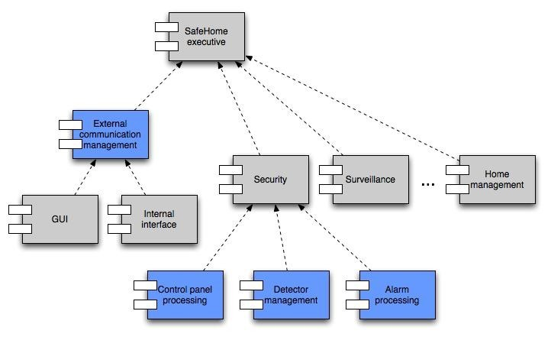
Component Structure

Slide 57
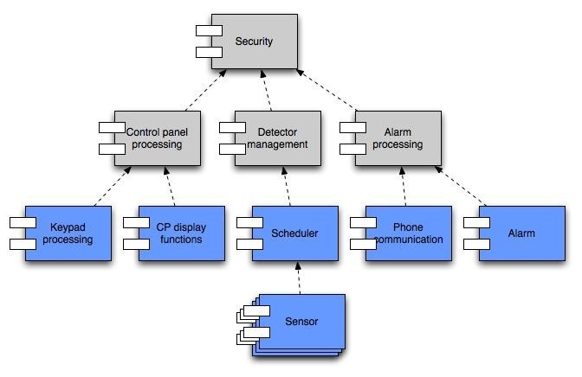
Component Elaboration

Slide 58
SOFTWARE TESTING FUNDAMENTALS
′ During software engineering activities, an engineer attempts to build software, where as during testing activities, the intent is to demolish the software.
′ Hence testing is psychologically destructive rather constructive.
′ A good and successful test is one that uncovers an undiscovered error.
′ All the test that are carried out should be traceable to customer requirements at the sometime exhaustive testing is not possible.

Slide 59

TESTING OBJECTIVES
′ Testing is a process of executing a program with the intent of finding an error.
′ A good test case is one that has a high probability of finding an as yet undiscovered error.
′ A successful test is one that uncovers an as yet undiscovered error.

Slide 60
COMMON TERMS:
Error:- difference between the actual output of a software and the correct output.
A mistake made by programmer. OR Anything that stops the execution of application.
Fault: is a condition that cause a system to fail in performing its required function.
Bug: A Bug is a Application Error, in Software doesn't affect the whole application in terms of running. It doesn't stop the execution of application. It produces wrong output.
Failure: occurs when a fault is executed. The inability of a system or component to perform its required functions within specified performance requirements.

Slide 61
TESTING PRINCIPLES
“All tests should be traceable to customer requirements.” For a customer, the most severe defect are the one that causes the program to fail to meet the requirements.
“Tests should be planned long before testing begins.” All test can be planned and designed before any code has been generated
“Testing should begin ‘in the small’ and progress toward testing in the large.” The first test planned and executed generally focus on individual component.
′

Slide 62
TESTING PRINCIPLES
“As testing progresses focus shifts on integrated clusters of components and then the entire system.”
“Exhaustive testing is not possible.” to test exhaustively, even a small program could take years.
“To be more effective, testing should be conducted by an independent third party.”.
Software engineer who constricts the software is not always the best person to test it. So a third party deems to be more efficient.

Slide 63
SOFTWARE TESTING
There are two major types of software testing
Black box testing
White box testing/ Glass box testing.
Black box testing focuses on input, output, and principle function of a software module.
Glass box testing looks into the structural testing or glass box testing, statements paths and branches are checked for correct execution.

Slide 64
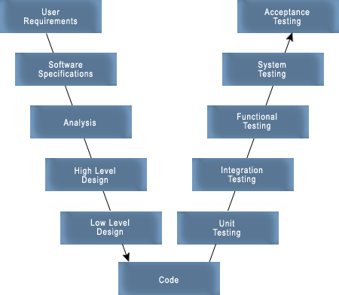
LEVELS OF SOFTWARE TESTING
′ Software Testing is carried out at different levels through the entire software development life cycle.

Slide 65
′ In unit testing, test cases verify the implementation of design of a each software element.
′
Integration testing traces detailed design and architecture of the system. Hardware and software elements are combined and tested until the entire system has been integrated.
Functional Test It is used to exercise the code with the common input values for which the expected values are available.
In system testing, it checks for system requirement.
′
′
′ In acceptance testing, it determines if test results satisfy acceptance criteria of project stake holders.

Slide 66
UNIT TESTING
′ Unit testing focuses verification effort on the smallest unit of software design—the software component or module.
′ Using the component-level design description as a guide, important control paths are tested to uncover errors within the boundary of the module.
′ The relative complexity of tests and uncovered errors is limited by the constrained scope established for unit testing.
′ The unit test is white-box oriented, and the step can be conducted in parallel for multiple components.

Slide 67
Unit Test Considerations
′ The module interface is tested to ensure that information properly flows into and out of the program unit under test.
′ The local data structure is examined to ensure that data stored temporarily maintains its integrity during all steps in an algorithm's execution.
′ Boundary conditions are tested to ensure that the module operates properly at boundaries established to limit or restrict processing.
′
All independent paths (basis paths) through the control structure are
exercised to ensure that all statements in a module have been executed at least once.
′ And finally, all error handling paths are tested.
′ Following are some types of errors commonly found during unit testing
misunderstood or incorrect arithmetic precedence
mixed mode operations,
incorrect initialization,
precision inaccuracy,

Slide 68
Unit Testing Precedence
′ Once the source level code has been developed, reviewed, and verified for correspondence to component level design, unit test case design begins.
′ a component is not a stand-alone program, driver and/or stub software must be developed for each unit test.
′ In most applications a driver is nothing more than a "main program" that accepts test case data, passes such data to the component (to be tested), and prints relevant results.
′ Stubs serve to replace modules that are subordinate (called by) the component to be tested. A stub or "dummy subprogram" uses the subordinate module's interface, may do minimal data manipulation, prints verification of entry, and returns control to the module undergoing testing.
′ Drivers and stubs represent overhead. That is, both are software that must be written (formal design is not commonly applied) but that is not delivered with the final software product.

Slide 69
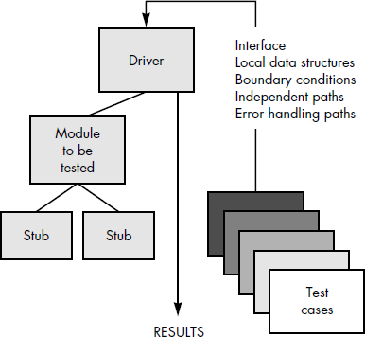

Slide 70
Integration Testing
′ Unit that otherwise seem to be working fine individually, starts causing problems when integrated together.
′ Data can be lost across an interface; one module can have an inadvertent, adverse affect on another; sub- functions, when combined, may not produce the desired major function; individually acceptable imprecision may be magnified to unacceptable levels; global data structures can present problems.
′ Integration testing is a systematic technique for constructing the program structure while at the same time conducting tests to uncover errors associated with interfacing.

Slide 71
′ Non-Incremental integration or "big bang" approach:
Combines all the components at the same time and then tests the program on the whole. This approach gives a number of errors that are difficult to isolate and trace as the whole program now is very vast. The correction of such errors seems to go into infinite loop.
′ Incremental integration:
constructed and tested in small increments, where errors are easier to isolate and correct; interfaces are more likely to be tested completely; and a systematic test approach may be applied.
Top-down Integration
Bottom-up Integration

Slide 72
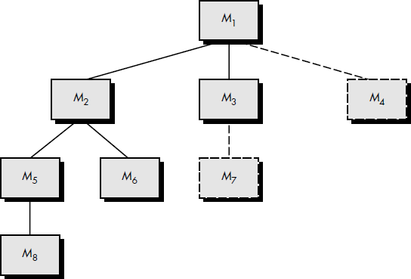
Top-down Integration
′ Top-down integration testing is an incremental approach to construction of program structure.
′ Modules are integrated by moving downward through the control hierarchy, beginning with the main control module (main program).
′ Modules subordinate (and ultimately subordinate) to the main control module are incorporated into the structure in either a depth-first or breadth-first manner.

Slide 73
Depth-first integration & Breadth-first integration
′ depth-first integration would integrate all components on a major control path of the structure.
Selection of a major path is somewhat arbitrary and depends on application-specific characteristics.
′ For example, selecting the left-hand path, components M1, M2 , M5 would be integrated first. Next, M8 or (if necessary for proper functioning of M2) M6 would be integrated.
′ Then, the central and right-hand control paths are built.
′ Breadth-first integration incorporates all components directly subordinate at each level, moving across the structure horizontally.
′ components M2, M3, and M4 would be integrated first. The next control level, M5, M6, and so on, follows.
′

Slide 74
′ The integration process is performed in a series of five steps:
1. The main control module is used as a test driver and stubs are substituted for all components directly subordinate to the main control module.
2. Depending on the integration approach selected (i.e., depth or breadth first), subordinate stubs are replaced one at a time with actual components.
3. Tests are conducted as each component is integrated.
4. On completion of each set of tests, another stub is replaced with the real component.
5. Regression testing may be conducted to ensure that new errors have not been introduced.
′ The process continues from step 2 until the entire program structure is built.

Slide 75
Bottom-up Integration
′ Bottom-up integration testing, as its name implies, begins construction and testing with atomic modules i.e., components at the lowest levels in the program structure.
′ Because components are integrated from the bottom up, processing required for components subordinate to a given level is always available and the need for stubs is eliminated.
′ A bottom-up integration strategy may be implemented with the following steps:
1. Low-level components are combined into clusters (sometimes called builds) that perform a specific software subfunction.
2. A driver (a control program for testing) is written to coordinate test case input and output.
3. The cluster is tested.
4. Drivers are removed and clusters are combined moving upward in the program structure.

Slide 76
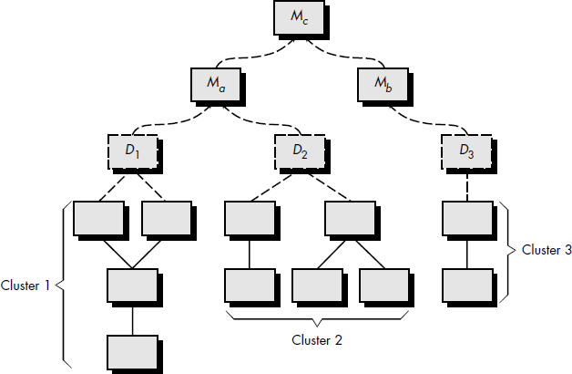
′
Components are combined to form clusters 1, 2, and 3. Each of the clusters is tested using a driver (shown as a dashed block). Components in clusters 1 and 2 are subordinate to Ma.
Drivers D1 and D2 are removed and the clusters are interfaced directly to Ma.
Similarly, driver D3 for cluster 3 is removed prior to integration with module Mb. Both Ma and Mb will ultimately be integrated with component Mc, and so forth.
′
′

Slide 77
Regression Testing
′ Each time a new module is added as part of integration testing, the software changes. New data flow paths are established, new I/O may occur, and new control logic is invoked.
′ These changes may cause problems with functions that previously worked flawlessly.
′ In the context of an integration test strategy, regression testing is the re-execution of some subset of tests that have already been conducted to ensure that changes have not propagated unintended side effects.
′ Regression testing is the activity that helps to ensure that changes (due to testing or for other reasons) do not introduce unintended behavior or additional errors.

Slide 78
′ The regression test suite (the subset of tests to be executed) contains three different classes of test cases:
A representative sample of tests that will exercise all software functions.
Additional tests that focus on software functions that are likely to be affected by the change.
Tests that focus on the software components that have been changed.
′ As integration testing proceeds, the number of regression tests can grow quite large.
′ Therefore, the regression test suite should be designed to include only those tests that address one or more classes of errors in each of the major program functions.
′ It is impractical and inefficient to re-execute every test for every program function once a change has occurred.

Slide 79
Smoke Testing
′ Smoke testing is an integration testing approach that is commonly used when “shrinkwrapped” software products are being developed. It is designed as a pacing mechanism for time-critical projects, allowing the software team to assess its project on a frequent basis.
′ the smoke testing approach encompasses the following activities:
1. Software components that have been translated into code are integrated into a “build.” A build includes all data files, libraries, reusable modules, and engineered components that are required to implement one or more product functions.
2. A series of tests is designed to expose errors that will keep the build from properly performing its function. The intent should be to uncover “show stopper” errors that have the highest likelihood of throwing the software project behind schedule.
3. The build is integrated with other builds and the entire product (in its current form) is smoke tested daily. The integration approach may be top down or bottom up.

Slide 80
′ Smoke testing provides a number of benefits when it is applied on complex, timecritical software engineering projects:
Integration risk is minimized. Because smoke tests are conducted daily, incompatibilities and other show-stopper errors are uncovered early, thereby reducing the likelihood of serious schedule impact when errors are uncovered.
The quality of the end-product is improved. Because the approach is construction (integration) oriented, smoke testing is likely to uncover both functional errors and architectural and component- level design defects. If these defects are corrected early, better product quality will result.
Error diagnosis and correction are simplified. Like all integration testing approaches, errors uncovered during smoke testing are likely to be associated with “new software increments”—that is, the software that has just been added to the build(s) is a probable cause of a newly discovered error.
Progress is easier to assess. With each passing day, more of the software has been integrated and more has been demonstrated to work. This improves team morale and gives managers a good indication that progress is being made.

Slide 81
Validation testing /Acceptance Testing
′ After integration testing, one may start with validation testing.
′ validation succeeds when software functions in a manner that can be reasonably expected by the customer.
′ Software validation is achieved through a series of black-box tests that demonstrate conformity with requirements.
′ This is to ensure that all functional requirements are satisfied, all behavioral characteristics are achieved, all performance requirements are attained, documentation is correct, and other requirements are met

Slide 82
′ It is virtually impossible for a software developer to foresee how the customer will really use a program.
′ When custom software is built for one customer, a series of acceptance tests are conducted to enable the customer to validate all requirements.
′ Conducted by the end-user rather than software engineers, an acceptance test can range from an informal "test drive" to a planned and systematically executed series of tests.

Slide 83

WHITE BOX TESTING
′ Focus: Thoroughness (Coverage). Every statement in the component is executed at least once.
′ White box testing is also known as structural testing or code-based testing.
′ The major objective of white box testing is to focus in internal program structure, and discover all internal program errors.

Slide 84
ADVANTAGE OF WHITE BOX TESTING
′ Helps optimizing the code.
′ Helps removing extra line of code.
′ All possible code pathways can be tested including error handling, resource dependencies, & additional internal code logic/flow.
′ Enables tester to find programming errors quickly.
′ Good quality of coding work and coding standards.

Slide 85
DISADVANTAGE OF WHITE BOX TESTING
′ Knowledge of code & internal structure is a prerequisite, a skilled tester is needed to carry out this type of testing, which increase the cost.
′ Impossible to look into every bit of code to find out hidden errors.
′ Very expensive technique.
′ Requires knowledge of target system, testing tools and coding language.
′ Requires specialized tools such as source code analyzer, debugger, and fault injectors.

Slide 86
TRADITIONAL WHITE BOX TESTING
′ White box testing is further divided into 2 types
BASIS PATH TESTING
′Flow graph
′Cyclomatic complexity
′Graph matrix
CONTROL STRUCTURE
′Condition testing
′Data flow testing
′Loop testing

Slide 87
BASIS PATH TESTING
′ It is a white box testing technique that enables the designer to derive a logical complexity measure of a procedural design.
′ Test cases based on Basis path testing grantee to execute every statement in program at least once.

Slide 88
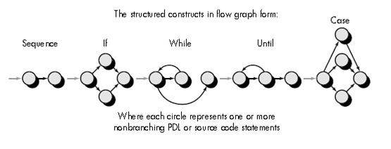
FLOW GRAPH
′ A flow graph depicts the logical control flow using the following notations
′ Every structural construct has a corresponding flow graph symbol.

Slide 89
FLOW GRAPH
′ Each circle, called flow graph node, represents one or more procedural statements.
′ The arrows called as links or edged represent flow of control.
′ Areas bounded by edges are called regions. while counting regions the area outside the graph is also taken as a region.
′ Each node containing a condition is called a predicate node and has 2 or more edges out of it.

Slide 90
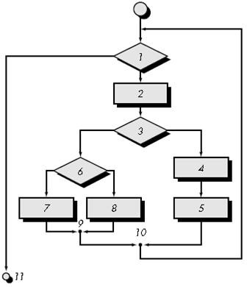

Slide 91
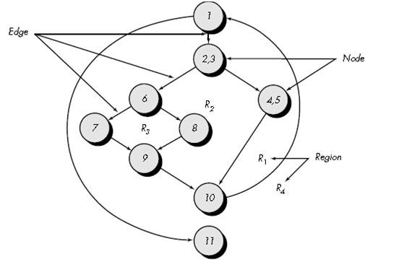

Slide 92
CYCLOMATIC COMPLEXITY
′ Cyclomatic complexity is software metric that provides a quantitative measure of the logical complexity of a program.
cyclomatic complexity defines the number of independent paths in the basis set of a program.
′ This number gives us an upper bound for the number of tests that must be conducted to ensure that all statements have been executed at least once.
′ An independent path is any path through the program that introduces at least one new set of processing statements or a new condition.
′

Slide 93
′ For example, a set of independent paths for the flow graph illustrated in Figure
′ path 1: 1-11
path 2: 1-2-3-4-5-10-1-11
path 3: 1-2-3-6-8-9-10-1-11
path 4: 1-2-3-6-7-9-10-1-11
′ Note that each new path introduces a new edge.
′ Paths 1, 2, 3, and 4 constitute a “basis set” for the flow graph
′ Basis set is a set where every statement in the program is visited at least once. This set is not unique.

Slide 94
′ Computing the cyclomatic would tell us how many paths are required in the basis set.
′ Complexity is computed in one of three ways:
The number of regions of the flow graph correspond to the cyclomatic complexity.
Cyclomatic complexity, V(G), for a flow graph, G, is defined as V(G) = E - N + 2 where E is the number of flow graph edges, N is the number of flow graph nodes.
Cyclomatic complexity, V(G), for a flow graph, G, is also defined as V(G) = P + 1 where P is the number of predicate nodes contained in the flow graph G.
′ the cyclomatic complexity can be computed using each of the algorithms just noted:
The flow graph has four regions.
V(G) = 11 edges - 9 nodes + 2 = 4.
V(G) = 3 predicate nodes + 1 = 4.

Slide 95
GRAPH MATRICES
′ To develop a software tool that assists in basis path testing, a data structure, called a graph matrix, can be quite useful.
′ A graph matrix is a square matrix whose size (i.e., number of rows and columns)is equal to the number of nodes on the flow graph. Each row and column corresponds to an identified node, and matrix entries correspond to connections (an edge) between nodes.
′ The graph matrix is nothing more than a tabular representation of a flow graph.

Slide 96
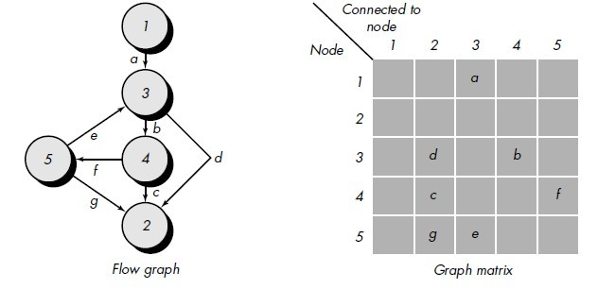

Slide 97
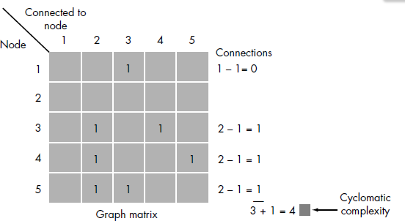
′ each row with two or more entries represents a predicate node.
′ Therefore, performing the arithmetic shown to the right of the connection matrix provides us with still another method for determining cyclomatic complexity.

Slide 98
CONTROL STRUCTURE TESTING
′ Although basis path testing is simple and highly effective, it is not sufficient in itself.
′ other variations on control structure improve quality of white-box testing.
′ Control Structure testing controls over the order in which the instructions in program are executed.
′ One of the major objective of control structure testing includes the selection of the test case to meet various criteria for covering the code.
′ Test cased are derived to exercise control over the order of the execution of the code.

Slide 99
′ Coverage based testing works by choosing test cases according to well defined coverage criteria.
′ The more common coverage criteria are the following:
′ Statement Coverage or Node Coverage:
Every statement of the program should be exercised at least once.
′ Branch Coverage or Decision Coverage:
Every possible alternative in a branch of the program should be exercised at least once.
′ Condition Coverage
Each condition in a branch is made to evaluate to true and false at least once.
′ Decision/Condition Coverage
Each condition in a branch is made to evaluate to both true and false and each branch is made to evaluate to both true and false.

Slide 100
Conditional Testing
′ In this kind of testing various test cases are designed so that the logical conditions contained in a program can be exercised.
′ A simple condition can be defined as a single Boolean variable or a relational expression.
′ The conditional testing method tries to focus on testing each and every condition which is existing in a program and gives a path to execute.
′ Adv
Measurement of test coverage of a condition is simple
The test coverage of condition in a program makes guidance for the generation of extra tests for the program

Slide 101
Data Flow testing
′ Testing in which test cases are designed based on variable usage within the code.
′ Data-flow testing looks at the lifecycle of a particular variable.
′ The two major types of usage node are:
P-use: predicate use – the variable is used when making a decision (e.g. if b > 6).
C-use: computation use – the variable is used in a computation (for example, b = 3 + d – with respect to the variable d).

Slide 102
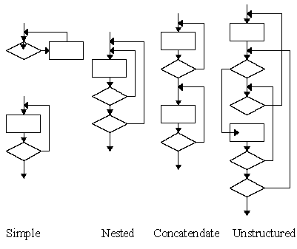
Loop Testing
′ Four different classes of loops exist
Simple loops
Nested loops
Concatenated loops
Unstructured loops

Slide 103
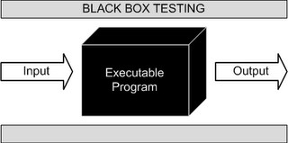
Black Box Testing
′ Black-box testing, also called behavioral testing,
focuses on the functional requirements of the software.
′ That is, black-box testing enables the software engineer to derive sets of input conditions that will fully exercise all functional requirements for a program.
′ Black-box testing is not an alternative to white-box techniques. Rather, it is a complementary approach that is likely to uncover a different class of errors than white-box methods.

Slide 104
Black Box Testing
′ Black-box testing attempts to find errors in the following categories:
incorrect or missing functions,
interface errors,
errors in data structures or external data base access,
behavior or performance errors, and
initialization and termination errors.
′ Stages of Black Box Testing
Equivalence Partitioning
Boundary Value Analysis
Robustness Testing

Slide 105
Advantage’s of Black Box Testing
More effective on larger units of code than glass box testing
′ Tester needs no knowledge of implementation, including specific programming
languages
′ Tester and programmer are independent of each other
′ Tests are done from a user's point of view
′ Will help to expose any ambiguities or inconsistencies in the specifications
′ Test cases can be designed as soon as the specifications are complete
′

Slide 106
Disadvantages of Black Box Testing
Only a small number of possible inputs can actually be tested, to test every
possible input stream would take nearly forever
′ Without clear and concise specifications, test cases are hard to design
′ There may be unnecessary repetition of test inputs if the tester is not informed of
test cases the programmer has already tried
′

