Slide 1
Operational Research
Mr.K.Muthuramalingam
Assistant Professor
School of Computer Science and Engineering
Bharathidasan University

Slide 2
Transportation Problem

Slide 3
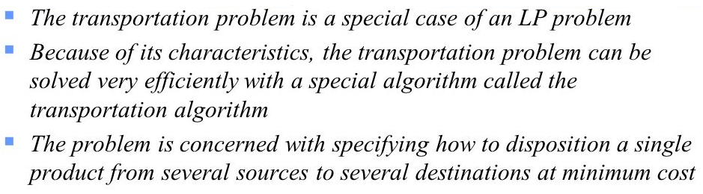
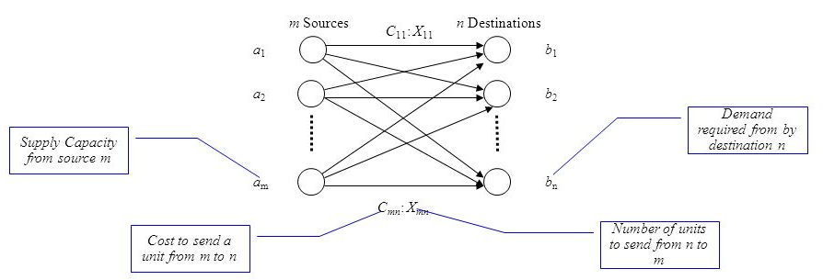

Slide 4
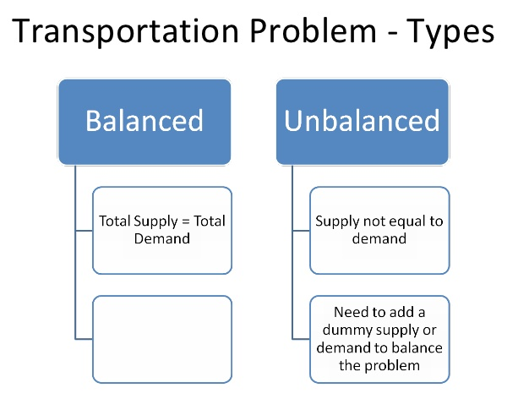

Slide 5

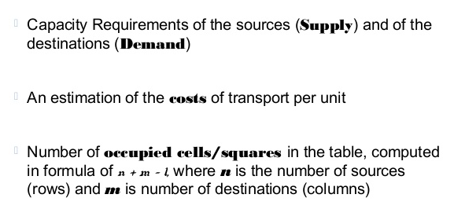

Slide 6
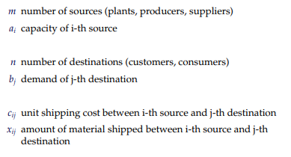

Slide 7
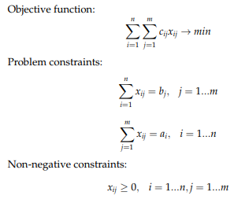

Slide 8
Initial Solution
The Least Cost Method is another method used to obtain the initial feasible solution for the transportation problem. Here, the allocation begins with the. cell which has the minimum cost. The lower cost cells are chosen over the higher-cost cell with the objective to have the least cost of transportation
Step by Step Procedure for Least Cost Method
Step-1: | Select the cell having minimum unit cost cij and allocate as much as possible, i.e. min(si,dj).
Step-2: | a. Subtract this min value from supply si and demand dj. b. If the supply si is 0, then cross (strike) that row and If the demand dj is 0 then cross (strike) that column. c. If min unit cost cell is not unique, then select the cell where maximum allocation can be possible
Step-3: | Repeact this steps for all uncrossed (unstriked) rows and columns until all supply and demand values are 0.

Slide 9
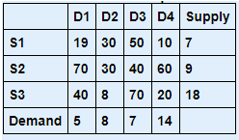
Least Cost Method
Problem
Find Solution of Transportation Problem using Least Cost method
.

Slide 10
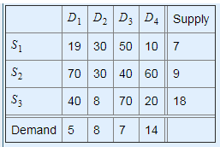
Least Cost Method
Solution
Total Number of Supply Constraints is 3
Total Number of Demand Constraints is 4
The smallest transportation cost is 8 in cell S2D3
The allocation to this cell is min(18, 8) = 8
This satisfies the entire demand of D2 and leaves 18-8 = 10 units with S3

Slide 11
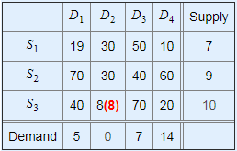
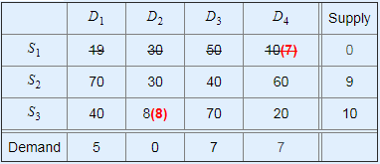
The smallest transportation cost is 10 in cell S1D4
The allocation to this cell is min(7, 14) = 7
This exhausts the capacity of S1 and leaves 14-7 = 7 units with D4
The smallest transportation cost is 20 in cell S7D4
The allocation to this cell is min(10, 7) = 7
This satisfies the entire demand of D4 and leaves 10-7 = 3 units with S3

Slide 12
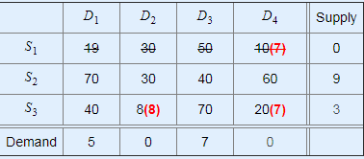
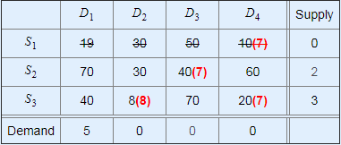
The smallest transportation cost is 40 in cell S2D3
The allocation to this cell is min(9, 7) = 7
This satisfies the entire demand of D3 and leaves 9-7 = 2 units with S2
The smallest transportation cost is 40 in cell S3D1
The allocation to this cell is min(3, 5) = 3
This exhausts the capacity of S3 and leaves 5-3 = 2 units with D1

Slide 13
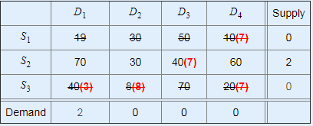
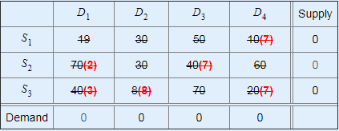
The smallest transportation cost is 70 in cell S2D1
The allocation to this cell is min(2, 2) = 2

Slide 14
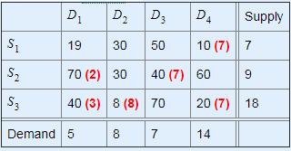
Initial Basic Feasible solution is
The Minimum total transportation = 10x7 + 70x 2 + 40x7 + 40x3 + 8x8 = 814. Here, the number of allocation cells = 6 is equal to m+n -1 = 3+ 4 -1 = 6. Therefore, The solution is non-degenerate.

Slide 15
Advantage & Disadvantages of this Method
Advantages
This method provides accurate solution as transportation cost is consider while making allocation.  It is very simple & easy to calculate optimum solution under this method.
Disadvantages
This method does not follow step by step rule for obtaining optimal solution  This method is based on the selection through personnel observation when three is tie in the minimum cost it does not follow any systematic rule.

Slide 16


