Slide 1
Operational Research
Mr.K.Muthuramalingam
Assistant Professor
School of Computer Science and Engineering
Bharathidasan University

Slide 2
Linear programming solution
Problem
A company makes two products (X and Y) using two machines (A and B). Each unit of X that is produced requires 50 minutes processing time on machine A and 30 minutes processing time on machine B. Each unit of Y that is produced requires 24 minutes processing time on machine A and 33 minutes processing time on machine B.
At the start of the current week there are 30 units of X and 90 units of Y in stock. Available processing time on machine A is forecast to be 40 hours and on machine B is forecast to be 35 hours.
The demand for X in the current week is forecast to be 75 units and for Y is forecast to be 95 units. Company policy is to maximise the combined sum of the units of X and the units of Y in stock at the end of the week.
Formulate the problem of deciding how much of each product to make in the current week as a linear program. Solve this linear program graphically.

Slide 3
Linear programming solution
Solution
Let
x be the number of units of X produced in the current week
y be the number of units of Y produced in the current week
then the constraints are:
50x + 24y <= 40(60) machine A time30x + 33y <= 35(60) machine B timex >= 75 - 30i.e. x >= 45 so production of X >= demand (75) - initial stock (30), which ensures we meet demand y >= 95 - 90i.e. y >= 5 so production of Y >= demand (95) - initial stock (90), which ensures we meet demand.
The objective is: maximise (x+30-75) + (y+90-95) = (x+y-50) i.e. to maximise the number of units left in stock at the end of the week
It is plain from the diagram below that the maximum occurs at the intersection of x=45 and 50x + 24y = 2400

Slide 4
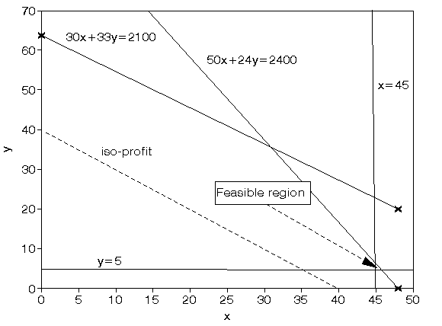
Solving simultaneously, rather than by reading values off the graph, we have that x=45 and y=6.25 with the value of the objective function being 1.25

Slide 5
Linear programming solution
Problem
A store sells two types of toys, A and B. The store owner pays $8 and $14 for each one unit of toy A and B respectively. One unit of toys A yields a profit of $2 while a unit of toys B yields a profit of $3. The store owner estimates that no more than 2000 toys will be sold every month and he does not plan to invest more than $20,000 in inventory of these toys. How many units of each type of toys should be stocked in order to maximize his monthly total profit profit?
Solution
Let x be the total number of toys A and y the number of toys B; x and y cannot be negative, hence x ≥ 0 and y ≥ 0 The store owner estimates that no more than 2000 toys will be sold every month x + y ≤ 2000 One unit of toys A yields a profit of $2 while a unit of toys B yields a profit of $3, hence the total profit P is given by P = 2 x + 3 y The store owner pays $8 and $14 for each one unit of toy A and B respectively and he does not plan to invest more than $20,000 in inventory of these toys 8 x + 14 y ≤ 20,000

Slide 6
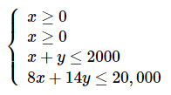
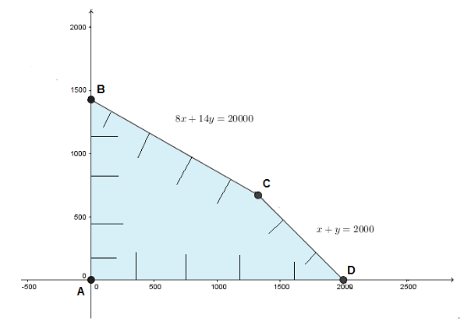
What do we have to solve? Find x and y so that P = 2 x + 3 y is maximum under the conditions
The solution set of the system of inequalities given above and the vertices of the region obtained are shown below:

Slide 7
Vertices of the solution set: A at (0 , 0) B at (0 , 1429) C at (1333 , 667) D at (2000 , 0) Calculate the total profit P at each vertex P(A) = 2 (0) + 3 ()) = 0 P(B) = 2 (0) + 3 (1429) = 4287 P(C) = 2 (1333) + 3 (667) = 4667 P(D) = 2(2000) + 3(0) = 4000 The maximum profit is at vertex C with x = 1333 and y = 667. Hence the store owner has to have 1333 toys of type A and 667 toys of type B in order to maximize his profit.

Slide 8
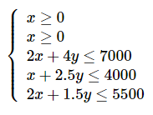
Problem
Linear programming solution
A company produces two types of tables, T1 and T2. It takes 2 hours to produce the parts of one unit of T1, 1 hour to assemble and 2 hours to polish. It takes 4 hours to produce the parts of one unit of T2, 2.5 hour to assemble and 1.5 hours to polish. Per month, 7000 hours are available for producing the parts, 4000 hours for assembling the parts and 5500 hours for polishing the tables. The profit per unit of T1 is $90 and per unit of T2 is $110. How many of each type of tables should be produced in order to maximize the total monthly profit?
Solution
Let x be the number of tables of type T1 and y the number of tables of type T2. Profit P(x , y) = 90 x + 110 y
The solution set of the system of inequalities above and the vertices of the feasible solution set obtained are shown below:

Slide 9
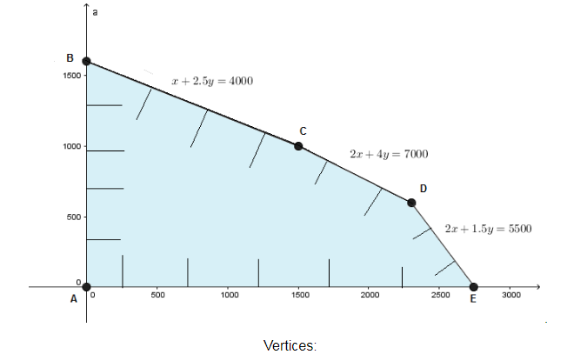

Slide 10
A at (0,0) B at (0,1600) C at (1500,1000) D at (2300,600) E at (2750,0)
Evaluate profit P(x,y) at each vertex A at (0,0) : P(0 , 0) = 0 B at (0,1600) : P(0 , 1600) = 90 (0) + 110 (1600) = 176000 C at (1500,1000) : P(1500,1000) = 90 (1500) + 110 (1000) = 245000 D at (2300,600): P(2300,600) = 90 (2300) + 110 (600) = 273000 E at (2750,0) : P(2750,0) = 90 (2750) + 110 (0) = 247500
The maximum profit of $273000 is at vertex D. Hence the company needs to produce 2300 tables of type T1 and 600 tables of type T2 in order to maximize its profit.

Slide 11
Thank You

