Slide 1
OOAD - Basics
Dr.M.Balamurugan
Professor and Head of the Department
School of Computer Science and Engineering
Bharathidasan University

Slide 2
OOAD
Object–Oriented Analysis (OOA) –
Is the procedure of identifying software engineering requirements and developing software specifications in terms of a software system’s object model, which comprises of interacting objects.

Slide 3
The primary tasks in object-oriented analysis (OOA)
Identifying objects
Organizing the objects by creating object model diagram
Defining the internals of the objects, or object attributes
Defining the behavior of the objects, i.e., object actions
Describing how the objects interact

Slide 4
OOP Vs POP

Slide 5
OOP Vs POP Contd..

Slide 6
Orthogonal View of the Software
A software system is a set of mechanism for performing certain action on certain data
―Algorithm + Data structure = Program‖

Slide 7
Object Oriented System Development Methodology
OO development offers a different model from the traditional software development approach. This is based on functions and procedures.
To develop s/w by building self contained modules or objects that can be easily replaced, modified and reused.
In OO environment , s/w is a collection of discrete object that encapsulate their data as well as the functionality to model real world ―objects‖
Each object has attributes (data) and method (function).
Objects grouped in to classes and object are responsible for itself
A chart object is responsible for things like maintaining its data and labels and even for drawing itself

Slide 8
Benefits of Object Orientation
Faster development,
Reusability,
Increased quality
Object technology emphasizes modeling the real world and provides us with the stronger equivalence of the real world‘s entities (objects) than other methodologies.
Raising the level of abstraction to the point where application can be implemented in the same terms as they are described

Slide 9
Object Orientation
High level of abstraction.
Seamless transition among different phases of software development.
Encourage of good programming techniques.
Promotion of reusability.

Slide 10
High level of abstraction
Top-down approach - It supports abstraction of the function level.
Objects oriented approach - It supports abstraction at the object level.
The object encapsulate both the data (attributes) and functions (methods), they work as a higher level of abstraction.
The development can proceed at the object level, this makes designing, coding, testing, and maintaining the system much simpler.

Slide 11
Seamless transition among different phases of software development
Traditional Approach: The software development using this approach requires different styles and methodologies for each step of the process.
So moving from one phase to another requires more complex transistion.
Object-oriented approach: We use the same language to talk about analysis, design, programming and database design. It returns the level of complexity and reboundary, which makes clearer and robust system development.

Slide 12
Encouragement of good programming techniques:
The classes are grouped into subsystems but remain independent one class has no impact on other classes.
Raising the level of abstraction from function level to object level and focusing on the real-world aspects of the system, the object oriented method tends to Promote clearer designs.
Makes implementation easier.
Provide overall better communication.

Slide 13
Promotion of Reusability:
Objects are reusable
object orientation adds inheritance, which is a powerful technique that allows classes to built from each other

Slide 14
OBJECT-ORIENTED SYSTEM DEVELOPMENT
Traditional Software Development: The S/W development is based on function and procedures.
Object-oriented software development: Everything is an object and each object is responsible for itself.
A way to develop software by building self-contained modules or objects that can be easily replaced, modified and reused.
In an object-oriented environment, software is a collection of discrete objects that encapsulate their data as well as the functionality
Each object has attributes (data) and methods (function). Objects are grouped into classes.

Slide 15
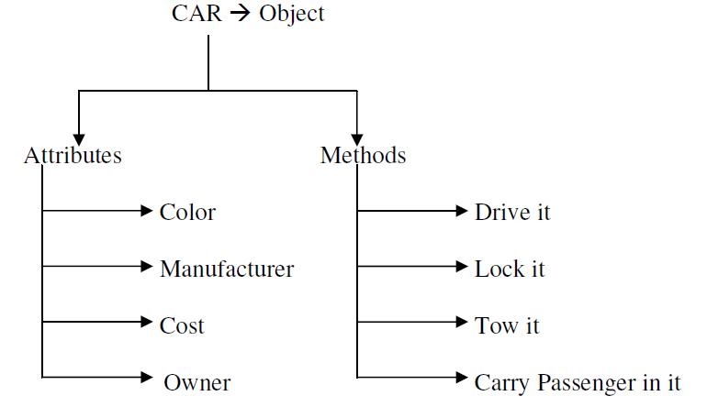
Object Basics
The term object means a combination or data and logic that represent some real-world entity.
Attributes:
Data of an object.
Properties of an object.
Methods:
Procedures of an object.
or
Behaviour of an object.

Slide 16
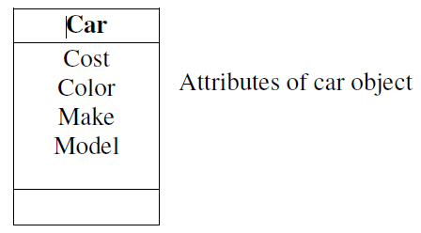
Object state and properties (Attributes)
Properties represent the state of an object

Slide 17
Object Behavior and Methods
We can describe the set of things that an object can do on its own (or) we can do with it.
For example: Consider an object car,
  We can drive the car.
  We can stop the car.
The objects behavior is described in methods or procedures.
A method is a function or procedures that is defined in a class and typically can access to perform some operation.

Slide 18
Objects Respond to Messages
The capability of an object’s is determined by the methods defined for it.
To do an operation, a message is sent to an object.
Objects represented to messages according to the methods defined in its class.

Slide 19
Objects are grouped in classes
The classification of objects into various classes is based its properties (states) and behavior (methods).
Classes are used to distinguish are type of object from another.

Slide 20
Class Hierarchy
An object-oriented system organizes classes into a subclass super class hierarchy.
The properties and behaviors are used as the basis for making distinctions between classes are at the top and more specific are at the bottom of the class hierarchy.
The family car is the subclass of car.
A subclass inherits all the properties and methods defined in its super class.

Slide 21
Class Hierarchy

Slide 22
Inheritance
It is the property of object-oriented systems that allow objects to be built from other objects.
Inheritance describes the ability of one class or object to possess characteristics and functionality of another class or object.
The derived class holds the properties and behavior of base class in addition to the properties and behavior of derived class.

Slide 23
Inheritance Contd…
Process of creating a new Class, called the Derived Class, from the existing class, called the Base Class.
Advantage : Reusability of code. Rather than developing new Objects from scratch, new code can be based on the work of other developers, adding only the new features that are needed.
The reuse of existing classes saves time and effort.
Types :
Single Inheritance
Multi Level Inheritance
Hierarchical Inheritance
Hybrid Inheritance
Multipath inheritance
Multiple Inheritance

Slide 24
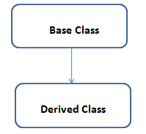
Single Inheritance
When a Derived Class to inherit properties and behavior from a single Base Class, it is called as single inheritance.

Slide 25
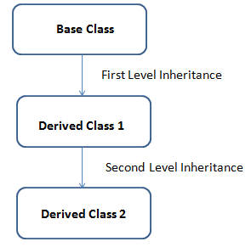
Multi Level Inheritance
A derived class is created from another derived class is called Multi Level Inheritance

Slide 26
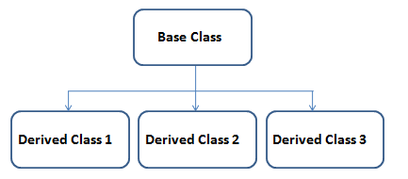
Hierarchical Inheritance
More than one derived class are created from a single base class, is called Hierarchical Inheritance

Slide 27
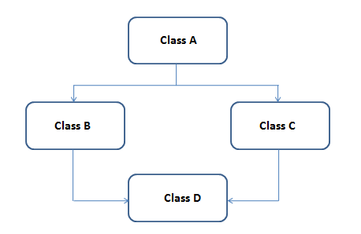
Hybrid Inheritance
Any combination of above three inheritance (single, hierarchical and multi level) is called as hybrid inheritance.

Slide 28
Multipath inheritance
Multiple inheritance is a method of inheritance in which one derived class can inherit properties of base class in different paths. This inheritance is not supported in .NET Languages such as C#.

Slide 29
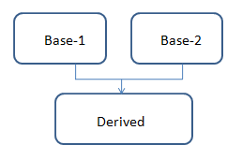
Multiple Inheritance
Multiple inheritances allows programmers to create classes that combine aspects of multiple classes and their corresponding hierarchies.

Slide 30
Encapsulation and Information Hiding
Encapsulation : Binds together the data and functions that manipulate the data, and that keeps both safe from outside interference and misuse
Information hiding is the principle of concealing the internal data and procedures of an object.
In C++ , encapsulation protection mechanism with private, public and protected members.

Slide 31
Polymorphism
Poly → ”many”
Morph → “form”
It means objects that can take on or assume many different forms.
Polymorphism means that the same operations may behave differently on different
classes.
Polymorphism allows us to write generic, reusable code more easily.
Example:
In a pay roll system, manager, office worker and production worker objects all will respond to the compute payroll message, but the actual operations performed are object specific.

Slide 32
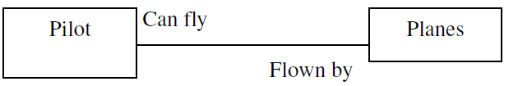
Object Relationship and associations
Association is a relationship between two objects. In other words, association defines the multiplicity between objects. Associations are bidirectional.
The directions implied by the name are the forward direction and the opposite is the inverse direction.
A pilot “can fly” planes. The inverse of can fly is “is flown by “. Plane “is flown by” pilot

Slide 33
Cardinality
It specifies how many instances of one class may relate to a single instance of an associated class.
Cardinality constrains the number of related objects and often is described as being “one” or “many”

Slide 34
Consumer-producer association
A special form of association
Also known as a client-server association
It can be viewed as one-way interaction.
One object requests the service or another object. The object that makes the request is the consumer or client and the object that receives the request and provides the service is the producer (or) server

Slide 35
Aggregations
Aggregation or composition is a relationship among classes by which a class can be made up of any combination of objects of other classes.
It allows objects to be placed directly within the body of other classes.
Aggregation is referred as a “part–of” or “has–a” relationship, with the ability to navigate from the whole to its parts.
An aggregate object is an object that is composed of one or more other objects.

Slide 36
Static and Dynamic Binding
Binding means connecting the function call to a function implementation.
Static binding is a binding in which the class association is made during compile time. This is also called as Early binding.
Dynamic binding is a binding in which the class association is not made until the object is created at execution time. It is also called as Late binding.

Slide 37
Object Persistence
Objects have a lifetime
An object occupies a memory space and exists for a particular period of time.
In traditional programming, the lifespan of an object was typically the lifespan of the execution of the program that created it.
In files or databases, the object lifespan is longer than the duration of the process creating the object.
This property by which an object continues to exist even after its creator ceases to exist is known as persistence.

Slide 38
Meta-Classes
Meta class is a class of a class i.e. the objects of this class can themselves act as classes.
The attributes of a meta class can be used to describe a class
Metaclasses are hidden from the user

Slide 39
Object-Oriented Systems Development Life Cycle [OOSDLC]
The S/W development process that consists of Analysis,
Design,
Implementation,
Testing and refinement .
The object oriented approach
We have to spend more time on gathering requirements, developing a requirements model and an analysis model, then turning them into the design model

Slide 40
Software Development Process
It a series of transformations
Where the output of one transformation becomes the input of the subsequent transformation.
Transformation 1 [Analysis]
Transformation 2 [Design]
Transformation 3 [Implementation]

Slide 41
Software Development Process Contd…
Transformation 1 [Analysis] : It translates the users’ needs into system requirements and responsibilities. The way they use can provide insight into user requirements
Transformation 2 [Design] : It begins with a problem statement and ends with a detailed design that can be transformed into an operational system.
Transformation 3 [Implementation] : It refines the detailed design into the system deployment that will satisfy the users needs. It represents embedding the software product within its operational environment.

Slide 42
The water fall S/W development process
what is to be done (what is the problem)
How to accomplish them
Which we do it
Test the result to see it we have satisfied the users requirements
Finally we use what we have done

Slide 43
Building High-Quality Software
To achieve high quality software we need to be able to answer the following question.
How do we determine when the system is ready for delivery?
It is now operational system that satisfies uses needs?
It is correct and operating as we thought it should?
Does it pass an evaluation process?

Slide 44
System evaluation
System evaluation in terms of four quality measures,
Correspondence - how well the delivered system matches the needs of the operational environment as described in the original requirements statement
Correctness - measures the consistency of the product requirements with respect to the design specification
Verification - is the exercise of determining correctness
Validation - is the task of predicting correspondence
Note : Verification- Am I building the product right?
Validation- Am I building the right product

Slide 45
Object-Oriented Systems Development: A use-case Driven Approach
The object-oriented S/W development Life Cycle (SDLC) consists of three macro process.
Object-Oriented Analysis
Object-oriented Design and
Object-oriented Implementation

Slide 48
Object-Oriented Analysis –Use-Case Driven
This phase is concerned with determing the system requirements and identifying classes and their relationship to other classes in the problem domain.
To understand the system requirements we need to identify the users or the actors.
Who are the actors and how do they use the system, scenarios are used to help analysis to understand the requirements.

Slide 49
Object-Oriented Analysis –Use-Case Driven Contd…
A use-case is a typical interaction between a user and a system that captures user goals & needs.
Once the use case model is better understood and developed we should start to identify classes and create their relationships.
The physical objects in the system also provide us important information an objects in the system.
The objects could be individuals’ organizations, machines, units of information; pictures (or) what ever else makes up the application and makes sense in the context of the real-world system.
For example: The object in the payroll system is as follows,
The employee, worker, supervisor, office admin.
The paycheck.
The product being made.
The process used to make the product

Slide 50
Object-oriented design
After the analysis phase, the conceptual model is developed further into an object-oriented model using object-oriented design (OOD).
In OOD, the technology-independent concepts in the analysis model are mapped onto implementing classes, constraints are identified, and interfaces are designed, resulting in a model for the solution domain.
In a nutshell, a detailed description is constructed specifying how the system is to be built on concrete technologies
The stages for object–oriented design can be identified as:
Definition of the context of the system
Designing system architecture
Identification of the objects in the system
Construction of design models
Specification of object interfaces

Slide 51
Object-oriented design Contd…
Few guide lines to use in object-oriented design.
Reuse, rather than build, anew class, know the existing classes.
Design a large number of simple classes, rather than a small number of complex classes.
Design methods.
Critique what we have proposed. It possible go back and refine the classes

Slide 52
Prototyping
A prototype is a version of a software product developed in the early stages of the product’s life cycle for specific, experimental purposes.
It enables to fully understand how easy or difficult it will be to implement some of the features of the system.
It gives users a chance to comment on the usability and usefulness of the user interface design, it can define use cases and it makes use Case modeling much easier.
Prototyping was used as a “quick and dirty” way to test the design, user interface and so forth, something to be thrown away when the “industrial strength” version was developed.
The rapid application development (RAD) refines the prototype into the final product.
Prototyping is a useful exercise of almost any stage of the development.
Prototyping should be done in parallel with the preparation of the functional specification.
It also results in modification to the specification.

Slide 53
Prototyping Categorization
Horizontal prototype : It is a simulation of the interface but contains no functionality.
This has the advantages of being very quick to implement, providing a good overall feel of the system and allowing users to evaluate the interface on the basis of their normal, expected perception of the system.
Vertical prototype :It is a subset of the system features with complete functionality.
The advantage of this method is that the few implemented functions can be tested in great depth.
The prototypes are hybrid between horizontal and vertical, the major portions of the interface are established so the user can get the feel of the system and features having a high degree of risk are prototyped with much more functionality.

Slide 54
Prototyping Categorization Contd…
Analysis prototype :It is an aid for exploring the problem domain.
This class of prototype is used to inform the user and demonstrate the proof of a concept.
It is not used as the basis of development and is discarded when it has served its purpose
Domain prototype: It is an aid for the incremental development of the ultimate software solution.
It demonstrates the feasibility of the implementation and eventually will evolve into a deliverable product.

Slide 55
Prototype Contd…
The typical time required to produce a prototype is anywhere from a few days to several weeks, depending on the type and function of prototype.
The prototype makes the end users and management members to ascertain that the general structure of the prototype meets the requirements established for the overall design.
The purpose of this review is
To demonstrate that the prototype has been developed according to the specification and that the final specification is appropriate.
To collect information about errors or other problems in the system, such as user interface problems that need to be addressed in the intermediate prototype stage
To give management and everyone connected with the project the first glimpse of what the technology can provide.

Slide 56
Component-Based Development
Component-Based Development is an industrialized approach to the software development process.
Application development to assembly of prebuilt, pretested, reusable software components that operate with each other
The two basic ideas of using Component-Based development.
1. The application development can be improved significantly if applications can be assembled quickly from prefabricated software components.
2. An increasingly large collection of interpretable software components could be made available to developers in both general and specified catalogs.

Slide 57
CBD Contd…
A CBD developer can assemble components to construct a complete software system.
The software components are the functional units of a program, building blocks offering a collection of reusable services.
The object-Oriented concept addresses analysis, design and programming, where as component-Based development is concerned with the implementation and system integration aspects of software development.

Slide 58
CBD Implementation
Software components are built and tested in-house, using a wide range of technologies.
Computer aided software engineering (CASE) tools allow their users to rapidly develop information systems.
The main goal of CASE technology is the automation of the entire information system’s development life cycle process using a set of integrated software tools, such as modeling, methodology and automatic code generation.
The code generated by CASE tools is only the skeleton of an application and a lot needs to be filled in by programming by hand.

Slide 59
Rapid Application Development (RAD)
RAD is a set of tools and techniques that can be used to build application faster than typically possible with traditional methods.
The term is often conjunction with S/W prototyping. RAD encourages the incremental development approach of “grow, do not build” software.
Main objective is to build a version of an application rapidly to see whether we actually understood the problem
It involves number of iterations

Slide 60
Incremental Testing
In Incremental integration testing, the developers integrate the modules one by one using stubs or drivers to uncover the defects.
Incremental Testing - Features
Each Module provides a definitive role to play in the project/product structure
Each Module has clearly defined dependencies some of which can be known only at the runtime.
The incremental integration testing's greater advantage is that the defects are found early in a smaller assembly when it is relatively easy to detect the root cause of the same.
Dis.Adv: A disadvantage is that it can be time-consuming since stubs and drivers have to be developed for performing these tests.

