Slide 1
Microprocessor & Interfacing
K.Muthuramalingam
Assistant Professor
School of Computer Science and Engineering
Bharathidasan University

Slide 2
Classification of Instruction Set in 8085

Slide 3
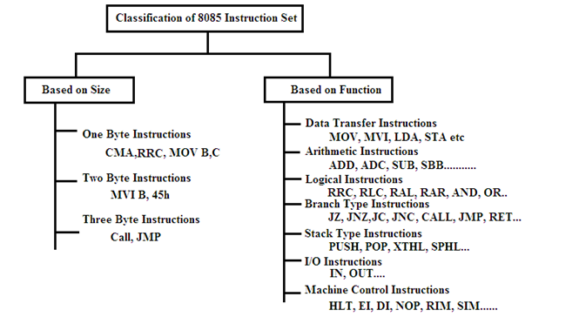

Slide 4
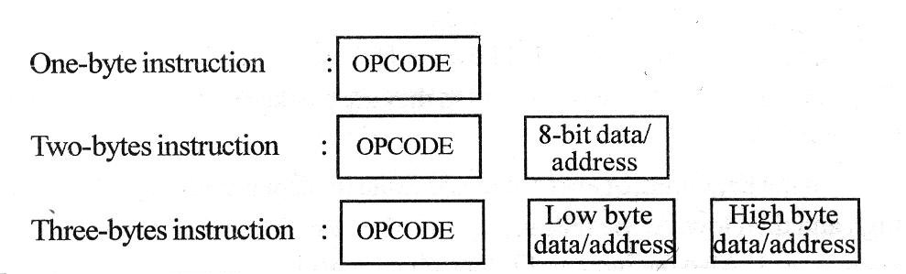
Classification of Instruction – Based on Size

Slide 5
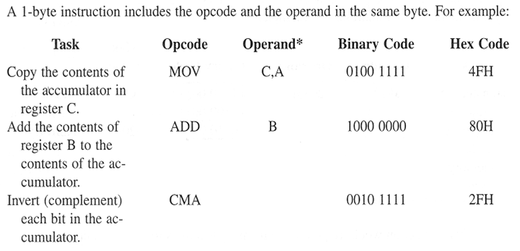
Classification of Instruction – Based on Size
One Byte Instruction

Slide 6
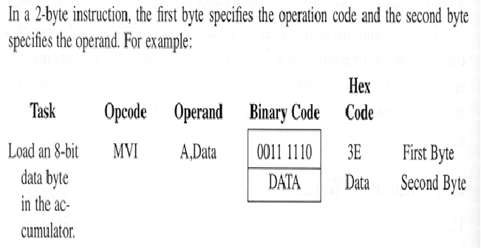
Classification of Instruction – Based on Size
Two Byte Instruction

Slide 7
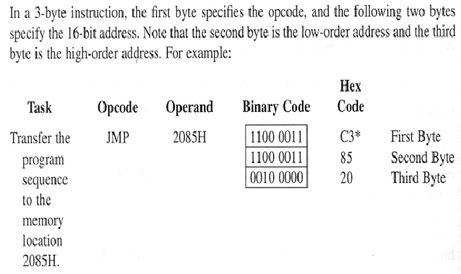
Classification of Instruction – Based on Size
Three Byte Instruction

Slide 8
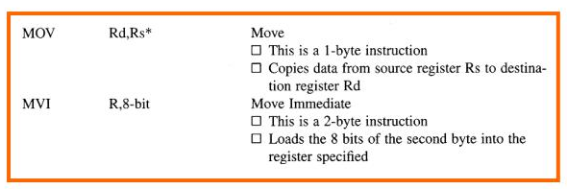
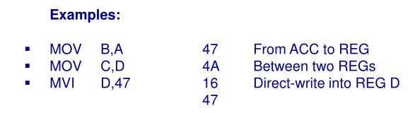
Classification of Instruction – Based on Functions
Data Transfer Instruction

Slide 9
Classification of Instruction – Based on Functions
Arithmetic Instruction
Add register or memory to accumulator ADD R
The contents of the operand (register or memory) are M added to the contents of the accumulator and the result is stored in the accumulator. If the operand is a memory location, its location is specified by the contents of the HL registers. All flags are modified to reflect the result of the addition.
Example: ADD B or ADD M
Add register to accumulator with carry ADC R
The contents of the operand (register or memory) and M the Carry flag are added to the contents of the accumulator and the result is stored in the accumulator. If the operand is a memory location, its location is specified by the contents of the HL registers. All flags are modified to reflect the result of the addition.
Example: ADC B or ADC M

Slide 10
Classification of Instruction – Based on Functions
Arithmetic Instruction
Add immediate to accumulator
ADI 8-bit data The 8-bit data (operand) is added to the contents of the accumulator and the result is stored in the accumulator. All flags are modified to reflect the result of the addition.
Example: ADI 45H
Add immediate to accumulator with carry
ACI 8-bit data The 8-bit data (operand) and the Carry flag are added to the contents of the accumulator and the result is stored in the accumulator. All flags are modified to reflect the result of the addition.
Example: ACI 45H

Slide 11
Classification of Instruction – Based on Functions
Arithmetic Instruction
Add register pair to H and L registers
DAD Reg. pair The 16-bit contents of the specified register pair are added to the contents of the HL register and the sum is stored in the HL register. The contents of the source register pair are not altered. If the result is larger than 16 bits, the CY flag is set. No other flags are affected.
Example: DAD H
Subtract register or memory from accumulator
SUB R The contents of the operand (register or memory ) are M subtracted from the contents of the accumulator, and the result is stored in the accumulator. If the operand is a memory location, its location is specified by the contents of the HL registers. All flags are modified to reflect the result of the subtraction.
Example: SUB B or SUB M

Slide 12
Classification of Instruction – Based on Functions
Arithmetic Instruction
Subtract source and borrow from accumulator
SBB R The contents of the operand (register or memory ) and M the Borrow flag are subtracted from the contents of the accumulator and the result is placed in the accumulator. If the operand is a memory location, its location is specified by the contents of the HL registers. All flags are modified to reflect the result of the subtraction.
Example: SBB B or SBB M
Subtract immediate from accumulator
ARITHMETIC INSTRUCTIONS SUI 8-bit data The 8-bit data (operand) is subtracted from the contents of the accumulator and the result is stored in the accumulator. All flags are modified to reflect the result of the subtraction.
Example: SUI 45H

Slide 13
Classification of Instruction – Based on Functions
Arithmetic Instruction
Subtract immediate from accumulator with borrow
SBI 8-bit data The 8-bit data (operand) and the Borrow flag are subtracted from the contents of the accumulator and the result is stored in the accumulator. All flags are modified to reflect the result of the subtraction.
Example: SBI 45H
Increment register or memory by 1
INR R The contents of the designated register or memory) are M incremented by 1 and the result is stored in the same place. If the operand is a memory location, its location is specified by the contents of the HL registers.
Example: INR B or INR M

Slide 14
Classification of Instruction – Based on Functions
Arithmetic Instruction
Increment register pair by 1
INX R The contents of the designated register pair are incremented by 1 and the result is stored in the same place.
Example: INX H
Decrement register or memory by 1
DCR R The contents of the designated register or memory are M decremented by 1 and the result is stored in the same place. If the operand is a memory location, its location is specified by the contents of the HL registers.
Example: DCR B or DCR M
Decrement register pair by 1
DCX R The contents of the designated register pair are decremented by 1 and the result is stored in the same place.
Example: DCX H

Slide 15
Classification of Instruction – Based on Functions
Arithmetic Instruction
Decimal adjust accumulator
DAA none The contents of the accumulator are changed from a binary value to two 4-bit binary coded decimal (BCD) digits. This is the only instruction that uses the auxiliary flag to perform the binary to BCD conversion, and the conversion procedure is described below. S, Z, AC, P, CY flags are altered to reflect the results of the operation. If the value of the low-order 4-bits in the accumulator is greater than 9 or if AC flag is set, the instruction adds 6 to the low-order four bits. If the value of the high-order 4-bits in the accumulator is greater than 9 or if the Carry flag is set, the instruction adds 6 to the high-order four bits.
Example: DAA

Slide 16
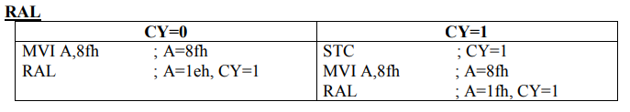
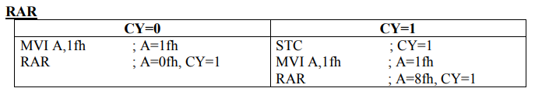
Classification of Instruction – Based on Functions
Logical Instruction
RAL: Each binary bit of the accumulator is rotated left by one position through the carry flag. Bit D7 is placed in the bit in the carry flag and the carry flag is placed in the least significant position D0.
RAR: Each binary bit of the accumulator is rotated right by one position through the carry flag. Bit D0 is placed in the carry flag and the bit in the carry flag is placed in the most significant position D7.

Slide 17
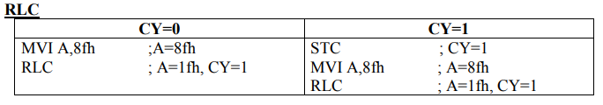
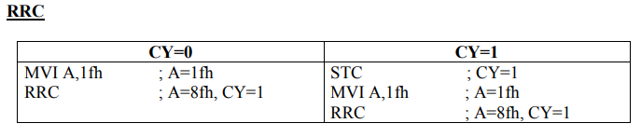
Classification of Instruction – Based on Functions
Logical Instruction
RLC: Each binary bit of the accumulator is rotated left by one position Bit D7 is placed in the position of D0 as well as in the carry flag.
RRC: Each binary bit of the accumulator is rotated right by one position Bit D0 is placed in the position of D7 as well as in the carry flag.

Slide 18
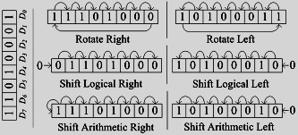
Classification of Instruction – Based on Functions
Logical Instruction

Slide 19
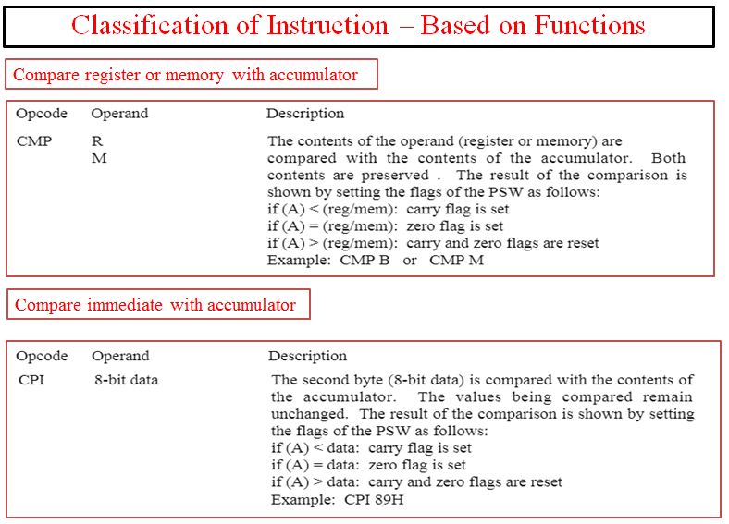

Slide 20
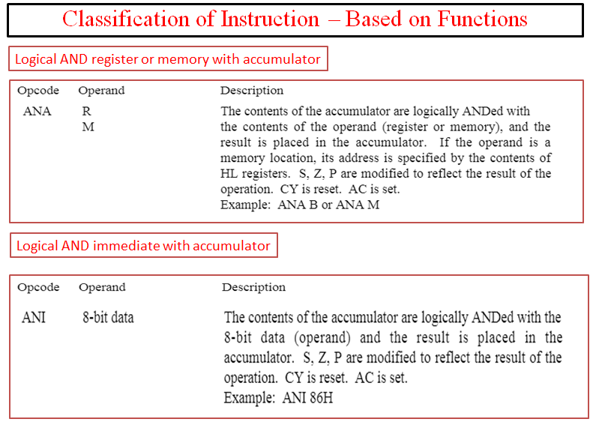

Slide 21
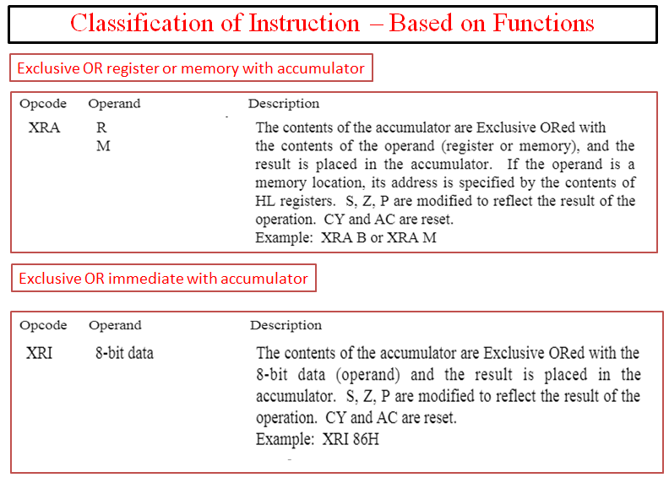

Slide 22
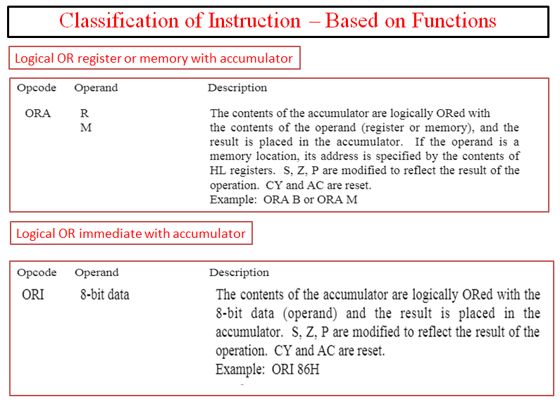

Slide 23
Classification of Instruction – Based on Functions
Branching Instruction
JMP: - (unconditionally jump) The program sequence is transferred to the memory location specified by the16-bit address given in the operand.
Eg: - JMP 2034H ( jump to location 2034H) there is no condition to jump.
JMP ABC (jump to abc level)
JC: - (conditional jump) The program sequence is transferred to a particular level or a 16-bit address if C=1 (or carry is 1)
Eg: - JC ABC (jump to the level abc if C=1)
JNC:- (conditional jump) The program sequence is transferred to a particular level or a 16-bit address if C=0 (or carry is 0)
Eg: JNC ABC (jump to the level abc if C=0)

Slide 24
Classification of Instruction – Based on Functions
Branching Instruction
JP: - (conditional jump) The program sequence is transferred to a particular level or a 16-bit address if S=0 (or sign is 0)
Eg: - JP ABC (jump to the level abc if S=0)
JM: - (conditional jump) The program sequence is transferred to a particular level or a 16-bit address if S=1 (or sign is 1)
Eg: - JM ABC (jump to the level abc if S=1)
JZ: - (conditional jump) The program sequence is transferred to a particular level or a 16-bit address if Z=1 (or zero flag is 0)
Eg: - JZ ABC (jump to the level abc if Z=1)
JNZ: - (conditional jump) The program sequence is transferred to a particular level or a 16-bit address if Z=0 (or zero flag is 0)
Eg: - JNZ ABC (jump to the level abc if Z=0)

Slide 25
Classification of Instruction – Based on Functions
Branching Instruction
JPE: - (conditional jump) The program sequence is transferred to a particular level or a 16-bit address if P=1 (or parity flag is 1)
Eg: - JPE ABC (jump to the level abc if P=1)
JPO: - (conditional jump) The program sequence is transferred to a particular level or a 16-bit address if P=0 (or parity flag is 0)
Eg: - JPO ABC (jump to the level abc if P=0)

Slide 26

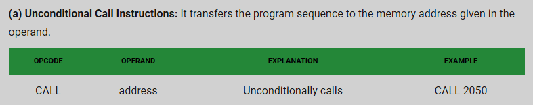
Classification of Instruction – Based on Functions
Branching Instruction

Slide 27
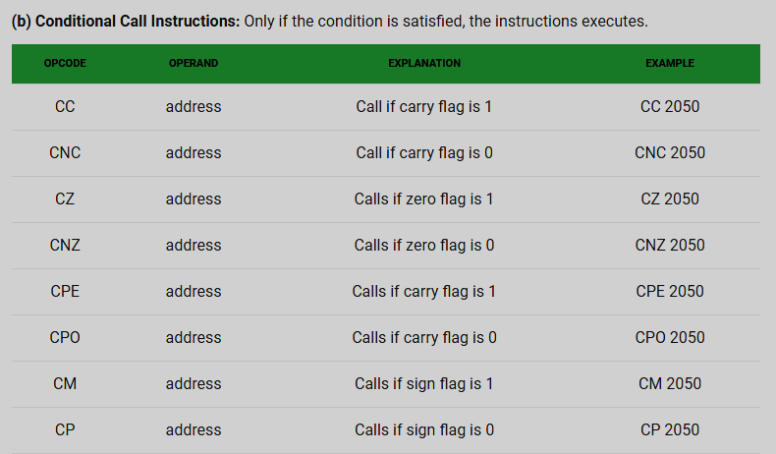
Classification of Instruction – Based on Functions
Branching Instruction

Slide 28

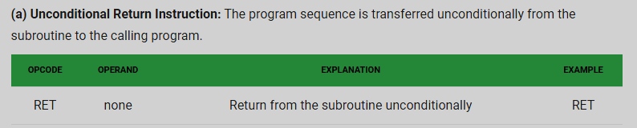
Classification of Instruction – Based on Functions
Branching Instruction

Slide 29
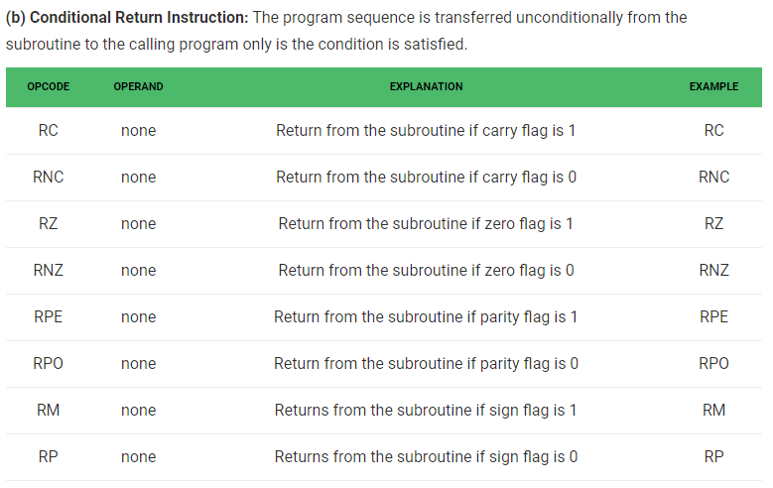
Classification of Instruction – Based on Functions
Branching Instruction

Slide 30
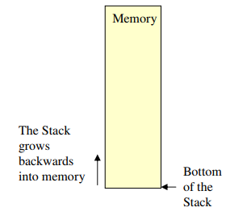
Classification of Instruction – Based on Functions
Stack Instruction
•The stack is an area of memory identified by the programmer for temporary storage of information.
•The stack is a LIFO structure. – Last In First Out.
•The stack normally grows backwards into memory.
– In other words, the programmer defines the bottom of the stack and the stack grows up into reducing address range.

Slide 31
Classification of Instruction – Based on Functions
Stack Instruction
Given that the stack grows backwards into memory, it is customary to place the bottom of the stack at the end of memory to keep it as far away from user programs as possible.
In the 8085, the stack is defined by setting the SP (Stack Pointer) register.
LXI SP, FFFFH
This sets the Stack Pointer to location FFFFH (end of memory for the 8085).
The Size of the stack is limited only by the available memory
Information is saved on the stack by PUSHing it on.
– It is retrieved from the stack by POPing it off.
The 8085 provides two instructions: PUSH and POP for storing information on the stack and retrieving it back.
– Both PUSH and POP work with register pairs ONLY.

Slide 32
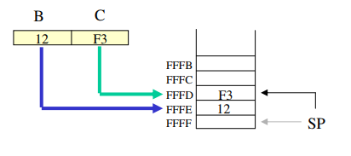
Classification of Instruction – Based on Functions
PUSH Instruction
PUSH B (1 Byte Instruction)
– Decrement SP
– Copy the contents of register B to the memory location pointed to by SP
– Decrement SP
– Copy the contents of register C to the memory location pointed to by SP

Slide 33
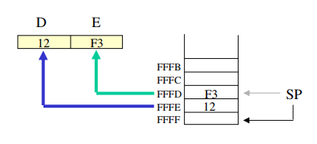
Classification of Instruction – Based on Functions
POP Instruction
POP D (1 Byte Instruction)
– Copy the contents of the memory location pointed to by the SP to register E
– Increment SP
– Copy the contents of the memory location pointed to by the SP to register D
– Increment SP

Slide 34
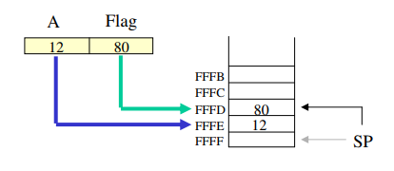
Classification of Instruction – Based on Functions
PUSH PSW Register Pair Instruction
PUSH PSW (1 Byte Instruction)
– Decrement SP
– Copy the contents of register A to the memory location pointed to by SP
– Decrement SP
– Copy the contents of Flag register to the memory location pointed to by SP

Slide 35
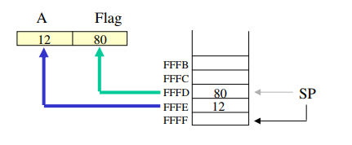
Classification of Instruction – Based on Functions
POP PSW Register Pair Instruction
POP PSW (1 Byte Instruction)
– Copy the contents of the memory location pointed to by the SP to Flag register
– Increment SP
– Copy the contents of the memory location pointed to by the SP to register A
– Increment SP

Slide 36


