Slide 1
Microprocessor & Interfacing
K.Muthuramalingam
Assistant Professor
School of Computer Science and Engineering
Bharathidasan University

Slide 2
8085 Microprocessor – Functional Units

Slide 3
8085 Microprocessor
It is an 8-bit microprocessor designed by Intel in 1977 using NMOS technology.
It has the following configuration :
8-bit data bus
16-bit address bus, which can address upto 64KB
A 16-bit program counter
A 16-bit stack pointer
Six 8-bit registers arranged in pairs: BC, DE, HL
Requires +5V supply to operate at 3.2 MHZ single phase clock

Slide 4
8085 Microprocessor – Functional Units
Accumulator
Arithmetic and logic unit
General purpose register
Program counter
Stack pointer
Temporary register
Flag register
Instruction register and decoder
Timing and control unit
Interrupt control
Serial Input/output control
Address buffer and address-data buffer
Address bus and data bus

Slide 5
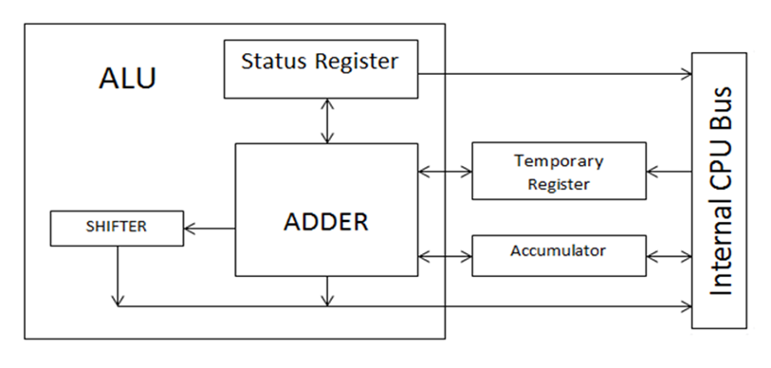
8085 Microprocessor – Accumulator
Accumulator
It is an 8-bit register used to perform arithmetic, logical, I/O & LOAD/STORE operations. It is connected to internal data bus & ALU.

Slide 6
8085 Microprocessor – Arithmetic and logic unit
Arithmetic and logic unit
As the name suggests, it performs arithmetic and logical operations like Addition, Subtraction, AND, OR, etc. on 8-bit data.
The inclusion of inverters on the inputs enables the same ALU hardware to perform the subtraction operation (adding an inverted operand), and the operations NAND and NOR.

Slide 7
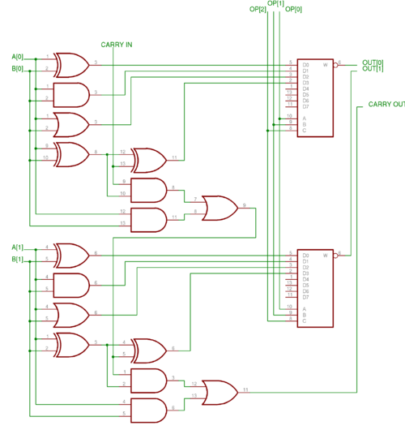
8085 Microprocessor – Internal structure of ALU
2 bits of ALU

Slide 8
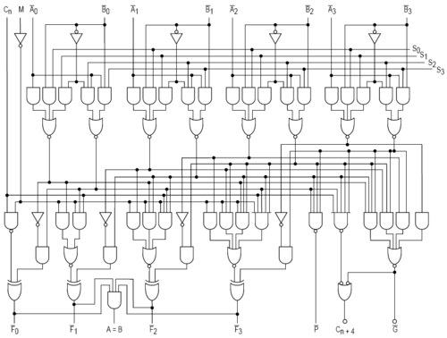
8085 Microprocessor – Internal structure of ALU
4 bits of ALU

Slide 9
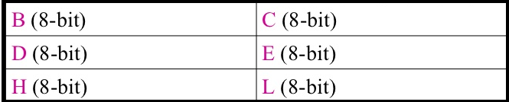
8085 Microprocessor – General purpose register
General purpose register
In 8085 general purpose registers are used to hold data like any other registers.
There are six types of general purpose registers, they are B,C,D,E,H and L. Each holds 8 bit data.
They can work in pairs such as B-C, D-E, H-L to store 16 bit data.
The H-L pair work as a memory pointer
A memory pointer holds the address of a particular memory location.

Slide 10
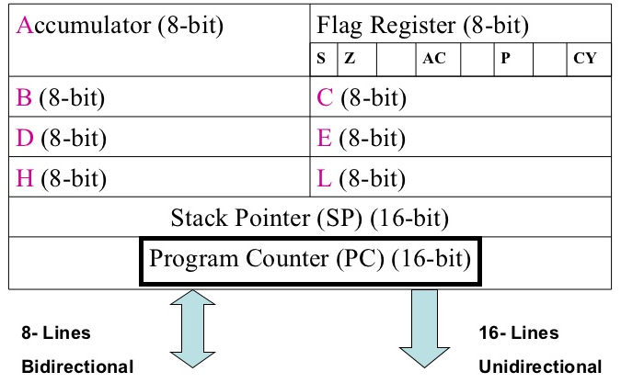
8085 Microprocessor – Program counter
Program counter
It is a 16-bit register used to store the memory address location of the next instruction to be executed.
Stores address of a memory location where next instruction byte is to be fetched by the 8085.
PC is incremented by one.
PC is now pointing to the address of next instruction.

Slide 11
8085 Microprocessor – Stack pointer
Stack pointer
It is also a 16-bit register works like stack, which is always incremented/decremented by 2 during push & pop operations.
The stack pointer is also a 16-bit register that is used to point into memory.
The memory this register points to is a special area called the stack.
The stack is an area of memory used to hold data that will be retreived soon.
The stack is usually accessed in a Last In First Out (LIFO) fashion.

Slide 12
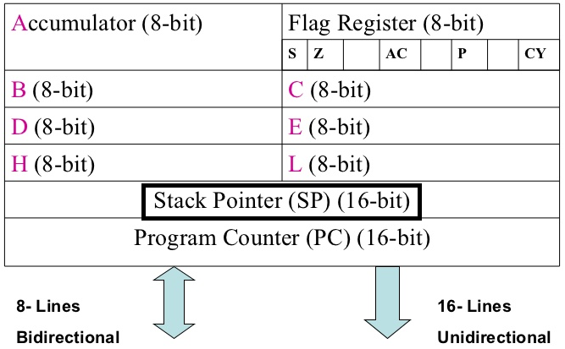

Slide 13
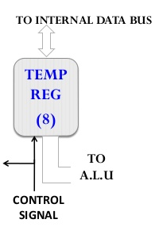
8085 Microprocessor – Temporary register
Temporary register
It is an 8-bit register, which holds the temporary data of arithmetic and logical operations.
Programmer cannot access this registers externally
W and Z are used as temp.registers.
It is also called operand register (8 bit)
It provides operands to ALU. ALU can store immediate results in temporary register.
8085 uses them internally to hold data temporary during the execution of some instruction.

Slide 14
8085 Microprocessor – Flag register
Flag register
A flag is a flip-flop which is set or reset by the processor to indicate certain conditions.
It is an 8-bit register having five 1-bit flip-flops, which holds either 0 or 1 depending upon the result stored in the accumulator.
A flag register contains a number of flags either to indicate certain conditions arising after arithmetic and logical operations or to control certain operations.
The flags which indicate conditions are known as condition flags.
The flags which are used to control certain operations are called control flags.

Slide 15
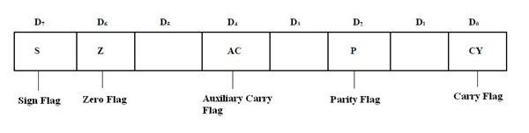
8085 Microprocessor – Flag register
Flag register
These are the set of 5 flip-flops :
Sign (S)
Zero (Z)
Auxiliary Carry (AC)
Parity (P)
Carry ©

Slide 16
Flag register
If an operation performed in ALU generates the carry from D7 to next stage then CY flag is set, else it is reset.
Auxiliary Carry (AC):
If an operation performed in ALU generates the carry from lower nibble (D0 to D3) to upper nibble (D4 to D7) AC flag is set, else it resets.
Zero Flag(z):
If an operation performed in ALU results 0value of entire 8-bits then zero flag is set, else it resets.
Sign Flag(s):
If MSB bit =0 then the number is positive, else it is negative.
Parity Flag(p):
If the result contains even no. of ones this flag is set and for odd no. of ones this flag is reset.

Slide 17
8085 Microprocessor – Instruction register and decoder
Instruction register and decoder
It is an 8-bit register. When an instruction is fetched from memory
then it is stored in the Instruction register. Instruction decoder
decodes the information present in the Instruction register.
Temporary stores the current instruction of a program.
Latest instruction sent here from memory prior to execution.
Decoder then takes instruction and decodes or interprets the instruction.
Decoded instruction then passed to next stage.
Instruction register is 8-bit register just like every other register of microprocessor.

Slide 18
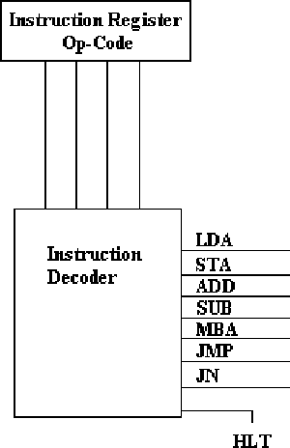
8085 Microprocessor – Instruction register and decoder
Instruction register and decoder
Consider an instruction. The instruction may be anything like adding two data's, moving a data, copying a data etc. When such an instruction is fetched from memory, it is directed to Instruction register. So the instruction registers are specifically to store the instructions that are fetched from memory. There is an Instruction decoder which decodes the information's present in the Instruction register for further processing.

Slide 19
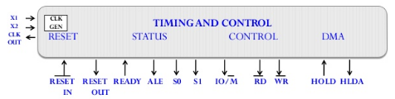
8085 Microprocessor – Timing and control unit
Timing and control unit
Timing and control unit synchronizes the registers and other units to perform operations in microprocessor. This unit consists of the following:
Control Signals: READY, RD [bar], WR [bar], ALE
Status Signals: S0, S1, IO/M [bar]
DMA Signals: HOLD, HLDA
RESET Signals: RESET IN [bar], RESET OUT

Slide 20
8085 Microprocessor – Timing and control unit
Control and Status Signals :
RD – Read (active low).
To indicate that the I/O or memory selected is to be read and data are available on the bus.
WR – Write: Active low.
This is to indicate that the data available on the bus are to be written to memory or I/O ports.
IO/M – To differentiate I/O operation of memory operations.
• ‘0’ - indicates a memory operation.
• ‘1’-indicates an I/O operation.
IO/M combined with RD and WR to generate I/O and memory control signals.
S1 and S0: Status signals, similar to IO/M, can identify various operations.

Slide 21
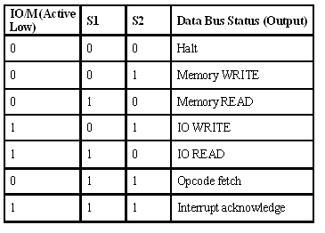
8085 Microprocessor – Timing and control unit
Signal Status :

Slide 22
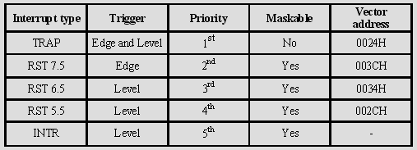
8085 Microprocessor – Interrupt control
Interrupt control :
It controls the interrupts during a process. During the execution of a program when there exist an interrupt, the processor shifts the control to the incoming request. After the request is completed, the control goes back to the main program.
The following are the 5 interrupt signals:
INTR
RST 7.5
RST 6.5
RST 5.5
TRAP

Slide 23
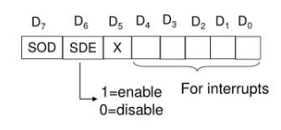
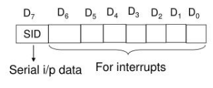
8085 Microprocessor – Serial Input/output control
Serial Input/output control:
There are 2 serial signals, i.e. SID and SOD and these signals are used for serial communication.
SOD (Serial output data line) − The output SOD is set/reset as specified by the SIM instruction.
SID (Serial input data line) − The data on this line is loaded into accumulator whenever a RIM instruction is executed.
Serial output data line Serial input data line

Slide 24
8085 Microprocessor – Address buffer and address-data buffer
Address buffer and address-data buffer:
The content stored in the stack pointer and program counter is loaded into the address buffer and address-data buffer to communicate with the CPU. The memory and I/O chips are connected to these buses. The CPU can exchange the desired data with the memory and I/O chips.
Address Buffer:
It is 8-bit unidirectional buffer
Used For address line
It is used to isolating the microprocessor from getting loaded
It used to drive the higher order bus.
Address/Data Buffer:
It is 8-bit bidirectional buffer
Used For address line
It is used to drive the lower order address and data bus

Slide 25
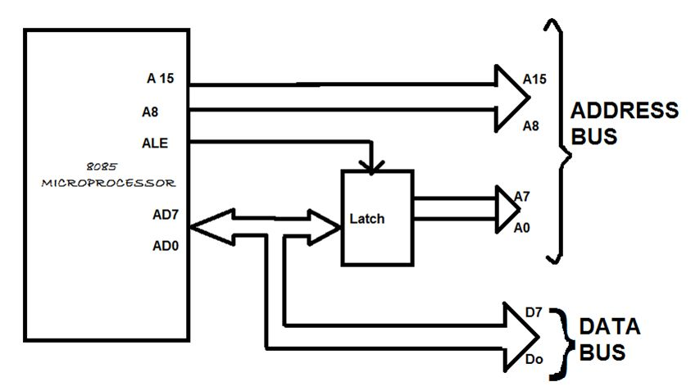
8085 Microprocessor – Address bus and Data bus
Address bus and data bus:
Data bus carries the data to be stored. It is bidirectional, whereas address bus carries the location to where it should be stored and it is unidirectional. It is used to transfer the data & Address I/O devices.

Slide 26


