Slide 1
Microprocessor & Interfacing
K.Muthuramalingam
Assistant Professor
School of Computer Science and Engineering
Bharathidasan University

Slide 2
ADDRESSING MODES OF 8051

Slide 3
CONTENTS
Addressing modes of 8051
Types of addressing modes
    Immediate addressing mode
    Register addressing mode
    Direct addressing mode
    Indirect addressing mode
    Implied addressing mode
Conclusion

Slide 4
ADDRESSING MODES
These are the instructions used to transfer the data from one register to another register, from the memory to the register, and from the register to the memory without any alteration in the content. Addressing modes in 8085 is classified into 5 groups .
They are
Immediate addressing mode
Register addressing mode
Direct addressing mode
Register Indirect addressing mode
Implied addressing mode

Slide 5
IMMEDIATE ADDRESSING MODE
In immediate addressing mode the source operand is always data.
If the data is 8-bit, then the instruction will be of 2 bytes,
if the data is of 16-bit then the instruction will be of 3 bytes.
Examples:
MVI B 45 (move the data 45H immediately to register B)
LXI H 3050 (load the H-L pair with the operand 3050H immediately)
JMP address (jump to the operand address immediately)

Slide 6
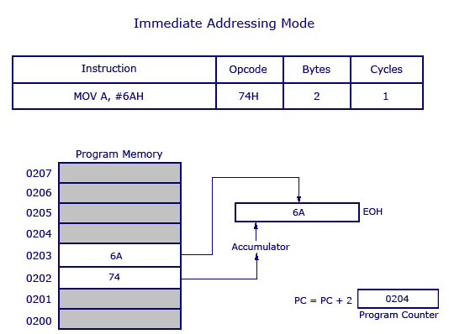
IMMEDIATE ADDRESSING MODE

Slide 7
REGISTER ADDRESSING MODE
In register addressing mode, the data to be operated is available inside the register(s) and register(s) is(are) operands. Therefore the operation is performed within various registers of the microprocessor.
Examples:
MOV A, B (move the contents of register B to register A)
ADD B (add contents of registers A and B and store the result in register A)
INR A (increment the contents of register A by one)

Slide 8
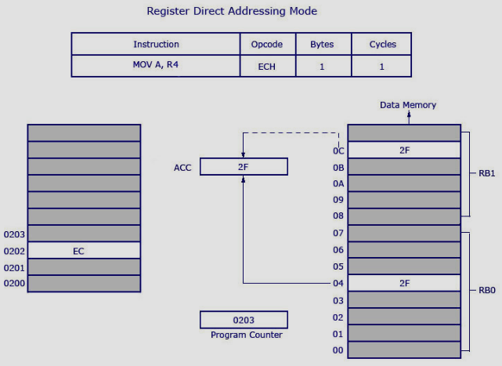
REGISTER ADDRESSING MODE

Slide 9
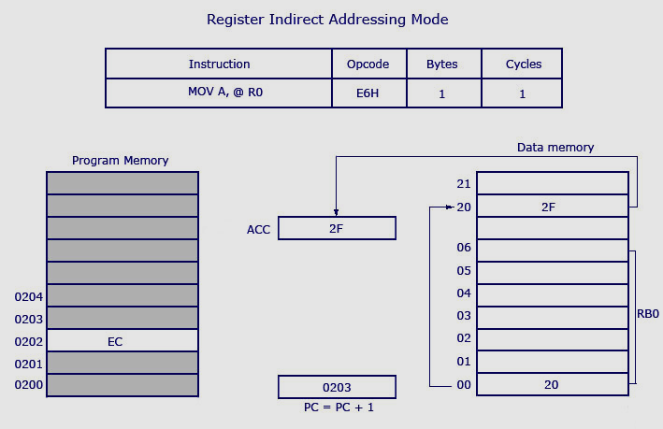
REGISTER ADDRESSING MODE

Slide 10
DIRECT ADDRESSING MODE
In direct addressing mode, the data to be operated is available inside a memory location and that memory location is directly specified as an operand. The operand is directly available in the instruction itself.
Examples:
LDA 2050 (load the contents of memory location into accumulator A)
LHLD address (load contents of 16-bit memory location into H-L register pair)
IN 35 (read the data from port whose address is 01)

Slide 11
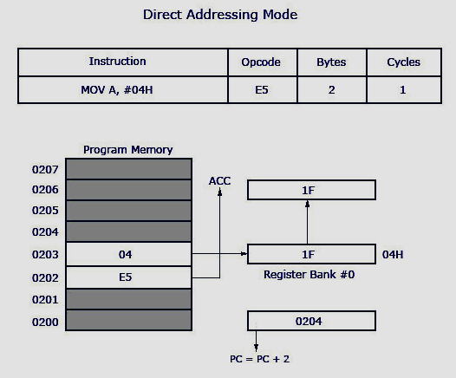
DIRECT ADDRESSING MODE

Slide 12
REGISTER INDIRECT ADDRESSING MODE
IN register indirect addressing mode, the data to be operated is available inside a memory location and that memory location is indirectly specified b a register pair
Examples:
MOV A, M (move the contents of the memory location pointed by the H-L pair to the accumulator)
LDAX B (move contains of B-C register to the accumulator)
LXIH 9570 (load immediate the H-L pair with the address of the location 9570)

Slide 13
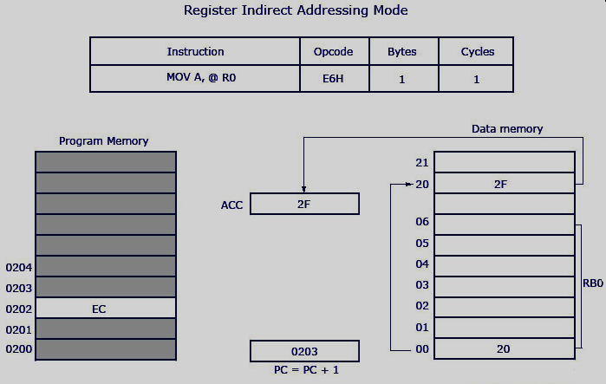
REGISTER INDIRECT ADDRESSING MODE

Slide 14
IMPLIED ADDRESSING MODE
In implied/implicit addressing mode the operand is hidden and the data to be operated is available in the instruction itself
Examples:
CMA (finds and stores the 1’s complement of the contains of accumulator A in A)
RRC (rotate accumulator A right by one bit)
RLC (rotate accumulator A left by one bit)

Slide 15
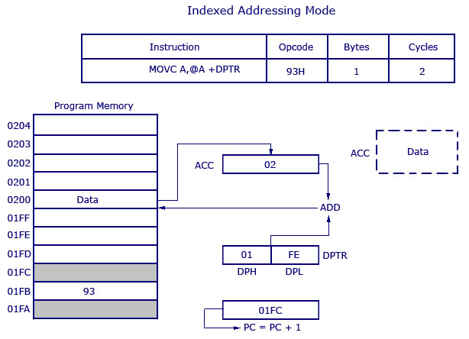
INDEXED ADDRESSING MODE

Slide 16


