Slide 1
DIGITAL SYSTEM
K.Muthuramalingam
Assistant Professor
School of Computer Science and Engineering
Bharathidasan University

Slide 2
Combinational Circuits & Half - Adder & Full - Adder

Slide 3
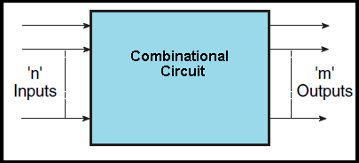
Combinational Circuits
Combinational circuit is a circuit in which we combine the different gates in the circuit, for example encoder, decoder, multiplexer and demultiplexer. Some of the characteristics of combinational circuits are following :−
The output of combinational circuit at any instant of time, depends only on the levels present at input terminals.
The combinational circuit do not use any memory. The previous state of input does not have any effect on the present state of the circuit.
A combinational circuit can have an n number of inputs and m number of outputs.

Slide 4
Combinational Logic Circuits
Combinational Logic Circuits are made up from basic logic NAND, NOR or NOT gates that are “combined” or connected together to produce more complicated switching circuits. These logic gates are the building blocks of combinational logic circuits. An example of a combinational circuit is a decoder, which converts the binary code data present at its input into a number of different output lines, one at a time producing an equivalent decimal code at its output. Combinational logic circuits can be very simple or very complicated and any combinational circuit can be implemented with only NAND and NOR gates as these are classed as “universal” gates.
The three main ways of specifying the function of a combinational logic circuit are:
1. Boolean Algebra – This forms the algebraic expression showing the operation of the logic circuit for each input variable either True or False that results in a logic “1” output.
2. Truth Table – A truth table defines the function of a logic gate by providing a concise list that shows all the output states in tabular form for each possible combination of input variable that the gate could encounter.
3. Logic Diagram – This is a graphical representation of a logic circuit that shows the wiring and connections of each individual logic gate, represented by a specific graphical symbol, that implements the logic circuit.

Slide 5
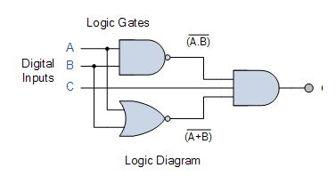
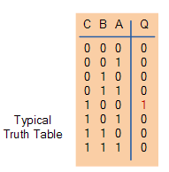

All three of these logic circuit representations are show
Logic Diagram
Boolean Algebra
Truth Table

Slide 6
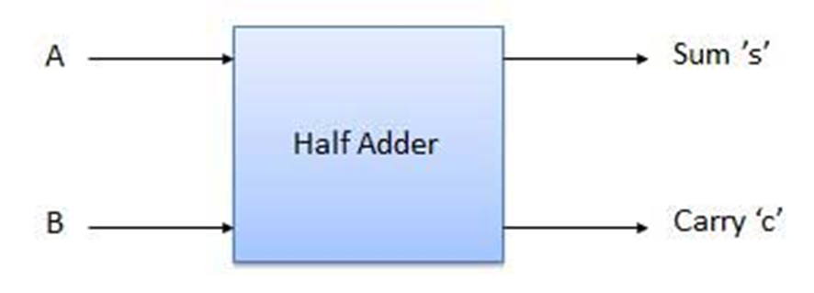
HALF ADDER
A half adder is a type of adder, an electronic circuit that performs the addition of numbers. The half adder is able to add two single binary digits and provide the output plus a carry value. It has two inputs, called A and B, and two outputs S (sum) and C (carry). The common representation uses a XOR logic gate and an AND logic gate.
The adder works by combining the operations of basic logic gates, with the simplest form using only a XOR and an AND gate. This can also be converted into a circuit that only has AND, OR and NOT gates. This is especially useful since these three simpler logic gate ICs (integrated circuits) are more common and available than the XOR IC, though this might result in a bigger circuit since three different chips are used instead of just one.
Block Diagram of Half Adder

Slide 7
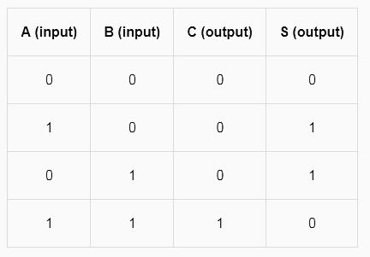
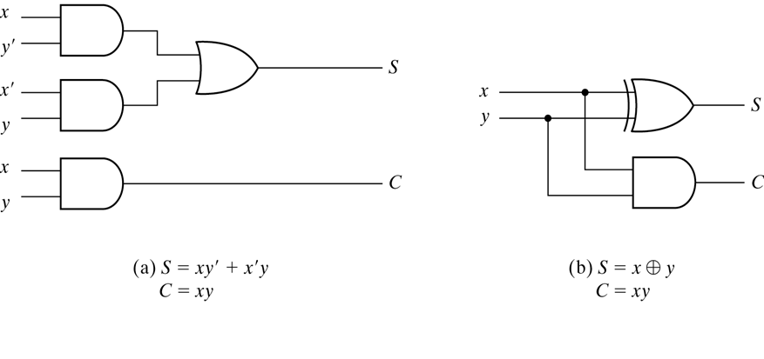
HALF ADDER:
Truth Table
Circuit Diagram

Slide 8
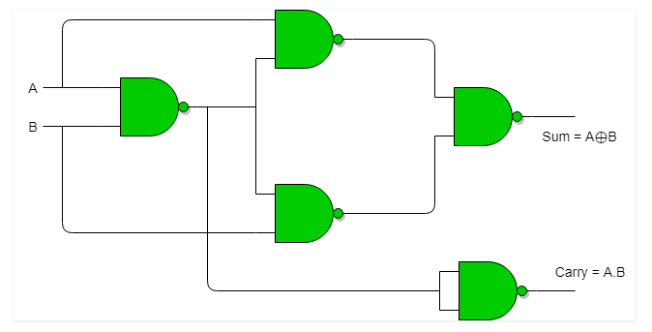
Half Adder using NAND gates
Total 5 NAND gates are required to implement half adder.

Slide 9
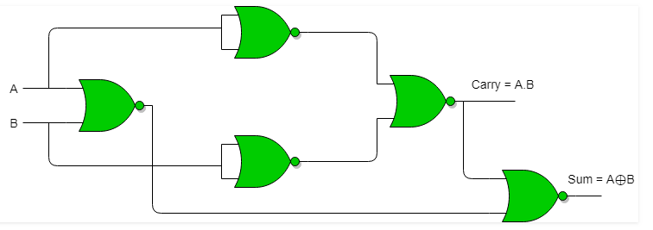
Half Adder using NOR gates
Total 5 NOR gates are required to implement half adder.

Slide 10
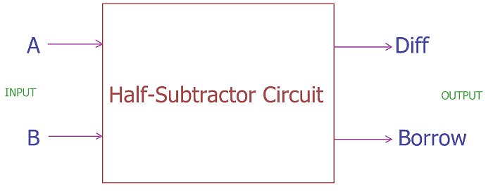
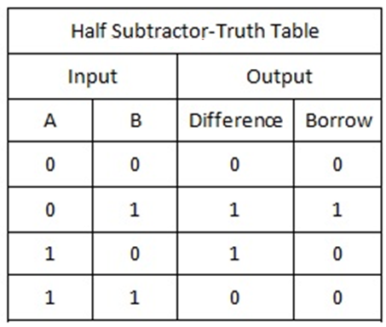
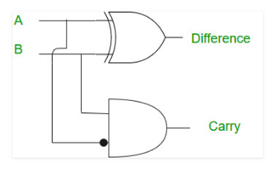
Half-Subtractor
Half subtractor is a combination circuit with two inputs and two outputs (difference and borrow). It produces the difference between the two binary bits at the input and also produces an output (Borrow) to indicate if a 1 has been borrowed. In the subtraction (A-B), A is called as Minuend bit and B is called as Subtrahend bit.

Slide 11
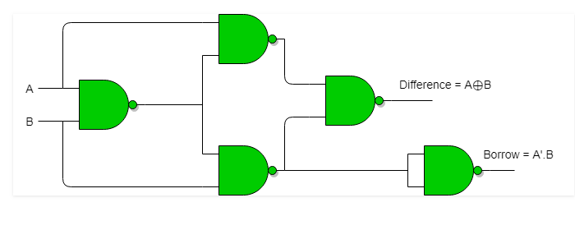
Half Subtractor using NAND gates
Total 5 NAND gates are required to implement half Subtractor.

Slide 12
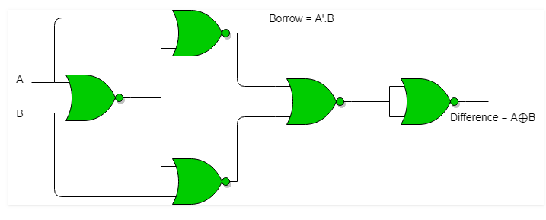
Half Subtractor using NOR gates
Total 5 NOR gates are required to implement half Subtractor.

Slide 13
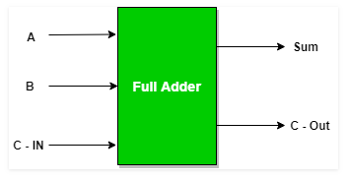
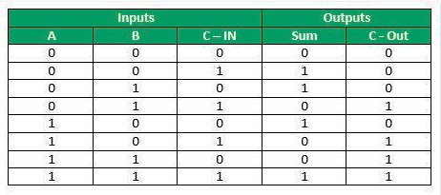
FULL ADDER
Full Adder is the adder which adds three inputs and produces two outputs. The first two inputs are A and B and the third input is an input carry as C-IN. The output carry is designated as C-OUT and the normal output is designated as S which is SUM.
A full adder logic is designed in such a manner that can take eight inputs together to create a byte-wide adder and cascade the carry bit from one adder to the another.
Block Diagram
Truth Table

Slide 14
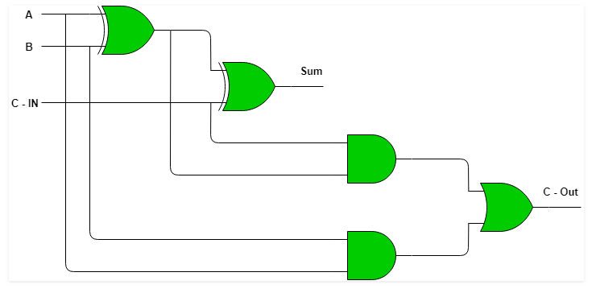
Logic Circuit of Full Adder
Two Half Adder and OR gate is required to implement a Full Adder

Slide 15
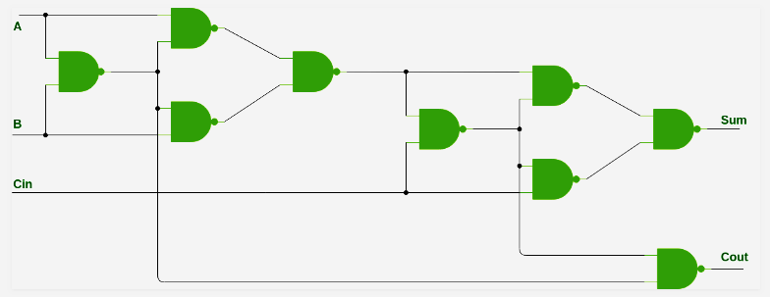
Implementation of Full Adder using NAND gate

Slide 16
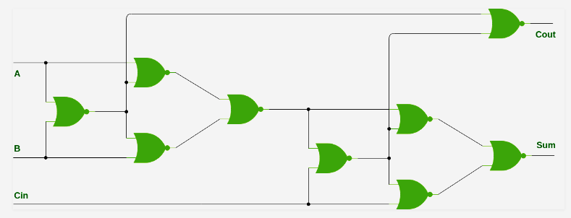
Implementation of Full Adder using NOR gate

Slide 17
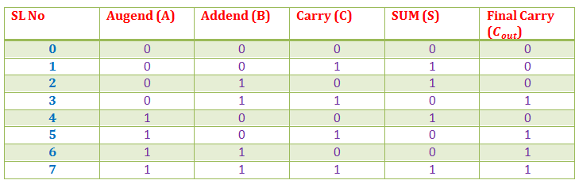
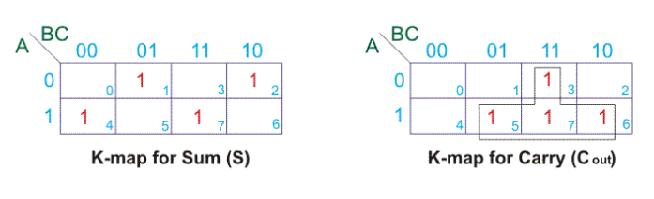
Full Adder Truth Table
From the above table, we can draw K-map for sum (s) and final carry (C_{out}).

Slide 18
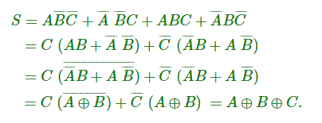
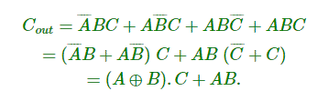
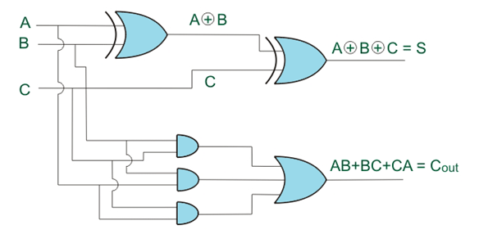
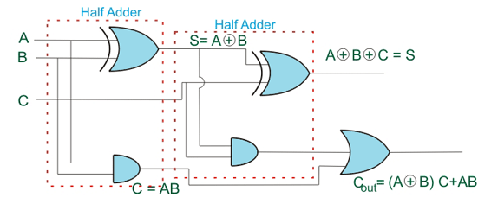
From the K - Maps

Slide 19
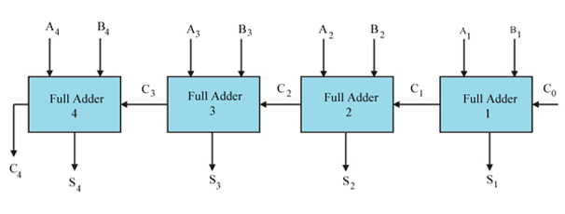
Binary Parallel Adder
A full binary adder performs addition of any single bit of one binary number, same significant or same position bit of another binary numbers and carry comes from result of addition of previous right side bits of both binary numbers. But a single full adder cannot add more than one bits binary number instantly. This can be done only by connecting as many full adders as the number of bits of the binary numbers whose addition is to be performed. This parallel combination of full adders which performs addition of specific bits binary numbers is called binary parallel adder. For adding two 4 bit binary numbers we have to connect 4 full adders to make 4 bit parallel adder.
4 full adder in 4bit parallel adder

Slide 20
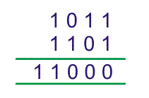

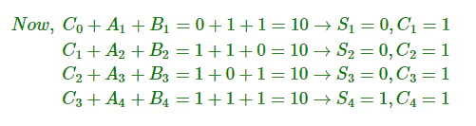

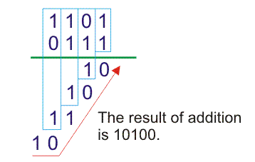
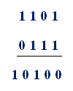
Let us examine the justification of the above circuit by taking an example of addition of two 4 bit binary numbers. Let us add 1011 with 1101.
Therefore, final result of the addition would be
There are 1 bit, 2 bits and 4 bits parallel adders ICs commercially available in market. For n bit parallel adder required number of such ICs are connected together. 4 bit parallel adder IC is 4008. In n bit parallel adder, output carry terminal of one IC would be connected with input carry terminal of next IC.

Slide 21
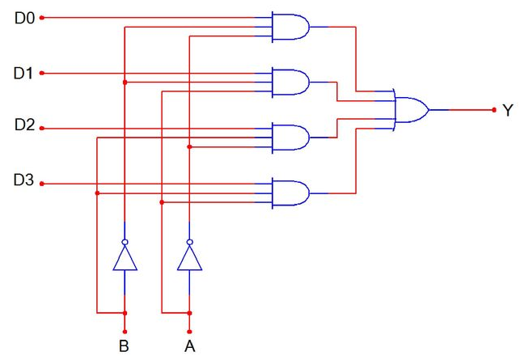
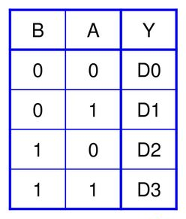
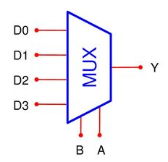
Multiplexers
Multiplexer is a special type of combinational circuit. There are n-data inputs, one output and m select inputs with 2m = n. It is a digital circuit which selects one of the n data inputs and routes it to the output. The selection of one of the n inputs is done by the selected inputs. Depending on the digital code applied at the selected inputs, one out of n data sources is selected and transmitted to the single output Y. E is called the strobe or enable input which is useful for the cascading. It is generally an active low terminal that means it will perform the required operation when it is low.

Slide 22
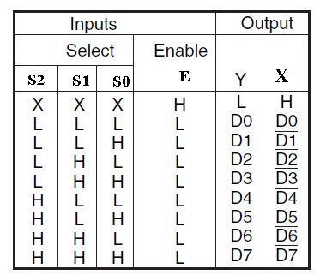
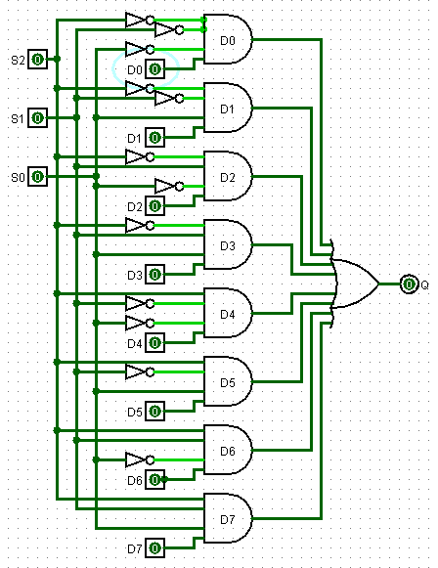
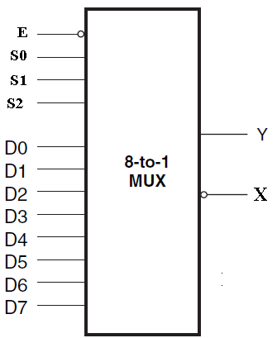
8 to 1 MUX designed with Medium Scale Integration (MSI)
E : ENABLE input
S₀, S₁,S₂ : Select inputs
D0 – D7 :Data inputs
Y, X : Outputs

Slide 23
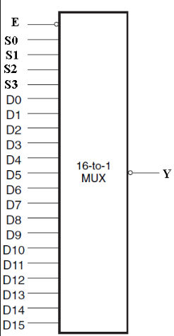
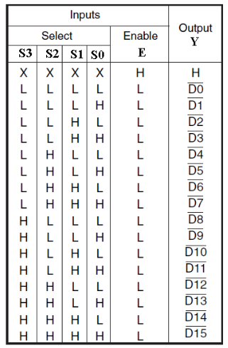
16 to 1 MUX designed with Medium Scale Integration (MSI)

Slide 24
Application of Multiplexer

Slide 25
Demultiplexer
Demultiplexers
A demultiplexer performs the reverse operation of a multiplexer i.e. it receives one input and distributes it over several outputs. It has only one input, n outputs, m select input. At a time only one output line is selected by the select lines and the input is transmitted to the selected output line. A de-multiplexer is equivalent to a single pole multiple way switch as shown in fig.
Demultiplexers comes in multiple variations.
1 : 2 demultiplexer
1 : 4 demultiplexer
1 : 16 demultiplexer
1 : 32 demultiplexer

Slide 26
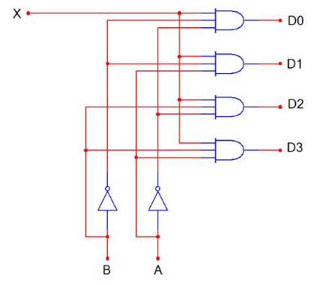
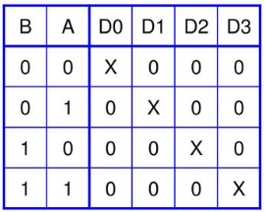
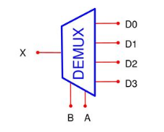
Demultiplexer
Demultiplexers
A demultiplexer performs the reverse operation of a multiplexer i.e. it receives one input and distributes it over several outputs. It has only one input, n outputs, m select input. At a time only one output line is selected by the select lines and the input is transmitted to the selected output line. A de-multiplexer is equivalent to a single pole multiple way switch.
Demultiplexers comes in multiple variations.
1 : 2 demultiplexer
1 : 4 demultiplexer
1 : 16 demultiplexer
1 : 32 demultiplexer

Slide 27
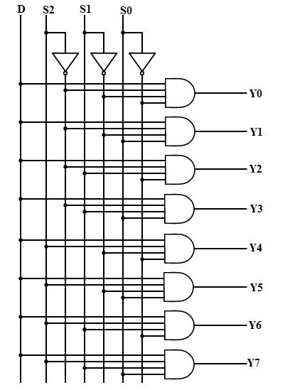
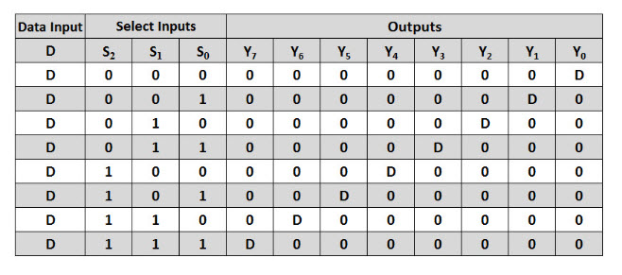
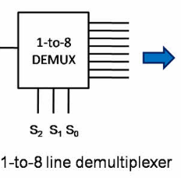
1 to 8 DEMUX designed with Medium Scale Integration (MSI)

Slide 28
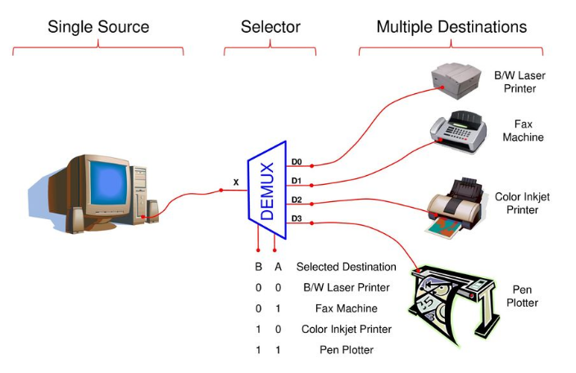
Application of Demultiplexer

Slide 29
Binary Encoders
An encoder is a device which converts familiar numbers or characters or symbols into a coded format. It accepts the alphabetic characters and decimal numbers as inputs and produces the outputs as a coded representation of the inputs.
It encodes the given information into a more compact form. In other words, it is a combinational circuit that performs the opposite function of a decoder.
These are mainly used to reduce the number of bits needed to represent given information. In digital systems, encoders are used for transmitting the information. Thus the transmission link uses fewer lines to transmit the encoded information.
In addition, these encoders are used for encoding the data which is to be stored for later use as it facilitates fewer bits storing over the available space. Let us discuss various types of binary encoders.
A binary encoder has 2n input lines and n output lines, hence it encodes the information from 2n inputs into an n-bit code. From all the input lines, only one of an input line is activated at a time, and depending on the input line, it produces the n bit output code.

Slide 30
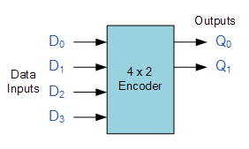
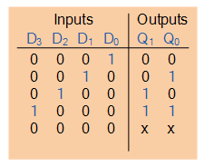

Binary Encoders
Unlike a multiplexer that selects one individual data input line and then sends that data to a single output line or switch, Digital Encoder more commonly called a Binary Encoder takes ALL its data inputs one at a time and then converts them into a single encoded output. A binary encoder, is a multi-input combinational logic circuit that converts the logic level “1” data at its inputs into an equivalent binary code at its output. Generally, digital encoders produce outputs of 2-bit, 3-bit or 4-bit codes depending upon the number of data input lines. An “n-bit” binary encoder has 2^{n} input lines and n-bit output lines with common types that include 4-to-2, 8-to-3 and 16-to-4 line configurations. The output lines of a digital encoder generate the binary equivalent of the input line whose value is equal to “1” and are available to encode either a decimal or hexadecimal input pattern to typically a binary or “B.C.D” (binary coded decimal) output code.

Slide 31
Binary Decoder
Binary Decoder is another combinational logic circuit constructed from individual logic gates and is the exact opposite to that of an Encoder. The name “Decoder” means to translate or decode coded information from one format into another, so a binary decoder transforms “n” binary input signals into an equivalent code using 2^{n} outputs.
Binary Decoders are another type of digital logic device that has inputs of 2-bit, 3-bit or 4-bit codes depending upon the number of data input lines, so a decoder that has a set of two or more bits will be defined as having an n-bit code, and therefore it will be possible to represent 2^{n} possible values. Thus, a decoder generally decodes a binary value into a non-binary one by setting exactly one of its n outputs to logic “1”. If a binary decoder receives n inputs (usually grouped as a single Binary or Boolean number) it activates one and only one of its 2^{n} outputs based on that input with all other outputs deactivated.
So for example, an inverter ( NOT-gate ) can be classed as a 1-to-2 binary decoder as 1-input and 2-outputs (2¹) is possible because with an input A it can produce two outputs A and A (not-A) as shown. Then we can say that a standard combinational logic decoder is an n-to-m decoder, where m ≤ 2^{n}, and whose output, Q is dependent only on its present input states. In other words, a binary decoder looks at its current inputs, determines which binary code or binary number is present at its inputs and selects the appropriate output that corresponds to that binary input. A Binary Decoder converts coded inputs into coded outputs, where the input and output codes are different and decoders are available to “decode” either a Binary or BCD (8421 code) input pattern to typically a Decimal output code. Commonly available BCD-to-Decimal decoders include the TTL 7442 or the CMOS 4028. Generally a decoders output code normally has more bits than its input code and practical “binary decoder” circuits include, 2-to-4, 3-to-8 and 4-to-16 line configurations.

Slide 32
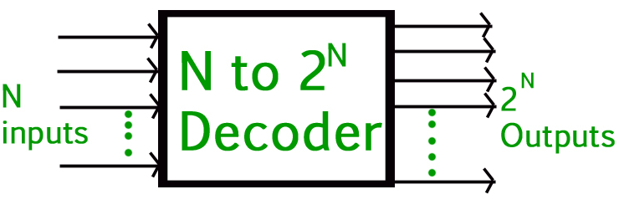
So for example, an inverter ( NOT-gate ) can be classed as a 1-to-2 binary decoder as 1-input and 2-outputs (2¹) is possible because with an input A it can produce two outputs A and A (not-A) as shown. Then we can say that a standard combinational logic decoder is an n-to-m decoder, where m ≤ 2^{n}, and whose output, Q is dependent only on its present input states. In other words, a binary decoder looks at its current inputs, determines which binary code or binary number is present at its inputs and selects the appropriate output that corresponds to that binary input. A Binary Decoder converts coded inputs into coded outputs, where the input and output codes are different and decoders are available to “decode” either a Binary or BCD (8421 code) input pattern to typically a Decimal output code. Commonly available BCD-to-Decimal decoders include the TTL 7442 or the CMOS 4028. Generally a decoders output code normally has more bits than its input code and practical “binary decoder” circuits include, 2-to-4, 3-to-8 and 4-to-16 line configurations.

Slide 33


