Slide 1
Boolean Algebra – Basic Theorems
K.Muthuramalingam
Assistant Professor
School of Computer Science and Engineering
Bharathidasan University

Slide 2
Boolean Algebra
Boolean algebra was invented by George Boole in 1854. The algebraic mathematical operations that are performed to analyse the digital logical circuits by using the binary numbers or logical values is known as Boolean algebra. The Boolean algebra deals purely with the binary variables. That is, the binary variables usually take the values of 1 or 0, where 1 represents true (high) and 0 represents false (low). The elements of Boolean algebra with two binary operations “+ and · ” satisfy the axioms listed below:

Slide 3
Rule in Boolean Algebra:
Following are the important rules used in Boolean algebra.
  Variable used can have only two values. Binary 1 for HIGH and Binary 0 for LOW.
  Complement of a variable is represented by an overbar (-). Thus, complement of variable B is represented as B Bar. Thus if B = 0 then B Bar = 1 and B = 1 then B Bar = 0.
  ORing of the variables is represented by a plus (+) sign between them. For example ORing of A, B, C is represented as A + B + C.
  Logical ANDing of the two or more variable is represented by writing a dot between them such as A.B.C. Sometime the dot may be omitted like ABC.

Slide 4
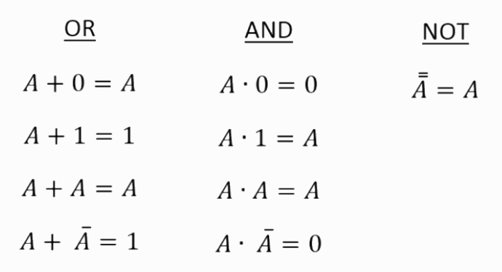
Fundamental laws

Slide 5
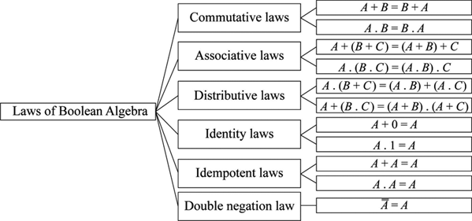

Slide 6
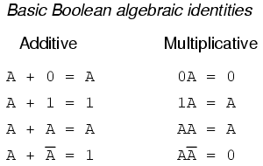

Slide 7
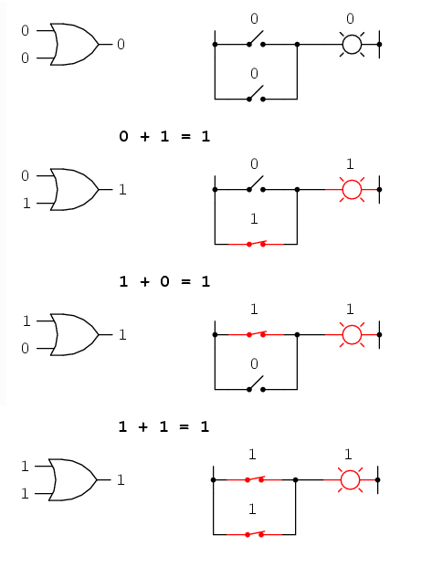
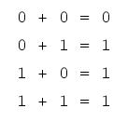
Boolean Arithmetic's

Slide 8
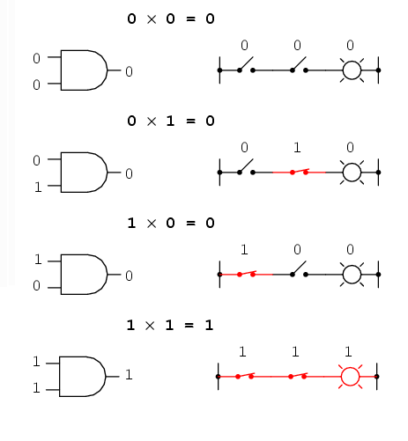
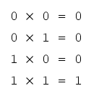
Boolean Arithmetic's

Slide 9
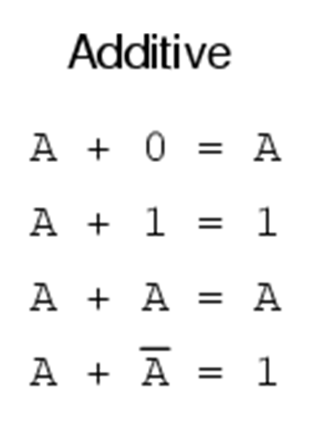
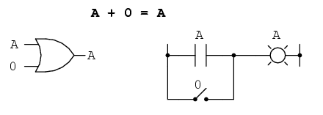
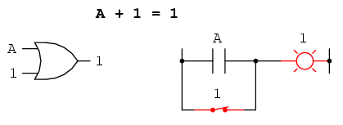
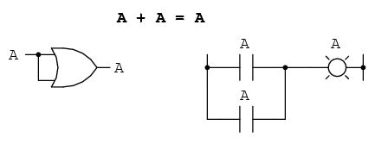
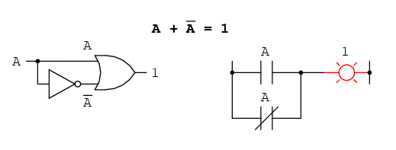
Boolean algebraic identities

Slide 10
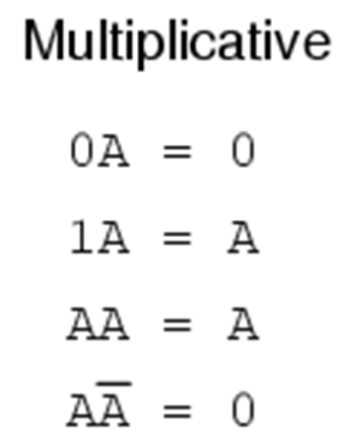
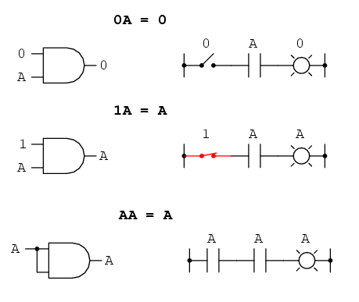
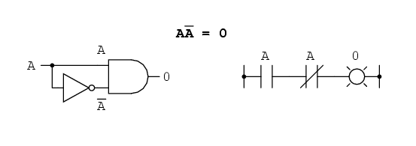
Boolean algebraic identities

Slide 11
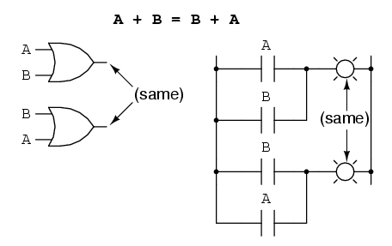
Boolean Algebraic Properties – Commutative Property of Addition

Slide 12
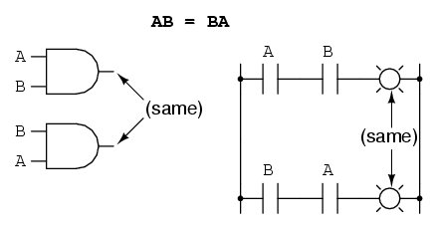
Boolean Algebraic Properties – Commutative Property of Multiplication

Slide 13
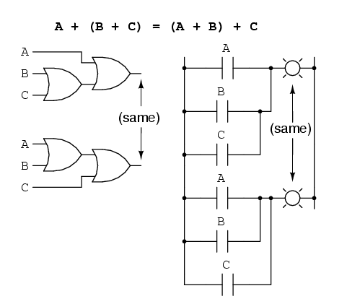
Boolean Algebraic Properties – Associative Property of Addition

Slide 14
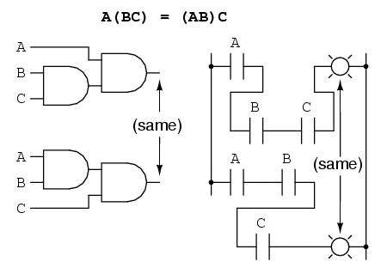
Boolean Algebraic Properties – Associative Property of Multiplication

Slide 15
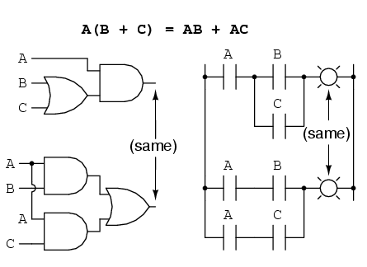
Boolean Algebraic Properties – Distributive Property

Slide 16


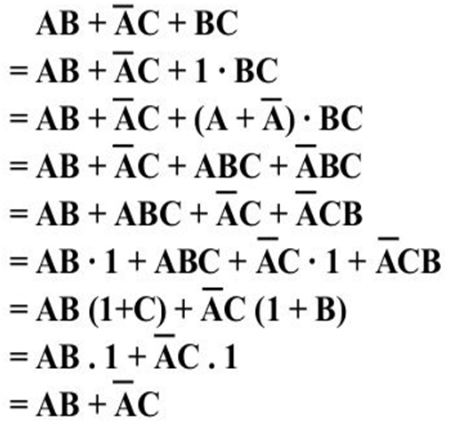
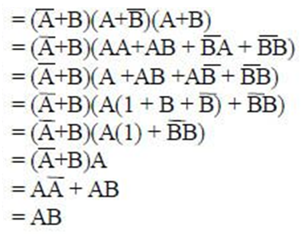
Boolean Simplification

Slide 17
