Slide 1

Data Structures
Dr.B.Smitha

Slide 2
Stack
Stack ADT
Basic operations of stack
  Pushing, popping etc.
Implementations of stacks using
  array
  linked list

Slide 3
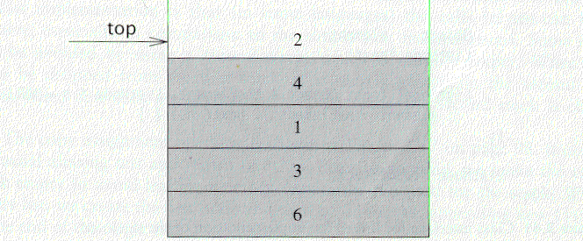
The Stack ADT
A stack is a list with the restriction
  that insertions and deletions can only be performed at the top of the list
  The other end is called bottom
Fundamental operations:
  Push: Equivalent to an insert
  Pop: Deletes the most recently inserted element
  Top: points to the topmost element in the stack.

Slide 4
Stack ADT
Stacks are known as LIFO (Last In, First Out) lists.
  The last element inserted will be the first to be retrieved

Slide 5
Push and Pop
Primary operations: Push and Pop
Push
  Add an element to the top of the stack
Pop
  Remove the element at the top of the stack
empty stack
push an element
push another
pop
top
B
top
top
top
A
A
A

Slide 6
Implementation of Stacks
Any list implementation could be used to implement a stack
  Arrays (static: the size of stack is given initially)
  Linked lists (dynamic: never become full)
We will explore implementations based on array and linked list
Let’s see how to use an array to implement a stack first

Slide 7
Array Implementation
Need to declare an array size ahead of time
Associated with each stack is TopOfStack
  for an empty stack, set TopOfStack to -1
Push
  (1) Increment TopOfStack by 1.
  (2) Set Stack[TopOfStack] = X
Pop
  (1) Set return value to Stack[TopOfStack]
  (2) Decrement TopOfStack by 1
These operations are performed in very fast constant time

Slide 8
Push Stack
Void push(int item,stack,n,top)
{// insert item into the STACK of maximum size n;top is the number of elements currently in STACK)
If top>=n then call STACKFULL() endif
top←top+1
Stack(top)←item
}

Slide 9
Pop Stack
Void pop(int item,stack,top)
{// remove the top element of STACK and store
//it in item unless STACK is empty
If top<=0 then call STACKEMPTY() endif
item←Stack(top)
top←top-1
}

Slide 10
Postfix Expressions
Calculate 4.99 * 1.06 + 5.99 + 6.99 * 1.06
  Need to know the precedence rules
Postfix (reverse Polish) expression
  4.99 1.06 * 5.99 + 6.99 1.06 * +
Use stack to evaluate postfix expressions
  When a number is seen, it is pushed onto the stack
  When an operator is seen, the operator is applied to the 2 numbers that are popped from the stack. The result is pushed onto the stack
Example
  evaluate 6 5 2 3 + 8 * + 3 + *
The time to evaluate a postfix expression is O(N)
  processing each element in the input consists of stack operations and thus takes constant time

Slide 11
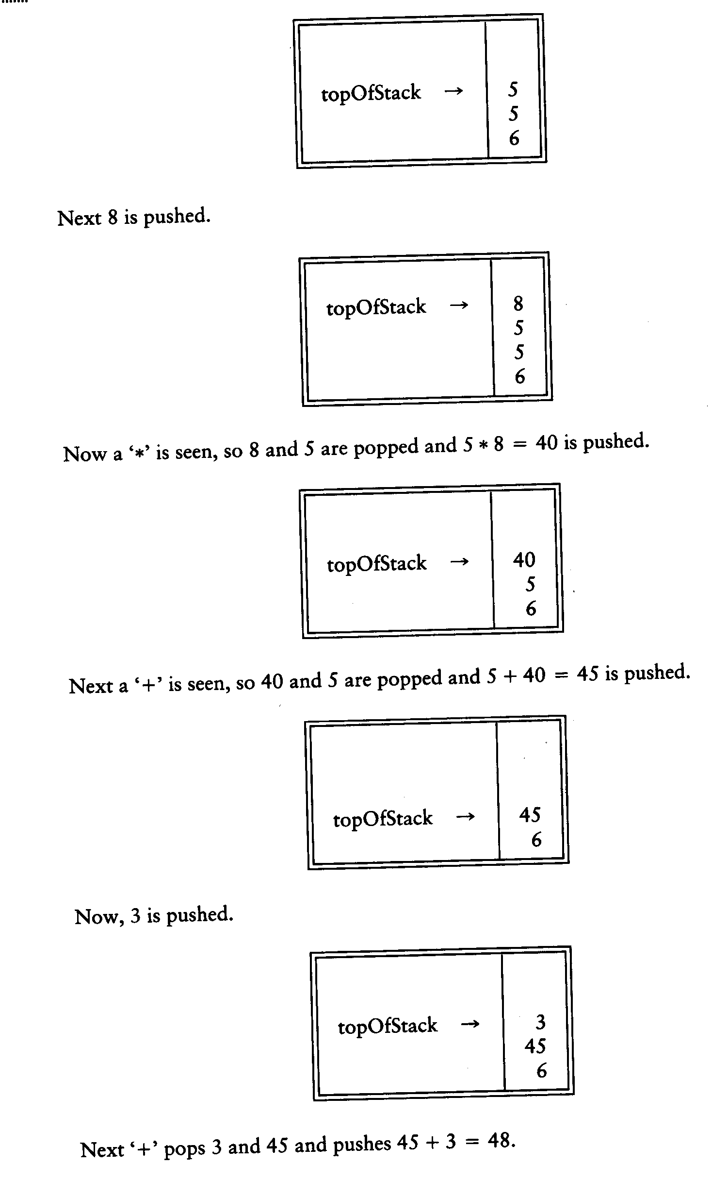
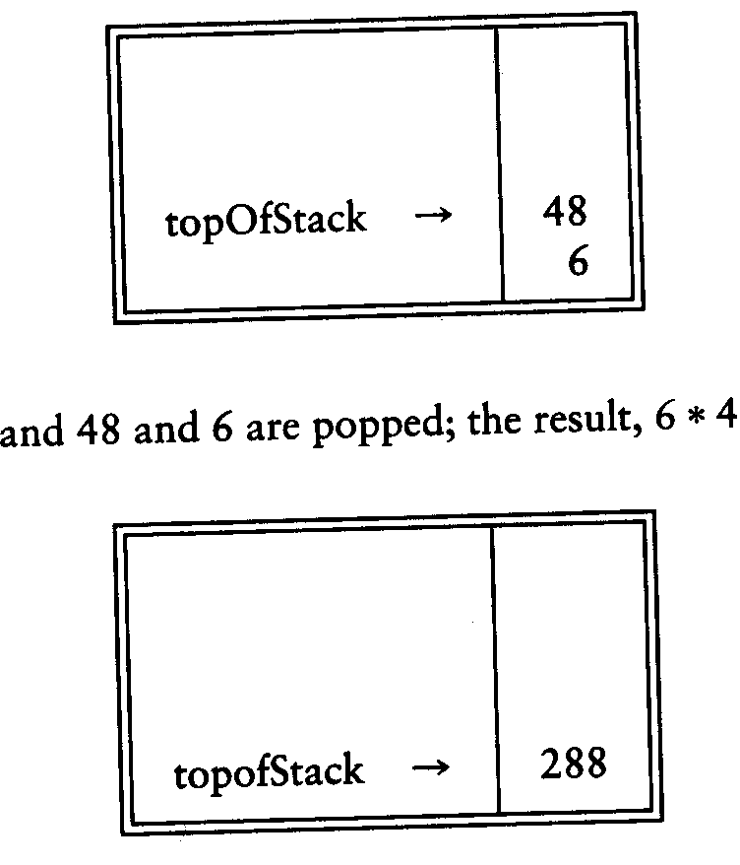
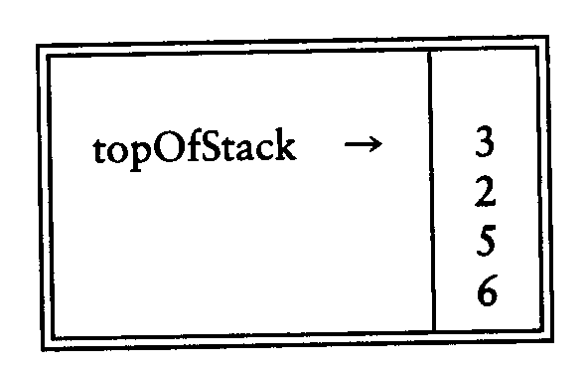

Slide 12
Queue
Queue ADT
Basic operations of queue
  Enqueuing, dequeuing etc.
Implementation of queue
  Array
  Linked list

Slide 13
Queue ADT
Like a stack, a queue is also a list. However, with a queue, insertion is done at one end, while deletion is performed at the other end.
Queue is also known as First In First Out(FIFO)

Slide 14
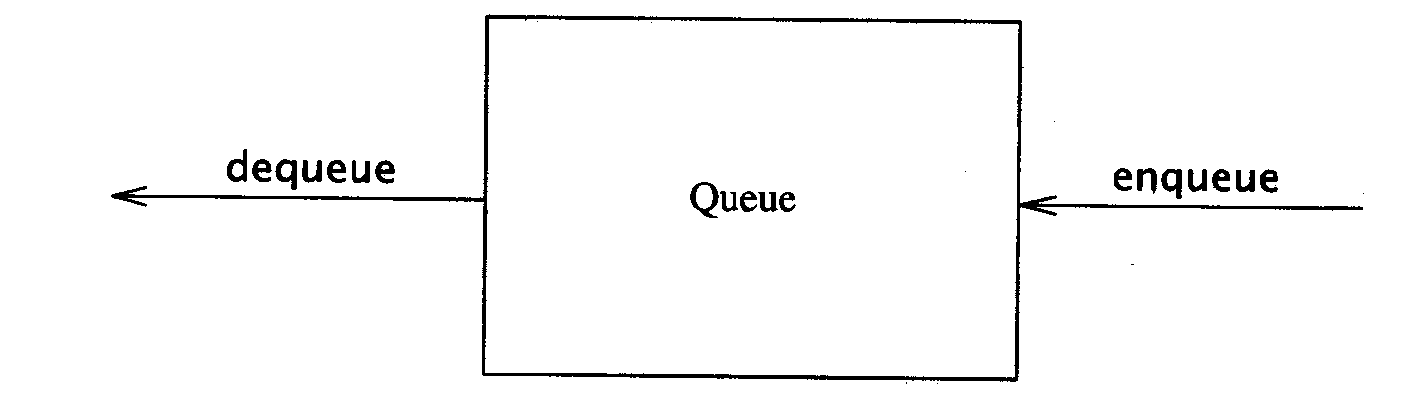
The Queue ADT
  Insertion is done at one end, whereas deletion is performed at the other end
Basic operations:
  enqueue: insert an element at the rear of the list
  dequeue: delete the element at the front of the list

Slide 15
Enqueue and Dequeue
Primary queue operations: Enqueue and Dequeue
Like check-out lines in a store, a queue has a front and a rear.
Enqueue
  Insert an element at the rear of the queue
Dequeue
  Remove an element from the front of the queue
Remove
(Dequeue)
Insert
(Enqueue)
front
rear

Slide 16
Queue Implementation of Array
There are several different algorithms to implement Enqueue and Dequeue
Naïve way
  When enqueuing, the front index is always fixed and the rear index moves forward in the array.
rear
rear
rear
3
3
6
3
6
9
front
front
front
Enqueue(3)
Enqueue(6)
Enqueue(9)

Slide 17

Doubly Linked List

Slide 18
Motivation
Doubly linked lists are useful for playing video and sound files with “rewind” and instant “replay”
They are also useful for other linked data where “require” a “fast forward” of the data as needed

Slide 19
list using an array:
  Knowledge of list size
  Access is easy (get the ith element)
  Insertion/Deletion is harder
list using ‘singly’ linked lists:
  Insertion/Deletion is easy
  Access is harder
  But, can not ‘go back’!

Slide 20
Doubly Linked Lists
In a Doubly Linked-List each item points to both its predecessor and successor
  prev points to the predecessor
  next points to the successor
10
20
40
55
70
Head
Cur->prev
Cur->next
Cur

Slide 21
Doubly Linked List Definition
struct Node{
int data;
Node* next;
Node* prev;
};
typedef Node* NodePtr;

Slide 22
Doubly Linked List Operations
insertNode(NodePtr& Head, int item)
//add new node to ordered doubly linked //list
deleteNode(NodePtr& Head, int item)
//remove a node from doubly linked list
SearchNode(NodePtr Head, int item)
Print(nodePtr Head, int item)

Slide 23
Deleting a Node
Delete a node Cur (not at front or rear)
(Cur->prev)->next = Cur->next;
(Cur->next)->prev = Cur->prev;
delete Cur;
10
20
40
55
70
Head
Cur

Slide 24
void deleteNode(NodePtr& head, int item) {
NodePtr cur;
cur = searchNode(head, item);
if (head==NULL) { …
}
else if (cur->prev == NULL) { …
}
else if (cur->next==NULL) { …
}
else {
(cur->prev)->next = cur->next;
(cur->next)->prev = cur->prev;
delete cur;
}
}
Empty case
At-the-beginning case
At-the-end case
General case
A systematic way is to start from all these cases, then try to simply the codes, …

Slide 25
Inserting a Node
Insert a node New before Cur (not at front or rear)
New->next = Cur;
New->prev = Cur->prev;
Cur->prev = New;
(New->prev)->next = New;
10
20
55
70
40
Head
Cur
New

Slide 26
void insertNode(NodePtr& head, int item) {
NodePtr cur;
cur = searchNode(head, item);
if (head==NULL) { …
}
else if (cur->prev == NULL) { …
}
else if (cur->next==NULL) { …
}
else {
blablabla … }
}
Many special cases to consider.

Slide 27
Many different linked lists …
singly linked lists
  Without ‘dummy’
  With dummy
  circular
doubly linked lists
  Without ‘dummy’
  With dummy
Using ‘dummy’ is a matter of personal preference!
+ simplify codes (not that much ☺
- Less logically sounds

Slide 28
singly linked list
Head
10
20
40
55
70
20
(singly) circular linked list
10
20
40
55
70
Rear
(regular) doubly linked list
10
20
40
55
70
Head
doubly linked list with dummy
Dummy
10
20
40
55
70
Head

Slide 29
Doubly Linked Lists with Dummy Head Node
To simplify insertion and deletion by avoiding special cases of deletion and insertion at front and rear, a dummy head node is added at the head of the list
The last node also points to the dummy head node as its successor

Slide 30
Idea of ‘dummy’ object
‘dummy object’ is also called a ‘sentinel’, it allows the simplification of special cases, but confuses the emptyness NULL!
Instead of pointing to NULL, point to the ‘dummy’!!!
Skip over the dummy for the real list
Dummy Head Node
10
20
40
55
70
Head

Slide 31
Empty list:
Dummy Head Node
Head
Head->next = head; compared with head=NULL;

Slide 32
operations
Doubly linked with dummy
Singly linked
void createHead(NodePtr& head){
head = new Node;
head->next = head;
head->prev = head;
}
NodePtr head;
createHead(head);
NodePtr cur=head;
cur=cur->next;
cur=head; // dummy head
NodePtr head=NULL;
NodePtr cur=head;
cur=head;
cur=NULL; // or head=NULL;
creation
reference
Start from
Empty test

Slide 33
Print the whole list:
void print(NodePtr head){
NodePtr cur=head->next;
while(cur != head){
cout << cur->data << " ";
cur = cur->next;
}
}

Slide 34
Searching a node
(returning NULL if not found the element):
NodePtr searchNode(NodePtr head, int item){
NodePtr cur = head->next;
while ((cur != head) && (item != cur->data)) cur=cur->next;
if (cur == head) cur = NULL; // we didn’t find
return cur;
}
End of the list, empty

Slide 35
Deleting a Node
Delete a node Cur at front
(Cur->prev)->next = Cur->next;
(Cur->next)->prev = Cur->prev;
delete Cur;
Dummy Head Node
10
20
40
55
70
Head
Cur

Slide 36
Delete a node Cur in the middle
(Cur->prev)->next = Cur->next;
(Cur->next)->prev = Cur->prev;
delete Cur; // same as delete front!
Dummy Head Node
10
20
40
55
70
Cur
Head

Slide 37
Delete a node Cur at rear
(Cur->prev)->next = Cur->next;
(Cur->next)->prev = Cur->prev;
delete Cur; // same as delete front and middle!
Dummy Head Node
10
20
40
55
70
Head
Cur

Slide 38
void deleteNode(NodePtr head, int item){
NodePtr cur;
cur = searchNode(head, item);
if(cur != NULL){
cur->prev->next = cur->next;
cur->next->prev = cur->prev;
delete cur;
}
}
If we found the element, it does not mean any emptyness!

Slide 39
Inserting a Node
Insert a Node New after dummy node and before Cur
New->next = Cur;
New->prev = Cur->prev;
Cur->prev = New;
(New->prev)->next = New;
Dummy Head Node
20
10
Head
New
Cur

Slide 40
Insert a Node New at Rear (with Cur pointing to dummy head)
New->next = Cur;
New->prev = Cur->prev;
Cur->prev = New;
(New->prev)->next = New;
Dummy Head Node
10
20
40
55
70
Cur
Head
New

Slide 41
Insert a Node New in the middle and before Cur
New->next = Cur;
New->prev = Cur->prev;
Cur->prev = New;
(New->prev)->next = New;
Dummy Head Node
10
20
55
40
New
Cur
Head

Slide 42
Insert a Node New to Empty List (with Cur pointing to dummy head node)
New->next = Cur;
New->prev = Cur->prev;
Cur->prev = New;
(New->prev)->next = New;
Dummy Head Node
20
Head
Cur
New

Slide 43
void insertNode(NodePtr head, int item){
NodePtr newp, cur;
newp = new Node;
newp->data = item;
cur = head->next;
while ((cur != head)&&(!(item<=cur->data)))
cur = cur->next;
newp->next = cur;
newp->prev = cur->prev;
cur->prev = newp;
(newp->prev)->next = newp;
}
creation
location
insertion
It is similar to, but different from SearchNode!
(it returns NULL if no element)

Slide 44
void main(){
NodePtr Head, temp;
createHead(Head);
insertNode(Head, 3);
insertNode(Head, 5);
insertNode(Head, 2);
print(Head);
insertNode(Head, 7);
insertNode(Head, 1);
insertNode(Head, 8);
print(Head);
deleteNode(Head, 7);
deleteNode(Head, 0);
print(Head);
temp = searchNode(Head, 5);
if(temp !=NULL)
cout<<" Data is contained in the list"<<endl;
else
cout<<" Data is NOT contained in the list"<<endl;
}
Result is
2 3 5
1 2 3 5 7 8
1 2 3 5 8
Data is contained in the list

Slide 45

Sorting

Slide 46
Bubble sort
for (i=0; i<n-1; i++) {
for (j=0; j<n-1-i; j++) {
if (a[j+1] < a[j]) { // compare the two neighbors
tmp = a[j]; // swap a[j] and a[j+1]
a[j] = a[j+1];
a[j+1] = tmp;
}
}
}
Worst-case analysis: N+N-1+ …+1= N(N+1)/2, so O(N^2)

Slide 47

Insertion sort
1) Initially p = 1
2) Let the first p elements be sorted.
3) Insert the (p+1)th element properly in the list (go inversely from right to left) so that now p+1 elements are sorted.
4) increment p and go to step (3)

Slide 48
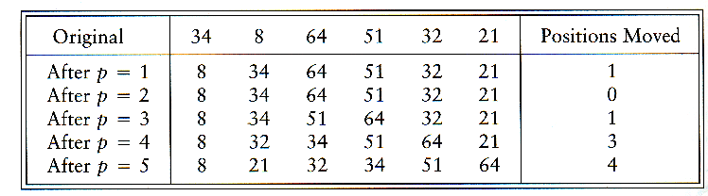
Insertion Sort

Slide 49
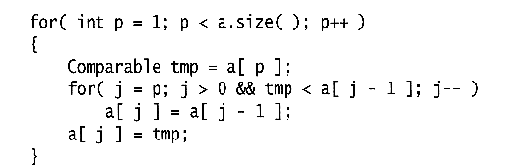
Insertion Sort
Consists of N - 1 passes
For pass p = 1 through N - 1, ensures that the elements in positions 0 through p are in sorted order
  elements in positions 0 through p - 1 are already sorted
  move the element in position p left until its correct place is found among the first p + 1 elements

Slide 50
Mergesort
Based on divide-and-conquer strategy
Divide the list into two smaller lists of about equal sizes
Sort each smaller list recursively
Merge the two sorted lists to get one sorted list

Slide 51
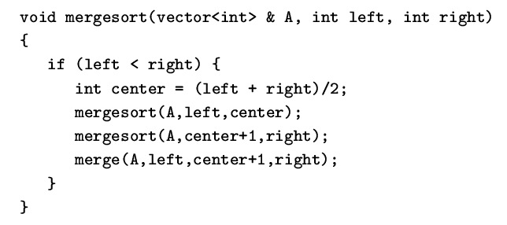
Mergesort
Divide-and-conquer strategy
  recursively mergesort the first half and the second half
  merge the two sorted halves together

Slide 52
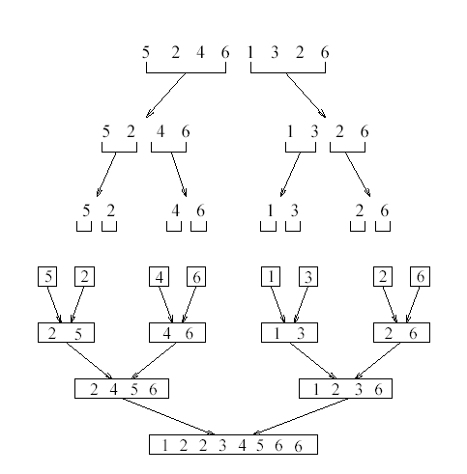

Slide 53
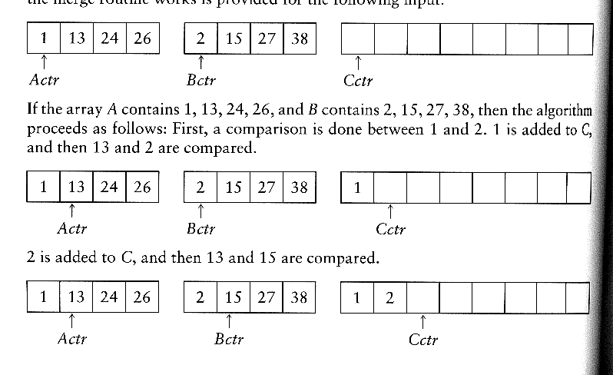
How to merge?
Input: two sorted array A and B
Output: an output sorted array C
Three counters: Actr, Bctr, and Cctr
  initially set to the beginning of their respective arrays
(1) The smaller of A[Actr] and B[Bctr] is copied to the next entry in C, and the appropriate counters are advanced
(2) When either input list is exhausted, the remainder of the other list is copied to C

Slide 54

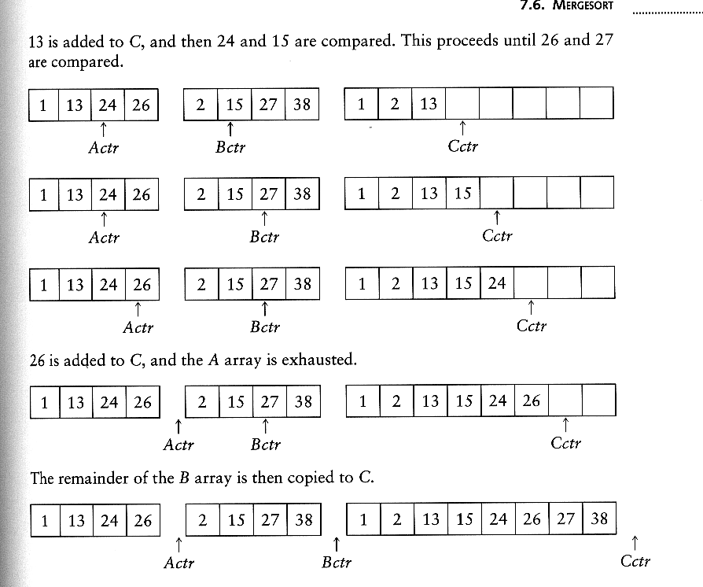
Example: Merge

Slide 55
Example: Merge...
Running time analysis:
  Clearly, merge takes O(m1 + m2) where m1 and m2 are
the sizes of the two sublists.
Space requirement:
  merging two sorted lists requires linear extra memory
  additional work to copy to the temporary array and back

Slide 56
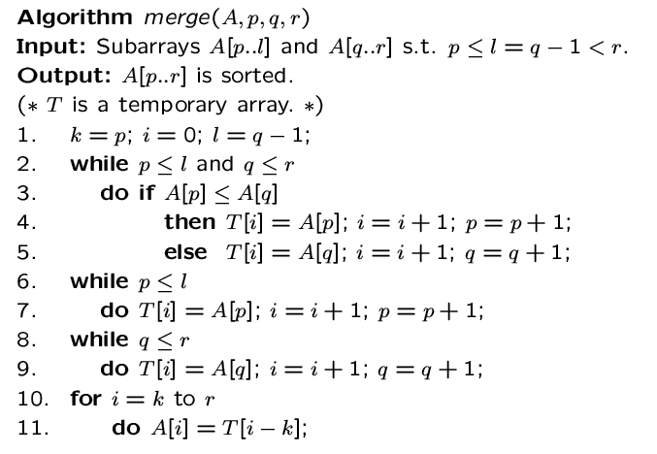

Slide 57
Analysis of mergesort
Let T(N) denote the worst-case running time of mergesort to sort N numbers.
Assume that N is a power of 2.
Divide step: O(1) time
Conquer step: 2 T(N/2) time
Combine step: O(N) time
Recurrence equation:
  T(1) = 1
  T(N) = 2T(N/2) + N

Slide 58
Analysis: solving recurrence
Since N=2^{k}, we have k=log₂ n

