Slide 1

Data Structures and Algorithm
Dr.B.Smitha

Slide 2

Trees
Linear access time of linked lists is prohibitive
  Does there exist any simple data structure for which the running time of most operations (search, insert, delete) is O(log N)?
Trees
  Basic concepts
  Tree traversal
  Binary tree
  Binary search tree and its operations

Slide 3
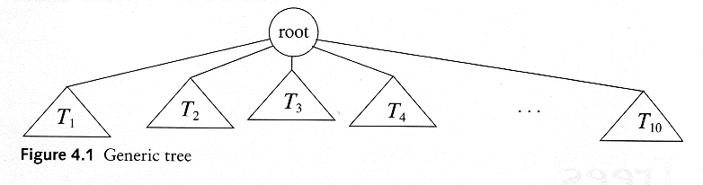
Trees
A tree T is a collection of nodes
  T can be empty
  (recursive definition) If not empty, a tree T consists of
    a (distinguished) node r (the root),
    and zero or more nonempty subtrees T₁, T₂, ...., T_{k}
Tree can be viewed as a ‘nested’ lists
Tree is also a graph …

Slide 4
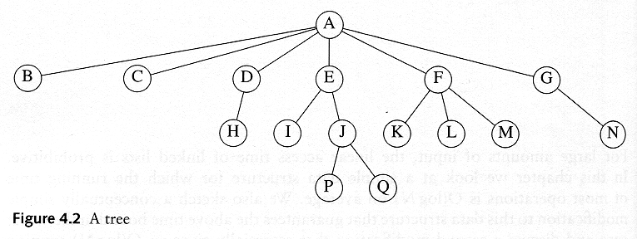
Some Terminologies
Child and Parent
  Every node except the root has one parent
  A node can have an zero or more children
Leaves
  Leaves are nodes with no children
Sibling
  nodes with same parent

Slide 5
More Terminologies
Path
  A sequence of edges
Length of a path
  number of edges on the path
Depth of a node
  length of the unique path from the root to that node
Height of a node
  length of the longest path from that node to a leaf
  all leaves are at height 0
The height of a tree = the height of the root
= the depth of the deepest leaf
Ancestor and descendant
  If there is a path from n1 to n2
  n1 is an ancestor of n2, n2 is a descendant of n1
  Proper ancestor and proper descendant

Slide 6
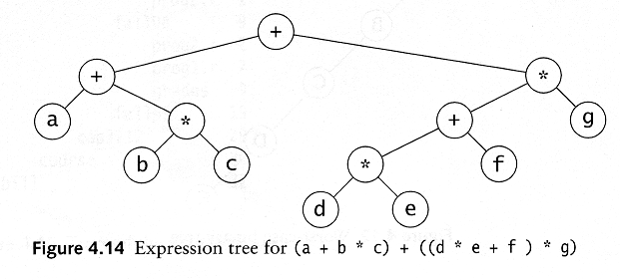
Example: Expression Trees
Leaves are operands (constants or variables)
The internal nodes contain operators
Will not be a binary tree if some operators are not binary

Slide 7
Tree Traversal
Used to print out the data in a tree in a certain order
Pre-order traversal
  Print the data at the root
  Recursively print out all data in the leftmost subtree
  …
  Recursively print out all data in the rightmost subtree

Slide 8
Preorder, Postorder and Inorder
Preorder traversal
  node, left, right
  prefix expression
    ++a*bc*+*defg

Slide 9
Preorder, Postorder and Inorder
Postorder traversal
  left, right, node
  postfix expression
    abc*+de*f+g*+
Inorder traversal
  left, node, right
  infix expression
    a+b*c+d*e+f*g

Slide 10
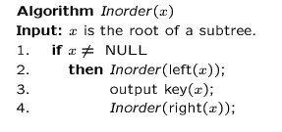
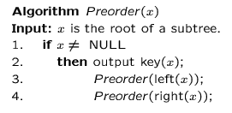
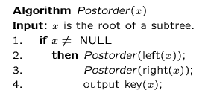
Preorder, Postorder and Inorder Pseudo Code

Slide 11
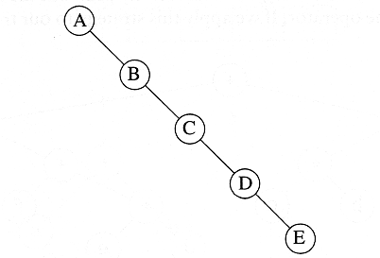
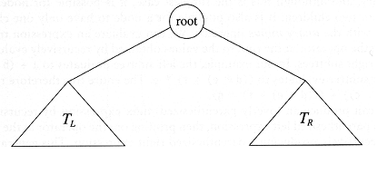
Binary Trees
A tree in which no node can have more than two children
The depth of an “average” binary tree is considerably smaller than N, even though in the worst case, the depth can be as large as N – 1.
Generic
binary tree
Worst-case
binary tree

Slide 12
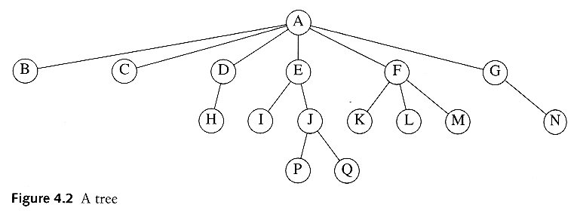
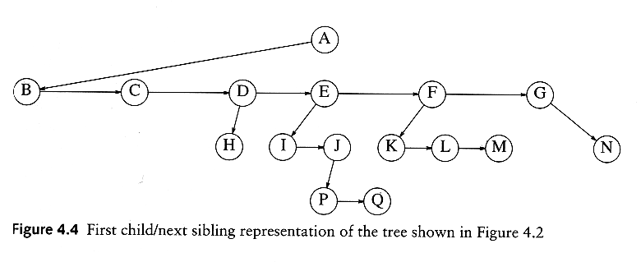
Convert a Generic Tree to a Binary Tree

Slide 13
Binary Tree ADT
Possible operations on the Binary Tree ADT
  Parent, left_child, right_child, sibling, root, etc
Implementation
  Because a binary tree has at most two children, we can keep direct pointers to them
  a linked list is physically a pointer, so is a tree.
Define a Binary Tree ADT later …

Slide 14
A drawing of linked list with one pointer …
A drawing of binary tree with two pointers …
Struct BinaryNode {
double element; // the data
BinaryNode* left; // left child
BinaryNode* right; // right child
}

Slide 15
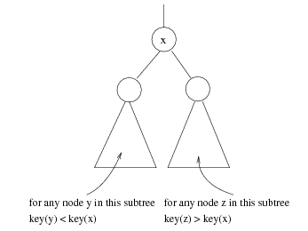
Binary Search Trees (BST)
A data structure for efficient searching, inser-tion and deletion
Binary search tree property
  For every node X
  All the keys in its left
  subtree are smaller than
  the key value in X
  All the keys in its right
  subtree are larger than the
  key value in X

Slide 16
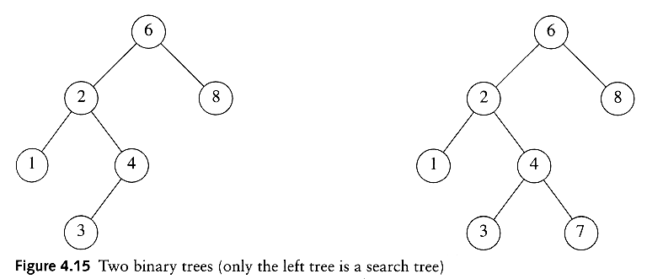
Binary Search Trees
A binary search tree
Not a binary search tree

Slide 17
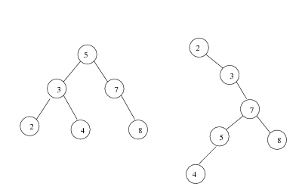
Binary Search Trees
The same set of keys may have different BSTs
Average depth of a node is O(log N)
Maximum depth of a node is O(N)

Slide 18
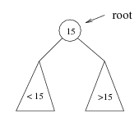
Searching BST
If we are searching for 15, then we are done.
If we are searching for a key < 15, then we should search in the left subtree.
If we are searching for a key > 15, then we should search in the right subtree.

Slide 19
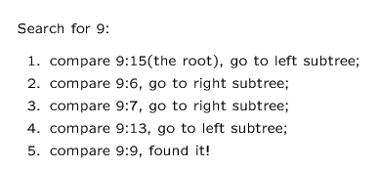
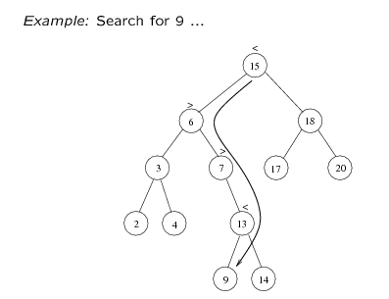

Slide 20
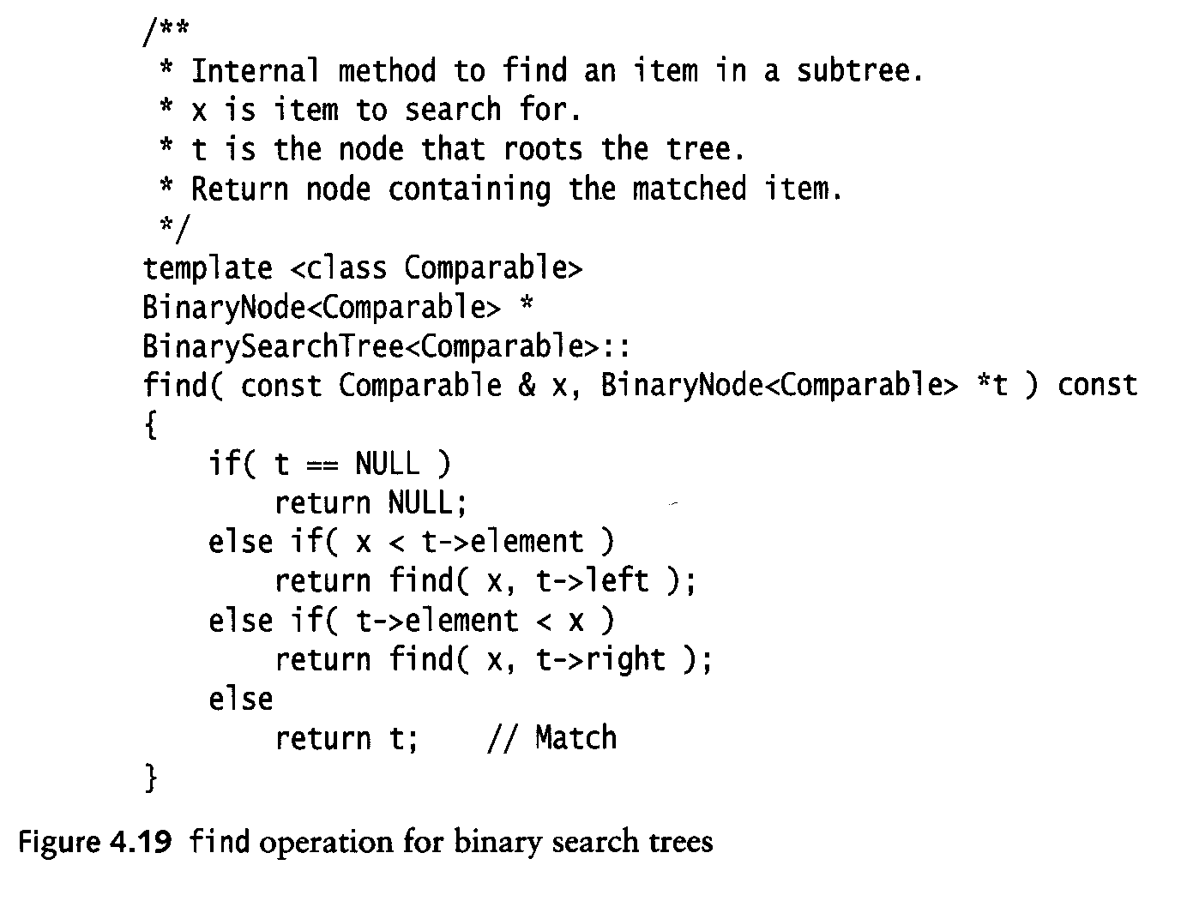
Searching (Find)
Find X: return a pointer to the node that has key X, or NULL if there is no such node
Time complexity: O(height of the tree)
find(const double x, BinaryNode* t) const

Slide 21
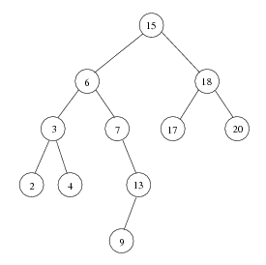
Inorder Traversal of BST
Inorder traversal of BST prints out all the keys in sorted order
Inorder: 2, 3, 4, 6, 7, 9, 13, 15, 17, 18, 20

Slide 22
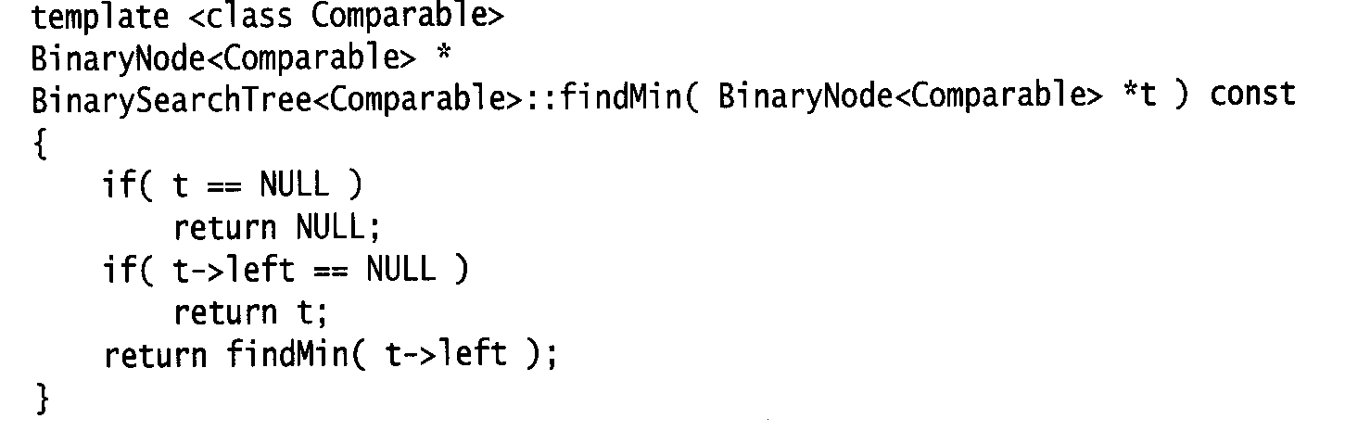
findMin/ findMax
Goal: return the node containing the smallest (largest) key in the tree
Algorithm: Start at the root and go left (right) as long as there is a left (right) child. The stopping point is the smallest (largest) element
Time complexity = O(height of the tree)
BinaryNode* findMin(BinaryNode* t) const

Slide 23
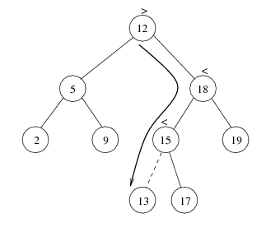
Insertion
Proceed down the tree as you would with a find
If X is found, do nothing (or update something)
Otherwise, insert X at the last spot on the path traversed
Time complexity = O(height of the tree)

Slide 24
void insert(double x, BinaryNode*& t)
{
if (t==NULL) t = new BinaryNode(x,NULL,NULL);
else if (x<t->element) insert(x,t->left);
else if (t->element<x) insert(x,t->right);
else ; // do nothing
}

Slide 25


Deletion
When we delete a node, we need to consider how we take care of the children of the deleted node.
  This has to be done such that the property of the search tree is maintained.

Slide 26
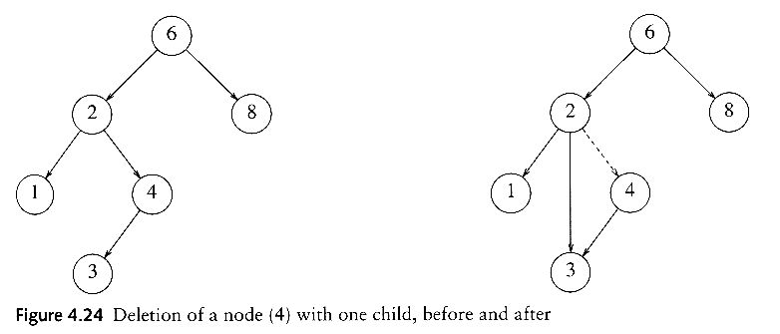
Deletion under Different Cases
Case 1: the node is a leaf
  Delete it immediately
Case 2: the node has one child
  Adjust a pointer from the parent to bypass that node

Slide 27
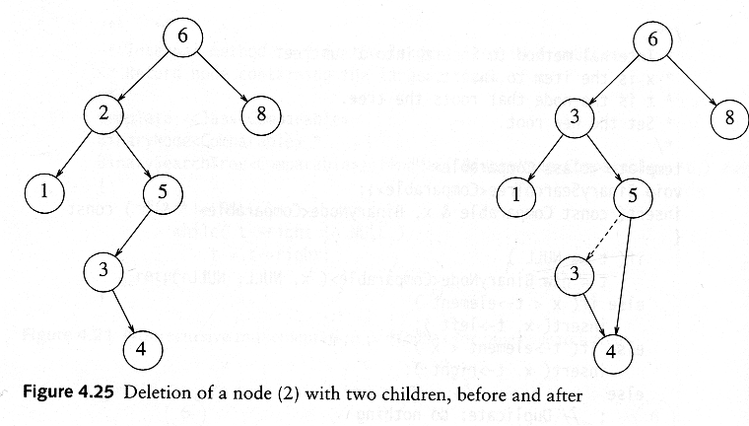
Deletion Case 3
Case 3: the node has 2 children
  Replace the key of that node with the minimum element at the right subtree
  Delete that minimum element
    Has either no child or only right child because if it has a left child, that left child would be smaller and would have been chosen. So invoke case 1 or 2.
Time complexity = O(height of the tree)

Slide 28
Graphs
Extremely useful tool in modeling problems
Consist of:
  Vertices
  Edges
Vertices can be
considered “sites”
or locations.
Edges represent
connections.
D
E
C
A
F
B
Vertex
Edge
Notes:
28

Slide 29
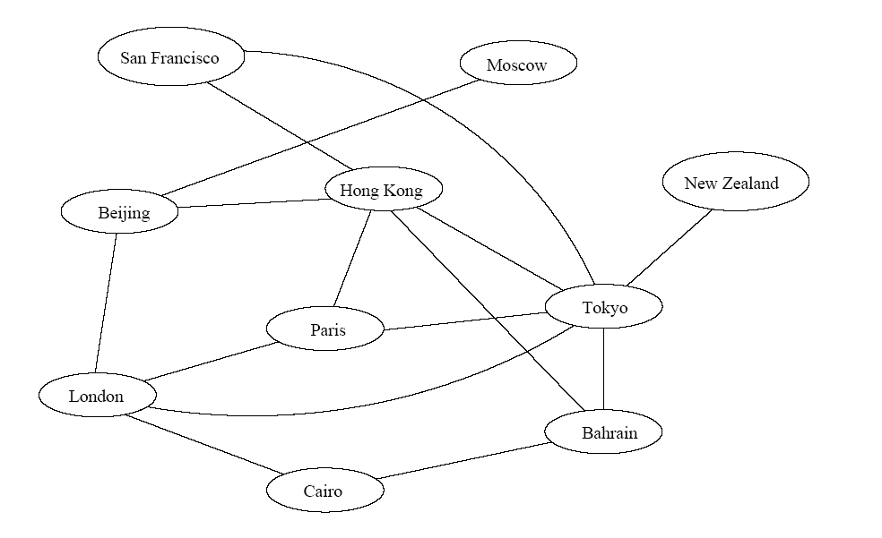
Application 1
Air flight system
Each vertex represents a city
Each edge represents a direct flight between two cities
A query on direct flights = a query on whether an edge exists
A query on how to get to a location = does a path exist from A to B
We can even associate costs to edges (weighted graphs), then ask “what is the cheapest path from A to B”
Notes:
29

Slide 30
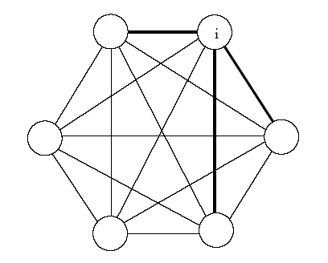
Application 2
Wireless communication
Represented by a weighted complete graph (every two vertices are connected by an edge)
Each edge represents the Euclidean distance dij between two stations
Each station uses a certain power i to transmit messages. Given this power i, only a few nodes can be reached (bold edges). A station reachable by i then uses its own power to relay the message to other stations not reachable by i.
A typical wireless communication problem is: how to broadcast between all stations such that they are all connected and the power consumption is minimized.
Notes:
30

Slide 31
Graph, also called network (particularly when a weight is assgned to an edge)
A tree is a connected graph with no loops.
Graph algorithms might be very difficult!
  four color problem for planar graph!
171 only handles the simplest ones
  Traversal, BFS, DFS
  ((Minimum) spanning tree)
  Shortest paths from the source
  Connected components, topological sort
Notes:
31

Slide 32
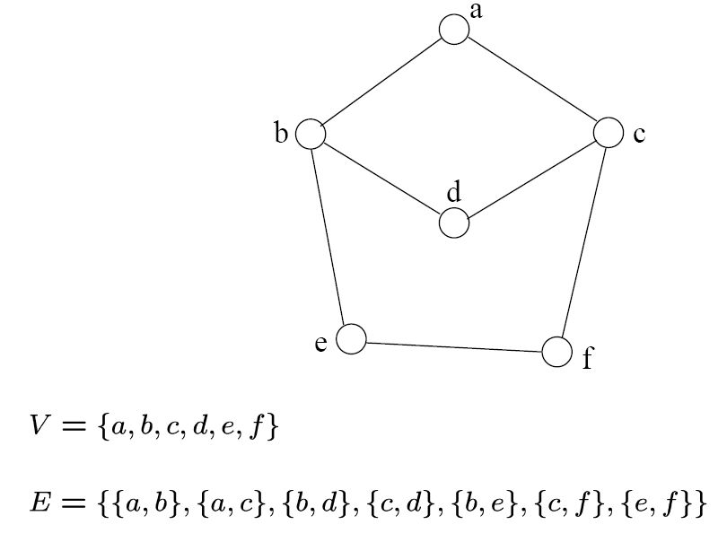
Definition
A graph G=(V, E) consists a set of vertices, V, and a set of edges, E.
Each edge is a pair of (v, w), where v, w belongs to V
If the pair is unordered, the graph is undirected; otherwise it is directed
{a,b}
{a,c}
{b,d}
{c,d}
{b,e}
{c,f}
{e,f}
An undirected graph
Notes:
32

Slide 33
Terminology
If v₁ and v₂ are connected, they are said to be adjacent vertices
    v₁ and v₂ are endpoints of the edge {v₁, v₂}
If an edge e is connected to v, then v is said to be incident on e. Also, the edge e is said to be incident on v.
{v₁, v₂} = {v₂, v₁}
If we are talking about directed graphs, where edges have direction. This
means that {v₁,v₂} ≠ {v₂,v₁} . Directed graphs are drawn with arrows (called arcs) between edges.
A
B
This means {A,B} only, not {B,A}
Notes:
33

Slide 34
Graph Representation
Two popular computer representations of a graph. Both represent the vertex set and the edge set, but in different ways.
  Adjacency Matrix
    Use a 2D matrix to represent the graph
  Adjacency List
    Use a 1D array of linked lists
Notes:
34

Slide 35
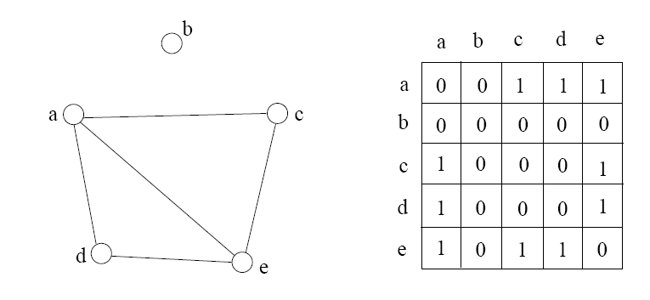
Adjacency Matrix
2D array A[0..n-1, 0..n-1], where n is the number of vertices in the graph
Each row and column is indexed by the vertex id
  e,g a=0, b=1, c=2, d=3, e=4
A[i][j]=1 if there is an edge connecting vertices i and j; otherwise, A[i][j]=0
The storage requirement is Θ(n²). It is not efficient if the graph has few edges. An adjacency matrix is an appropriate representation if the graph is dense: |E|=Θ(|V|²)
We can detect in O(1) time whether two vertices are connected.
Notes:
35

Slide 36
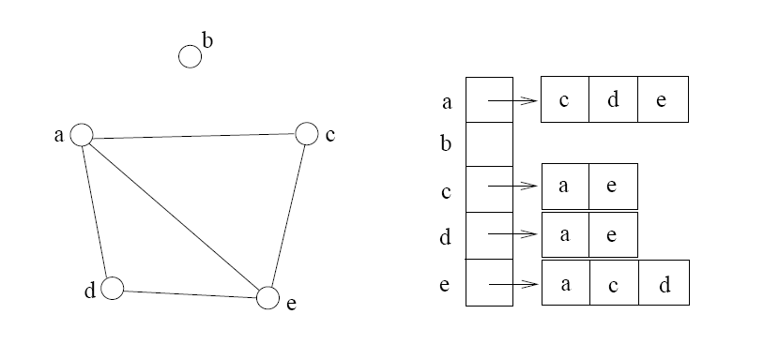
Adjacency List
If the graph is not dense, in other words, sparse, a better solution is an adjacency list
The adjacency list is an array A[0..n-1] of lists, where n is the number of vertices in the graph.
Each array entry is indexed by the vertex id
Each list A[i] stores the ids of the vertices adjacent to vertex i
Notes:
36

Slide 37
Adjacency Matrix Example
0
 | 0 | 1 | 2 | 3 | 4 | 5 | 6 | 7 | 8 | 9
0 | 0 | 0 | 0 | 0 | 0 | 0 | 0 | 0 | 1 | 0
1 | 0 | 0 | 1 | 1 | 0 | 0 | 0 | 1 | 0 | 1
2 | 0 | 1 | 0 | 0 | 1 | 0 | 0 | 0 | 1 | 0
3 | 0 | 1 | 0 | 0 | 1 | 1 | 0 | 0 | 0 | 0
4 | 0 | 0 | 1 | 1 | 0 | 0 | 0 | 0 | 0 | 0
5 | 0 | 0 | 0 | 1 | 0 | 0 | 1 | 0 | 0 | 0
6 | 0 | 0 | 0 | 0 | 0 | 1 | 0 | 1 | 0 | 0
7 | 0 | 1 | 0 | 0 | 0 | 0 | 1 | 0 | 0 | 0
8 | 1 | 0 | 1 | 0 | 0 | 0 | 0 | 0 | 0 | 1
9 | 0 | 1 | 0 | 0 | 0 | 0 | 0 | 0 | 1 | 0
8
2
9
1
3
7
6
4
5
Notes:
37

Slide 38
Adjacency List Example
0
0
1
2
3
4
5
6
7
8
9
8
2 | 3 | 7 | 9
8
1 | 4 | 8
2
9
1 | 4 | 5
1
2 | 3
7
3 | 6
3
6
5 | 7
4
5
1 | 6
0 | 2 | 9
1 | 8
Notes:
38

Slide 39
Storage of Adjacency List
The array takes up Θ(n) space
Define degree of v, deg(v), to be the number of edges incident to v. Then, the total space to store the graph is proportional to:
An edge e={u,v} of the graph contributes a count of 1 to deg(u) and contributes a count 1 to deg(v)
Therefore, Σ_{vertex v}deg(v) = 2m, where m is the total number of edges
In all, the adjacency list takes up Θ(n+m) space
  If m = O(n²) (i.e. dense graphs), both adjacent matrix and adjacent lists use Θ(n²) space.
  If m = O(n), adjacent list outperforms adjacent matrix
However, one cannot tell in O(1) time whether two vertices are connected
Notes:
39

Slide 40
Adjacency List vs. Matrix
Adjacency List
  More compact than adjacency matrices if graph has few edges
  Requires more time to find if an edge exists
Adjacency Matrix
  Always require n² space
    This can waste a lot of space if the number of edges are sparse
  Can quickly find if an edge exists
  It’s a matrix, some algorithms can be solved by matrix computation!
Notes:
40

Slide 41
Path between Vertices
A path is a sequence of vertices (v₀, v₁, v₂,… v_{k}) such that:
  For 0 ≤ i < k, {v_{i}, v_{i+1}} is an edge
  For 0 ≤ i < k-1, v_{i} ≠ v_{i+2}
    That is, the edge {v_{i}, v_{i+1}} ≠ {v_{i+1}, v_{i+2}}
  Note: a path is allowed to go through the same vertex or the same edge any number of times!
The length of a path is the number of edges on the path
Notes:
41

Slide 42
Types of paths
A path is simple if and only if it does not contain a vertex more than once.
A path is a cycle if and only if v₀= v_{k}
    The beginning and end are the same vertex!
A path contains a cycle as its sub-path if some vertex appears twice or more
Notes:
42

Slide 43
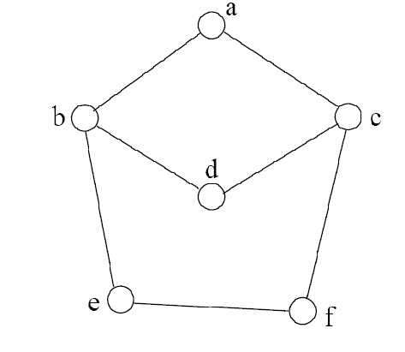
Path Examples
Are these paths?
Any cycles?
What is the path’s length?
1. {a,c,f,e}
1. {a,b,d,c,f,e}
1. {a, c, d, b, d, c, f, e}
2. {a,c,d,b,a}
1. {a,c,f,e,b,d,c,a}
Notes:
43

Slide 44
Summary
A graph G=(V, E) consists a set of vertices, V, and a set of edges, E. Each edge is a pair of (v, w), where v, w belongs to V
graph, directed and undirected graph
vertex, node, edge, arc
incident, adjacent
degree, in-degree, out-degree, isolated
path, simple path,
path of length k, subpath
cycle, simple cycle, acyclic
connected, connected component
neighbor, complete graph, planar graph

Slide 45

Graph Traversal
Application example
  Given a graph representation and a vertex s in the graph
  Find all paths from s to other vertices
Two common graph traversal algorithms
    Breadth-First Search (BFS)
      Find the shortest paths in an unweighted graph
    Depth-First Search (DFS)
      Topological sort
      Find strongly connected components
Notes:
45

Slide 46
Two common graph traversal algorithms
    Breadth-First Search (BFS) ← breadth first traversal of a tree
      Find the shortest paths in an unweighted graph
    Depth-First Search (DFS) ← depth first traversal of a tree
      Topological sort
      Find strongly connected components
Notes:
46

Slide 47
BFS and Shortest Path Problem
Given any source vertex s, BFS visits the other vertices at increasing distances away from s. In doing so, BFS discovers paths from s to other vertices
What do we mean by “distance”? The number of edges on a path from s
From ‘local’ to ‘global’, step by step.
Example
0
Consider s=vertex 1
8
2
Nodes at distance 1?
2, 3, 7, 9
1
2
s
9
1
1
Nodes at distance 2?
8, 6, 5, 4
7
1
3
6
2
4
1
5
Nodes at distance 3?
0
2
2
Notes:
47

Slide 48
BFS Algorithm
Input: source vertex s
Output: all visited vertices from s
BFS (s)
FLAG: A ‘visited table’ to store the ‘visited’ information
Initialization:
s is visited
Q is empty
enqueue(Q,s)
while not-empty(Q)
v <- dequeue(Q)
W = {unvisited neighbors of v}
for each w in W
w is visited
enqueue(Q,w)
Notes:
48

Slide 49
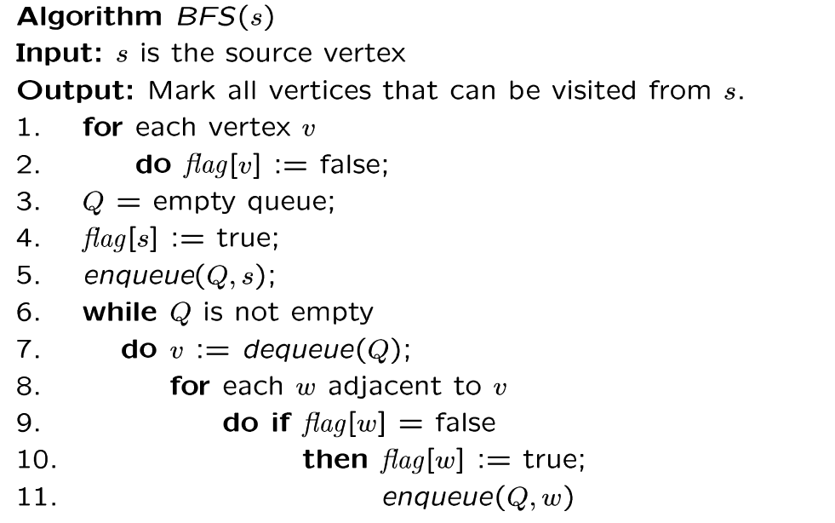
BFS Algorithm
// flag[ ]: visited table
Why use queue? Need FIFO
Notes:
49

Slide 50
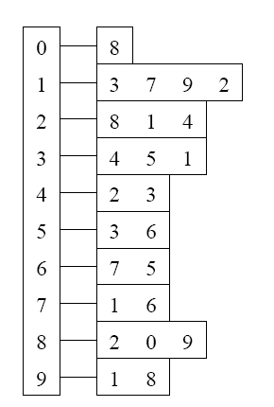
BFS Example
Adjacency List
Visited Table (T/F)
0
1
2
3
4
5
6
7
8
9
F
F
F
F
F
F
F
F
F
F
0
8
source
2
9
1
3
7
6
4
5
Initialize visited
table (all False)
Q =
{ }
Initialize Q to be empty
Notes:
50

Slide 51
Adjacency List
Visited Table (T/F)
0
1
2
3
4
5
6
7
8
9
F
F
T
F
F
F
F
F
F
F
0
8
source
2
9
1
3
7
6
4
5
Flag that 2 has
been visited
Q =
{ 2 }
Place source 2 on the queue
Notes:
51

Slide 52
Adjacency List
Visited Table (T/F)
0
1
2
3
4
5
6
7
8
9
F
T
T
F
T
F
F
F
T
F
0
8
Neighbors
source
2
9
1
3
7
6
4
5
Mark neighbors
as visited 1, 4, 8
Q =
{2} → { 8, 1, 4 }
Dequeue 2.
Place all unvisited neighbors of 2 on the queue
Notes:
52

Slide 53
Adjacency List
Visited Table (T/F)
0
1
2
3
4
5
6
7
8
9
T
T
T
F
T
F
F
F
T
T
0
8
source
2
9
1
3
7
Neighbors
6
4
5
Mark new visited
Neighbors 0, 9
Q =
{ 8, 1, 4 } → { 1, 4, 0, 9 }
Dequeue 8.
-- Place all unvisited neighbors of 8 on the queue.
-- Notice that 2 is not placed on the queue again, it has been visited!
Notes:
53

Slide 54
Adjacency List
Visited Table (T/F)
0
1
2
3
4
5
6
7
8
9
T
T
T
T
T
F
F
T
T
T
0
Neighbors
8
source
2
9
1
3
7
6
4
5
Mark new visited
Neighbors 3, 7
Q =
{ 1, 4, 0, 9 } → { 4, 0, 9, 3, 7 }
Dequeue 1.
-- Place all unvisited neighbors of 1 on the queue.
-- Only nodes 3 and 7 haven’t been visited yet.
Notes:
54

Slide 55
Adjacency List
Visited Table (T/F)
0
1
2
3
4
5
6
7
8
9
T
T
T
T
T
F
F
T
T
T
0
8
source
2
9
Neighbors
1
3
7
6
4
5
Q =
{ 4, 0, 9, 3, 7 } → { 0, 9, 3, 7 }
Dequeue 4.
-- 4 has no unvisited neighbors!
Notes:
55

Slide 56
Adjacency List
Visited Table (T/F)
Neighbors
0
1
2
3
4
5
6
7
8
9
T
T
T
T
T
F
F
T
T
T
0
8
source
2
9
1
3
7
6
4
5
Q =
{ 0, 9, 3, 7 } → { 9, 3, 7 }
Dequeue 0.
-- 0 has no unvisited neighbors!
Notes:
56

Slide 57
Adjacency List
Visited Table (T/F)
0
1
2
3
4
5
6
7
8
9
T
T
T
T
T
F
F
T
T
T
0
8
source
2
9
1
3
7
6
4
5
Neighbors
Q =
{ 9, 3, 7 } → { 3, 7 }
Dequeue 9.
-- 9 has no unvisited neighbors!
Notes:
57

Slide 58
Adjacency List
Visited Table (T/F)
0
1
2
3
4
5
6
7
8
9
T
T
T
T
T
T
F
T
T
T
0
8
Neighbors
source
2
9
1
3
7
6
4
5
Mark new visited
Vertex 5
Q =
{ 3, 7 } → { 7, 5 }
Dequeue 3.
-- place neighbor 5 on the queue.
Notes:
58

Slide 59
Adjacency List
Visited Table (T/F)
0
1
2
3
4
5
6
7
8
9
T
T
T
T
T
T
T
T
T
T
0
8
source
2
9
1
7
Neighbors
3
6
4
5
Mark new visited
Vertex 6
Q =
{ 7, 5 } → { 5, 6 }
Dequeue 7.
-- place neighbor 6 on the queue
Notes:
59

Slide 60
Adjacency List
Visited Table (T/F)
0
1
2
3
4
5
6
7
8
9
T
T
T
T
T
T
T
T
T
T
0
8
source
2
9
Neighbors
1
3
7
6
4
5
Q =
{ 5, 6} → { 6 }
Dequeue 5.
-- no unvisited neighbors of 5
Notes:
60

Slide 61
Adjacency List
Visited Table (T/F)
0
1
2
3
4
5
6
7
8
9
T
T
T
T
T
T
T
T
T
T
0
8
source
2
9
1
Neighbors
3
7
6
4
5
Q =
{ 6 } → { }
Dequeue 6.
-- no unvisited neighbors of 6
Notes:
61

Slide 62
Adjacency List
Visited Table (T/F)
0
1
2
3
4
5
6
7
8
9
T
T
T
T
T
T
T
T
T
T
0
8
source
2
9
1
3
7
6
4
5
What did we discover?
Look at “visited” tables.
There exists a path from source
vertex 2 to all vertices in the graph
Q =
{ }
STOP! Q is empty!
Notes:
62

Slide 63
Time Complexity of BFS
(Using Adjacency List)
Assume adjacency list
  n = number of vertices m = number of edges
O(n + m)
Each vertex will enter Q
at most once.
Each iteration takes time proportional to deg(v) + 1 (the number 1 is to account for the case where deg(v) = 0 --- the work required is 1, not 0).
Notes:
63

Slide 64
Running Time
Recall: Given a graph with m edges, what is the total degree?
The total running time of the while loop is:
this is summing over all the iterations in the while loop!
Σ_{vertex v} deg(v) = 2m
O( Σ_{vertex v} (deg(v) + 1) ) = O(n+m)
Notes:
64

Slide 65
Time Complexity of BFS
(Using Adjacency Matrix)
Assume adjacency list
  n = number of vertices m = number of edges
O(n²)
Finding the adjacent vertices of v requires checking all elements in the row. This takes linear time O(n).
Summing over all the n iterations, the total running time is O(n²).
So, with adjacency matrix, BFS is O(n²) independent of the number of edges m.
With adjacent lists, BFS is O(n+m); if m=O(n²) like in a dense graph, O(n+m)=O(n²).
Notes:
65

