Slide 1
C# - Inheritance
Dr.P.Sumathy
Assistant Professor
Department of Computer Science
Bharathidasan University

Slide 2
Inheritance
Acquiring (taking) the properties of one class into another class is called inheritance.
Inheritance provides reusability by allowing us to extend an existing class.
The reason behind OOP programming is to promote the reusability of code and to reduce complexity in code and it is possible by using inheritance.
This existing class is called the base class, and the new class is referred to as the derived class.
The idea of inheritance implements the IS-A relationship. For example, mammal IS A animal, dog IS-A mammal hence dog IS-A animal as well, and so on.
Base class - is the class from which features are to be inherited into another class.
Derived class - it is the class in which the base class features are inherited.

Slide 3

Inheritance Types
Syntax is
<acess-specifier> class <base_class>
{
...
}
class <derived_class> : <base_class>
{
...
}

Slide 4
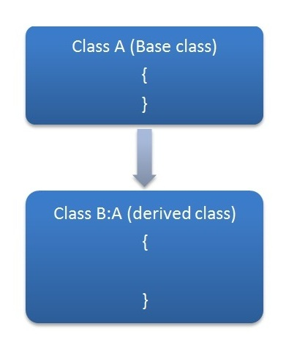
Single inheritance
It is the type of inheritance in which there is one base class and one derived class. In the example program Accountcreditinfo is the base class and debitinfo is the derived class.
For example,
public class Accountcreditinfo //base class
{
public string Credit()
{
return "balance is credited";
}
}
public class debitinfo : Accountcreditinfo //derived class
{
public string debit()
{
Credit(); ////derived class method
return "balance is debited";
}
}

Slide 5
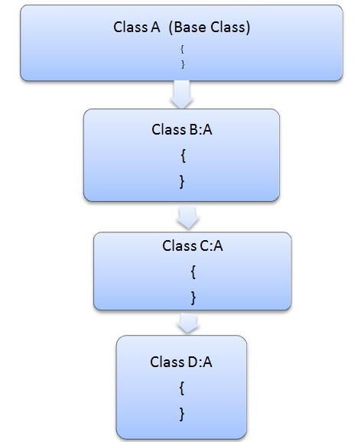
Hierarchical inheritance
This is the type of inheritance in which there are multiple classes derived from one base class.
This type of inheritance is used when there is a requirement of one class feature that is needed in multiple classes.
In the program one base class is derived in many classes hence it is a called a Hierarchical Inheritance.
For example,
class A //base class
{
public string msg()
{
return "this is A class Method";
}
}
class B : A
{
public string info()
{
msg();
return "this is B class Method";
} }
class C : A
{
public string getinfo()
{
msg();
return "this is C class Method";
}
}
}

Slide 6
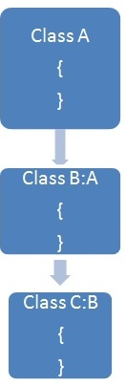
Multilevel inheritance
When one class is derived from another derived class then this type of inheritance is called multilevel inheritance.
In the preceding program, each class is derived from one class that is derived from another class hence this type of inheritance is called Multilevel Inheritance.
For example,
public class Person
{
public string persondet()
{
return "this is the person class";
}
}
public class Bird : Person
{
public string birddet()
{
persondet();
return "this is the birddet Class";
}
}
public class Animal : Bird
{
public string animaldet()
{
persondet();
birddet();
return "this is the Animal Class";
}
}

Slide 7
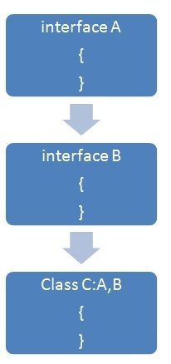
Multiple inheritance using Interfaces
C# does not support multiple inheritances of classes. To overcome this problem we can use interfaces
In the example the ICar class inherits the features of the two interfaces hence this type of inheritance is called Multiple Inheritance. The following are some key points about inheritance:
C# does not support multiple inheritances of classes, the same thing can be done using interfaces.
Private members are not accessed in a derived class when one class is derived from another.
For example,
public interface IA //ineterface 1
{
string setImgs(string a);
}
public interface IB //Interface 2
{
int getAmount(int Amt);
}
public class ICar : IA, IB //implementatin
{
public int getAmount(int Amt)
{
return 100;
}
public string setImgs(string a)
{
return "this is the car";
}
}

Slide 8
C# - Properties
In C#, properties are a member that provides a flexible mechanism to read, write, or compute the value of a private field.
C# is one of the first languages that offers direct support of Properties.
Properties looks similar to a public variable on which we can do get() or set() operations.
Properties are named members of classes, structures, and interfaces. Member variables or methods in a class or structures are called Fields. Properties are an extension of fields and are accessed using the same syntax.
They use accessors through which the values of the private fields can be read, written or manipulated.
Properties do not name the storage locations. Instead, they have accessors that read, write, or compute their values.
For example, let us have a class named Student, with private fields for age, name, and code.
We cannot directly access these fields from outside the class scope, but we can have properties for accessing these private fields.

Slide 9
Syntax
The following is the syntax of Properties:
//Define the Properties Accessors
Public < type > < Property Name >
{
Get
{
Return
<var > ;
}
Set
{
If(Is Valid(Value))
<var > = Value;
}
}
The access modifier can be Private, Public, Protected or Internal.
The return type can be any valid C# data type, such as a string or integer.
The ”this” keyword shows that the object is for the current class.
The get() and set() operations of the syntax are known as accessors.
There are the following 4 types of Properties:
Read-Write Property
Read-Only Property
Static Property
Indexer Property

Slide 10
Read and write Property
Programmers allow you to access the internal data of a class in a less cumbersome manner.
Earlier programmers were required to define two separate methods, one for assigning a value of a variable and the other for retrieving the value of a variable.
When you create a property, the compiler automatically generates class methods to set() and get() the property value and makes calls to these methods automatically when a programmer uses the property .
Here is a simple program of a Read and Write Property.

Slide 11
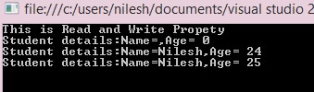
using System; using System.Collections.Generic; using System.Linq; using System.Text; namespace Read_and_Write_Property { class student { public string Myname = ""; public int Myage = 0; //Declare a Name Property of type String public string Name { get { return Myname; } set { Myname = value; } } //Declare an Age Property of type int public int Age { get { return Myage; } set { Myage = value; } } public override string ToString() { return ("Name=" + Name + ",Age= " + Age); } } | class Program { static void Main(string[] args) { Console.WriteLine("This is Read and Write Propety"); // Create a new object for student class student s = new student(); Console.WriteLine("Student details:" + s); s.Name = "Nilesh"; s.Age = 24; Console.WriteLine("Student details:" + s); //increment the age property s.Age += 1; Console.Write("Student details:" + s); Console.ReadKey(); } } } Read-Write Property Output

Slide 12

Read-Only Property
Read-Only Property A read-only Property has a get accessor but does not have any set() operation. This means that you can retrieve the value of a variable using the read-only property but you cannot assign a value to the variable.
using System;
using System.Collections.Generic;
using System.Linq;
using System.Text;
namespace ConsoleApplication1
{
public class PropertyHolder
{
private int Myage = 0;
public PropertyHolder(int PropVal)
{
Myage = PropVal;
}
public int age
{
get {
return Myage;
}
}
}
class Program
{
static void Main(string[] args)
{
PropertyHolder p = new PropertyHolder(24);
Console.WriteLine("My age is: " + p.age);
Console.ReadKey();
}
}
}

Slide 13
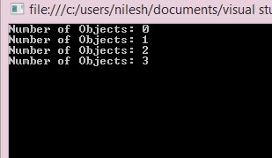
Static Property
A static Property can be used to access only the static members of the class.
using System;
using System.Collections.Generic;
using System.Linq;
using System.Text;
namespace Static_Property
{
public class CounterClass
{
private static int number = 0;
public CounterClass()
{
number++;
}
public static int NumberofObjects
{
get {
return number;
}
set {
number = value;
}
}
}
class Program
{
static void Main(string[] args)
{
Console.WriteLine("Number of Objects: {0}", CounterClass.NumberofObjects);
CounterClass object1 = new CounterClass();
Console.WriteLine("Number of Objects: {0}", CounterClass.NumberofObjects);
CounterClass object2 = new CounterClass();
Console.WriteLine("Number of Objects: {0}", CounterClass.NumberofObjects);
CounterClass object3 = new CounterClass();
Console.WriteLine("Number of Objects: {0}", CounterClass.NumberofObjects);
Console.ReadKey();
}
}
}

Slide 14
INDEXER IN C#:
C# indexers allow us to create classes which act like virtual arrays.
Indexer an object to be indexed in the same way as an array.
Indexer modifier can be private, public, protected or internal.
The return type can be any valid C# types.
Indexers in C# must have at least one parameter. Else the compiler will generate a compilation error.
The indexers allow instances of a class, struct or interface to be indexed just like arrays.
Indexer get accessor returns a value and set accessor assigns the value.
The keyword this is used to define the indexers.
The keyword value is used to define the value which is assigned by the set indexer.
It is not necessary that indexers have to be indexed by an integer value; it is up to us how to define the mechanism.
They can be overloaded and can have more than one formal parameter.

Slide 15
Syntax (indexer)
public int this[int index]
// Indexer declaration
{
// get and set accessors
}
public interface inter1
{
int this[int index]
{
get; set;
}
}
How to use Indexers
The indexers are syntactic convenience that enables us to create a class, struct or interface where client applications can access just like as an array.
They are frequently implemented in types whose main purpose is to encapsulate an internal collection or an array.
Indexer not only simplifies the syntax for client applications but it also makes the class and its purpose more intuitive for other developers to understand.

Slide 16
using System;
namespace ConsoleApplication1
{
class IndexedFruits
{
private string [] namelist = new string[size];
static public int size = 10;
public IndexedFruits()
{
for (int i = 0; i < size; i++)
namelist [i] = "Null";
}
public string this[int index]
{
get
{
string t;
if( index >= 0 && index <= size-1 )
{
t = namelist [index];
}
else
{
t = "";
}
return ( t );
}
set
{
if ( index >= 0 && index <= size-1 )
{
namelist [index] = value;
}
}
}
static void Main(string[] args)
{
IndexedFruits f = new IndexedFruits ( );
f [0] = "Apple";
f [1] = "Banana";
f [2] = "Lichi";
f [3] = "Cherry";
f [4] = "Orange";
f [5] = "Pineapple";
for (int i = 0; i < IndexedFruits.size; i++ )
{
Console.WriteLine (f[i]);
}
Console.ReadKey ();
}
}
}
Output:
Apple
Banana
Lichi
Cherry
Orange
Pineapple
Null
Null
Null
Null

Slide 17
Indexers in Overloading
The indexers can be overloaded and they can be declared with the multiple parameters and each parameter can be of different type.
As we have already studied that it is not necessary that indexer should be integers they can be of other types also. Let us understand through example:
Indexer overloaded
public int this[string name]
{
get
{
int index = 0;
while(index < size)
{
if (namelist[index] == name)
{
return index;
}
index++;
}
return index;
}
}
public string this[int index]
{
get
{
string t;
if( index >= 0 && index <= size-1 )
{
t = namelist [index];
}
else
{
t = "";
}
return ( t );
}

Slide 18
Indexers with Interfaces
The indexers can be declared with interfaces as the accessors of interface indexers are different from the accessors of the class indexers.
They are different in following ways:
The interface accessors do not use modifiers.
They do not have a body.
The purpose of the accessor is to indicate whether
the indexer is read-write, read-only or write only.
static void Main()
{
IndexerClass test = new IndexerClass();
Random rand = new Random();
// Call the indexer to initialize its elements.
for (int i = 0; i < 10; i++)
{
test[i] = rand.Next();
}
for (int i = 0; i < 10; i++)
{
Console.WriteLine ("The element {0} is:{1}", i, test[i]);
}
Console.ReadKey ();
}
}
Output:
The element 0 is: 531438917 The element 1 is: 557339696 The element 2 is: 8661852 The element 3 is: 101958769 The element 4 is: 299397112 The element 5 is: 1994789661 The element 6 is: 811107773 The element 7 is: 778755578 The element 8 is: 95880376 The element 9 is: 887315566
using System.IO;
using System;
public interface Interface1
{
// Indexer declaration:
int this[int index]
{
get;
set;
}
}
// Implementing the interface.
class IndexerClass : Interface1
{
private int[] arr = new int[100];
public int this[int index] // indexer declaration
{
get
{
// The arr object will throw IndexOutOfRange exception.
return arr[index];
}
set
{
arr[index] = value;
}
}
}

